Slide 1
9.6) Transforming trigonometric graphs

Slide 2
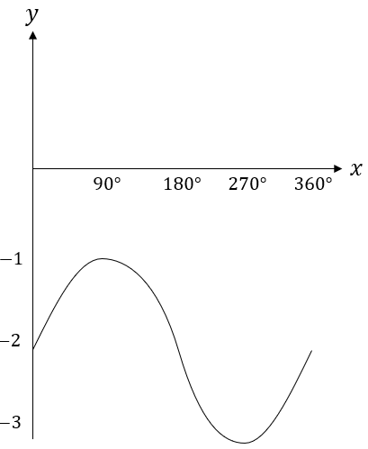
Worked example
Your turn
Sketch $y=\cos{x}+1$, $0≤x≤360°$
Sketch $y=\sin{x}−2$, $0≤x≤360°$

Slide 3
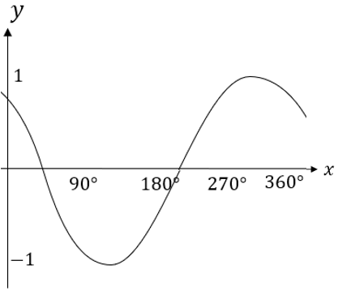
Worked example
Your turn
Sketch $y=\sin{(x−45°)}$, $0≤x≤360°$
Sketch $y=\cos\left(x+45°\right)$, $0≤x≤360°$

Slide 4
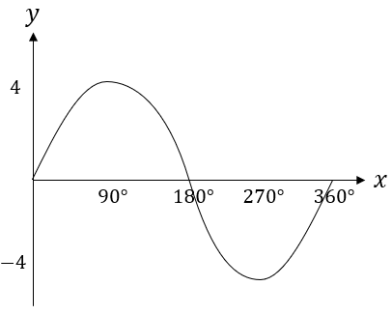
Worked example
Your turn
Sketch $y=3\cos{x}$, $0≤x≤360°$
Sketch $y=4\sin{x}$, $0≤x≤360°$

Slide 5
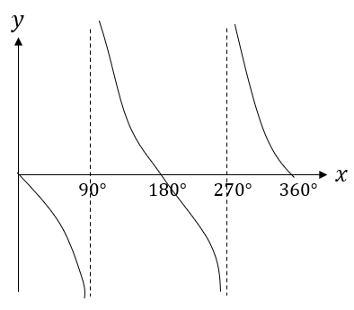
Worked example
Your turn
Sketch $y=−\sin{x}$, $0≤x≤360°$
Sketch $y=\cos{(−x)}$, $0≤x≤360°$
Sketch $y=−\tan{x}$, $0≤x≤360°$

Slide 6
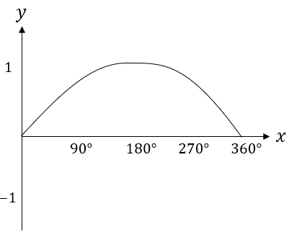
Worked example
Your turn
Sketch $y=\cos\left(2x\right)$, $0≤x≤360°$
Sketch $y=\sin\left(\frac{x}{2}\right)$, $0≤x≤360°$

