Slide 1
9.5) Graphs of sine, cosine and tangent

Slide 2
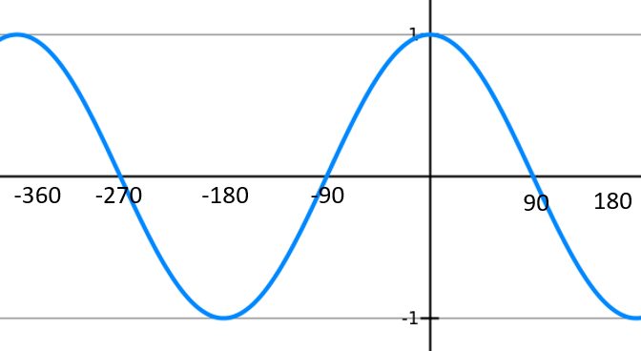
Worked example
Your turn
Sketch the graph of $y=\sin{x}, −180≤x≤360°$
Sketch the graph of $y=\cos{x}, −360≤x≤180°$

Slide 3
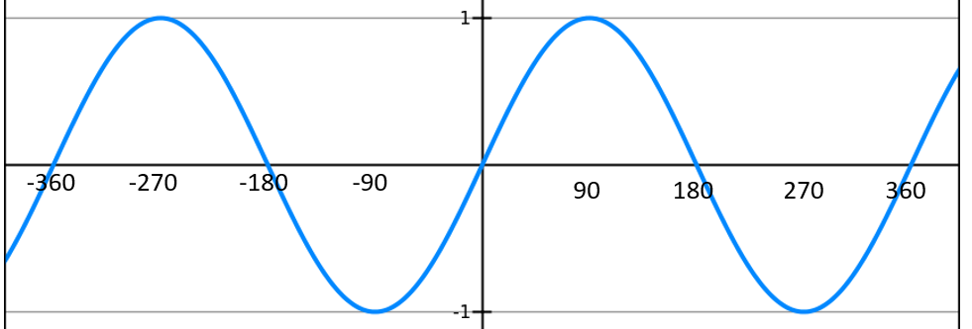
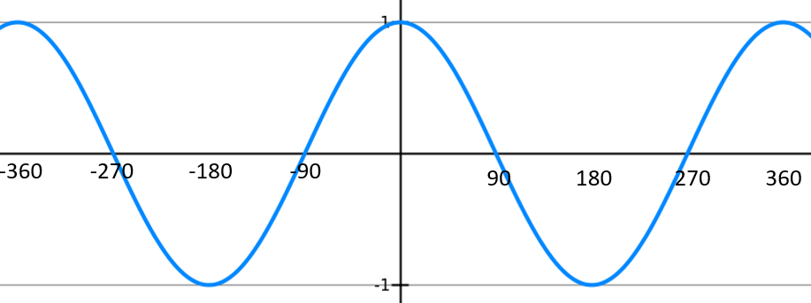
Worked example
Your turn
A sketch of $y=\sin{x}, −360°≤x≤360°$ is shown.
Given that $\sin{30}=\frac{1}{2}$, find:
a) $\sin{(150°)}$
b) $\sin{(−300°)}$
c) $\sin{(330°)}$
d) $\sin{(−210°})$
A sketch of $y=\cos{x}, −360°≤x≤360°$ is shown.
Given that $\cos{30}=\frac{\sqrt{3}}{2}$, find:
a) $\cos{(−30°)}$
b) $\cos{(330°)}$
c) $\cos{(150°)}$
d) $\cos{(−210°})$
a) $\frac{\sqrt{3}}{2}$
b) $\frac{\sqrt{3}}{2}$
c) $−\frac{\sqrt{3}}{2}$
d)$−\frac{\sqrt{3}}{2}$

Slide 4
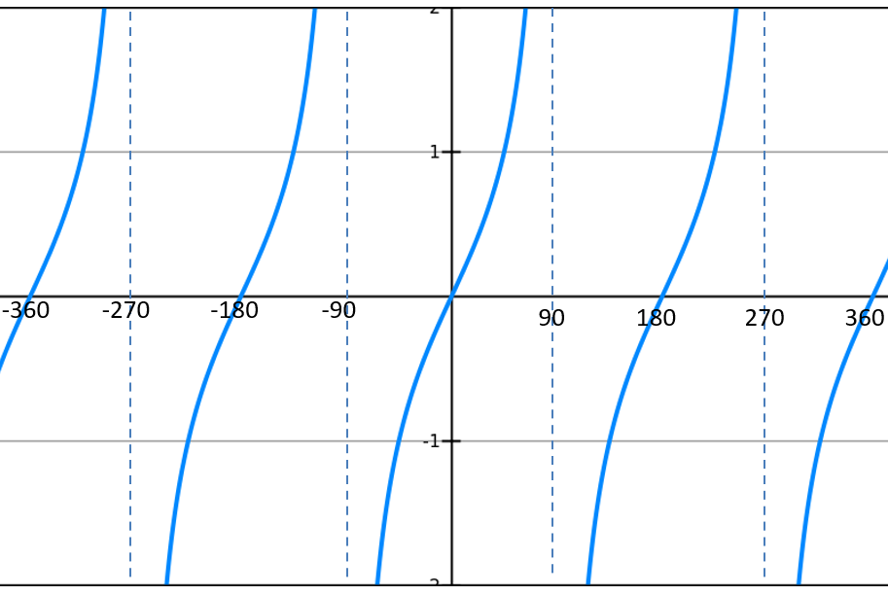
Worked example
Your turn
A sketch of $y=\tan{x}, −360°≤x≤360°$ is shown.
Given that $\tan{60}=\sqrt{3}$, find:
a) $\tan{(−60°)}$
b) $\tan{(−300°)}$
c) $\tan{(120°)}$
A sketch of $y=\tan{x}, −360°≤x≤360°$ is shown.
Given that $\tan{30}=\frac{\sqrt{3}}{3}$, find:
a) $\tan{(−30°)}$
b) $\tan{(−330°)}$
c) $\tan{(150°)}$
a) $−\frac{\sqrt{3}}{3}$
b) $\frac{\sqrt{3}}{3}$
c) $−\frac{\sqrt{3}}{3}$

