Slide 1
9.4) Solving triangle problems

Slide 2
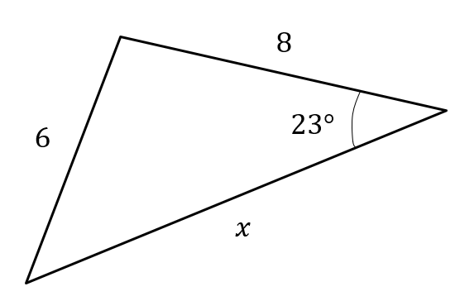
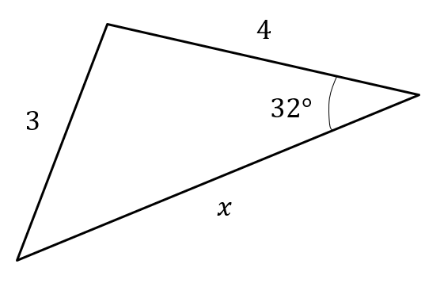
Worked example
Your turn
Calculate the value of $x$
Calculate the value of $x$
$x=5.52$ (3 sf)

Slide 3
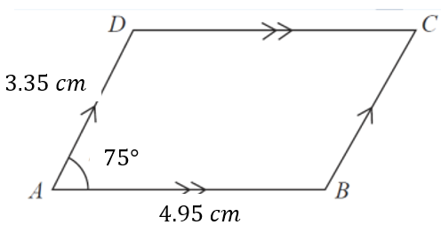
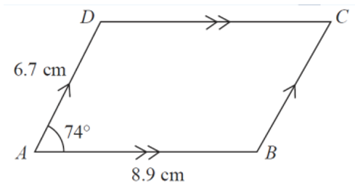
Worked example
Your turn
Calculate the area of the parallelogram
Calculate the area of the parallelogram
$57.32 cm^{2}$ (2 dp)

Slide 4
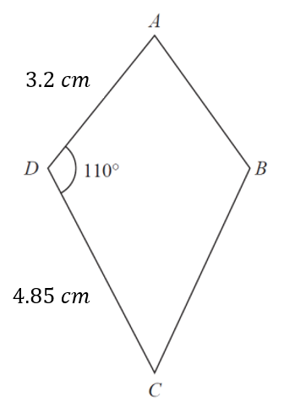
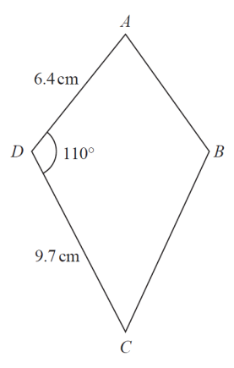
Worked example
Your turn
Calculate the area of the kite
Calculate the area of the kite
$58.34 cm^{2}$(2 dp)

Slide 5
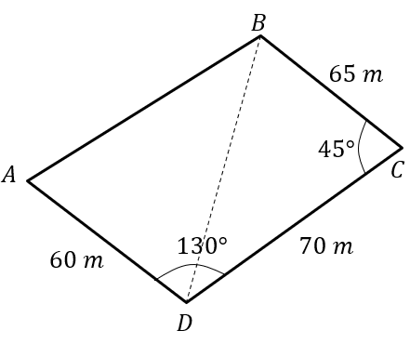
Worked example
Your turn
The diagram shows the locations of four mobile phone masts in a field.
$BC=75 m$, $CD=80m$, angle $BCD=55°$ and angle $ADC=140°$.
In order that the masts do not interfere with each other, they must be at least 65m apart.
Given that $A$ is the minimum distance from $D$, find:
The distance $A$ is from $B$
The angle $BAD$
The area enclosed by the four masts.
The diagram shows the locations of four mobile phone masts in a field.
$BC=75 m$, $CD=80m$, angle $BCD=55°$ and angle $ADC=140°$.
In order that the masts do not interfere with each other, they must be at least 70m apart.
Given that $A$ is the minimum distance from $D$, find:
The distance $A$ is from $B$
The angle $BAD$
The area enclosed by the four masts.
a) $9.21 m$ (3 sf)
b) $50.3°$ (3 sf)
c) $4940 m^{2}$ (3 sf)

