Slide 1
9.5) Vertical motion under gravity

Slide 2
Worked example
Your turn
A book falls off the top shelf of a bookcase.
The shelf is 2.8 m above a wooden floor. Find:
the time the book takes to reach the floor,
the speed with which the book strikes the floor.
A book falls off the top shelf of a bookcase.
The shelf is 1.4 m above a wooden floor. Find:
the time the book takes to reach the floor,
the speed with which the book strikes the floor.
a) $0.53 s$
b) $5.2 ms^{−1}$

Slide 3
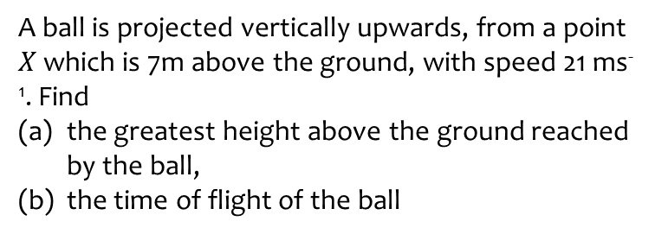
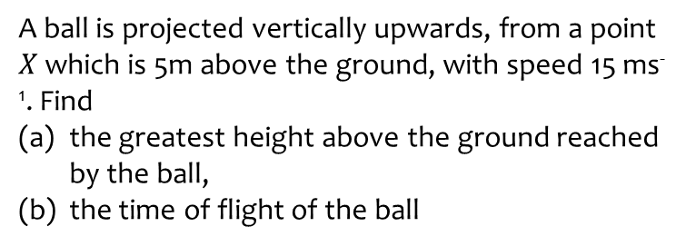
Worked example
Your turn
A ball is projected vertically upwards, from a point $X$ which is 5m above the ground, with speed 15 ms⁻¹. Find
the greatest height above the ground reached by the ball,
the time of flight of the ball
A ball is projected vertically upwards, from a point $X$ which is 7m above the ground, with speed 21 ms⁻¹. Find
the greatest height above the ground reached by the ball,
the time of flight of the ball
a) $30 m$ (2 sf)
b) $4.6 s$ (2 sf)

Slide 4
Worked example
Your turn
A ball is projected vertically upwards from ground level at a speed of 40 ms⁻¹.
Determine the amount of time the ball is at least 20m above ground level.
A ball is projected vertically upwards from ground level at a speed of 20 ms⁻¹.
Determine the amount of time the ball is at least 10m above ground level.
$2.9 s$ (2 sf)

Slide 5
Worked example
Your turn
A ball is projected vertically upwards with initial speed of 20 $ms^{−1}$.
It hits the ground $5 s$ later.
Find the height above the ground from which the ball was thrown.
A ball is projected vertically upwards with initial speed of 15 $ms^{−1}$.
It hits the ground $5 s$ later.
Find the height above the ground from which the ball was thrown.
$$47.5 m$$

Slide 6
Worked example
Your turn
A stone is thrown vertically upward from a point which is $8 m$ above the ground with speed $5 ms^{−1}$.
Find:
The time of flight of the stone
The total distance travelled by the stone
A stone is thrown vertically upward from a point which is $5 m$ above the ground with speed $8 ms^{−1}$.
Find:
The time of flight of the stone
The total distance travelled by the stone
a) $2.1$ s (2 sf)
b) $12 m$ (2 sf)

Slide 7
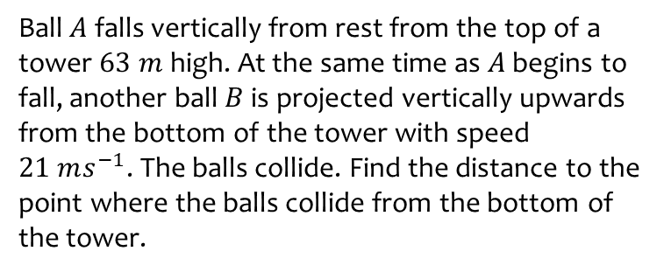
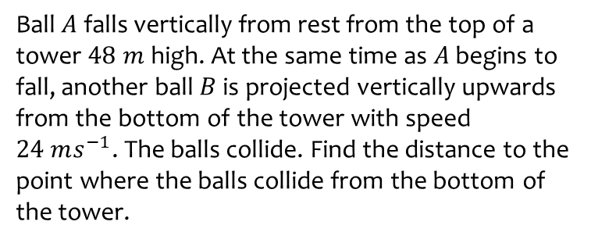
Worked example
Your turn
Ball $A$ falls vertically from rest from the top of a tower $48 m$ high. At the same time as $A$ begins to fall, another ball $B$ is projected vertically upwards from the bottom of the tower with speed $24 ms^{−1}$. The balls collide. Find the distance to the point where the balls collide from the bottom of the tower.
Ball $A$ falls vertically from rest from the top of a tower $63 m$ high. At the same time as $A$ begins to fall, another ball $B$ is projected vertically upwards from the bottom of the tower with speed $21 ms^{−1}$. The balls collide. Find the distance to the point where the balls collide from the bottom of the tower.
$19 m$ (2 sf)

Slide 8
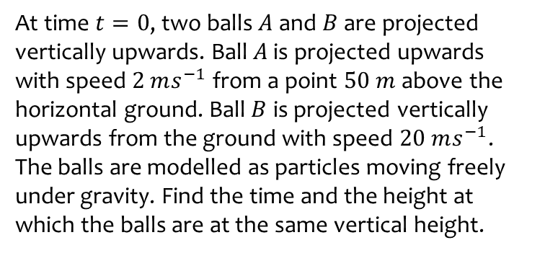
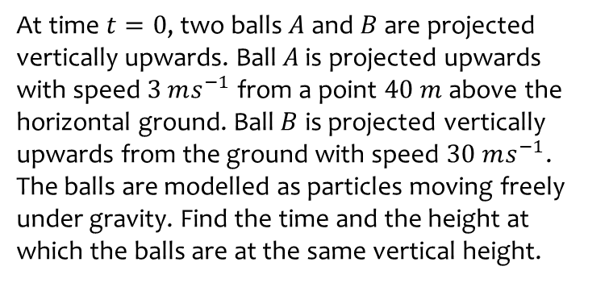
Worked example
Your turn
At time $t=0$, two balls $A$ and $B$ are projected vertically upwards. Ball $A$ is projected upwards with speed $3 ms^{−1}$ from a point $40 m$ above the horizontal ground. Ball $B$ is projected vertically upwards from the ground with speed $30 ms^{−1}$. The balls are modelled as particles moving freely under gravity. Find the time and the height at which the balls are at the same vertical height.
At time $t=0$, two balls $A$ and $B$ are projected vertically upwards. Ball $A$ is projected upwards with speed $2 ms^{−1}$ from a point $50 m$ above the horizontal ground. Ball $B$ is projected vertically upwards from the ground with speed $20 ms^{−1}$. The balls are modelled as particles moving freely under gravity. Find the time and the height at which the balls are at the same vertical height.
$t=2.8 s$ (2 sf)
$h=18 m$ (2 sf)

Slide 9
Worked example
Your turn
A ball is released from rest at a point which is $20 m$ above a wooden floor. Each time the ball strikes the floor, it rebounds with $\frac{2}{3}$ of the speed with which it strikes the floor.
Find the greatest height above the floor reached by the ball:
The first time it rebounds from the floor
The second time it rebounds from the floor.
A ball is released from rest at a point which is $10 m$ above a wooden floor. Each time the ball strikes the floor, it rebounds with $\frac{3}{4}$ of the speed with which it strikes the floor.
Find the greatest height above the floor reached by the ball:
The first time it rebounds from the floor
The second time it rebounds from the floor.
a) $5.6 m$ (2 sf)
b) $3.2 m$ (2 sf)

