Slide 1
9.3) Areas of triangles

Slide 2
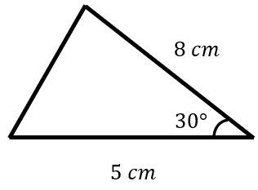
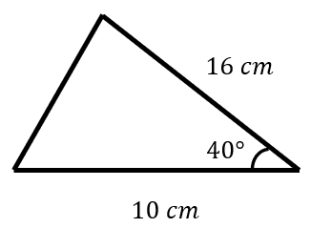
Worked example
Your turn
Calculate the area of the triangle:
Calculate the area of the triangle:
$51.42 cm^{2}$ (2 dp)

Slide 3
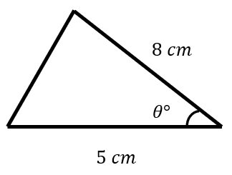
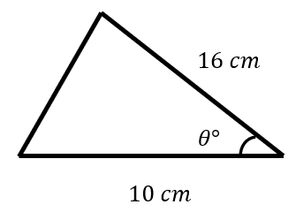
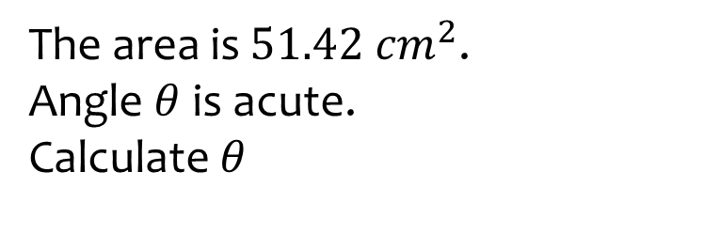
Worked example
Your turn
The area is $10 cm^{2}$.
Angle $θ$ is acute.
Calculate $θ$
The area is $51.42 cm^{2}$.
Angle $θ$ is acute.
Calculate $θ$
$θ=40.0$ (3 sf)

Slide 4
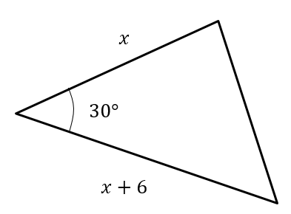
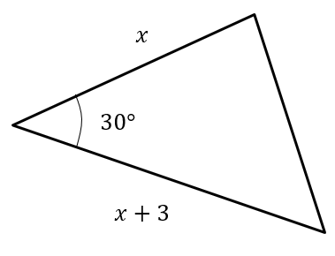
Worked example
Your turn
The area is $40$. Determine $x$
The area is $10$. Determine $x$
$$x=5$$

Slide 5
Worked example
Your turn
A triangle has sides $5.1$ $cm$, $3.4 cm$ and $2.85 cm$.
Work out the area of the triangle
A triangle has sides $10.2$ $cm$, $6.8 cm$ and $5.7 cm$.
Work out the area of the triangle
$18.3 cm^{2}$ (1 dp)

Slide 6
Worked example
Your turn
In $△ABC$, $AB=2.5cm, BC=3 cm$ and $∠ABC=x$.
Given that the area of $△ABC$ is $3 cm^{2}$ and that $AC$ is the longest side, find the value of $x$
In $△ABC$, $AB=5cm, BC=6 cm$ and $∠ABC=x$.
Given that the area of $△ABC$ is $12 cm^{2}$ and that $AC$ is the longest side, find the value of $x$
$x=127°$ (3 sf)

Slide 7
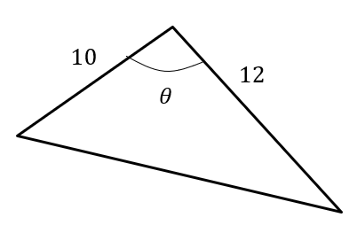
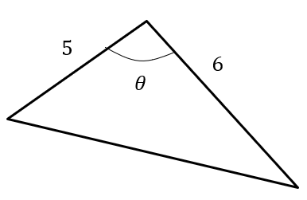
Worked example
Your turn
The area of this triangle is 40.
If $θ$ is obtuse, determine $θ$.
The area of this triangle is 10.
If $θ$ is obtuse, determine $θ$.
$θ=138°$ (3 sf)

