Slide 1
9.4) Constant acceleration formulae 2

Slide 2
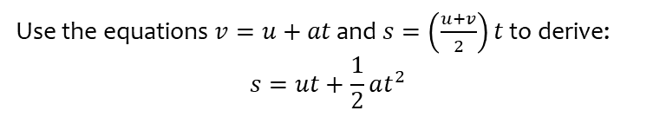

Worked example
Your turn
Use the equations $v=u+at$ and $s=\left(\frac{u+v}{2}\right)t$ to derive:
$$v^{2}=u^{2}+2as$$
$$s=vt−\frac{1}{2}at^{2}$$
Use the equations $v=u+at$ and $s=\left(\frac{u+v}{2}\right)t$ to derive:
$$s=ut+\frac{1}{2}at^{2}$$
Shown

Slide 3
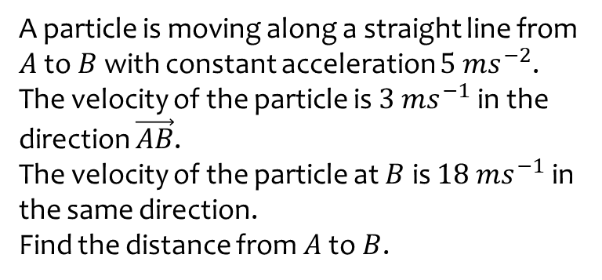
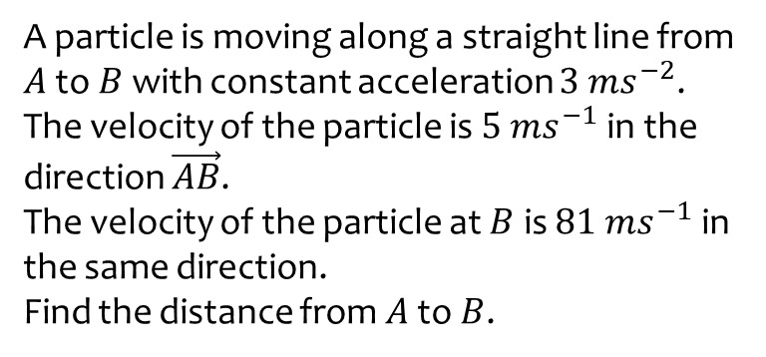
Worked example
Your turn
A particle is moving along a straight line from $A$ to $B$ with constant acceleration $3 ms^{−2}$.
The velocity of the particle is $5 ms^{−1}$ in the direction $\vec{AB}$.
The velocity of the particle at $B$ is $81 ms^{−1}$ in the same direction.
Find the distance from $A$ to $B$.
A particle is moving along a straight line from $A$ to $B$ with constant acceleration $5 ms^{−2}$.
The velocity of the particle is $3 ms^{−1}$ in the direction $\vec{AB}$.
The velocity of the particle at $B$ is $18 ms^{−1}$ in the same direction.
Find the distance from $A$ to $B$.
$$31.5 m$$

Slide 4
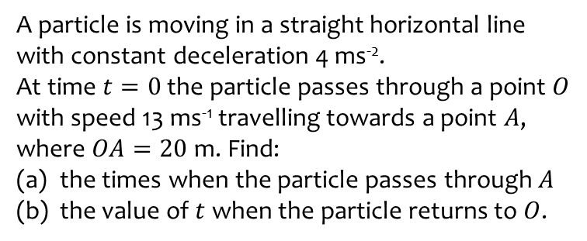
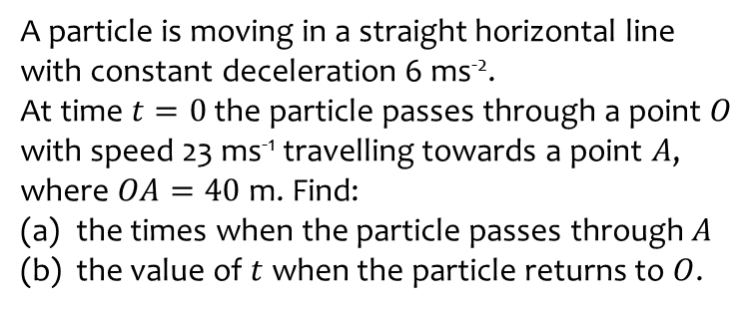
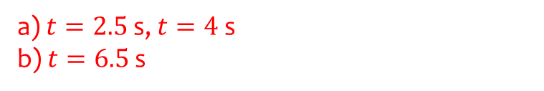
Worked example
Your turn
A particle is moving in a straight horizontal line with constant deceleration 6 ms⁻².
At time $t=0$ the particle passes through a point $O$ with speed 23 ms⁻¹ travelling towards a point $A$, where $OA=40$ m. Find:
the times when the particle passes through $A$
the value of $t$ when the particle returns to $O$.
A particle is moving in a straight horizontal line with constant deceleration 4 ms⁻².
At time $t=0$ the particle passes through a point $O$ with speed 13 ms⁻¹ travelling towards a point $A$, where $OA=20$ m. Find:
the times when the particle passes through $A$
the value of $t$ when the particle returns to $O$.
a) $t=2.5$ s, $t=4$ s
b) $t=6.5$ s

Slide 5
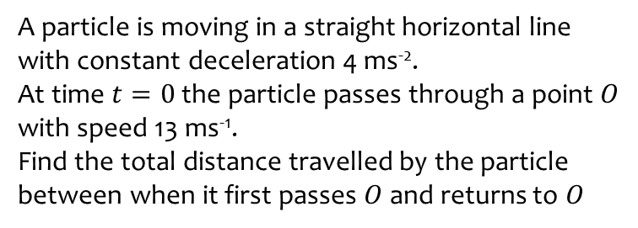
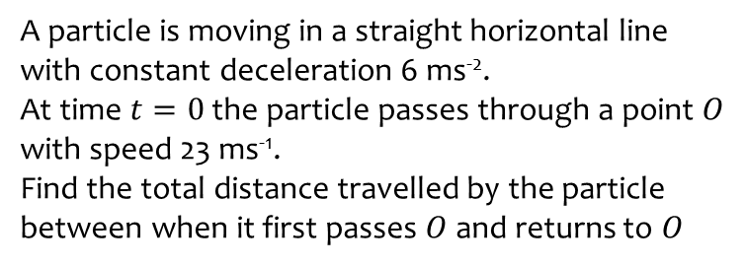
Worked example
Your turn
A particle is moving in a straight horizontal line with constant deceleration 6 ms⁻².
At time $t=0$ the particle passes through a point $O$ with speed 23 ms⁻¹.
Find the total distance travelled by the particle between when it first passes $O$ and returns to $O$
A particle is moving in a straight horizontal line with constant deceleration 4 ms⁻².
At time $t=0$ the particle passes through a point $O$ with speed 13 ms⁻¹.
Find the total distance travelled by the particle between when it first passes $O$ and returns to $O$
$$42.25 m$$

Slide 6
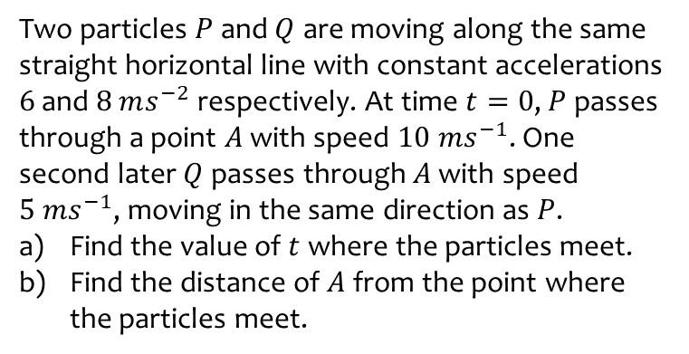
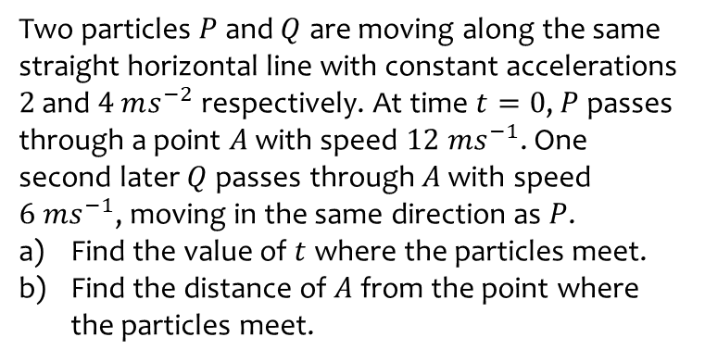
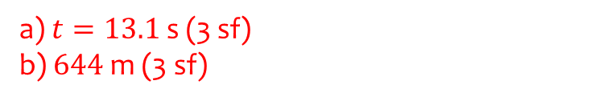
Worked example
Your turn
Two particles $P$ and $Q$ are moving along the same straight horizontal line with constant accelerations $2$ and $4$ $ms^{−2}$ respectively. At time $t=0$, $P$ passes through a point $A$ with speed $12 ms^{−1}$. One second later $Q$ passes through $A$ with speed $6 ms^{−1}$, moving in the same direction as $P$.
Find the value of $t$ where the particles meet.
Find the distance of $A$ from the point where the particles meet.
Two particles $P$ and $Q$ are moving along the same straight horizontal line with constant accelerations $6$ and $8$ $ms^{−2}$ respectively. At time $t=0$, $P$ passes through a point $A$ with speed $10 ms^{−1}$. One second later $Q$ passes through $A$ with speed $5 ms^{−1}$, moving in the same direction as $P$.
Find the value of $t$ where the particles meet.
Find the distance of $A$ from the point where the particles meet.
a) $t=13.1$ s (3 sf)
b) $644$ m (3 sf)

Slide 7
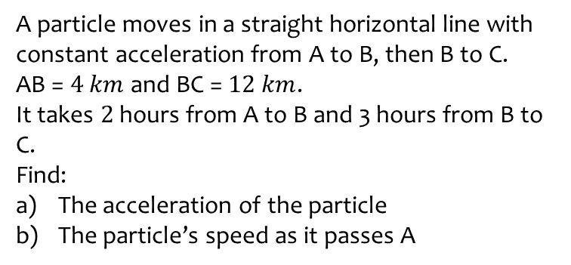
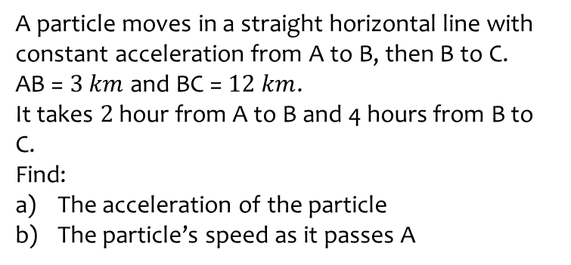
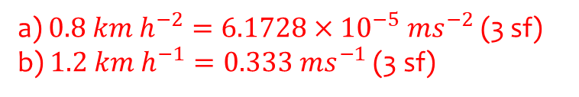
Worked example
Your turn
A particle moves in a straight horizontal line with constant acceleration from A to B, then B to C.
AB = $3 km$ and BC = $12 km$.
It takes $2$ hour from A to B and 4 hours from B to C.
Find:
The acceleration of the particle
The particle’s speed as it passes A
A particle moves in a straight horizontal line with constant acceleration from A to B, then B to C.
AB = $4 km$ and BC = $12 km$.
It takes $2$ hours from A to B and 3 hours from B to C.
Find:
The acceleration of the particle
The particle’s speed as it passes A
a) $0.8 km h^{−2}=6.1728×{10}^{−5} ms^{−2}$ (3 sf)
b) $1.2 km h^{−1}=0.333 ms^{−1}$ (3 sf)

