Slide 1
9.3) Constant acceleration formulae

Slide 2
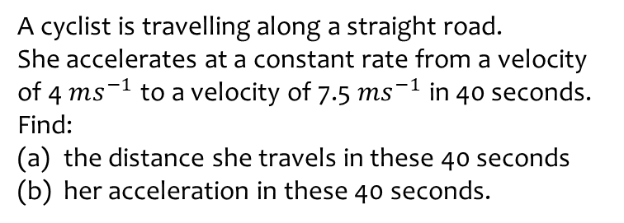
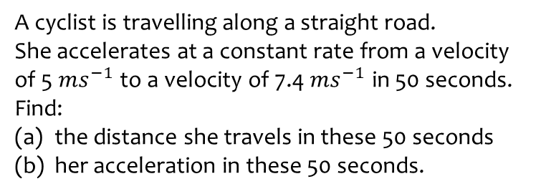
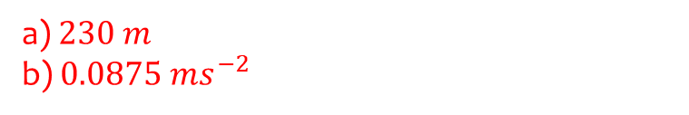
Worked example
Your turn
A cyclist is travelling along a straight road.
She accelerates at a constant rate from a velocity of 5 $ms^{−1}$ to a velocity of 7.4 $ms^{−1}$ in 50 seconds. Find:
the distance she travels in these 50 seconds
her acceleration in these 50 seconds.
A cyclist is travelling along a straight road.
She accelerates at a constant rate from a velocity of 4 $ms^{−1}$ to a velocity of 7.5 $ms^{−1}$ in 40 seconds. Find:
the distance she travels in these 40 seconds
her acceleration in these 40 seconds.
a) $230 m$
b) $0.0875 ms^{−2}$

Slide 3
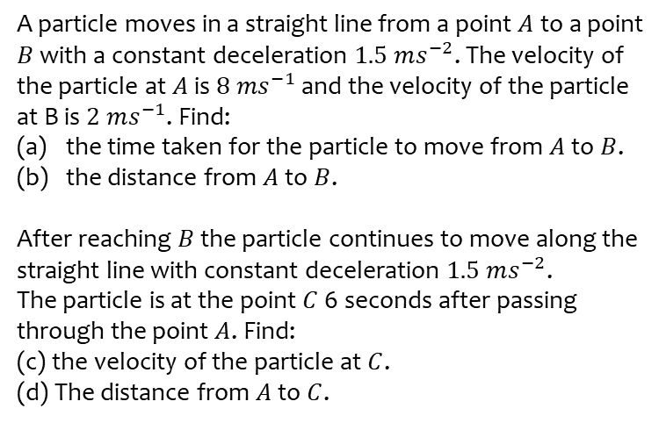
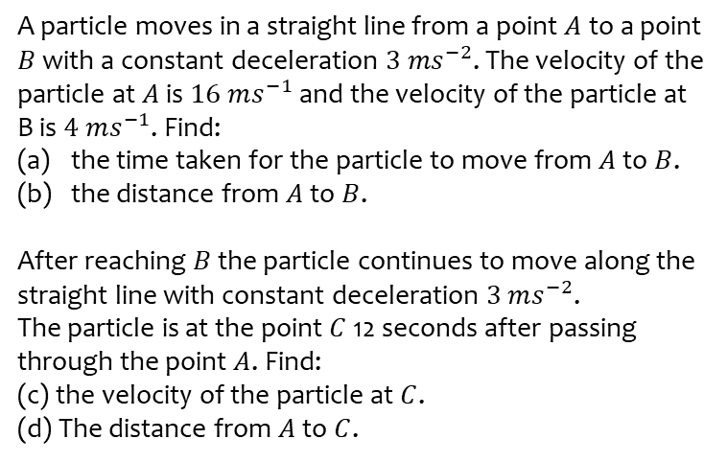
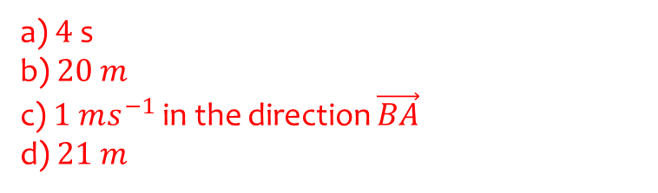
Worked example
Your turn
A particle moves in a straight line from a point $A$ to a point $B$ with a constant deceleration $3 ms^{−2}$. The velocity of the particle at $A$ is $16 ms^{−1}$ and the velocity of the particle at B is $4 ms^{−1}$. Find:
the time taken for the particle to move from $A$ to $B$.
the distance from $A$ to $B$.
After reaching $B$ the particle continues to move along the straight line with constant deceleration $3 ms^{−2}$.
The particle is at the point $C$ 12 seconds after passing through the point $A$. Find:
(c) the velocity of the particle at $C$.
(d) The distance from $A$ to $C$.
A particle moves in a straight line from a point $A$ to a point $B$ with a constant deceleration $1.5 ms^{−2}$. The velocity of the particle at $A$ is $8 ms^{−1}$ and the velocity of the particle at B is $2 ms^{−1}$. Find:
the time taken for the particle to move from $A$ to $B$.
the distance from $A$ to $B$.
After reaching $B$ the particle continues to move along the straight line with constant deceleration $1.5 ms^{−2}$.
The particle is at the point $C$ 6 seconds after passing through the point $A$. Find:
(c) the velocity of the particle at $C$.
(d) The distance from $A$ to $C$.
a) $4$ s
b) $20 m$
c) $1 ms^{−1}$ in the direction $\vec{BA}$
d) $21 m$

Slide 4
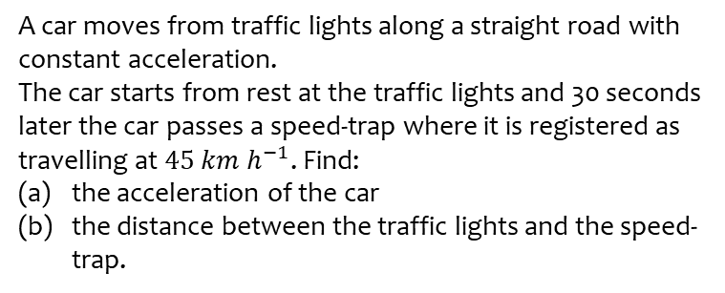
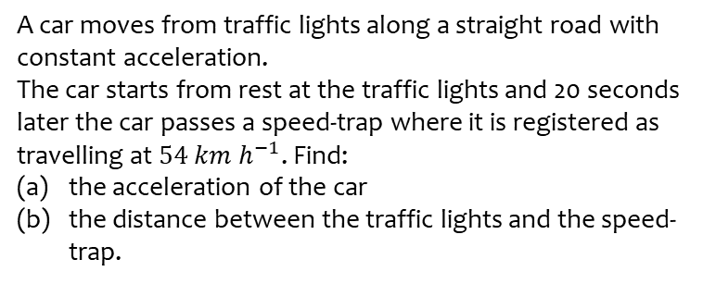
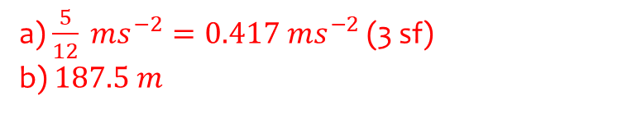
Worked example
Your turn
A car moves from traffic lights along a straight road with constant acceleration.
The car starts from rest at the traffic lights and 20 seconds later the car passes a speed-trap where it is registered as travelling at $54 km h^{−1}$. Find:
the acceleration of the car
the distance between the traffic lights and the speed-trap.
A car moves from traffic lights along a straight road with constant acceleration.
The car starts from rest at the traffic lights and 30 seconds later the car passes a speed-trap where it is registered as travelling at $45 km h^{−1}$. Find:
the acceleration of the car
the distance between the traffic lights and the speed-trap.
a) $\frac{5}{12} ms^{−2}=0.417 ms^{−2}$ (3 sf)
b) $187.5 m$

Slide 5
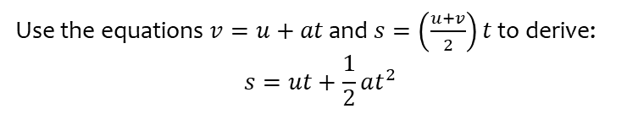

Worked example
Your turn
Use the equations $v=u+at$ and $s=\left(\frac{u+v}{2}\right)t$ to derive:
$$v^{2}=u^{2}+2as$$
$$s=vt−\frac{1}{2}at^{2}$$
Use the equations $v=u+at$ and $s=\left(\frac{u+v}{2}\right)t$ to derive:
$$s=ut+\frac{1}{2}at^{2}$$
Shown

Slide 6
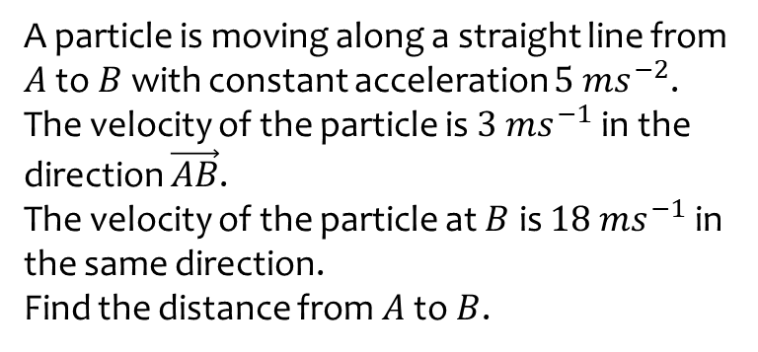
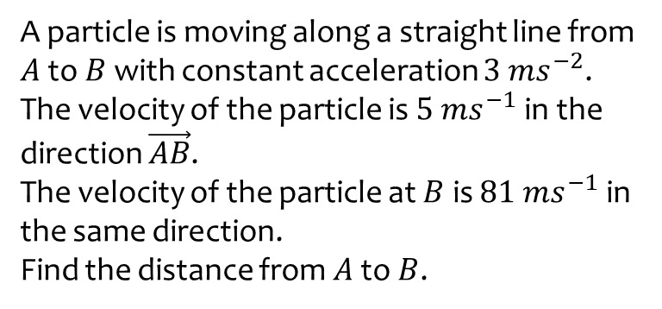
Worked example
Your turn
A particle is moving along a straight line from $A$ to $B$ with constant acceleration $3 ms^{−2}$.
The velocity of the particle is $5 ms^{−1}$ in the direction $\vec{AB}$.
The velocity of the particle at $B$ is $81 ms^{−1}$ in the same direction.
Find the distance from $A$ to $B$.
A particle is moving along a straight line from $A$ to $B$ with constant acceleration $5 ms^{−2}$.
The velocity of the particle is $3 ms^{−1}$ in the direction $\vec{AB}$.
The velocity of the particle at $B$ is $18 ms^{−1}$ in the same direction.
Find the distance from $A$ to $B$.
$$31.5 m$$

Slide 7
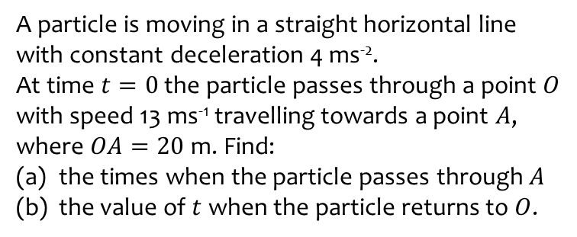
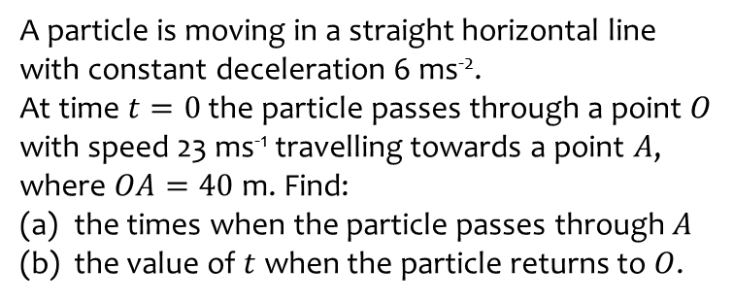
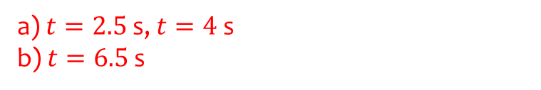
Worked example
Your turn
A particle is moving in a straight horizontal line with constant deceleration 6 ms⁻².
At time $t=0$ the particle passes through a point $O$ with speed 23 ms⁻¹ travelling towards a point $A$, where $OA=40$ m. Find:
the times when the particle passes through $A$
the value of $t$ when the particle returns to $O$.
A particle is moving in a straight horizontal line with constant deceleration 4 ms⁻².
At time $t=0$ the particle passes through a point $O$ with speed 13 ms⁻¹ travelling towards a point $A$, where $OA=20$ m. Find:
the times when the particle passes through $A$
the value of $t$ when the particle returns to $O$.
a) $t=2.5$ s, $t=4$ s
b) $t=6.5$ s

Slide 8
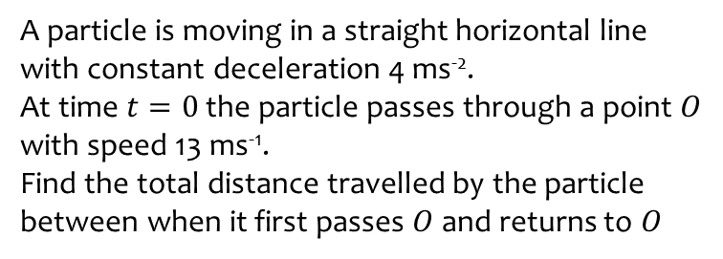
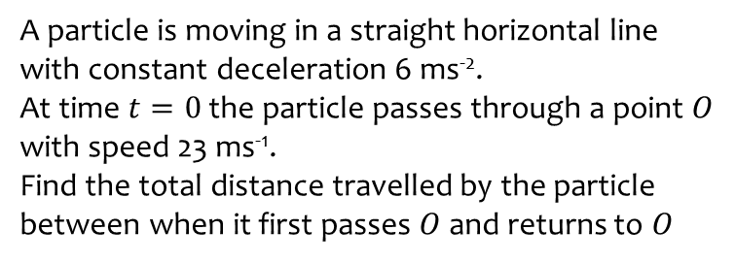
Worked example
Your turn
A particle is moving in a straight horizontal line with constant deceleration 6 ms⁻².
At time $t=0$ the particle passes through a point $O$ with speed 23 ms⁻¹.
Find the total distance travelled by the particle between when it first passes $O$ and returns to $O$
A particle is moving in a straight horizontal line with constant deceleration 4 ms⁻².
At time $t=0$ the particle passes through a point $O$ with speed 13 ms⁻¹.
Find the total distance travelled by the particle between when it first passes $O$ and returns to $O$
$$42.25 m$$

Slide 9
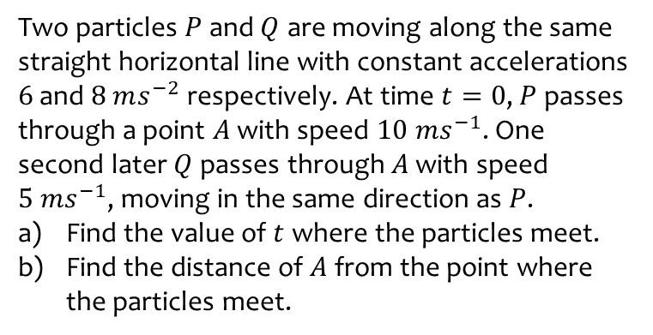
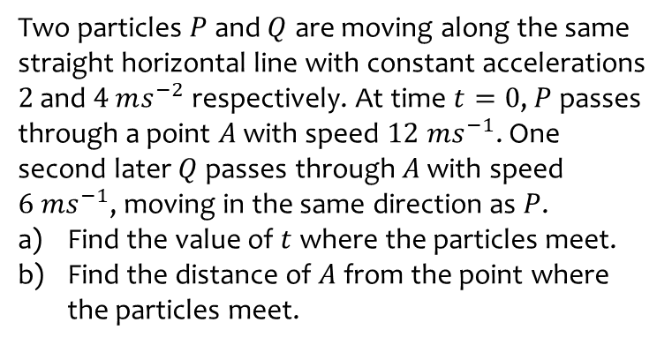
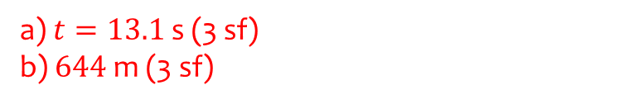
Worked example
Your turn
Two particles $P$ and $Q$ are moving along the same straight horizontal line with constant accelerations $2$ and $4$ $ms^{−2}$ respectively. At time $t=0$, $P$ passes through a point $A$ with speed $12 ms^{−1}$. One second later $Q$ passes through $A$ with speed $6 ms^{−1}$, moving in the same direction as $P$.
Find the value of $t$ where the particles meet.
Find the distance of $A$ from the point where the particles meet.
Two particles $P$ and $Q$ are moving along the same straight horizontal line with constant accelerations $6$ and $8$ $ms^{−2}$ respectively. At time $t=0$, $P$ passes through a point $A$ with speed $10 ms^{−1}$. One second later $Q$ passes through $A$ with speed $5 ms^{−1}$, moving in the same direction as $P$.
Find the value of $t$ where the particles meet.
Find the distance of $A$ from the point where the particles meet.
a) $t=13.1$ s (3 sf)
b) $644$ m (3 sf)

Slide 10
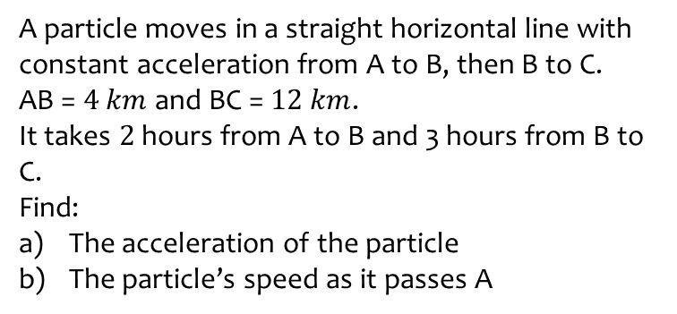
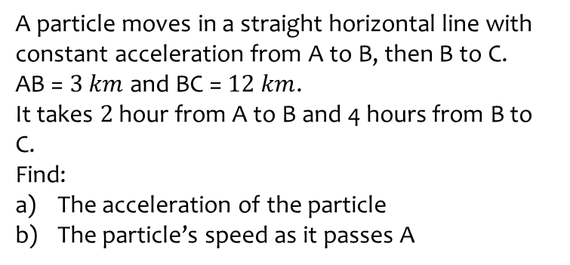
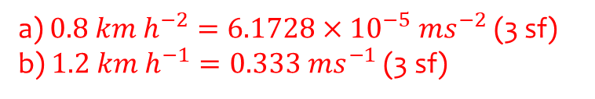
Worked example
Your turn
A particle moves in a straight horizontal line with constant acceleration from A to B, then B to C.
AB = $3 km$ and BC = $12 km$.
It takes $2$ hour from A to B and 4 hours from B to C.
Find:
The acceleration of the particle
The particle’s speed as it passes A
A particle moves in a straight horizontal line with constant acceleration from A to B, then B to C.
AB = $4 km$ and BC = $12 km$.
It takes $2$ hours from A to B and 3 hours from B to C.
Find:
The acceleration of the particle
The particle’s speed as it passes A
a) $0.8 km h^{−2}=6.1728×{10}^{−5} ms^{−2}$ (3 sf)
b) $1.2 km h^{−1}=0.333 ms^{−1}$ (3 sf)

