Slide 1
9.3) The chain rule

Slide 2
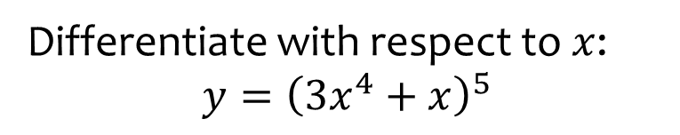

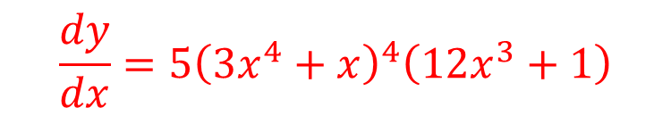
Worked example
Your turn
Differentiate with respect to $x$:
$$y={\left(4x^{3}−x\right)}^{7}$$
$$f(x)={\left(7x^{2}−3x\right)}^{4}$$
Differentiate with respect to $x$:
$$y={\left(3x^{4}+x\right)}^{5}$$
$$\frac{dy}{dx}=5{\left(3x^{4}+x\right)}^{4}\left(12x^{3}+1\right)$$

Slide 3
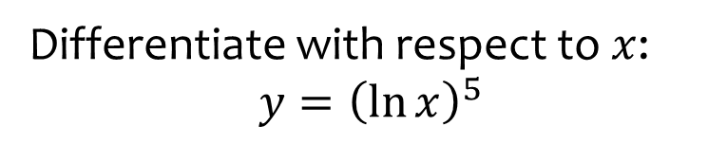


Worked example
Your turn
Differentiate with respect to $x$:
$$y={\left(\ln{x}\right)}^{3}$$
$$f(x)={\left(\ln{x}\right)}^{4}$$
Differentiate with respect to $x$:
$$y={\left(\ln{x}\right)}^{5}$$
$$\frac{dy}{dx}=\frac{5{\left(\ln{x}\right)}^{4}}{x}$$

Slide 4
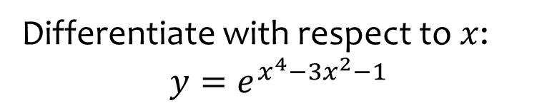

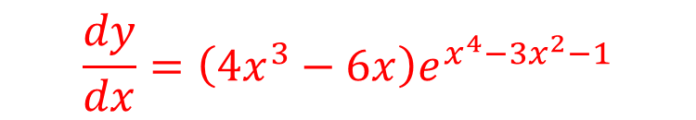
Worked example
Your turn
Differentiate with respect to $x$:
$$y=e^{x^{2}+x}$$
$$f(x)=e^{x^{3}−2x+1}$$
Differentiate with respect to $x$:
$$y=e^{x^{4}−{3x}^{2}−1}$$
$$\frac{dy}{dx}=\left(4x^{3}−6x\right)e^{x^{4}−3x^{2}−1}$$

Slide 5
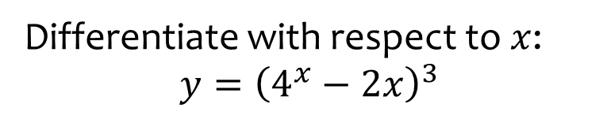

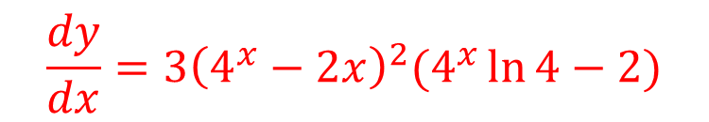
Worked example
Your turn
Differentiate with respect to $x$:
$$y={\left(3^{x}+1\right)}^{2}$$
$$f(x)={\left(2^{x}−3x\right)}^{4}$$
Differentiate with respect to $x$:
$$y={\left(4^{x}−2x\right)}^{3}$$
$$\frac{dy}{dx}=3{\left(4^{x}−2x\right)}^{2}(4^{x}\ln{4}−2)$$

Slide 6
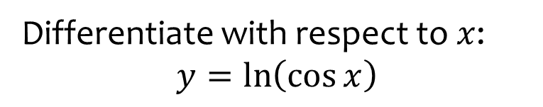
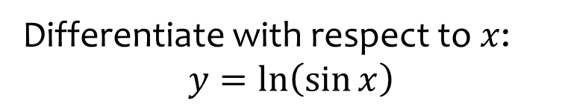

Worked example
Your turn
Differentiate with respect to $x$:
$$y=\ln\left(\sin{x}\right)$$
Differentiate with respect to $x$:
$$y=\ln\left(\cos{x}\right)$$
$$\frac{dy}{dx}=\tan{x}$$

Slide 7
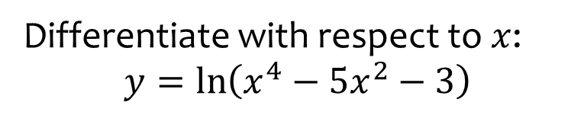


Worked example
Your turn
Differentiate with respect to $x$:
$$y=\ln\left(x^{2}−3x+4\right)$$
$$f(x)=\ln{(x^{3}−2x−5)}$$
Differentiate with respect to $x$:
$$y=\ln\left(x^{4}−5x^{2}−3\right)$$
$$\frac{dy}{dx}=\frac{4x^{3}−10x}{x^{4}−5x^{2}−3}$$

Slide 8
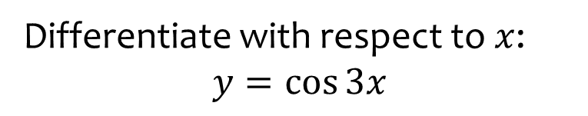


Worked example
Your turn
Differentiate with respect to $x$:
$$y=\sin{5x}$$
$$f(x)=\cos{(−4x)}$$
Differentiate with respect to $x$:
$$y=\cos{3x}$$
$$\frac{dy}{dx}=−3\sin{3x}$$

Slide 9
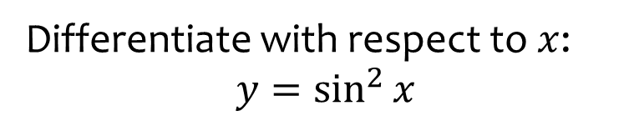

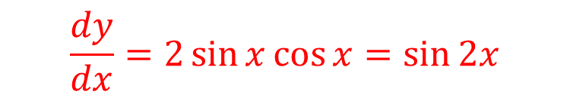
Worked example
Your turn
Differentiate with respect to $x$:
$$y=\sin^{4}{x}$$
$$f(x)=\cos^{3}{x}$$
Differentiate with respect to $x$:
$$y=\sin^{2}{x}$$
$$\frac{dy}{dx}=2\sin{x}\cos{x}=\sin{2x}$$

Slide 10
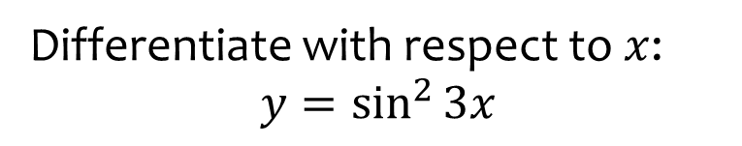

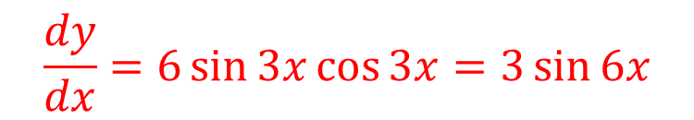
Worked example
Your turn
Differentiate with respect to $x$:
$$y=\sin^{4}{3x}$$
$$f(x)=\cos^{3}{2x}$$
Differentiate with respect to $x$:
$$y=\sin^{2}{3x}$$
$$\frac{dy}{dx}=6\sin{3x}\cos{3x}=3\sin{6x}$$

Slide 11
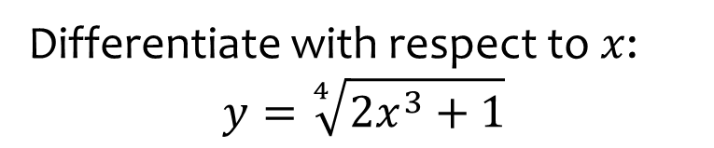

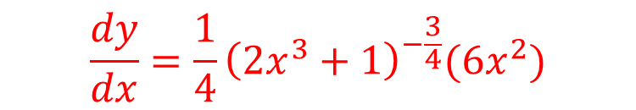
Worked example
Your turn
Differentiate with respect to $x$:
$$y=\sqrt{2x−1}$$
$$f(x)=\sqrt[3]{4x^{2}+5}$$
Differentiate with respect to $x$:
$$y=\sqrt[4]{2x^{3}+1}$$
$$\frac{dy}{dx}=\frac{1}{4}{\left(2x^{3}+1\right)}^{−\frac{3}{4}}(6x^{2})$$

Slide 12
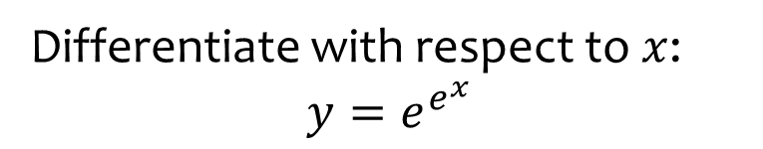
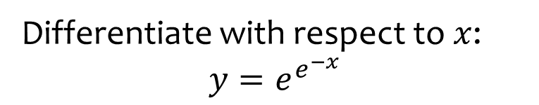

Worked example
Your turn
Differentiate with respect to $x$:
$$y=e^{e^{−x}}$$
Differentiate with respect to $x$:
$$y=e^{e^{x}}$$
$$\frac{dy}{dx}=e^{x}\left(e^{e^{x}}\right)$$

Slide 13



Worked example
Your turn
Given that $y=\sqrt{2x^{5}−2}$, find $\frac{dy}{dx}$ at $\left(3,22\right)$
Given that $y=\sqrt{5x^{2}+1}$, find $\frac{dy}{dx}$ at $\left(4,9\right)$
$$\frac{20}{9}$$

Slide 14
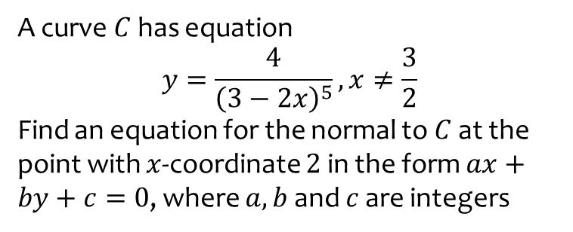
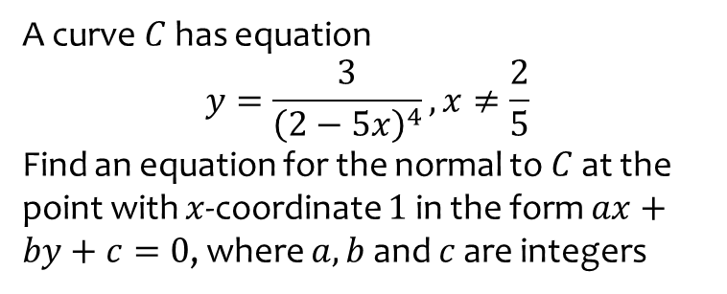

Worked example
Your turn
A curve $C$ has equation
$$y=\frac{3}{{\left(2−5x\right)}^{4}}, x≠\frac{2}{5}$$
Find an equation for the normal to $C$ at the point with $x$-coordinate $1$ in the form $ax+by+c=0$, where $a,b$ and $c$ are integers
A curve $C$ has equation
$$y=\frac{4}{{\left(3−2x\right)}^{5}}, x≠\frac{3}{2}$$
Find an equation for the normal to $C$ at the point with $x$-coordinate $2$ in the form $ax+by+c=0$, where $a,b$ and $c$ are integers
$$x+40y+158=0$$

