Slide 1
Worked example
Your turn
In $△ABC$, $AB=8cm, AC=6 cm$ and $∠ABC=88°$.
Work out the two possible values of $∠ACB$
In $△ABC$, $AB=4cm, AC=3 cm$ and $∠ABC=44°$.
Work out the two possible values of $∠ACB$
$67.9°$ and $112°$ (3 sf)

Slide 2
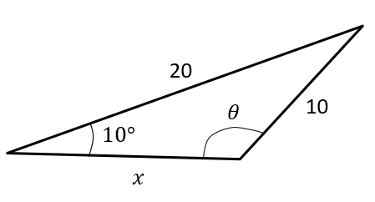
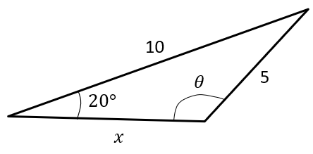
Worked example
Your turn
Given that the angle $θ$ is obtuse, determine $θ$ and hence determine the length of $x$.
Given that the angle $θ$ is obtuse, determine $θ$ and hence determine the length of $x$.
$θ=137°$ (3 sf)
$x=5.75$ (3 sf)

