Slide 1
9.3) Constant acceleration formulae 1

Slide 2
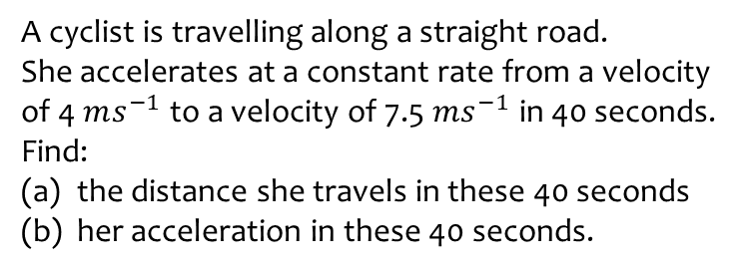
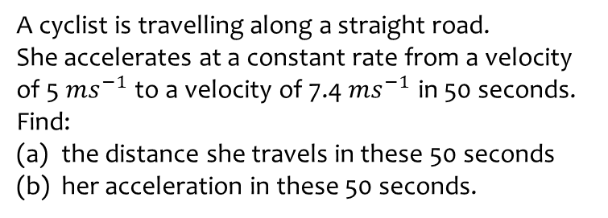
Worked example
Your turn
A cyclist is travelling along a straight road.
She accelerates at a constant rate from a velocity of 5 $ms^{−1}$ to a velocity of 7.4 $ms^{−1}$ in 50 seconds. Find:
the distance she travels in these 50 seconds
her acceleration in these 50 seconds.
A cyclist is travelling along a straight road.
She accelerates at a constant rate from a velocity of 4 $ms^{−1}$ to a velocity of 7.5 $ms^{−1}$ in 40 seconds. Find:
the distance she travels in these 40 seconds
her acceleration in these 40 seconds.
a) $230 m$
b) $0.0875 ms^{−2}$

Slide 3
Worked example
Your turn
A particle moves in a straight line from a point $A$ to a point $B$ with a constant deceleration $3 ms^{−2}$. The velocity of the particle at $A$ is $16 ms^{−1}$ and the velocity of the particle at B is $4 ms^{−1}$. Find:
the time taken for the particle to move from $A$ to $B$.
the distance from $A$ to $B$.
After reaching $B$ the particle continues to move along the straight line with constant deceleration $3 ms^{−2}$.
The particle is at the point $C$ 12 seconds after passing through the point $A$. Find:
(c) the velocity of the particle at $C$.
(d) The distance from $A$ to $C$.
A particle moves in a straight line from a point $A$ to a point $B$ with a constant deceleration $1.5 ms^{−2}$. The velocity of the particle at $A$ is $8 ms^{−1}$ and the velocity of the particle at B is $2 ms^{−1}$. Find:
the time taken for the particle to move from $A$ to $B$.
the distance from $A$ to $B$.
After reaching $B$ the particle continues to move along the straight line with constant deceleration $1.5 ms^{−2}$.
The particle is at the point $C$ 6 seconds after passing through the point $A$. Find:
(c) the velocity of the particle at $C$.
(d) The distance from $A$ to $C$.
a) $4$ s
b) $20 m$
c) $1 ms^{−1}$ in the direction $\vec{BA}$
d) $21 m$

Slide 4
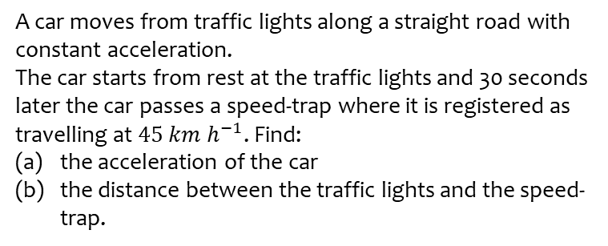
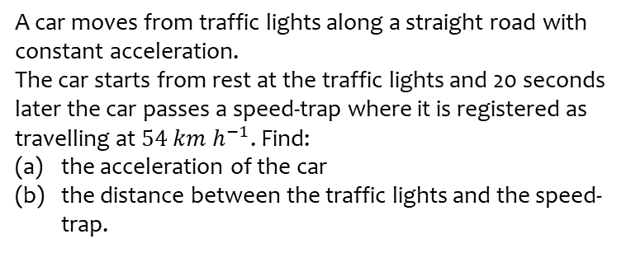
Worked example
Your turn
A car moves from traffic lights along a straight road with constant acceleration.
The car starts from rest at the traffic lights and 20 seconds later the car passes a speed-trap where it is registered as travelling at $54 km h^{−1}$. Find:
the acceleration of the car
the distance between the traffic lights and the speed-trap.
A car moves from traffic lights along a straight road with constant acceleration.
The car starts from rest at the traffic lights and 30 seconds later the car passes a speed-trap where it is registered as travelling at $45 km h^{−1}$. Find:
the acceleration of the car
the distance between the traffic lights and the speed-trap.
a) $\frac{5}{12} ms^{−2}=0.417 ms^{−2}$ (3 sf)
b) $187.5 m$

