Slide 1
9.2) Velocity-time graphs

Slide 2
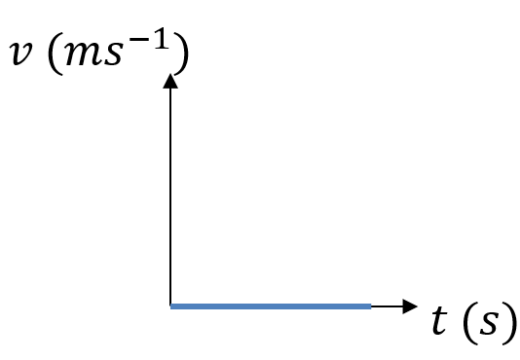
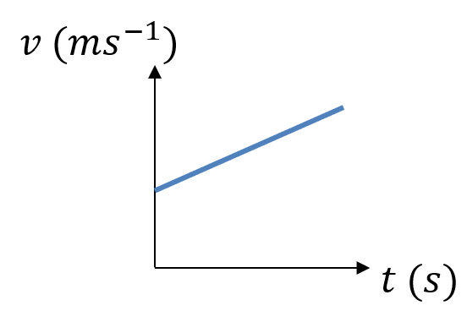
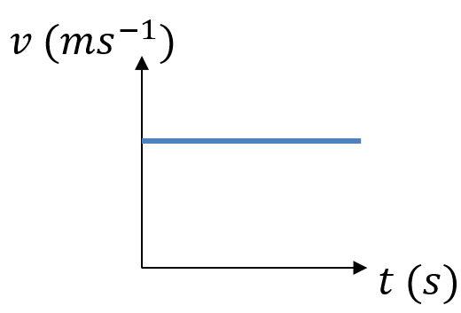
Worked example
Your turn
Describe the motion of each object from the velocity-time graph:
Describe the motion of each object from the velocity-time graph:
Object has constant acceleration. Velocity is increasing at a constant rate.
Diagrams/Graphs used with permission from DrFrostMaths: https://www.drfrostmaths.com/

Slide 3
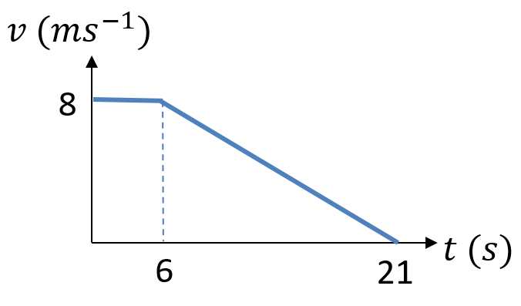
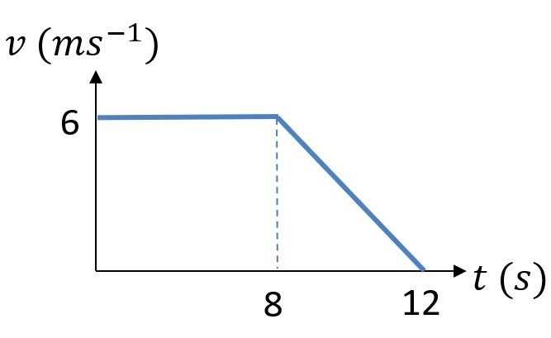
Worked example
Your turn
A cyclist is moving along a straight road for a period of 21 seconds. For the first 6 seconds, she moves at a constant speed of 8 $ms^{−1}$. She then decelerates at a constant rate, stopping after a further 15 seconds.
Find the displacement from the starting point of the cyclist after this 21 second period.
Work out the rate at which the cyclist decelerates.
A cyclist is moving along a straight road for a period of 12 seconds. For the first 8 seconds, she moves at a constant speed of 6 m s⁻¹. She then decelerates at a constant rate, stopping after a further 4 seconds.
Find the displacement from the starting point of the cyclist after this 12 second period.
Work out the rate at which the cyclist decelerates.
a) $60 m$
b) $1.5 ms^{−2}$
Diagrams/Graphs used with permission from DrFrostMaths: https://www.drfrostmaths.com/

Slide 4
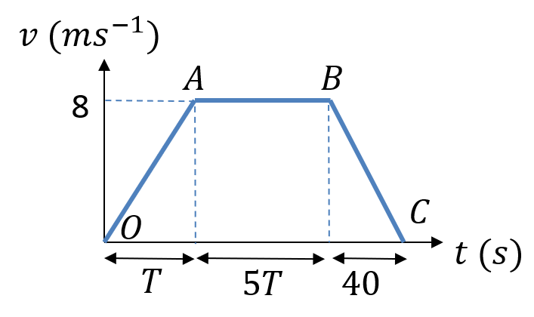
Worked example
Your turn
A particle moves along a straight line. The particle accelerates uniformly from rest to a velocity of 16 $ms^{−1}$ in $T$ seconds. The particle then travels at a constant velocity of 16 $ms^{−1}$ for $3T$ seconds. The particle then decelerates uniformly to rest in a further 4 s.
Sketch a velocity-time graph to illustrate the motion of the particle.
Give then the total displacement of the particle is 592m.
(b) find the value of $T$.
A particle moves along a straight line. The particle accelerates uniformly from rest to a velocity of 8 ms⁻¹ in $T$ seconds. The particle then travels at a constant velocity of 8 ms⁻¹ for $5T$ seconds. The particle then decelerates uniformly to rest in a further 40 s.
Sketch a velocity-time graph to illustrate the motion of the particle.
Give then the total displacement of the particle is 600m.
(b) find the value of $T$.
a)
b) $T=10$
Diagrams/Graphs used with permission from DrFrostMaths: https://www.drfrostmaths.com/

Slide 5
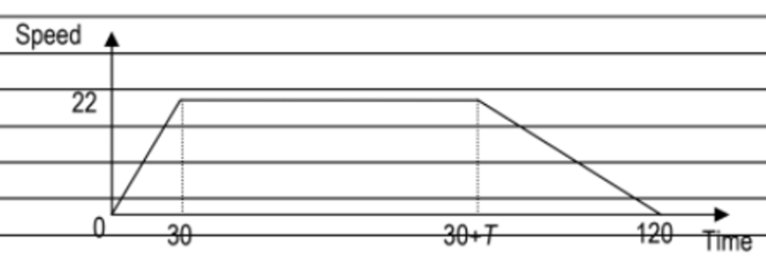
Worked example
Your turn
A car is travelling along a straight horizontal road. The car takes $60 s$ to travel between two sets of traffic lights which are $1072.5 m$ apart. The car starts from rest at the first set of traffic lights and moves with constant acceleration for $15 s$ until its speed is $11 m s^{−1}$. The car maintains this speed for $T$ seconds. The car then moves with constant deceleration, coming to rest at the second set of traffic lights.
Sketch a speed-time graph for the motion of the car between the two sets of traffic lights
Find the value of $T$
A car is travelling along a straight horizontal road. The car takes $120 s$ to travel between two sets of traffic lights which are $2145 m$ apart. The car starts from rest at the first set of traffic lights and moves with constant acceleration for $30 s$ until its speed is $22 m s^{−1}$. The car maintains this speed for $T$ seconds. The car then moves with constant deceleration, coming to rest at the second set of traffic lights.
Sketch a speed-time graph for the motion of the car between the two sets of traffic lights
Find the value of $T$
a)
b) $T=75$
Diagrams/Graphs used with permission from DrFrostMaths: https://www.drfrostmaths.com/

Slide 6
Worked example
Your turn
A car is travelling along a straight horizontal road. The car takes $60 s$ to travel between two sets of traffic lights which are $1072.5 m$ apart. The car starts from rest at the first set of traffic lights and moves with constant acceleration for $15 s$ until its speed is $11 m s^{−1}$. The car maintains this speed for $T$ seconds. The car then moves with constant deceleration, coming to rest at the second set of traffic lights.
Sketch a speed-time graph for the motion of the car between the two sets of traffic lights
Find the value of $T$
A car is travelling along a straight horizontal road. The car takes $120 s$ to travel between two sets of traffic lights which are $2145 m$ apart. The car starts from rest at the first set of traffic lights and moves with constant acceleration for $30 s$ until its speed is $22 m s^{−1}$. The car maintains this speed for $T$ seconds. The car then moves with constant deceleration, coming to rest at the second set of traffic lights.
Sketch a speed-time graph for the motion of the car between the two sets of traffic lights
Find the value of $T$
a)
b) $T=75$
Diagrams/Graphs used with permission from DrFrostMaths: https://www.drfrostmaths.com/

Slide 7
Worked example
Your turn
A car is travelling along a straight horizontal road. The car takes $60 s$ to travel between two sets of traffic lights which are $1072.5 m$ apart. The car starts from rest at the first set of traffic lights and moves with constant acceleration for $15 s$ until its speed is $11 m s^{−1}$. The car maintains this speed for $T$ seconds. The car then moves with constant deceleration, coming to rest at the second set of traffic lights.
A motorcycle leaves the first set of traffic lights $15$ s after the car has left the first set of traffic lights. The motorcycle moves from rest with constant acceleration, and passes the car at the point $A$ which is $495 m$ from the first set of traffic lights. When the motorcycle passes the car, the car is moving with speed $11 ms^{−1}$
c) Find the time it takes for the motorcycle to move from the first set of traffic lights to the point $A$
A car is travelling along a straight horizontal road. The car takes $120 s$ to travel between two sets of traffic lights which are $2145 m$ apart. The car starts from rest at the first set of traffic lights and moves with constant acceleration for $30 s$ until its speed is $22 m s^{−1}$. The car maintains this speed for $T$ seconds. The car then moves with constant deceleration, coming to rest at the second set of traffic lights.
A motorcycle leaves the first set of traffic lights $10$ s after the car has left the first set of traffic lights. The motorcycle moves from rest with constant acceleration, and passes the car at the point $A$ which is $990 m$ from the first set of traffic lights. When the motorcycle passes the car, the car is moving with speed $22 ms^{−1}$
c) Find the time it takes for the motorcycle to move from the first set of traffic lights to the point $A$
c) $50$ seconds

Slide 8
Worked example
Your turn
A car is moving along a straight horizontal road.
At time $t=0$, the car is moving with speed $10 ms^{−1}$ and is at the point $A$. The car maintains this speed for $50 s$.
The car then moves with constant deceleration $0.6 ms^{−2}$, reducing its speed from $10 ms^{−1}$ to $4 ms^{−1}$.
The car then moves with constant speed $4 ms^{−1}$ for $30 s$. The car then moves with constant acceleration until it is moving with speed $10 ms^{−1}$at the point $B$.
Given that the distance from $A$ to $B$ is $980 m$, find the time taken for the car to move from $A$to $B$
A car is moving along a straight horizontal road.
At time $t=0$, the car is moving with speed $20 ms^{−1}$ and is at the point $A$. The car maintains this speed for $25 s$.
The car then moves with constant deceleration $0.4 ms^{−2}$, reducing its speed from $20 ms^{−1}$ to $8 ms^{−1}$.
The car then moves with constant speed $8 ms^{−1}$ for $60 s$. The car then moves with constant acceleration until it is moving with speed $20 ms^{−1}$at the point $B$.
Given that the distance from $A$ to $B$ is $1960 m$, find the time taken for the car to move from $A$to $B$
$155$ seconds

