Slide 1
9.2) The sine rule

Slide 2
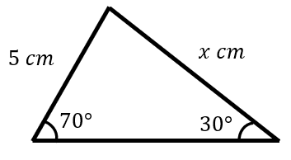
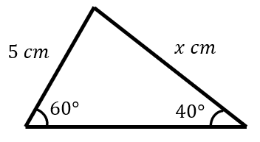
Worked example
Your turn
Find the value of $x$
Find the value of $x$
$x=6.74$ (2 dp)

Slide 3
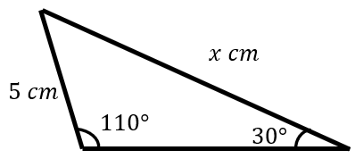
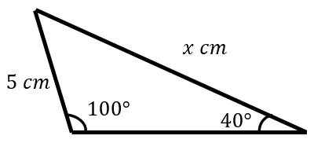
Worked example
Your turn
Find the value of $x$
Find the value of $x$
$x=7.66$ (2 dp)

Slide 4
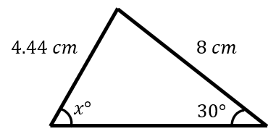
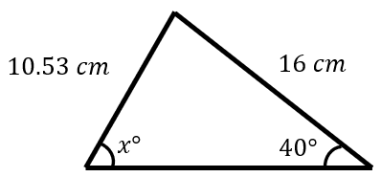
Worked example
Your turn
Find $x$, where $x<90$
Find $x$, where $x<90$
$$x=77.61$$

