Slide 1
9.2) Differentiating exponentials and logarithms

Slide 2


Worked example
Your turn
Prove that the derivative of $a^{kx}$ is $a^{kx}k\ln{a}$
Prove that the derivative of $a^{x}$ is $a^{x}\ln{a}$
Proof

Slide 3



Worked example
Your turn
Find:
$$\frac{d}{dx}({5e}^{2x})$$
$$\frac{d}{dx}(4e^{\frac{1}{3}x})$$
$$\frac{d}{dx}(3e^{−0.5x})$$
Find:
$$\frac{d}{dx}(2e^{\frac{1}{4}x})$$
$$\frac{1}{2}e^{\frac{1}{4}x}$$

Slide 4


Worked example
Your turn
Find:
$$\frac{d}{dx}(2^{x})$$
$$\frac{d}{dx}(3^{x})$$
$$\frac{d}{dx}(4^{x})$$
Find:
$$\frac{d}{dx}(5^{x})$$
$$5^{x}\ln{5}$$

Slide 5


Worked example
Your turn
Find:
$$\frac{d}{dx}(5\left(2^{x}\right))$$
$$\frac{d}{dx}(4\left(3^{x}\right))$$
$$\frac{d}{dx}(3\left(4^{x}\right))$$
Find:
$$\frac{d}{dx}(2\left(5^{x}\right))$$
$$5^{x} 2\ln{5}$$

Slide 6


Worked example
Your turn
Find:
$$\frac{d}{dx}(2^{5x})$$
$$\frac{d}{dx}(3^{4x})$$
$$\frac{d}{dx}(4^{3x})$$
Find:
$$\frac{d}{dx}(5^{2x})$$
$$5^{2x} 2\ln{5}$$

Slide 7



Worked example
Your turn
Find:
$$\frac{d}{dx}(3^{x})$$
$$\frac{d}{dx}(x^{3})$$
Find:
$$\frac{d}{dx}(5^{x})$$
$$\frac{d}{dx}(x^{5})$$
$$5^{x}\ln{5}$$
$$5x^{4}$$

Slide 8



Worked example
Your turn
Find:
$$\frac{d}{dx}(\ln{2x})$$
$$\frac{d}{dx}(\ln{3x})$$
$$\frac{d}{dx}(\ln{4x})$$
Find:
$$\frac{d}{dx}(\ln{5x})$$
$$\frac{1}{x}$$

Slide 9



Worked example
Your turn
Find:
$$\frac{d}{dx}(2\ln{x})$$
$$\frac{d}{dx}(3\ln{x})$$
$$\frac{d}{dx}(4\ln{x})$$
Find:
$$\frac{d}{dx}(5\ln{x})$$
$$\frac{5}{x}$$

Slide 10


Worked example
Your turn
Find:
$$\frac{d}{dx}(\ln{x^{2}})$$
$$\frac{d}{dx}(\ln{x^{3}})$$
$$\frac{d}{dx}(\ln{x^{4}})$$
Find:
$$\frac{d}{dx}(\ln{x^{5}})$$
$$\frac{5}{x}$$

Slide 11



Worked example
Your turn
Find:
$$\frac{d}{dx}\left(\frac{3+2e^{5x}}{7e^{4x}}\right)$$
$$\frac{d}{dx}\left(\frac{7−5e^{−4x}}{3e^{2x}}\right)$$
Find:
$$\frac{d}{dx}\left(\frac{2−3e^{7x}}{4e^{3x}}\right)$$
$$−\frac{3}{2}e^{−3x}−3e^{4x}$$

Slide 12


Worked example
Your turn
Find:
$$\frac{d}{dx}{\left(e^{x}−3\right)}^{2}$$
Find:
$$\frac{d}{dx}{\left(e^{x}+5\right)}^{2}$$
$$2e^{2x}+10e^{x}$$

Slide 13
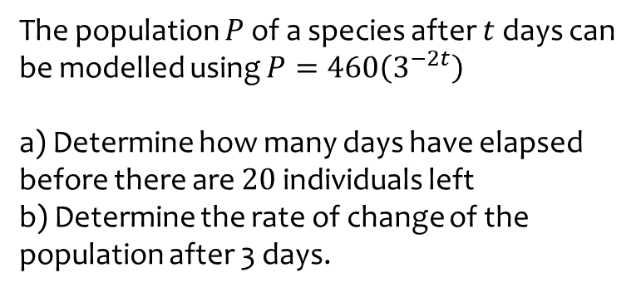
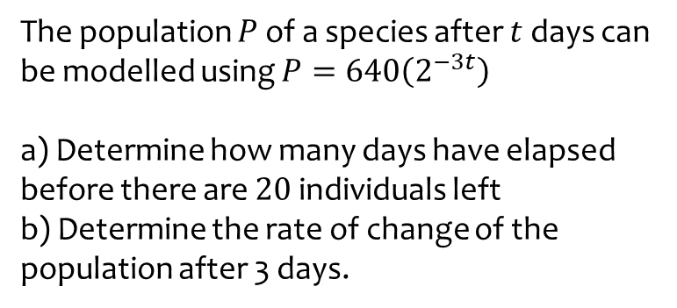
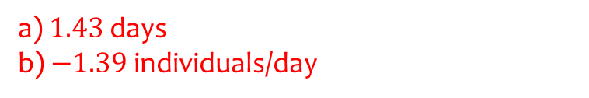
Worked example
Your turn
The population $P$ of a species after $t$ days can be modelled using $P=640\left(2^{−3t}\right)$
a) Determine how many days have elapsed before there are $20$ individuals left
b) Determine the rate of change of the population after 3 days.
The population $P$ of a species after $t$ days can be modelled using $P=460\left(3^{−2t}\right)$
a) Determine how many days have elapsed before there are $20$ individuals left
b) Determine the rate of change of the population after 3 days.
a) $1.43$ days
b) $−1.39$individuals/day

Slide 14
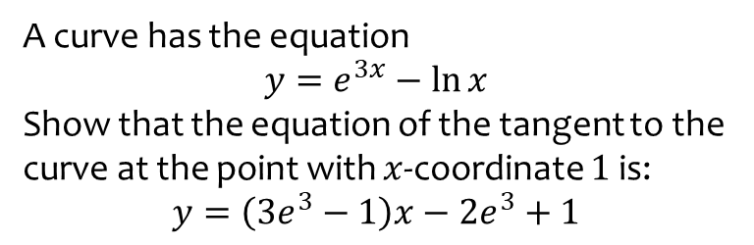
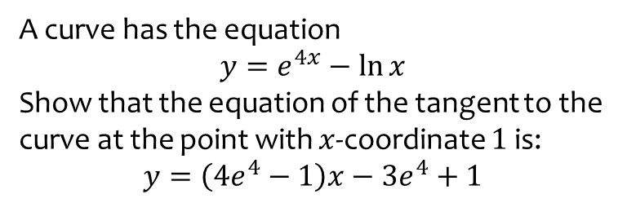
Worked example
Your turn
A curve has the equation
$$y=e^{4x}−\ln{x}$$
Show that the equation of the tangent to the curve at the point with $x$-coordinate $1$ is:
$$y=\left(4e^{4}−1\right)x−3e^{4}+1$$
A curve has the equation
$$y=e^{3x}−\ln{x}$$
Show that the equation of the tangent to the curve at the point with $x$-coordinate $1$ is:
$$y=\left(3e^{3}−1\right)x−2e^{3}+1$$
Shown

Slide 15
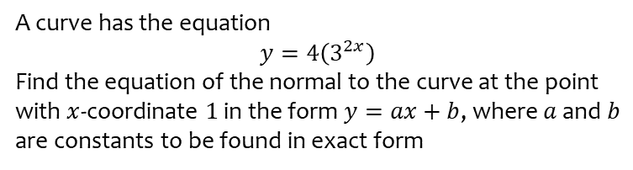
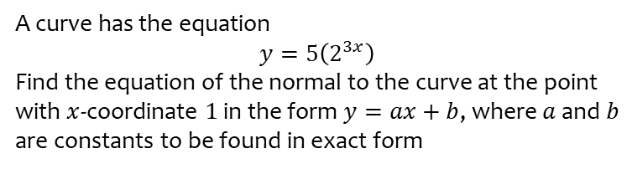
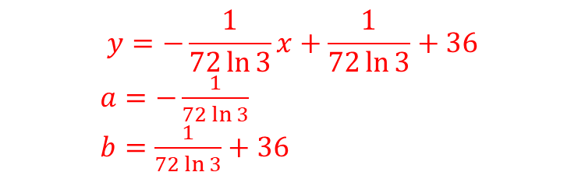
Worked example
Your turn
A curve has the equation
$$y=5\left(2^{3x}\right)$$
Find the equation of the normal to the curve at the point with $x$-coordinate $1$ in the form $y=ax+b$, where $a$ and $b$ are constants to be found in exact form
A curve has the equation
$$y=4\left(3^{2x}\right)$$
Find the equation of the normal to the curve at the point with $x$-coordinate $1$ in the form $y=ax+b$, where $a$ and $b$ are constants to be found in exact form
$$y=−\frac{1}{72\ln{3}}x+\frac{1}{72\ln{3}}+36$$
$a=−\frac{1}{72\ln{3}}$
$b=\frac{1}{72\ln{3}}+36$

