Slide 1
9.1) Displacement-time graphs

Slide 2
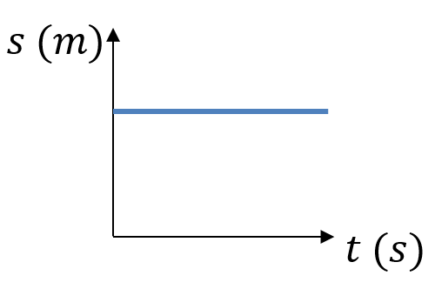
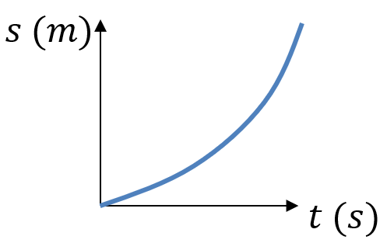
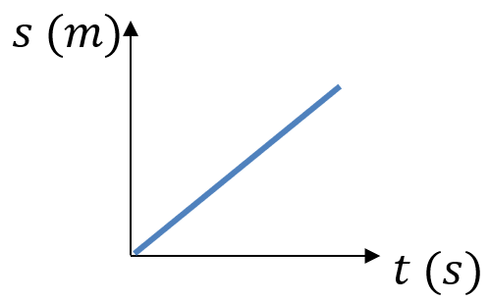
Worked example
Your turn
Describe the motion of each object from the displacement-time graph:
Describe the motion of each object from the displacement-time graph:
Object is accelerating
Diagrams/Graphs used with permission from DrFrostMaths: https://www.drfrostmaths.com/

Slide 3
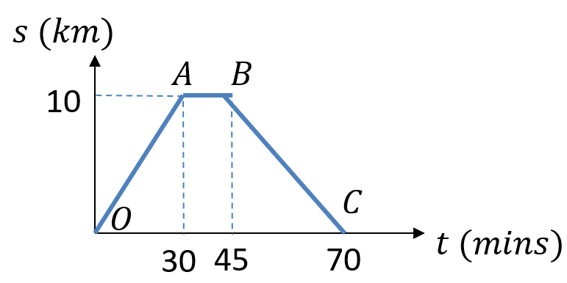
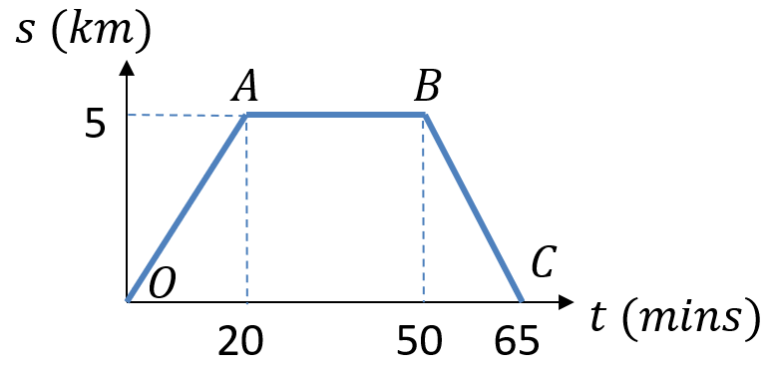
Worked example
Your turn
A cyclist rides in a straight line for 30 minutes. She waits for a quarter of an hour, then returns in a straight line to her starting point in 25 minutes.
Work out the average velocity for each stage of the journey in km h⁻¹.
Write down the average velocity for the whole journey.
Work out average speed for the whole journey.
A cyclist rides in a straight line for 20 minutes. She waits for half an hour, then returns in a straight line to her starting point in 15 minutes.
Work out the average velocity for each stage of the journey in km h⁻¹.
Write down the average velocity for the whole journey.
Work out average speed for the whole journey.
a) OA: $15 km h^{−1}$ ; AB: $0 km h^{−1}$ ; BC: $20 km h^{−1}$
b) $0$
c) $9.23 km h^{−1} (3sf)$
Diagrams/Graphs used with permission from DrFrostMaths: https://www.drfrostmaths.com/

