Slide 1
9.1) The cosine rule

Slide 2
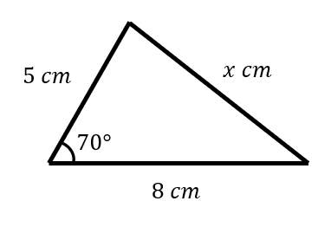
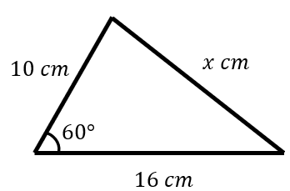
Worked example
Your turn
Find the value of $x$
Find the value of $x$
$$x=14$$

Slide 3
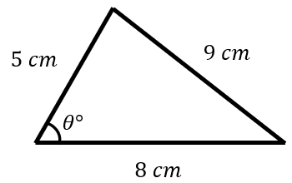
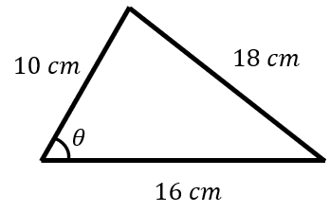
Worked example
Your turn
Find the value of $θ$
Find the value of $θ$
$θ=84.26°$ (2 dp)

Slide 4
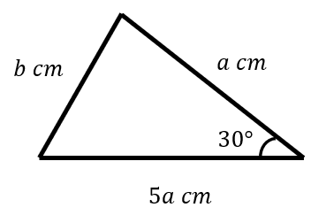
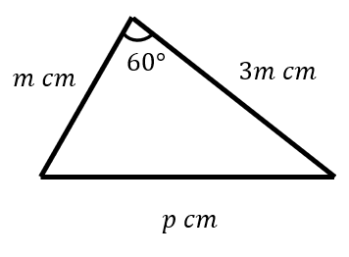
Worked example
Your turn
Express $b$ in terms of $a$
Express $p$ in terms of $m$
$$p=m\sqrt{7}$$

Slide 5
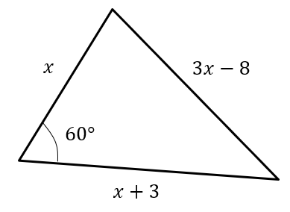
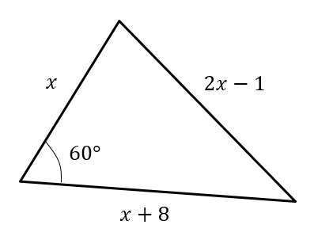
Worked example
Your turn
Determine the value of $x$
Determine the value of $x$
$$x=7$$

Slide 6
Worked example
Your turn
Find the size of the smallest angle in a triangle whose sides have lengths $6 cm, 10cm$ and $12 cm$
Find the size of the smallest angle in a triangle whose sides have lengths $3 cm, 5cm$ and $6 cm$
$29.9°$ (3 sf)

Slide 7
Worked example
Your turn
Coastguard station $B$ is 16 km, on a bearing of $030°$, from coastguard station $A$.
A ship $C$ is 8.4 km on a bearing of $081°$, away from $A$.
Calculate how far $C$ is from $B$.
Coastguard station $B$ is 8 km, on a bearing of $060°$, from coastguard station $A$.
A ship $C$ is 4.8 km on a bearing of $018°$, away from $A$.
Calculate how far $C$ is from $B$.
$5.47 km$ (3 sf)

Slide 8
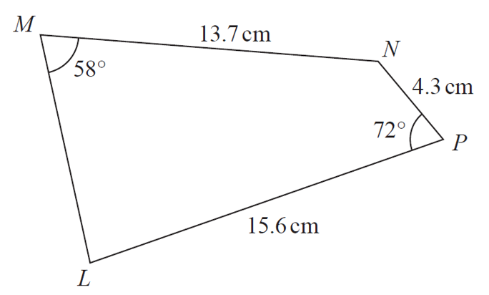
Worked example
Your turn
Calculate the size of angle MLP
Calculate the size of angle MLP
$$17.3 cm$$
$$72°$$
$$3.4 cm$$
$$58°$$
$$16.5 cm$$
$67.49°$(2 dp)

