Slide 1
9.1) Differentiating $\sin{x}$ and $\cos{x}$

Slide 2


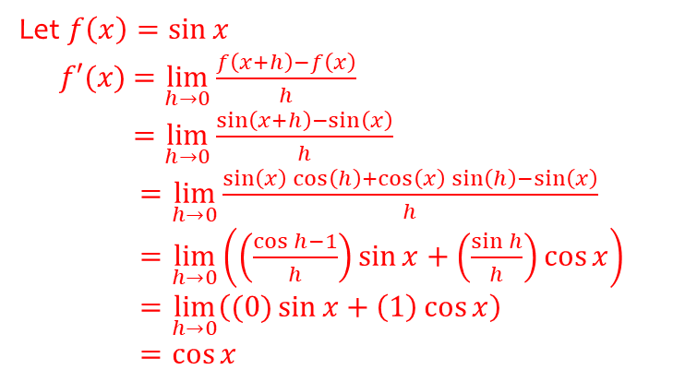
Worked example
Your turn
Prove, from first principles, that the derivative of $\sin{x}$ is $\cos{x}$.
You may assume that as $h→0,\frac{\sin{h}}{h}→1$ and $\frac{\cos{h}−1}{h}→0$
Prove, from first principles, that the derivative of $\sin{x}$ is $\cos{x}$.
You may assume that as $h→0,\frac{\sin{h}}{h}→1$ and $\frac{\cos{h}−1}{h}→0$
Let $f\left(x\right)=\sin{x}$
$f′(x)$ $=\lim_{h→0}{\frac{f\left(x+h\right)−f\left(x\right)}{h}}$
$=\lim_{h→0}{\frac{\sin\left(x+h\right)−\sin\left(x\right)}{h}}$
$=\lim_{h→0}{\frac{\sin\left(x\right)\cos\left(h\right)+\cos\left(x\right)\sin\left(h\right)−\sin\left(x\right)}{h}}$
$=\lim_{h→0}\left(\left(\frac{\cos{h}−1}{h}\right)\sin{x}+\left(\frac{\sin{h}}{h}\right)\cos{x}\right)$
$=\lim_{h→0}\left((0)\sin{x}+\left(1\right)\cos{x}\right)$
$=\cos{x}$

Slide 3



Worked example
Your turn
Find:
$$\frac{d}{dx}(\sin{5x})$$
$$\frac{d}{dx}(\cos{\frac{1}{2}x})$$
$$\frac{d}{dx}(6\sin{7x}−4\cos{3x})$$
Find:
$$\frac{d}{dx}(\sin{\frac{1}{2}x})$$
$$\frac{d}{dx}(\cos{5x})$$
$$\frac{d}{dx}(7\sin{6x}−3\cos{4x})$$
$$\frac{1}{2}\cos{2x}$$
$$−5\sin{5x}$$
$$42\cos{6x}+12\sin{4x}$$

Slide 4
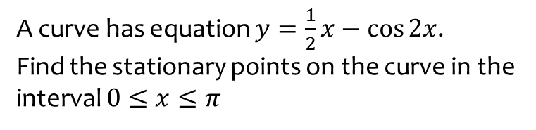
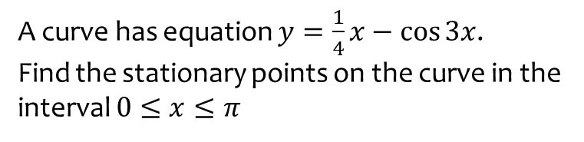

Worked example
Your turn
A curve has equation $y=\frac{1}{4}x−\cos{3x}$.
Find the stationary points on the curve in the interval $0≤x≤π$
A curve has equation $y=\frac{1}{2}x−\cos{2x}$.
Find the stationary points on the curve in the interval $0≤x≤π$
$(1.70, 1.82)$ and $(3.02, 0.539)$ (3 sf)

Slide 5
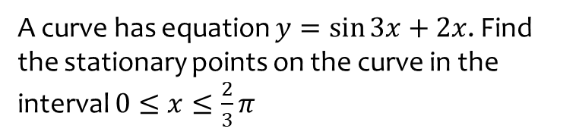
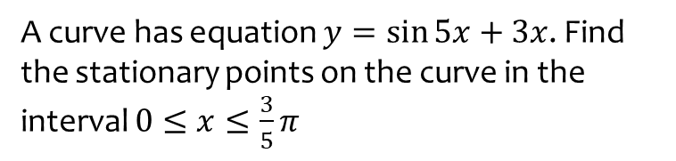

Worked example
Your turn
A curve has equation $y=\sin{5x}+3x$. Find the stationary points on the curve in the interval $0≤x≤\frac{3}{5}π$
A curve has equation $y=\sin{3x}+2x$. Find the stationary points on the curve in the interval $0≤x≤\frac{2}{3}π$
$(0.767, 2.279)$ and $(1.328, 1.910)$ (3 sf)

Slide 6
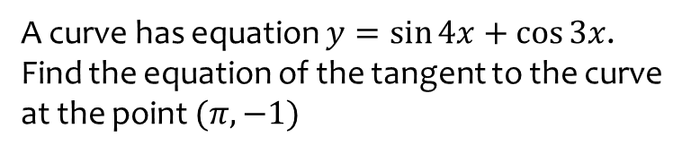
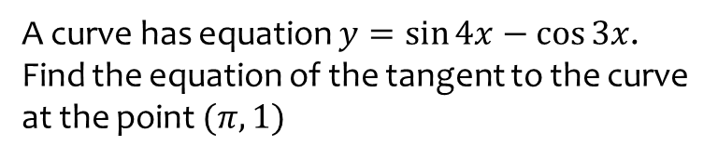
Worked example
Your turn
A curve has equation $y=\sin{4x}−\cos{3x}$. Find the equation of the tangent to the curve at the point $(π, 1)$
A curve has equation $y=\sin{4x}+\cos{3x}$. Find the equation of the tangent to the curve at the point $(π, −1)$
$$y=4x−4π−1$$

Slide 7
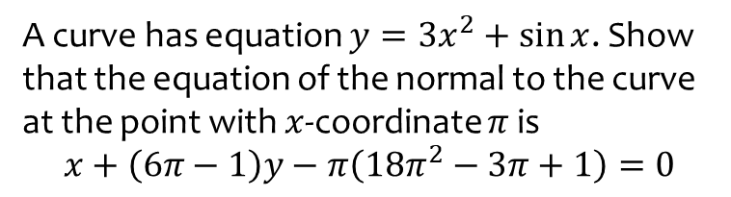
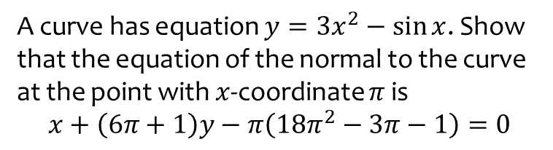
Worked example
Your turn
A curve has equation $y=3x^{2}−\sin{x}$. Show that the equation of the normal to the curve at the point with $x$-coordinate $π$ is
$$x+\left(6π+1\right)y−π\left(18π^{2}−3π−1\right)=0$$
A curve has equation $y=3x^{2}+\sin{x}$. Show that the equation of the normal to the curve at the point with $x$-coordinate $π$ is
$$x+\left(6π−1\right)y−π\left(18π^{2}−3π+1\right)=0$$
Shown

