Slide 1
9) Trigonometric ratios
9.1) The cosine rule
9.2) The sine rule
9.3) Areas of triangles
9.4) Solving triangle problems
9.5) Graphs of sine, cosine and tangent
9.6) Transforming trigonometric graphs

Slide 2
9.1) The cosine rule
Chapter CONTENTS

Slide 3
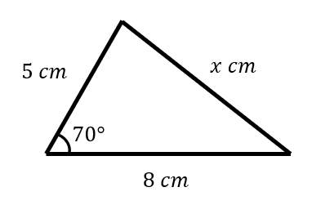
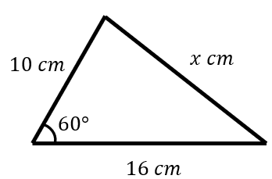
Worked example
Your turn
Find the value of $x$
Find the value of $x$
$$x=14$$

Slide 4
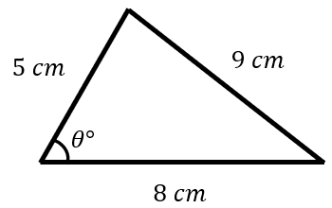
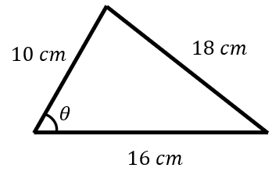
Worked example
Your turn
Find the value of $θ$
Find the value of $θ$
$θ=84.26°$ (2 dp)

Slide 5
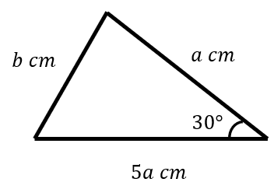
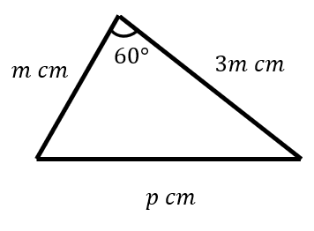
Worked example
Your turn
Express $b$ in terms of $a$
Express $p$ in terms of $m$
$$p=m\sqrt{7}$$

Slide 6
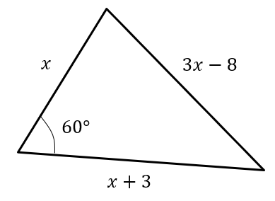
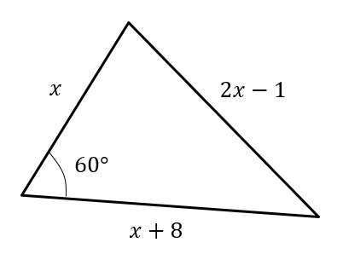
Worked example
Your turn
Determine the value of $x$
Determine the value of $x$
$$x=7$$

Slide 7
Worked example
Your turn
Find the size of the smallest angle in a triangle whose sides have lengths $6 cm, 10cm$ and $12 cm$
Find the size of the smallest angle in a triangle whose sides have lengths $3 cm, 5cm$ and $6 cm$
$29.9°$ (3 sf)

Slide 8
Worked example
Your turn
Coastguard station $B$ is 16 km, on a bearing of $030°$, from coastguard station $A$.
A ship $C$ is 8.4 km on a bearing of $081°$, away from $A$.
Calculate how far $C$ is from $B$.
Coastguard station $B$ is 8 km, on a bearing of $060°$, from coastguard station $A$.
A ship $C$ is 4.8 km on a bearing of $018°$, away from $A$.
Calculate how far $C$ is from $B$.
$5.47 km$ (3 sf)

Slide 9
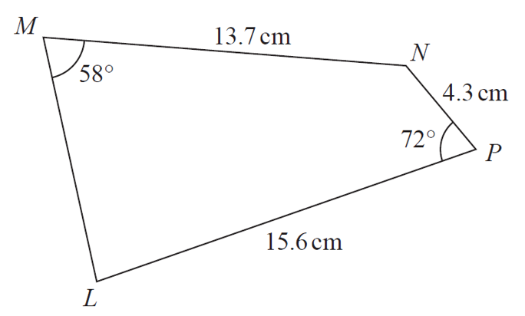
Worked example
Your turn
Calculate the size of angle MLP
Calculate the size of angle MLP
$$17.3 cm$$
$$72°$$
$$3.4 cm$$
$$58°$$
$$16.5 cm$$
$67.49°$(2 dp)

Slide 10
9.2) The sine rule
Chapter CONTENTS

Slide 11
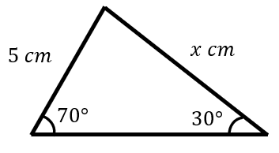
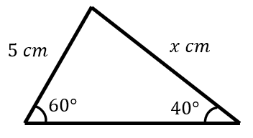
Worked example
Your turn
Find the value of $x$
Find the value of $x$
$x=6.74$ (2 dp)

Slide 12
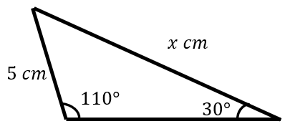
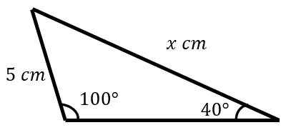
Worked example
Your turn
Find the value of $x$
Find the value of $x$
$x=7.66$ (2 dp)

Slide 13
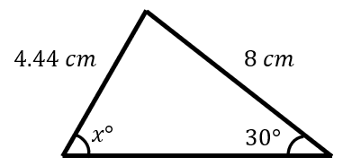
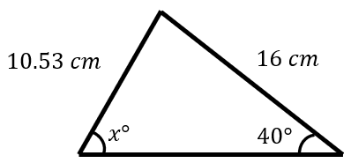
Worked example
Your turn
Find $x$, where $x<90$
Find $x$, where $x<90$
$$x=77.61$$

Slide 14
Worked example
Your turn
In $△ABC$, $AB=8cm, AC=6 cm$ and $∠ABC=88°$.
Work out the two possible values of $∠ACB$
In $△ABC$, $AB=4cm, AC=3 cm$ and $∠ABC=44°$.
Work out the two possible values of $∠ACB$
$67.9°$ and $112°$ (3 sf)

Slide 15
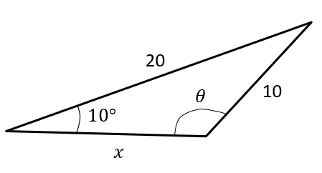
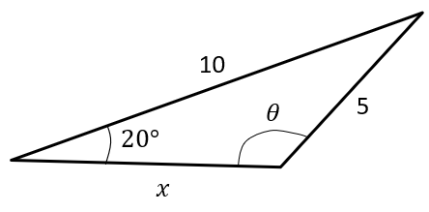
Worked example
Your turn
Given that the angle $θ$ is obtuse, determine $θ$ and hence determine the length of $x$.
Given that the angle $θ$ is obtuse, determine $θ$ and hence determine the length of $x$.
$θ=137°$ (3 sf)
$x=5.75$ (3 sf)

Slide 16
9.3) Areas of triangles
Chapter CONTENTS

Slide 17
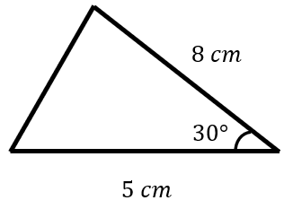
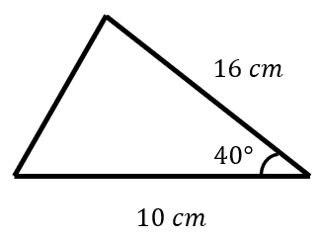
Worked example
Your turn
Calculate the area of the triangle:
Calculate the area of the triangle:
$51.42 cm^{2}$ (2 dp)

Slide 18
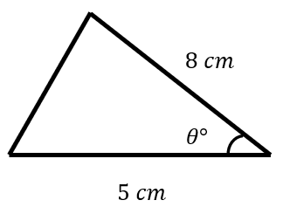
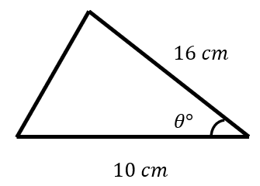
Worked example
Your turn
The area is $10 cm^{2}$.
Angle $θ$ is acute.
Calculate $θ$
The area is $51.42 cm^{2}$.
Angle $θ$ is acute.
Calculate $θ$
$θ=40.0$ (3 sf)

Slide 19
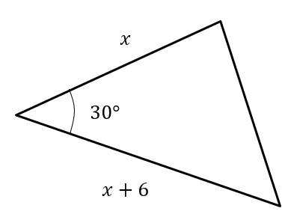
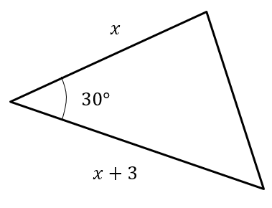
Worked example
Your turn
The area is $40$. Determine $x$
The area is $10$. Determine $x$
$$x=5$$

Slide 20
Worked example
Your turn
A triangle has sides $5.1$ $cm$, $3.4 cm$ and $2.85 cm$.
Work out the area of the triangle
A triangle has sides $10.2$ $cm$, $6.8 cm$ and $5.7 cm$.
Work out the area of the triangle
$18.3 cm^{2}$ (1 dp)

Slide 21
Worked example
Your turn
In $△ABC$, $AB=2.5cm, BC=3 cm$ and $∠ABC=x$.
Given that the area of $△ABC$ is $3 cm^{2}$ and that $AC$ is the longest side, find the value of $x$
In $△ABC$, $AB=5cm, BC=6 cm$ and $∠ABC=x$.
Given that the area of $△ABC$ is $12 cm^{2}$ and that $AC$ is the longest side, find the value of $x$
$x=127°$ (3 sf)

Slide 22
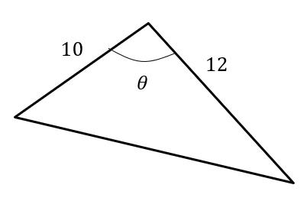
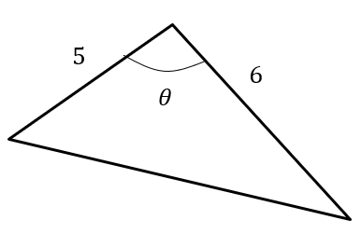
Worked example
Your turn
The area of this triangle is 40.
If $θ$ is obtuse, determine $θ$.
The area of this triangle is 10.
If $θ$ is obtuse, determine $θ$.
$θ=138°$ (3 sf)

Slide 23
9.4) Solving triangle problems
Chapter CONTENTS

Slide 24
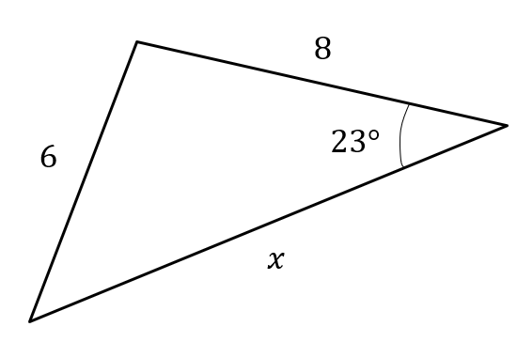
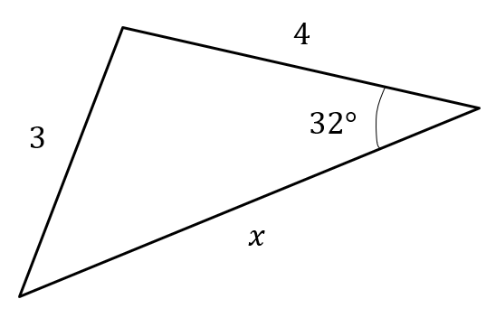
Worked example
Your turn
Calculate the value of $x$
Calculate the value of $x$
$x=5.52$ (3 sf)

Slide 25
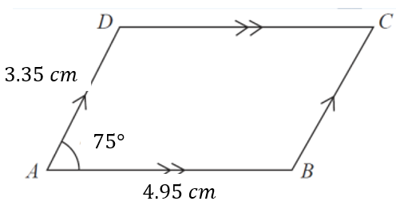
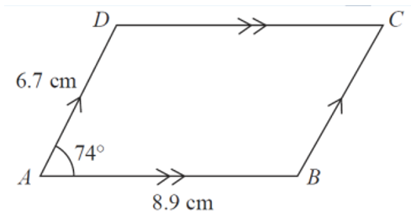
Worked example
Your turn
Calculate the area of the parallelogram
Calculate the area of the parallelogram
$57.32 cm^{2}$ (2 dp)

Slide 26
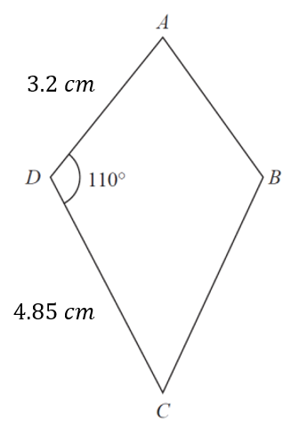
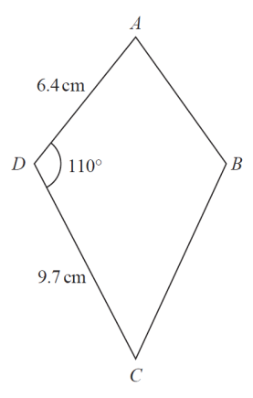
Worked example
Your turn
Calculate the area of the kite
Calculate the area of the kite
$58.34 cm^{2}$(2 dp)

Slide 27
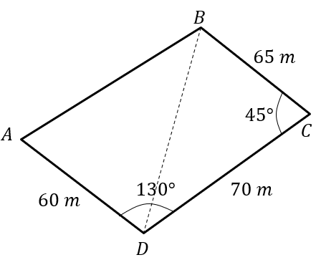
Worked example
Your turn
The diagram shows the locations of four mobile phone masts in a field.
$BC=75 m$, $CD=80m$, angle $BCD=55°$ and angle $ADC=140°$.
In order that the masts do not interfere with each other, they must be at least 65m apart.
Given that $A$ is the minimum distance from $D$, find:
The distance $A$ is from $B$
The angle $BAD$
The area enclosed by the four masts.
The diagram shows the locations of four mobile phone masts in a field.
$BC=75 m$, $CD=80m$, angle $BCD=55°$ and angle $ADC=140°$.
In order that the masts do not interfere with each other, they must be at least 70m apart.
Given that $A$ is the minimum distance from $D$, find:
The distance $A$ is from $B$
The angle $BAD$
The area enclosed by the four masts.
a) $9.21 m$ (3 sf)
b) $50.3°$ (3 sf)
c) $4940 m^{2}$ (3 sf)

Slide 28
9.5) Graphs of sine, cosine and tangent
Chapter CONTENTS

Slide 29
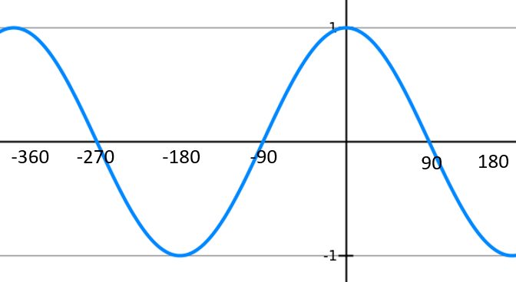
Worked example
Your turn
Sketch the graph of $y=\sin{x}, −180≤x≤360°$
Sketch the graph of $y=\cos{x}, −360≤x≤180°$

Slide 30
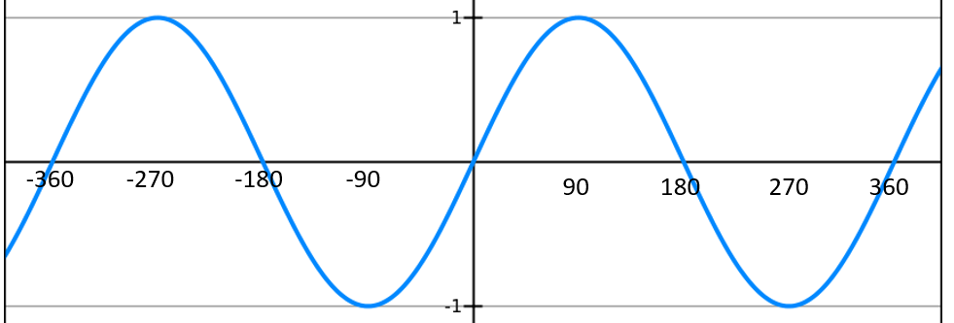
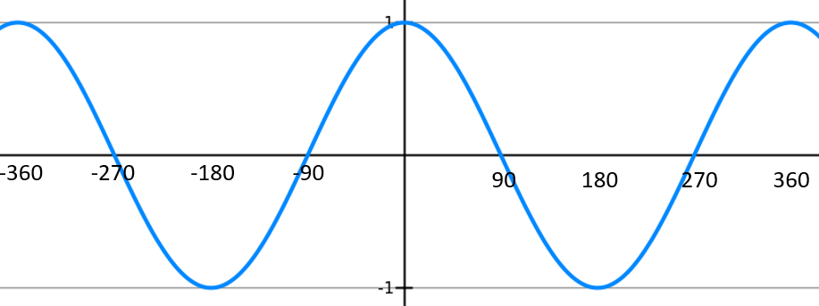
Worked example
Your turn
A sketch of $y=\sin{x}, −360°≤x≤360°$ is shown.
Given that $\sin{30}=\frac{1}{2}$, find:
a) $\sin{(150°)}$
b) $\sin{(−300°)}$
c) $\sin{(330°)}$
d) $\sin{(−210°})$
A sketch of $y=\cos{x}, −360°≤x≤360°$ is shown.
Given that $\cos{30}=\frac{\sqrt{3}}{2}$, find:
a) $\cos{(−30°)}$
b) $\cos{(330°)}$
c) $\cos{(150°)}$
d) $\cos{(−210°})$
a) $\frac{\sqrt{3}}{2}$
b) $\frac{\sqrt{3}}{2}$
c) $−\frac{\sqrt{3}}{2}$
d)$−\frac{\sqrt{3}}{2}$

Slide 31
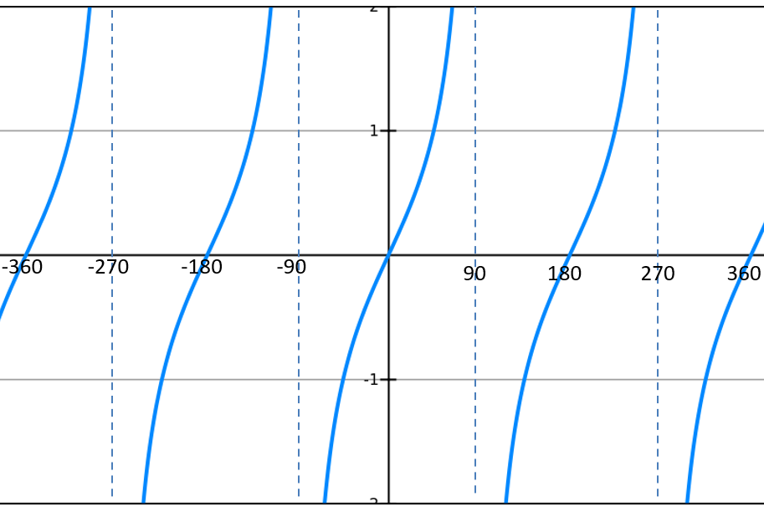
Worked example
Your turn
A sketch of $y=\tan{x}, −360°≤x≤360°$ is shown.
Given that $\tan{60}=\sqrt{3}$, find:
a) $\tan{(−60°)}$
b) $\tan{(−300°)}$
c) $\tan{(120°)}$
A sketch of $y=\tan{x}, −360°≤x≤360°$ is shown.
Given that $\tan{30}=\frac{\sqrt{3}}{3}$, find:
a) $\tan{(−30°)}$
b) $\tan{(−330°)}$
c) $\tan{(150°)}$
a) $−\frac{\sqrt{3}}{3}$
b) $\frac{\sqrt{3}}{3}$
c) $−\frac{\sqrt{3}}{3}$

Slide 32
9.6) Transforming trigonometric graphs
Chapter CONTENTS

Slide 33
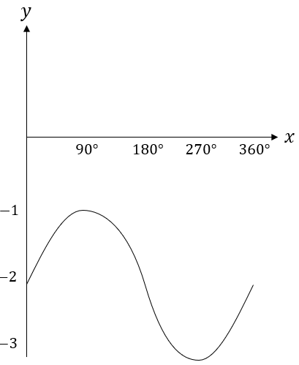
Worked example
Your turn
Sketch $y=\cos{x}+1$, $0≤x≤360°$
Sketch $y=\sin{x}−2$, $0≤x≤360°$

Slide 34
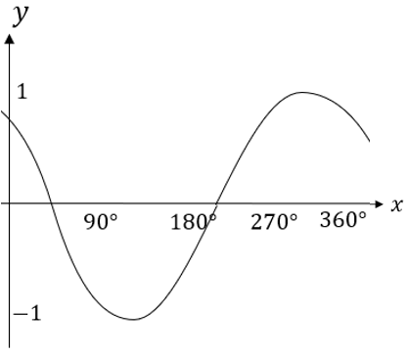
Worked example
Your turn
Sketch $y=\sin{(x−45°)}$, $0≤x≤360°$
Sketch $y=\cos\left(x+45°\right)$, $0≤x≤360°$

Slide 35
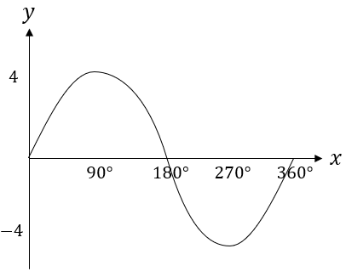
Worked example
Your turn
Sketch $y=3\cos{x}$, $0≤x≤360°$
Sketch $y=4\sin{x}$, $0≤x≤360°$

Slide 36
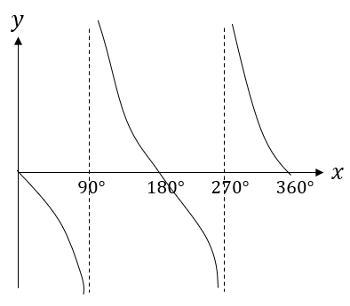
Worked example
Your turn
Sketch $y=−\sin{x}$, $0≤x≤360°$
Sketch $y=\cos{(−x)}$, $0≤x≤360°$
Sketch $y=−\tan{x}$, $0≤x≤360°$

Slide 37
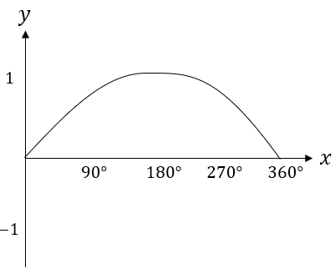
Worked example
Your turn
Sketch $y=\cos\left(2x\right)$, $0≤x≤360°$
Sketch $y=\sin\left(\frac{x}{2}\right)$, $0≤x≤360°$

