Slide 1
9) Constant acceleration
9.1) Displacement-time graphs
9.2) Velocity-time graphs
9.3) Constant acceleration formulae 1
9.4) Constant acceleration formulae 2
9.5) Vertical motion under gravity

Slide 2
9.1) Displacement-time graphs
Chapter CONTENTS

Slide 3
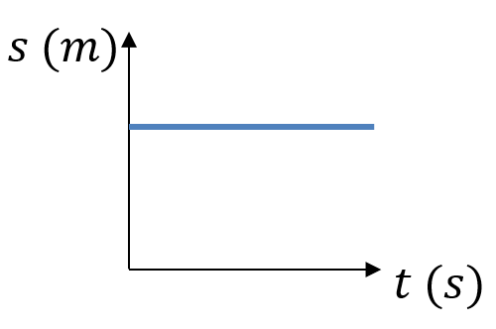
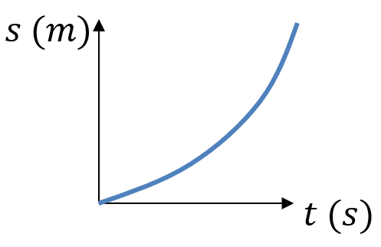
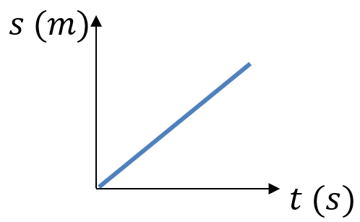
Worked example
Your turn
Describe the motion of each object from the displacement-time graph:
Describe the motion of each object from the displacement-time graph:
Object is accelerating
Diagrams/Graphs used with permission from DrFrostMaths: https://www.drfrostmaths.com/

Slide 4
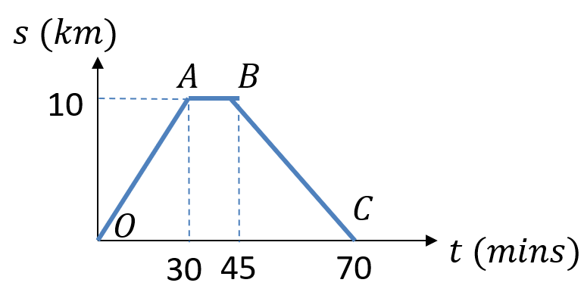
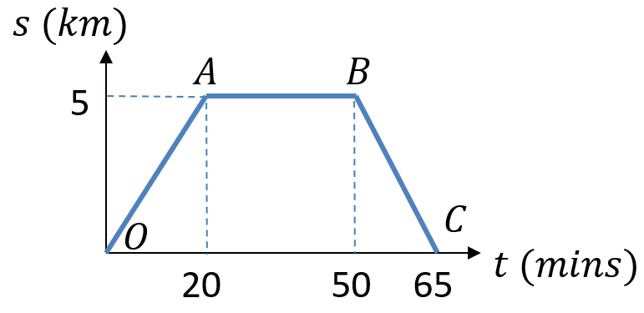
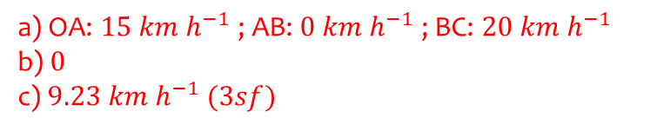
Worked example
Your turn
A cyclist rides in a straight line for 30 minutes. She waits for a quarter of an hour, then returns in a straight line to her starting point in 25 minutes.
Work out the average velocity for each stage of the journey in km h⁻¹.
Write down the average velocity for the whole journey.
Work out average speed for the whole journey.
A cyclist rides in a straight line for 20 minutes. She waits for half an hour, then returns in a straight line to her starting point in 15 minutes.
Work out the average velocity for each stage of the journey in km h⁻¹.
Write down the average velocity for the whole journey.
Work out average speed for the whole journey.
a) OA: $15 km h^{−1}$ ; AB: $0 km h^{−1}$ ; BC: $20 km h^{−1}$
b) $0$
c) $9.23 km h^{−1} (3sf)$
Diagrams/Graphs used with permission from DrFrostMaths: https://www.drfrostmaths.com/

Slide 5
9.2) Velocity-time graphs
Chapter CONTENTS

Slide 6
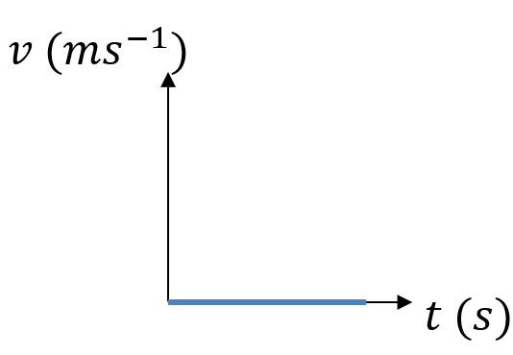
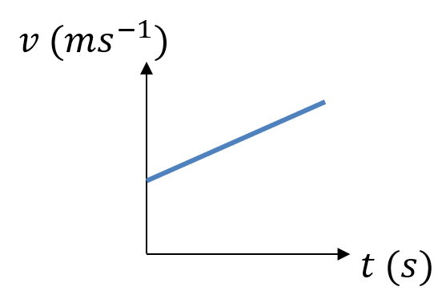
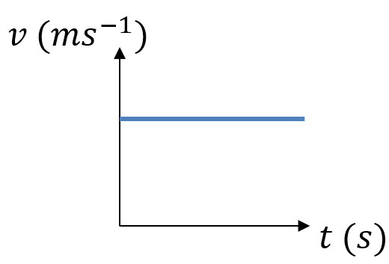
Worked example
Your turn
Describe the motion of each object from the velocity-time graph:
Describe the motion of each object from the velocity-time graph:
Object has constant acceleration. Velocity is increasing at a constant rate.
Diagrams/Graphs used with permission from DrFrostMaths: https://www.drfrostmaths.com/

Slide 7
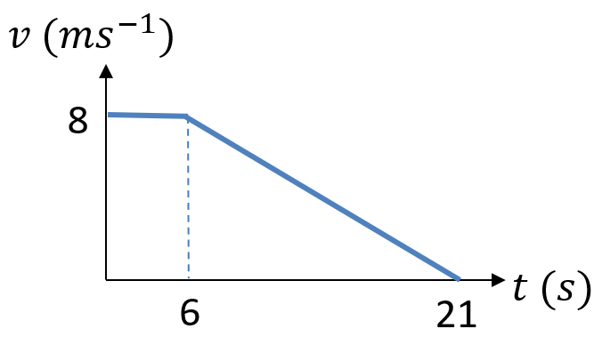
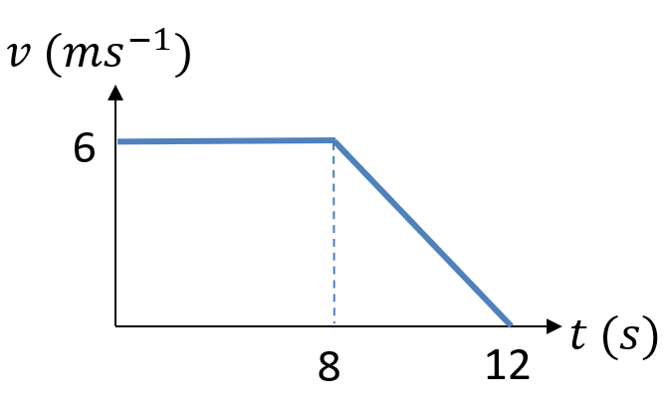
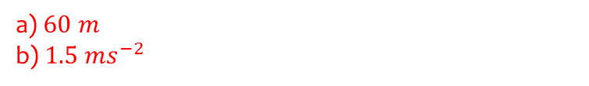
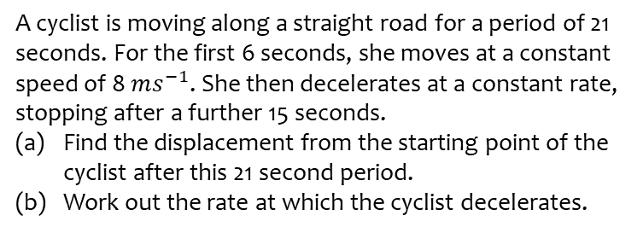
Worked example
Your turn
A cyclist is moving along a straight road for a period of 21 seconds. For the first 6 seconds, she moves at a constant speed of 8 $ms^{−1}$. She then decelerates at a constant rate, stopping after a further 15 seconds.
Find the displacement from the starting point of the cyclist after this 21 second period.
Work out the rate at which the cyclist decelerates.
A cyclist is moving along a straight road for a period of 12 seconds. For the first 8 seconds, she moves at a constant speed of 6 m s⁻¹. She then decelerates at a constant rate, stopping after a further 4 seconds.
Find the displacement from the starting point of the cyclist after this 12 second period.
Work out the rate at which the cyclist decelerates.
a) $60 m$
b) $1.5 ms^{−2}$
Diagrams/Graphs used with permission from DrFrostMaths: https://www.drfrostmaths.com/

Slide 8
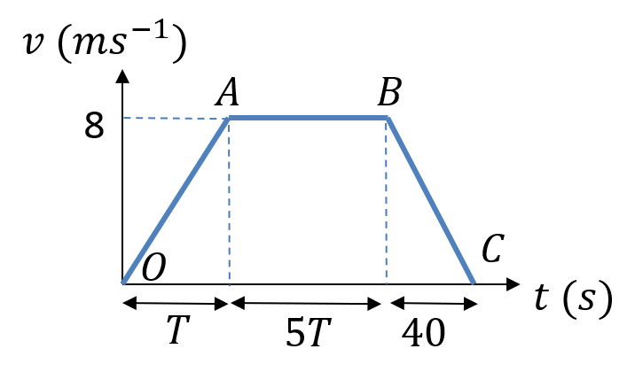
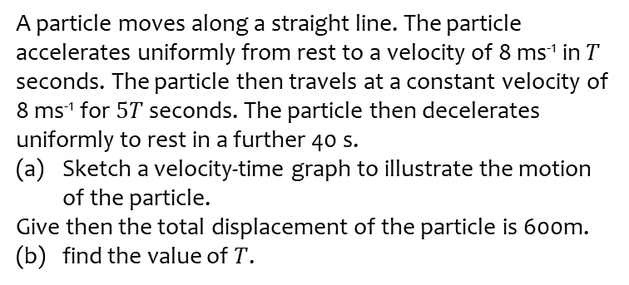
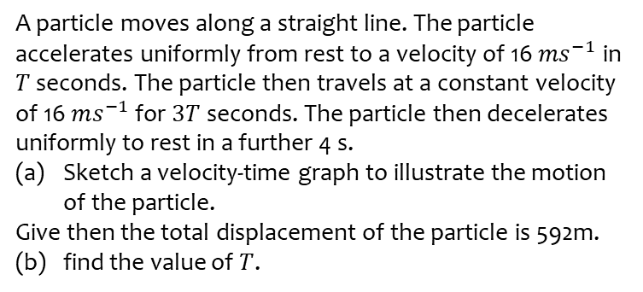

Worked example
Your turn
A particle moves along a straight line. The particle accelerates uniformly from rest to a velocity of 16 $ms^{−1}$ in $T$ seconds. The particle then travels at a constant velocity of 16 $ms^{−1}$ for $3T$ seconds. The particle then decelerates uniformly to rest in a further 4 s.
Sketch a velocity-time graph to illustrate the motion of the particle.
Give then the total displacement of the particle is 592m.
(b) find the value of $T$.
A particle moves along a straight line. The particle accelerates uniformly from rest to a velocity of 8 ms⁻¹ in $T$ seconds. The particle then travels at a constant velocity of 8 ms⁻¹ for $5T$ seconds. The particle then decelerates uniformly to rest in a further 40 s.
Sketch a velocity-time graph to illustrate the motion of the particle.
Give then the total displacement of the particle is 600m.
(b) find the value of $T$.
a)
b) $T=10$
Diagrams/Graphs used with permission from DrFrostMaths: https://www.drfrostmaths.com/

Slide 9
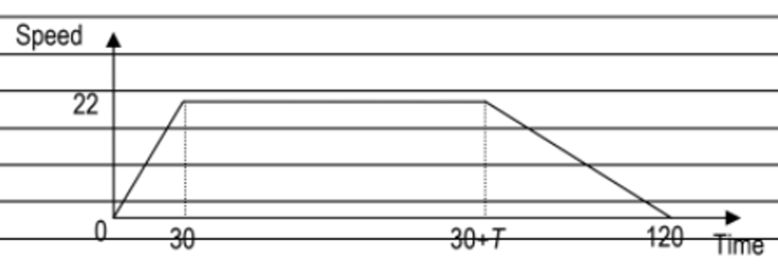
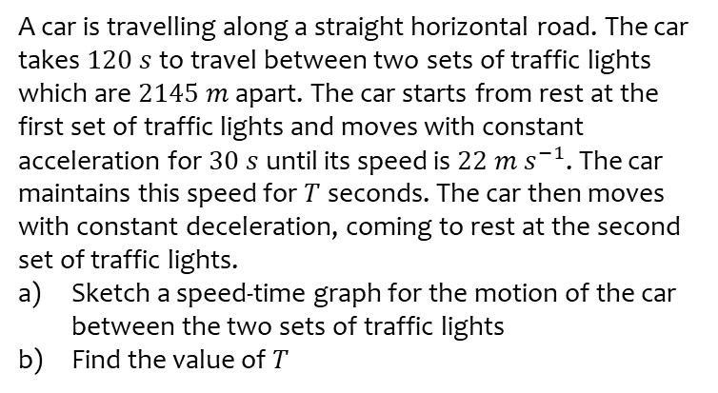
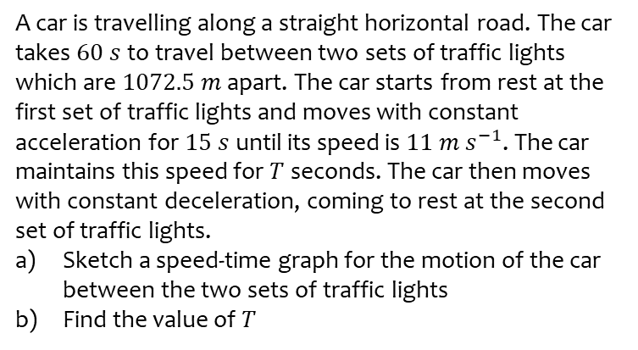

Worked example
Your turn
A car is travelling along a straight horizontal road. The car takes $60 s$ to travel between two sets of traffic lights which are $1072.5 m$ apart. The car starts from rest at the first set of traffic lights and moves with constant acceleration for $15 s$ until its speed is $11 m s^{−1}$. The car maintains this speed for $T$ seconds. The car then moves with constant deceleration, coming to rest at the second set of traffic lights.
Sketch a speed-time graph for the motion of the car between the two sets of traffic lights
Find the value of $T$
A car is travelling along a straight horizontal road. The car takes $120 s$ to travel between two sets of traffic lights which are $2145 m$ apart. The car starts from rest at the first set of traffic lights and moves with constant acceleration for $30 s$ until its speed is $22 m s^{−1}$. The car maintains this speed for $T$ seconds. The car then moves with constant deceleration, coming to rest at the second set of traffic lights.
Sketch a speed-time graph for the motion of the car between the two sets of traffic lights
Find the value of $T$
a)
b) $T=75$
Diagrams/Graphs used with permission from DrFrostMaths: https://www.drfrostmaths.com/

Slide 10
Worked example
Your turn
A car is travelling along a straight horizontal road. The car takes $60 s$ to travel between two sets of traffic lights which are $1072.5 m$ apart. The car starts from rest at the first set of traffic lights and moves with constant acceleration for $15 s$ until its speed is $11 m s^{−1}$. The car maintains this speed for $T$ seconds. The car then moves with constant deceleration, coming to rest at the second set of traffic lights.
Sketch a speed-time graph for the motion of the car between the two sets of traffic lights
Find the value of $T$
A car is travelling along a straight horizontal road. The car takes $120 s$ to travel between two sets of traffic lights which are $2145 m$ apart. The car starts from rest at the first set of traffic lights and moves with constant acceleration for $30 s$ until its speed is $22 m s^{−1}$. The car maintains this speed for $T$ seconds. The car then moves with constant deceleration, coming to rest at the second set of traffic lights.
Sketch a speed-time graph for the motion of the car between the two sets of traffic lights
Find the value of $T$
a)
b) $T=75$
Diagrams/Graphs used with permission from DrFrostMaths: https://www.drfrostmaths.com/

Slide 11
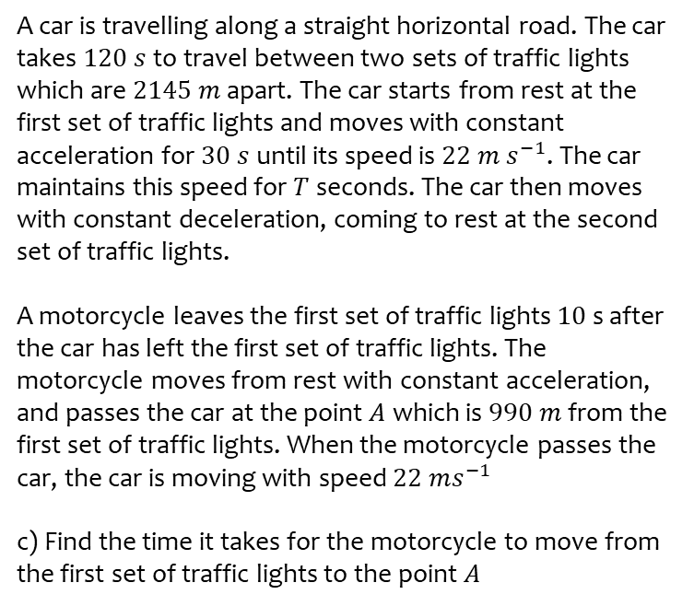
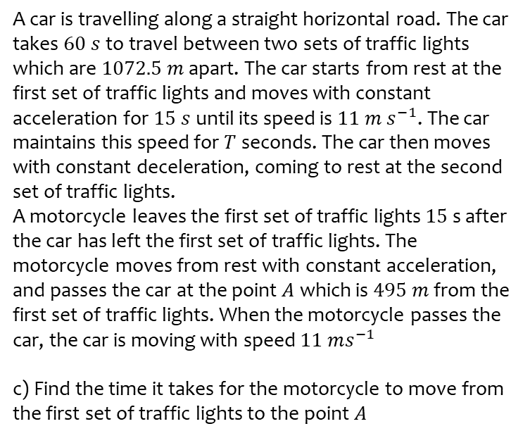
Worked example
Your turn
A car is travelling along a straight horizontal road. The car takes $60 s$ to travel between two sets of traffic lights which are $1072.5 m$ apart. The car starts from rest at the first set of traffic lights and moves with constant acceleration for $15 s$ until its speed is $11 m s^{−1}$. The car maintains this speed for $T$ seconds. The car then moves with constant deceleration, coming to rest at the second set of traffic lights.
A motorcycle leaves the first set of traffic lights $15$ s after the car has left the first set of traffic lights. The motorcycle moves from rest with constant acceleration, and passes the car at the point $A$ which is $495 m$ from the first set of traffic lights. When the motorcycle passes the car, the car is moving with speed $11 ms^{−1}$
c) Find the time it takes for the motorcycle to move from the first set of traffic lights to the point $A$
A car is travelling along a straight horizontal road. The car takes $120 s$ to travel between two sets of traffic lights which are $2145 m$ apart. The car starts from rest at the first set of traffic lights and moves with constant acceleration for $30 s$ until its speed is $22 m s^{−1}$. The car maintains this speed for $T$ seconds. The car then moves with constant deceleration, coming to rest at the second set of traffic lights.
A motorcycle leaves the first set of traffic lights $10$ s after the car has left the first set of traffic lights. The motorcycle moves from rest with constant acceleration, and passes the car at the point $A$ which is $990 m$ from the first set of traffic lights. When the motorcycle passes the car, the car is moving with speed $22 ms^{−1}$
c) Find the time it takes for the motorcycle to move from the first set of traffic lights to the point $A$
c) $50$ seconds

Slide 12
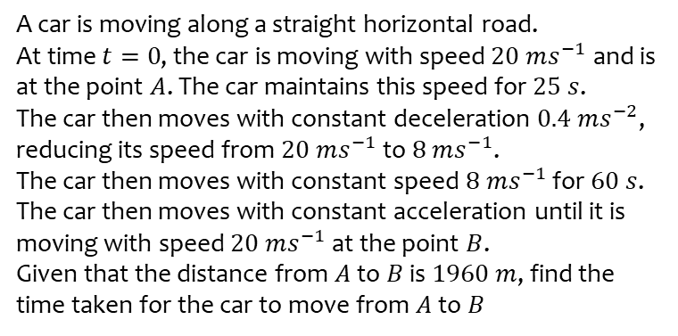
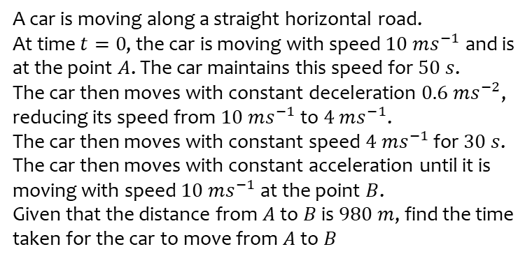
Worked example
Your turn
A car is moving along a straight horizontal road.
At time $t=0$, the car is moving with speed $10 ms^{−1}$ and is at the point $A$. The car maintains this speed for $50 s$.
The car then moves with constant deceleration $0.6 ms^{−2}$, reducing its speed from $10 ms^{−1}$ to $4 ms^{−1}$.
The car then moves with constant speed $4 ms^{−1}$ for $30 s$. The car then moves with constant acceleration until it is moving with speed $10 ms^{−1}$at the point $B$.
Given that the distance from $A$ to $B$ is $980 m$, find the time taken for the car to move from $A$to $B$
A car is moving along a straight horizontal road.
At time $t=0$, the car is moving with speed $20 ms^{−1}$ and is at the point $A$. The car maintains this speed for $25 s$.
The car then moves with constant deceleration $0.4 ms^{−2}$, reducing its speed from $20 ms^{−1}$ to $8 ms^{−1}$.
The car then moves with constant speed $8 ms^{−1}$ for $60 s$. The car then moves with constant acceleration until it is moving with speed $20 ms^{−1}$at the point $B$.
Given that the distance from $A$ to $B$ is $1960 m$, find the time taken for the car to move from $A$to $B$
$155$ seconds

Slide 13
9.3) Constant acceleration formulae 1
Chapter CONTENTS

Slide 14
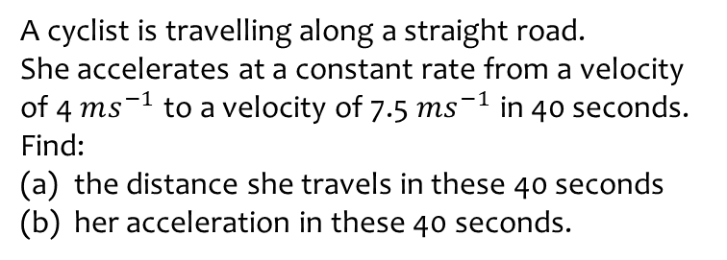
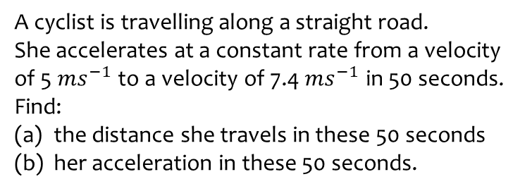
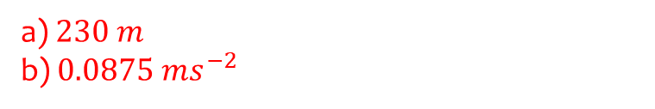
Worked example
Your turn
A cyclist is travelling along a straight road.
She accelerates at a constant rate from a velocity of 5 $ms^{−1}$ to a velocity of 7.4 $ms^{−1}$ in 50 seconds. Find:
the distance she travels in these 50 seconds
her acceleration in these 50 seconds.
A cyclist is travelling along a straight road.
She accelerates at a constant rate from a velocity of 4 $ms^{−1}$ to a velocity of 7.5 $ms^{−1}$ in 40 seconds. Find:
the distance she travels in these 40 seconds
her acceleration in these 40 seconds.
a) $230 m$
b) $0.0875 ms^{−2}$

Slide 15
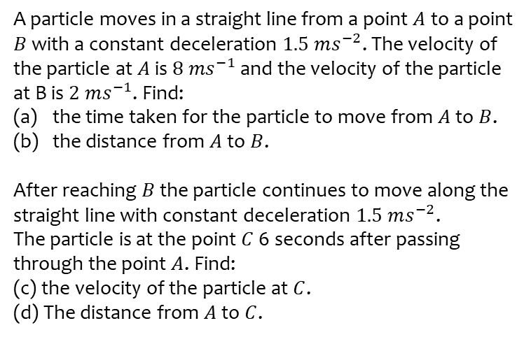
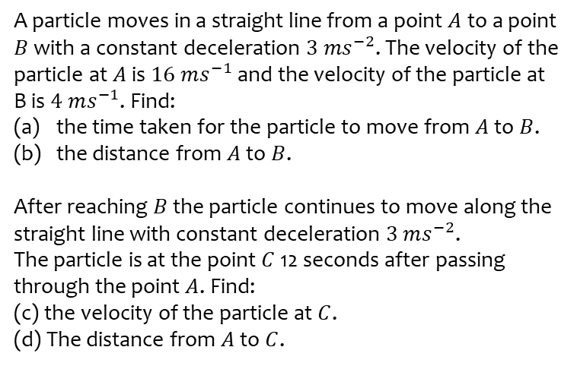
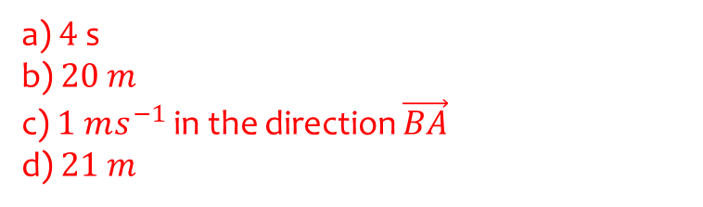
Worked example
Your turn
A particle moves in a straight line from a point $A$ to a point $B$ with a constant deceleration $3 ms^{−2}$. The velocity of the particle at $A$ is $16 ms^{−1}$ and the velocity of the particle at B is $4 ms^{−1}$. Find:
the time taken for the particle to move from $A$ to $B$.
the distance from $A$ to $B$.
After reaching $B$ the particle continues to move along the straight line with constant deceleration $3 ms^{−2}$.
The particle is at the point $C$ 12 seconds after passing through the point $A$. Find:
(c) the velocity of the particle at $C$.
(d) The distance from $A$ to $C$.
A particle moves in a straight line from a point $A$ to a point $B$ with a constant deceleration $1.5 ms^{−2}$. The velocity of the particle at $A$ is $8 ms^{−1}$ and the velocity of the particle at B is $2 ms^{−1}$. Find:
the time taken for the particle to move from $A$ to $B$.
the distance from $A$ to $B$.
After reaching $B$ the particle continues to move along the straight line with constant deceleration $1.5 ms^{−2}$.
The particle is at the point $C$ 6 seconds after passing through the point $A$. Find:
(c) the velocity of the particle at $C$.
(d) The distance from $A$ to $C$.
a) $4$ s
b) $20 m$
c) $1 ms^{−1}$ in the direction $\vec{BA}$
d) $21 m$

Slide 16
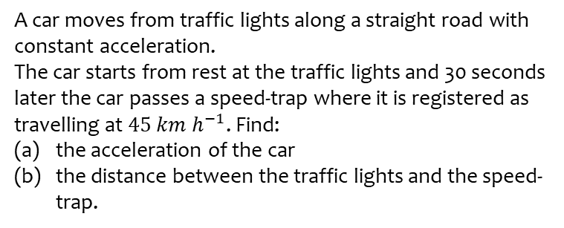
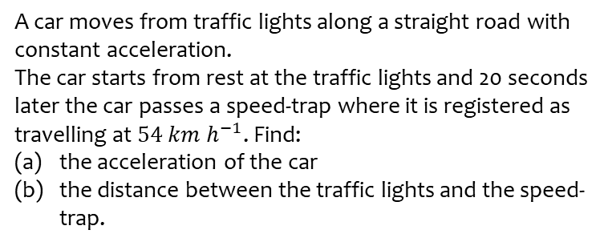
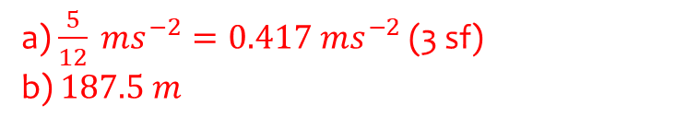
Worked example
Your turn
A car moves from traffic lights along a straight road with constant acceleration.
The car starts from rest at the traffic lights and 20 seconds later the car passes a speed-trap where it is registered as travelling at $54 km h^{−1}$. Find:
the acceleration of the car
the distance between the traffic lights and the speed-trap.
A car moves from traffic lights along a straight road with constant acceleration.
The car starts from rest at the traffic lights and 30 seconds later the car passes a speed-trap where it is registered as travelling at $45 km h^{−1}$. Find:
the acceleration of the car
the distance between the traffic lights and the speed-trap.
a) $\frac{5}{12} ms^{−2}=0.417 ms^{−2}$ (3 sf)
b) $187.5 m$

Slide 17
9.4) Constant acceleration formulae 2
Chapter CONTENTS

Slide 18
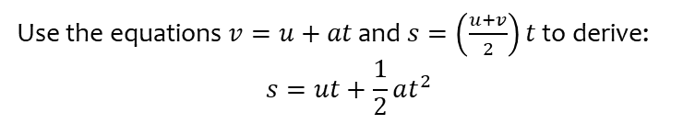

Worked example
Your turn
Use the equations $v=u+at$ and $s=\left(\frac{u+v}{2}\right)t$ to derive:
$$v^{2}=u^{2}+2as$$
$$s=vt−\frac{1}{2}at^{2}$$
Use the equations $v=u+at$ and $s=\left(\frac{u+v}{2}\right)t$ to derive:
$$s=ut+\frac{1}{2}at^{2}$$
Shown

Slide 19
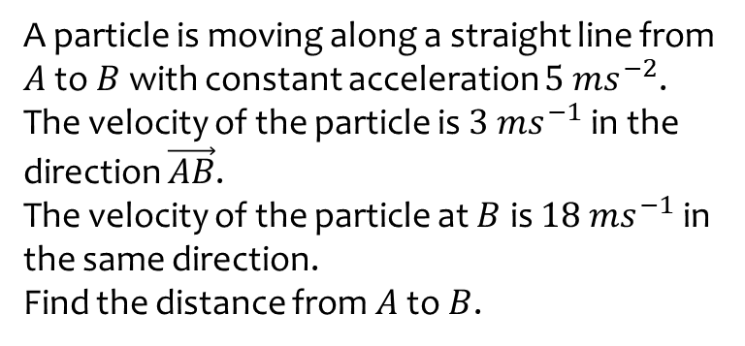
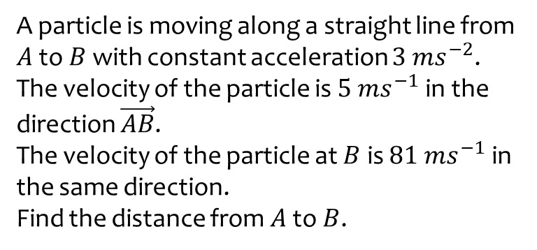
Worked example
Your turn
A particle is moving along a straight line from $A$ to $B$ with constant acceleration $3 ms^{−2}$.
The velocity of the particle is $5 ms^{−1}$ in the direction $\vec{AB}$.
The velocity of the particle at $B$ is $81 ms^{−1}$ in the same direction.
Find the distance from $A$ to $B$.
A particle is moving along a straight line from $A$ to $B$ with constant acceleration $5 ms^{−2}$.
The velocity of the particle is $3 ms^{−1}$ in the direction $\vec{AB}$.
The velocity of the particle at $B$ is $18 ms^{−1}$ in the same direction.
Find the distance from $A$ to $B$.
$$31.5 m$$

Slide 20
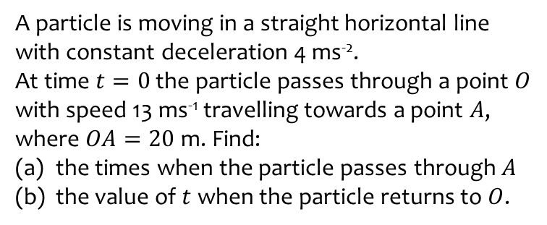
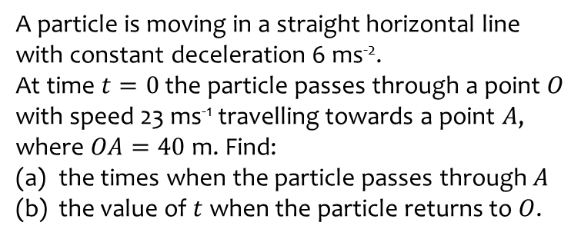
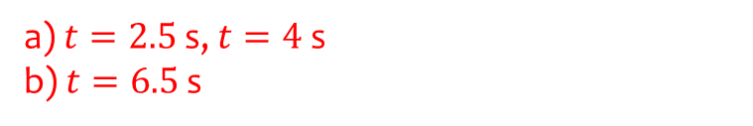
Worked example
Your turn
A particle is moving in a straight horizontal line with constant deceleration 6 ms⁻².
At time $t=0$ the particle passes through a point $O$ with speed 23 ms⁻¹ travelling towards a point $A$, where $OA=40$ m. Find:
the times when the particle passes through $A$
the value of $t$ when the particle returns to $O$.
A particle is moving in a straight horizontal line with constant deceleration 4 ms⁻².
At time $t=0$ the particle passes through a point $O$ with speed 13 ms⁻¹ travelling towards a point $A$, where $OA=20$ m. Find:
the times when the particle passes through $A$
the value of $t$ when the particle returns to $O$.
a) $t=2.5$ s, $t=4$ s
b) $t=6.5$ s

Slide 21
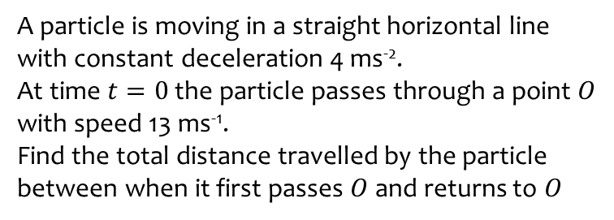
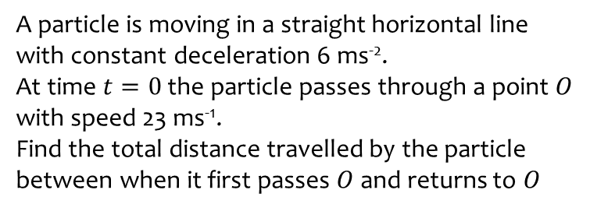
Worked example
Your turn
A particle is moving in a straight horizontal line with constant deceleration 6 ms⁻².
At time $t=0$ the particle passes through a point $O$ with speed 23 ms⁻¹.
Find the total distance travelled by the particle between when it first passes $O$ and returns to $O$
A particle is moving in a straight horizontal line with constant deceleration 4 ms⁻².
At time $t=0$ the particle passes through a point $O$ with speed 13 ms⁻¹.
Find the total distance travelled by the particle between when it first passes $O$ and returns to $O$
$$42.25 m$$

Slide 22
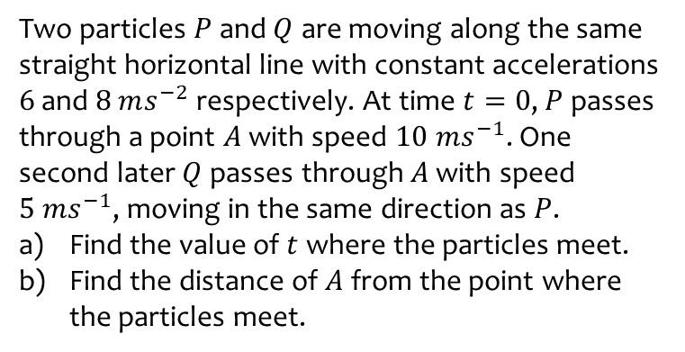
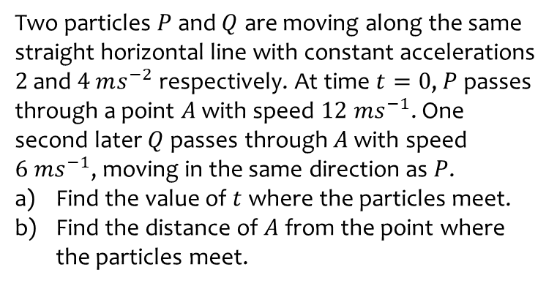
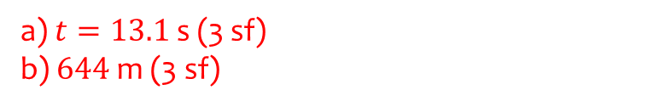
Worked example
Your turn
Two particles $P$ and $Q$ are moving along the same straight horizontal line with constant accelerations $2$ and $4$ $ms^{−2}$ respectively. At time $t=0$, $P$ passes through a point $A$ with speed $12 ms^{−1}$. One second later $Q$ passes through $A$ with speed $6 ms^{−1}$, moving in the same direction as $P$.
Find the value of $t$ where the particles meet.
Find the distance of $A$ from the point where the particles meet.
Two particles $P$ and $Q$ are moving along the same straight horizontal line with constant accelerations $6$ and $8$ $ms^{−2}$ respectively. At time $t=0$, $P$ passes through a point $A$ with speed $10 ms^{−1}$. One second later $Q$ passes through $A$ with speed $5 ms^{−1}$, moving in the same direction as $P$.
Find the value of $t$ where the particles meet.
Find the distance of $A$ from the point where the particles meet.
a) $t=13.1$ s (3 sf)
b) $644$ m (3 sf)

Slide 23
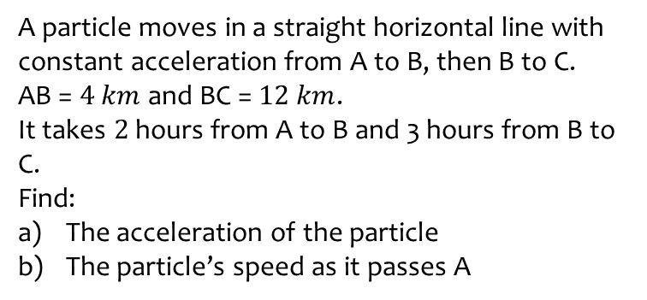
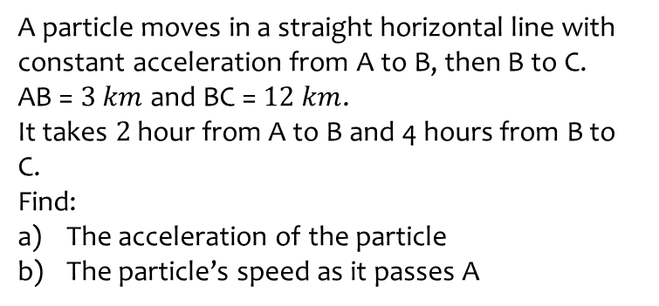
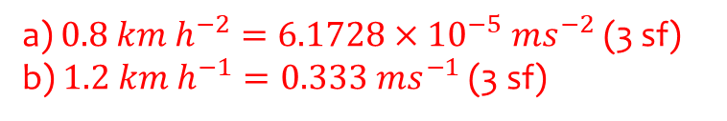
Worked example
Your turn
A particle moves in a straight horizontal line with constant acceleration from A to B, then B to C.
AB = $3 km$ and BC = $12 km$.
It takes $2$ hour from A to B and 4 hours from B to C.
Find:
The acceleration of the particle
The particle’s speed as it passes A
A particle moves in a straight horizontal line with constant acceleration from A to B, then B to C.
AB = $4 km$ and BC = $12 km$.
It takes $2$ hours from A to B and 3 hours from B to C.
Find:
The acceleration of the particle
The particle’s speed as it passes A
a) $0.8 km h^{−2}=6.1728×{10}^{−5} ms^{−2}$ (3 sf)
b) $1.2 km h^{−1}=0.333 ms^{−1}$ (3 sf)

Slide 24
9.5) Vertical motion under gravity
Chapter CONTENTS

Slide 25
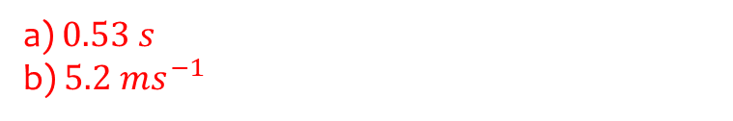
Worked example
Your turn
A book falls off the top shelf of a bookcase.
The shelf is 2.8 m above a wooden floor. Find:
the time the book takes to reach the floor,
the speed with which the book strikes the floor.
A book falls off the top shelf of a bookcase.
The shelf is 1.4 m above a wooden floor. Find:
the time the book takes to reach the floor,
the speed with which the book strikes the floor.
a) $0.53 s$
b) $5.2 ms^{−1}$

Slide 26



Worked example
Your turn
A ball is projected vertically upwards, from a point $X$ which is 5m above the ground, with speed 15 ms⁻¹. Find
the greatest height above the ground reached by the ball,
the time of flight of the ball
A ball is projected vertically upwards, from a point $X$ which is 7m above the ground, with speed 21 ms⁻¹. Find
the greatest height above the ground reached by the ball,
the time of flight of the ball
a) $30 m$ (2 sf)
b) $4.6 s$ (2 sf)

Slide 27

Worked example
Your turn
A ball is projected vertically upwards from ground level at a speed of 40 ms⁻¹.
Determine the amount of time the ball is at least 20m above ground level.
A ball is projected vertically upwards from ground level at a speed of 20 ms⁻¹.
Determine the amount of time the ball is at least 10m above ground level.
$2.9 s$ (2 sf)

Slide 28


Worked example
Your turn
A ball is projected vertically upwards with initial speed of 20 $ms^{−1}$.
It hits the ground $5 s$ later.
Find the height above the ground from which the ball was thrown.
A ball is projected vertically upwards with initial speed of 15 $ms^{−1}$.
It hits the ground $5 s$ later.
Find the height above the ground from which the ball was thrown.
$$47.5 m$$

Slide 29



Worked example
Your turn
A stone is thrown vertically upward from a point which is $8 m$ above the ground with speed $5 ms^{−1}$.
Find:
The time of flight of the stone
The total distance travelled by the stone
A stone is thrown vertically upward from a point which is $5 m$ above the ground with speed $8 ms^{−1}$.
Find:
The time of flight of the stone
The total distance travelled by the stone
a) $2.1$ s (2 sf)
b) $12 m$ (2 sf)

Slide 30



Worked example
Your turn
Ball $A$ falls vertically from rest from the top of a tower $48 m$ high. At the same time as $A$ begins to fall, another ball $B$ is projected vertically upwards from the bottom of the tower with speed $24 ms^{−1}$. The balls collide. Find the distance to the point where the balls collide from the bottom of the tower.
Ball $A$ falls vertically from rest from the top of a tower $63 m$ high. At the same time as $A$ begins to fall, another ball $B$ is projected vertically upwards from the bottom of the tower with speed $21 ms^{−1}$. The balls collide. Find the distance to the point where the balls collide from the bottom of the tower.
$19 m$ (2 sf)

Slide 31



Worked example
Your turn
At time $t=0$, two balls $A$ and $B$ are projected vertically upwards. Ball $A$ is projected upwards with speed $3 ms^{−1}$ from a point $40 m$ above the horizontal ground. Ball $B$ is projected vertically upwards from the ground with speed $30 ms^{−1}$. The balls are modelled as particles moving freely under gravity. Find the time and the height at which the balls are at the same vertical height.
At time $t=0$, two balls $A$ and $B$ are projected vertically upwards. Ball $A$ is projected upwards with speed $2 ms^{−1}$ from a point $50 m$ above the horizontal ground. Ball $B$ is projected vertically upwards from the ground with speed $20 ms^{−1}$. The balls are modelled as particles moving freely under gravity. Find the time and the height at which the balls are at the same vertical height.
$t=2.8 s$ (2 sf)
$h=18 m$ (2 sf)

Slide 32



Worked example
Your turn
A ball is released from rest at a point which is $20 m$ above a wooden floor. Each time the ball strikes the floor, it rebounds with $\frac{2}{3}$ of the speed with which it strikes the floor.
Find the greatest height above the floor reached by the ball:
The first time it rebounds from the floor
The second time it rebounds from the floor.
A ball is released from rest at a point which is $10 m$ above a wooden floor. Each time the ball strikes the floor, it rebounds with $\frac{3}{4}$ of the speed with which it strikes the floor.
Find the greatest height above the floor reached by the ball:
The first time it rebounds from the floor
The second time it rebounds from the floor.
a) $5.6 m$ (2 sf)
b) $3.2 m$ (2 sf)

