Slide 1
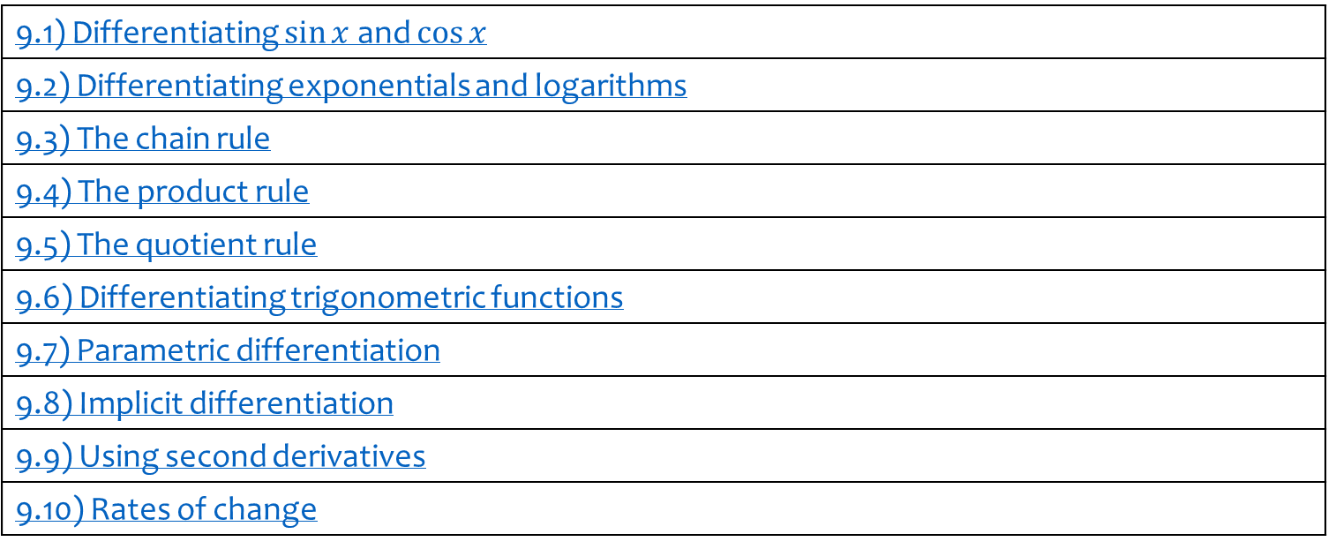
9) Differentiation
9.1) Differentiating $\sin{x}$ and $\cos{x}$
9.2) Differentiating exponentials and logarithms
9.3) The chain rule
9.4) The product rule
9.5) The quotient rule
9.6) Differentiating trigonometric functions
9.7) Parametric differentiation
9.8) Implicit differentiation
9.9) Using second derivatives
9.10) Rates of change

Slide 2
9.1) Differentiating $\sin{x}$ and $\cos{x}$
Chapter CONTENTS

Slide 3


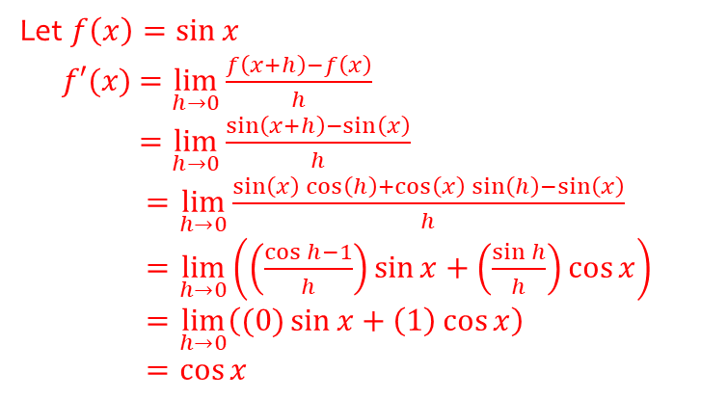
Worked example
Your turn
Prove, from first principles, that the derivative of $\sin{x}$ is $\cos{x}$.
You may assume that as $h→0,\frac{\sin{h}}{h}→1$ and $\frac{\cos{h}−1}{h}→0$
Prove, from first principles, that the derivative of $\sin{x}$ is $\cos{x}$.
You may assume that as $h→0,\frac{\sin{h}}{h}→1$ and $\frac{\cos{h}−1}{h}→0$
Let $f\left(x\right)=\sin{x}$
$f′(x)$ $=\lim_{h→0}{\frac{f\left(x+h\right)−f\left(x\right)}{h}}$
$=\lim_{h→0}{\frac{\sin\left(x+h\right)−\sin\left(x\right)}{h}}$
$=\lim_{h→0}{\frac{\sin\left(x\right)\cos\left(h\right)+\cos\left(x\right)\sin\left(h\right)−\sin\left(x\right)}{h}}$
$=\lim_{h→0}\left(\left(\frac{\cos{h}−1}{h}\right)\sin{x}+\left(\frac{\sin{h}}{h}\right)\cos{x}\right)$
$=\lim_{h→0}\left((0)\sin{x}+\left(1\right)\cos{x}\right)$
$=\cos{x}$

Slide 4



Worked example
Your turn
Find:
$$\frac{d}{dx}(\sin{5x})$$
$$\frac{d}{dx}(\cos{\frac{1}{2}x})$$
$$\frac{d}{dx}(6\sin{7x}−4\cos{3x})$$
Find:
$$\frac{d}{dx}(\sin{\frac{1}{2}x})$$
$$\frac{d}{dx}(\cos{5x})$$
$$\frac{d}{dx}(7\sin{6x}−3\cos{4x})$$
$$\frac{1}{2}\cos{2x}$$
$$−5\sin{5x}$$
$$42\cos{6x}+12\sin{4x}$$

Slide 5
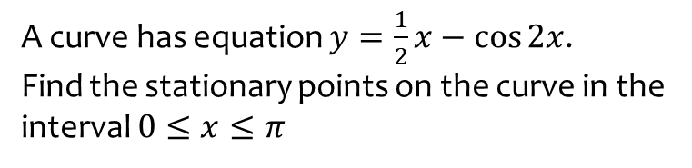
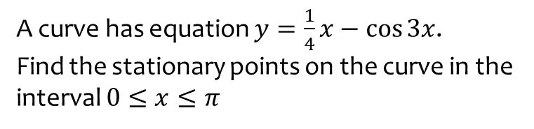

Worked example
Your turn
A curve has equation $y=\frac{1}{4}x−\cos{3x}$.
Find the stationary points on the curve in the interval $0≤x≤π$
A curve has equation $y=\frac{1}{2}x−\cos{2x}$.
Find the stationary points on the curve in the interval $0≤x≤π$
$(1.70, 1.82)$ and $(3.02, 0.539)$ (3 sf)

Slide 6
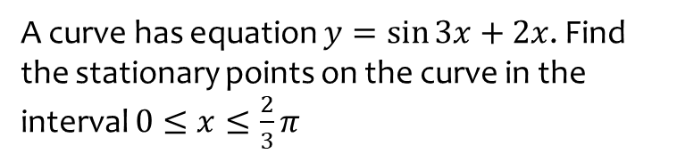
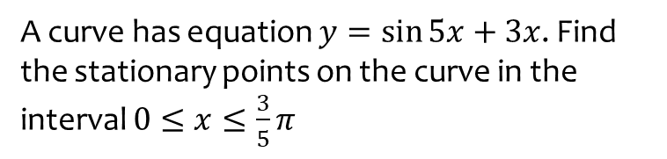

Worked example
Your turn
A curve has equation $y=\sin{5x}+3x$. Find the stationary points on the curve in the interval $0≤x≤\frac{3}{5}π$
A curve has equation $y=\sin{3x}+2x$. Find the stationary points on the curve in the interval $0≤x≤\frac{2}{3}π$
$(0.767, 2.279)$ and $(1.328, 1.910)$ (3 sf)

Slide 7
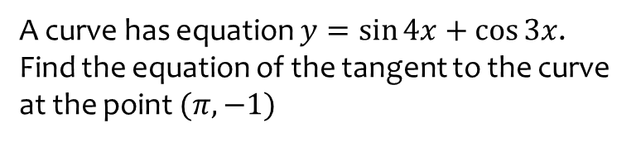
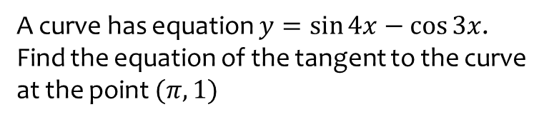
Worked example
Your turn
A curve has equation $y=\sin{4x}−\cos{3x}$. Find the equation of the tangent to the curve at the point $(π, 1)$
A curve has equation $y=\sin{4x}+\cos{3x}$. Find the equation of the tangent to the curve at the point $(π, −1)$
$$y=4x−4π−1$$

Slide 8
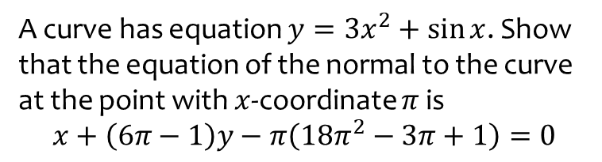
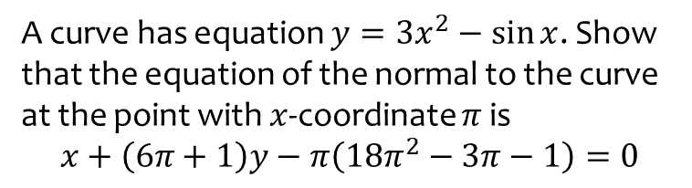
Worked example
Your turn
A curve has equation $y=3x^{2}−\sin{x}$. Show that the equation of the normal to the curve at the point with $x$-coordinate $π$ is
$$x+\left(6π+1\right)y−π\left(18π^{2}−3π−1\right)=0$$
A curve has equation $y=3x^{2}+\sin{x}$. Show that the equation of the normal to the curve at the point with $x$-coordinate $π$ is
$$x+\left(6π−1\right)y−π\left(18π^{2}−3π+1\right)=0$$
Shown

Slide 9
9.2) Differentiating exponentials and logarithms
Chapter CONTENTS

Slide 10


Worked example
Your turn
Prove that the derivative of $a^{kx}$ is $a^{kx}k\ln{a}$
Prove that the derivative of $a^{x}$ is $a^{x}\ln{a}$
Proof

Slide 11



Worked example
Your turn
Find:
$$\frac{d}{dx}({5e}^{2x})$$
$$\frac{d}{dx}(4e^{\frac{1}{3}x})$$
$$\frac{d}{dx}(3e^{−0.5x})$$
Find:
$$\frac{d}{dx}(2e^{\frac{1}{4}x})$$
$$\frac{1}{2}e^{\frac{1}{4}x}$$

Slide 12


Worked example
Your turn
Find:
$$\frac{d}{dx}(2^{x})$$
$$\frac{d}{dx}(3^{x})$$
$$\frac{d}{dx}(4^{x})$$
Find:
$$\frac{d}{dx}(5^{x})$$
$$5^{x}\ln{5}$$

Slide 13


Worked example
Your turn
Find:
$$\frac{d}{dx}(5\left(2^{x}\right))$$
$$\frac{d}{dx}(4\left(3^{x}\right))$$
$$\frac{d}{dx}(3\left(4^{x}\right))$$
Find:
$$\frac{d}{dx}(2\left(5^{x}\right))$$
$$5^{x} 2\ln{5}$$

Slide 14


Worked example
Your turn
Find:
$$\frac{d}{dx}(2^{5x})$$
$$\frac{d}{dx}(3^{4x})$$
$$\frac{d}{dx}(4^{3x})$$
Find:
$$\frac{d}{dx}(5^{2x})$$
$$5^{2x} 2\ln{5}$$

Slide 15



Worked example
Your turn
Find:
$$\frac{d}{dx}(3^{x})$$
$$\frac{d}{dx}(x^{3})$$
Find:
$$\frac{d}{dx}(5^{x})$$
$$\frac{d}{dx}(x^{5})$$
$$5^{x}\ln{5}$$
$$5x^{4}$$

Slide 16



Worked example
Your turn
Find:
$$\frac{d}{dx}(\ln{2x})$$
$$\frac{d}{dx}(\ln{3x})$$
$$\frac{d}{dx}(\ln{4x})$$
Find:
$$\frac{d}{dx}(\ln{5x})$$
$$\frac{1}{x}$$

Slide 17



Worked example
Your turn
Find:
$$\frac{d}{dx}(2\ln{x})$$
$$\frac{d}{dx}(3\ln{x})$$
$$\frac{d}{dx}(4\ln{x})$$
Find:
$$\frac{d}{dx}(5\ln{x})$$
$$\frac{5}{x}$$

Slide 18


Worked example
Your turn
Find:
$$\frac{d}{dx}(\ln{x^{2}})$$
$$\frac{d}{dx}(\ln{x^{3}})$$
$$\frac{d}{dx}(\ln{x^{4}})$$
Find:
$$\frac{d}{dx}(\ln{x^{5}})$$
$$\frac{5}{x}$$

Slide 19



Worked example
Your turn
Find:
$$\frac{d}{dx}\left(\frac{3+2e^{5x}}{7e^{4x}}\right)$$
$$\frac{d}{dx}\left(\frac{7−5e^{−4x}}{3e^{2x}}\right)$$
Find:
$$\frac{d}{dx}\left(\frac{2−3e^{7x}}{4e^{3x}}\right)$$
$$−\frac{3}{2}e^{−3x}−3e^{4x}$$

Slide 20


Worked example
Your turn
Find:
$$\frac{d}{dx}{\left(e^{x}−3\right)}^{2}$$
Find:
$$\frac{d}{dx}{\left(e^{x}+5\right)}^{2}$$
$$2e^{2x}+10e^{x}$$

Slide 21
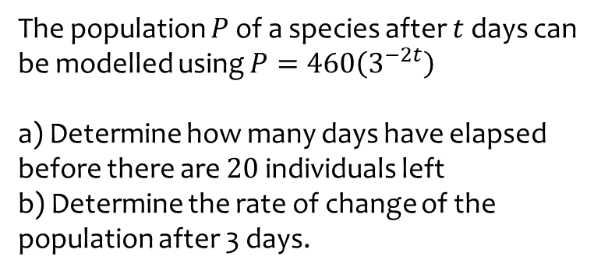
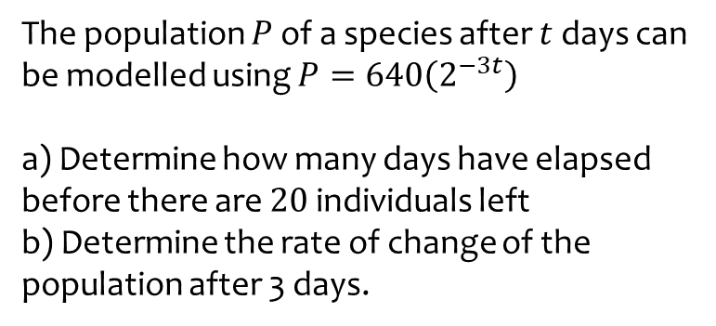
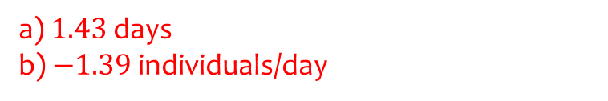
Worked example
Your turn
The population $P$ of a species after $t$ days can be modelled using $P=640\left(2^{−3t}\right)$
a) Determine how many days have elapsed before there are $20$ individuals left
b) Determine the rate of change of the population after 3 days.
The population $P$ of a species after $t$ days can be modelled using $P=460\left(3^{−2t}\right)$
a) Determine how many days have elapsed before there are $20$ individuals left
b) Determine the rate of change of the population after 3 days.
a) $1.43$ days
b) $−1.39$individuals/day

Slide 22
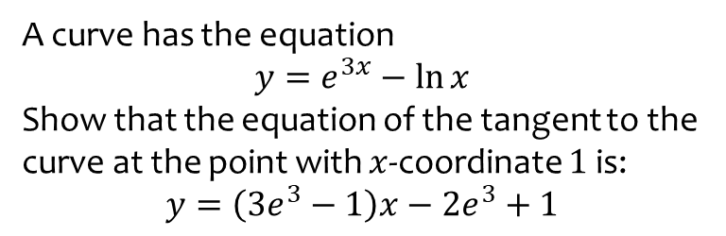
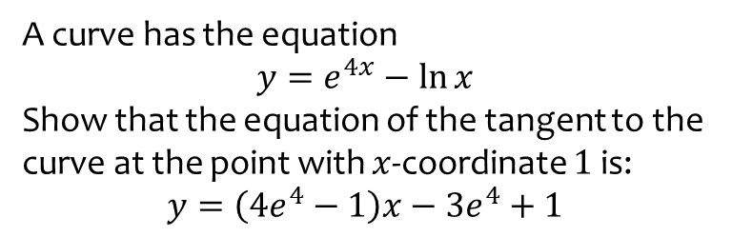
Worked example
Your turn
A curve has the equation
$$y=e^{4x}−\ln{x}$$
Show that the equation of the tangent to the curve at the point with $x$-coordinate $1$ is:
$$y=\left(4e^{4}−1\right)x−3e^{4}+1$$
A curve has the equation
$$y=e^{3x}−\ln{x}$$
Show that the equation of the tangent to the curve at the point with $x$-coordinate $1$ is:
$$y=\left(3e^{3}−1\right)x−2e^{3}+1$$
Shown

Slide 23
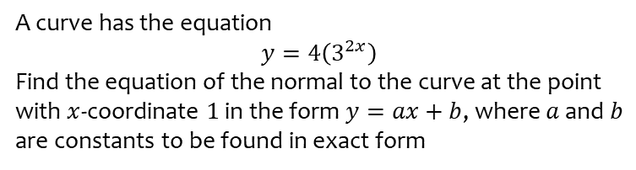
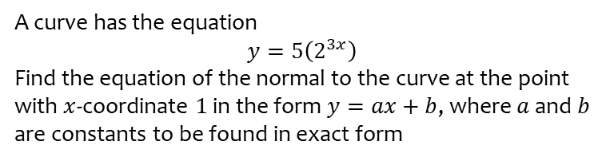
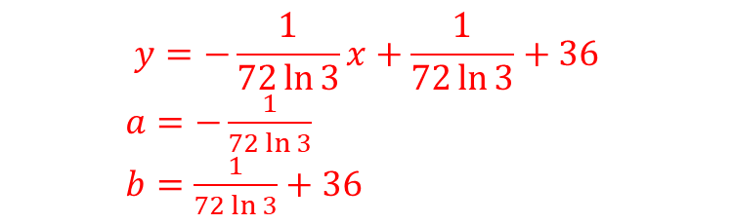
Worked example
Your turn
A curve has the equation
$$y=5\left(2^{3x}\right)$$
Find the equation of the normal to the curve at the point with $x$-coordinate $1$ in the form $y=ax+b$, where $a$ and $b$ are constants to be found in exact form
A curve has the equation
$$y=4\left(3^{2x}\right)$$
Find the equation of the normal to the curve at the point with $x$-coordinate $1$ in the form $y=ax+b$, where $a$ and $b$ are constants to be found in exact form
$$y=−\frac{1}{72\ln{3}}x+\frac{1}{72\ln{3}}+36$$
$a=−\frac{1}{72\ln{3}}$
$b=\frac{1}{72\ln{3}}+36$

Slide 24
9.3) The chain rule
Chapter CONTENTS

Slide 25
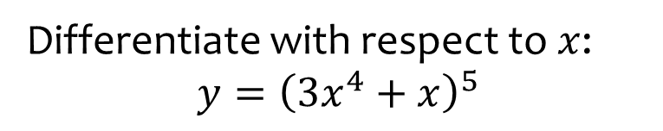

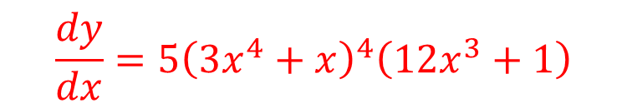
Worked example
Your turn
Differentiate with respect to $x$:
$$y={\left(4x^{3}−x\right)}^{7}$$
$$f(x)={\left(7x^{2}−3x\right)}^{4}$$
Differentiate with respect to $x$:
$$y={\left(3x^{4}+x\right)}^{5}$$
$$\frac{dy}{dx}=5{\left(3x^{4}+x\right)}^{4}\left(12x^{3}+1\right)$$

Slide 26
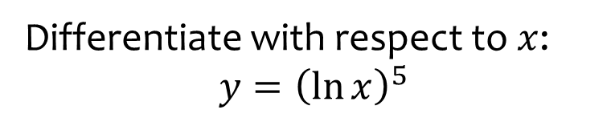


Worked example
Your turn
Differentiate with respect to $x$:
$$y={\left(\ln{x}\right)}^{3}$$
$$f(x)={\left(\ln{x}\right)}^{4}$$
Differentiate with respect to $x$:
$$y={\left(\ln{x}\right)}^{5}$$
$$\frac{dy}{dx}=\frac{5{\left(\ln{x}\right)}^{4}}{x}$$

Slide 27
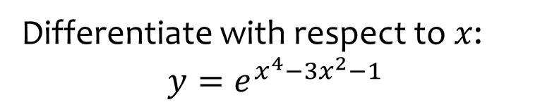

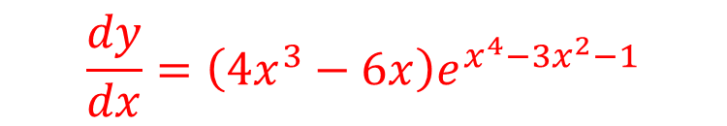
Worked example
Your turn
Differentiate with respect to $x$:
$$y=e^{x^{2}+x}$$
$$f(x)=e^{x^{3}−2x+1}$$
Differentiate with respect to $x$:
$$y=e^{x^{4}−{3x}^{2}−1}$$
$$\frac{dy}{dx}=\left(4x^{3}−6x\right)e^{x^{4}−3x^{2}−1}$$

Slide 28
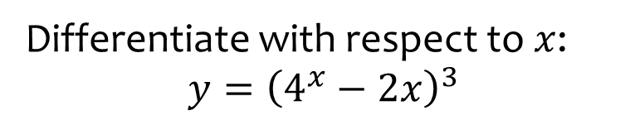

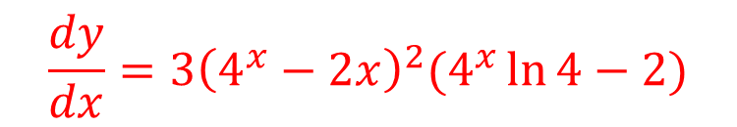
Worked example
Your turn
Differentiate with respect to $x$:
$$y={\left(3^{x}+1\right)}^{2}$$
$$f(x)={\left(2^{x}−3x\right)}^{4}$$
Differentiate with respect to $x$:
$$y={\left(4^{x}−2x\right)}^{3}$$
$$\frac{dy}{dx}=3{\left(4^{x}−2x\right)}^{2}(4^{x}\ln{4}−2)$$

Slide 29
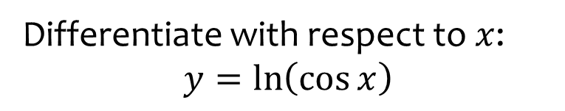
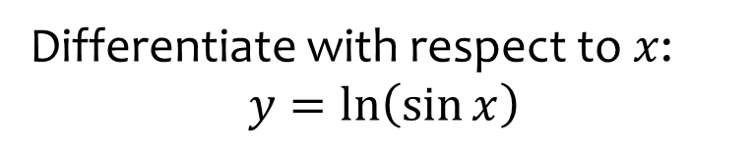

Worked example
Your turn
Differentiate with respect to $x$:
$$y=\ln\left(\sin{x}\right)$$
Differentiate with respect to $x$:
$$y=\ln\left(\cos{x}\right)$$
$$\frac{dy}{dx}=\tan{x}$$

Slide 30
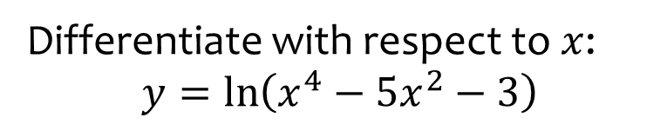


Worked example
Your turn
Differentiate with respect to $x$:
$$y=\ln\left(x^{2}−3x+4\right)$$
$$f(x)=\ln{(x^{3}−2x−5)}$$
Differentiate with respect to $x$:
$$y=\ln\left(x^{4}−5x^{2}−3\right)$$
$$\frac{dy}{dx}=\frac{4x^{3}−10x}{x^{4}−5x^{2}−3}$$

Slide 31
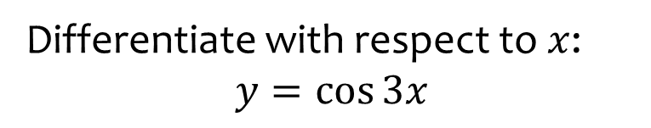


Worked example
Your turn
Differentiate with respect to $x$:
$$y=\sin{5x}$$
$$f(x)=\cos{(−4x)}$$
Differentiate with respect to $x$:
$$y=\cos{3x}$$
$$\frac{dy}{dx}=−3\sin{3x}$$

Slide 32
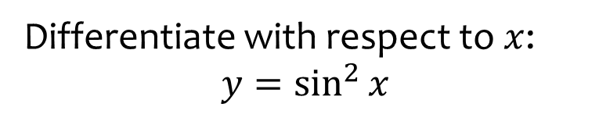


Worked example
Your turn
Differentiate with respect to $x$:
$$y=\sin^{4}{x}$$
$$f(x)=\cos^{3}{x}$$
Differentiate with respect to $x$:
$$y=\sin^{2}{x}$$
$$\frac{dy}{dx}=2\sin{x}\cos{x}=\sin{2x}$$

Slide 33



Worked example
Your turn
Differentiate with respect to $x$:
$$y=\sin^{4}{3x}$$
$$f(x)=\cos^{3}{2x}$$
Differentiate with respect to $x$:
$$y=\sin^{2}{3x}$$
$$\frac{dy}{dx}=6\sin{3x}\cos{3x}=3\sin{6x}$$

Slide 34



Worked example
Your turn
Differentiate with respect to $x$:
$$y=\sqrt{2x−1}$$
$$f(x)=\sqrt[3]{4x^{2}+5}$$
Differentiate with respect to $x$:
$$y=\sqrt[4]{2x^{3}+1}$$
$$\frac{dy}{dx}=\frac{1}{4}{\left(2x^{3}+1\right)}^{−\frac{3}{4}}(6x^{2})$$

Slide 35



Worked example
Your turn
Differentiate with respect to $x$:
$$y=e^{e^{−x}}$$
Differentiate with respect to $x$:
$$y=e^{e^{x}}$$
$$\frac{dy}{dx}=e^{x}\left(e^{e^{x}}\right)$$

Slide 36



Worked example
Your turn
Given that $y=\sqrt{2x^{5}−2}$, find $\frac{dy}{dx}$ at $\left(3,22\right)$
Given that $y=\sqrt{5x^{2}+1}$, find $\frac{dy}{dx}$ at $\left(4,9\right)$
$$\frac{20}{9}$$

Slide 37


Worked example
Your turn
Find the gradient of$:$
$x={\left(1+2y\right)}^{3}$ when $y=1$
$x={\left(3y^{2}−2\right)}^{4}$ at $(1, −1)$
Find the gradient of$:$
$x={\left(2y^{3}−3\right)}^{5}$ at $(−1,1)$
$$30$$

Slide 38



Worked example
Your turn
Find $\frac{dy}{dx}$ when:
$$x=2y^{2}+y$$
$$x=3y^{4}−y^{2}−1$$
Find $\frac{dy}{dx}$ when:
$$x=4y^{3}−y+2$$
$$\frac{1}{12y^{2}−1}$$

Slide 39



Worked example
Your turn
A curve $C$ has equation
$$y=\frac{3}{{\left(2−5x\right)}^{4}}, x≠\frac{2}{5}$$
Find an equation for the normal to $C$ at the point with $x$-coordinate $1$ in the form $ax+by+c=0$, where $a,b$ and $c$ are integers
A curve $C$ has equation
$$y=\frac{4}{{\left(3−2x\right)}^{5}}, x≠\frac{3}{2}$$
Find an equation for the normal to $C$ at the point with $x$-coordinate $2$ in the form $ax+by+c=0$, where $a,b$ and $c$ are integers
$$x+40y+158=0$$

Slide 40
9.4) The product rule
Chapter CONTENTS

Slide 41



Worked example
Your turn
Differentiate with respect to $x$:
$$y=x^{2}e^{3x}$$
$$f\left(x\right)=x^{5}e^{2x}$$
Differentiate with respect to $x$:
$$y=x^{3}e^{2x}$$
$$\frac{dy}{dx}=x^{2}e^{2x}(2x+3)$$

Slide 42



Worked example
Your turn
Differentiate with respect to $x$:
$$y=x^{2}\ln{3x}$$
$$f\left(x\right)=x^{4}\ln{5x}$$
Differentiate with respect to $x$:
$$y=x^{3}\ln{2x}$$
$$\frac{dy}{dx}=x^{2}(1+3\ln{2x})$$

Slide 43



Worked example
Your turn
Differentiate with respect to $x$:
$$y=2x^{3}{\left(4x−5\right)}^{6}$$
$$f\left(x\right)=6x^{5}{\left(4x−3\right)}^{2}$$
Differentiate with respect to $x$:
$$y=3x^{2}{\left(6x−5\right)}^{4}$$
$$\frac{dy}{dx}=6x{\left(6x−5\right)}^{3}(18x−5)$$

Slide 44



Worked example
Your turn
Differentiate with respect to $x$:
$$y=x^{3}\sin{x}$$
$$f\left(x\right)=x^{4}\cos{x}$$
Differentiate with respect to $x$:
$$y=x^{2}\sin{x}$$
$$\frac{dy}{dx}=x(x\cos{x}+2\sin{x})$$

Slide 45



Worked example
Your turn
Differentiate with respect to $x$:
$$y=e^{3x}\sin^{4}{2x}$$
$$f\left(x\right)=e^{2x}\cos^{3}{4x}$$
Differentiate with respect to $x$:
$$y=e^{4x}\sin^{2}{3x}$$
$$\frac{dy}{dx}=e^{4x}\sin{3x}(6\cos{3x}+4\sin{3x})$$

Slide 46



Worked example
Your turn
Determine the coordinates of the turning point:
$$y=xe^{3x}$$
$$f\left(x\right)=xe^{4x}$$
Determine the coordinates of the turning point:
$$y=xe^{2x}$$
$$\left(−\frac{1}{2}, −\frac{1}{2e}\right)$$

Slide 47



Worked example
Your turn
Differentiate with respect to $x$:
$$y=x^{2}\sqrt{5x−2}$$
Differentiate with respect to $x$:
$$y=x^{2}\sqrt{3x−1}$$
$$\frac{dy}{dx}=\frac{x\left(15x−4\right)}{2\sqrt{3x−1}}$$

Slide 48



Worked example
Your turn
Find the equation of the tangent to the curve with equation $y=x^{2}\sin{(x^{2})}$ at the point $\left(\frac{\sqrt{π}}{2},\frac{π\sqrt{2}}{8}\right)$ in the form $ax+by+c=0$ where $a,b$ and $c$ are exact constants.
Find the equation of the tangent to the curve with equation $y=x^{2}\cos{(x^{2})}$ at the point $\left(\frac{\sqrt{π}}{2},\frac{π\sqrt{2}}{8}\right)$ in the form $ax+by+c=0$ where $a,b$ and $c$ are exact constants.
$$\sqrt{2π}\left(π−4\right)x+8y−π\sqrt{2}\left(\frac{π−2}{2}\right)=0$$

Slide 49



Worked example
Your turn
Differentiate with respect to $x$:
$$\frac{dy}{dx}=\frac{1}{5x{\left(x+1\right)}^{\frac{1}{2}}}$$
Differentiate with respect to $x$:
$$\frac{dy}{dx}=\frac{1}{6x{\left(x−1\right)}^{\frac{1}{2}}}$$
$$\frac{d^{2}y}{dx^{2}}=\frac{2−3x}{12x^{2}{\left(x−1\right)}^{\frac{3}{2}}}$$

Slide 50
9.5) The quotient rule
Chapter CONTENTS

Slide 51



Worked example
Your turn
Differentiate with respect to $x$:
$$y=\frac{3x}{5x−2}$$
Differentiate with respect to $x$:
$$y=\frac{x}{2x+5}$$
$$\frac{dy}{dx}=\frac{5}{{\left(2x+5\right)}^{2}}$$

Slide 52



Worked example
Your turn
Differentiate with respect to $x$:
$$y=\frac{x^{2}}{\ln{5x}}$$
$$y=\frac{\ln{4x}}{x^{4}}$$
Differentiate with respect to $x$:
$$y=\frac{x^{3}}{\ln{3x}}$$
$$\frac{dy}{dx}=\frac{x^{2}\left(3\ln{3x}−1\right)}{{\left(\ln{3x}\right)}^{2}}$$

Slide 53



Worked example
Your turn
Differentiate with respect to $x$:
$$y=\frac{\cos{3x}}{x^{4}}$$
$$f(x)=\frac{x^{4}}{\cos{3x}}$$
Differentiate with respect to $x$:
$$y=\frac{\sin{4x}}{x^{3}}$$
$$\frac{dy}{dx}=\frac{4x\cos{4x}−3\sin{4x}}{x^{4}}$$

Slide 54



Worked example
Your turn
Find the stationary point of
$y=\frac{\cos{x}}{e^{3x}}$ , $0<x<π$
Find the stationary point of
$y=\frac{\sin{x}}{e^{2x}}$ , $0<x<π$
$(0.464, 0.177)$ (3 dp)

Slide 55



Worked example
Your turn
Find the equation of the tangent to the curve $y=\frac{e^{\frac{1}{4}x}}{x}$ at the point $(4,\frac{1}{4}e$)
Find the equation of the tangent to the curve $y=\frac{e^{\frac{1}{2}x}}{x}$ at the point $(2,\frac{1}{2}e$)
$$y=\frac{1}{2}e$$

Slide 56
9.6) Differentiating trigonometric functions
Chapter CONTENTS

Slide 57



Worked example
Your turn
Differentiate with respect to $x$:
$$y=\cot{x}$$
Differentiate with respect to $x$:
$$y=\tan{x}$$
$$\frac{dy}{dx}=\sec^{2}{x}$$

Slide 58



Worked example
Your turn
Differentiate with respect to $x$:
$$y=\operatorname{cosec}{x}$$
Differentiate with respect to $x$:
$$y=\sec{x}$$
$$\frac{dy}{dx}=\sec{x}\tan{x}$$

Slide 59



Worked example
Your turn
Differentiate with respect to $x$:
$$y=\tan{2x}$$
$$f\left(x\right)=\tan{(−\frac{x}{3})}$$
Differentiate with respect to $x$:
$$y=\tan{4x}$$
$$\frac{dy}{dx}=4\sec^{2}{4x}$$

Slide 60



Worked example
Your turn
Differentiate with respect to $x$:
$$y=\cot{2x}$$
$$f\left(x\right)=\cot{(−\frac{x}{3})}$$
Differentiate with respect to $x$:
$$y=\cot{4x}$$
$$\frac{dy}{dx}=−4 cosec^{2}4x$$

Slide 61



Worked example
Your turn
Differentiate with respect to $x$:
$$y=\sec{2x}$$
$$f\left(x\right)=\sec{(−\frac{x}{3})}$$
Differentiate with respect to $x$:
$$y=\sec{4x}$$
$$\frac{dy}{dx}=4\sec{4x}\tan{4x}$$

Slide 62



Worked example
Your turn
Differentiate with respect to $x$:
$$y=\operatorname{cosec}{2x}$$
$$f\left(x\right)=\operatorname{cosec}{(−\frac{x}{3})}$$
Differentiate with respect to $x$:
$$y=\operatorname{cosec}{4x}$$
$$\frac{dy}{dx}=−4\operatorname{cosec}{4x}\cot{4x}$$

Slide 63



Worked example
Your turn
Differentiate with respect to $x$:
$$y=\tan^{4}{2x}$$
$$f\left(x\right)=\tan^{3}{(−\frac{x}{3})}$$
Differentiate with respect to $x$:
$$y=\tan^{2}{4x}$$
$$\frac{dy}{dx}=8\tan{4x}\sec^{2}{4x}$$

Slide 64



Worked example
Your turn
Differentiate with respect to $x$:
$$y=\cot^{4}{2x}$$
$$f\left(x\right)=\cot^{3}{(−\frac{x}{3})}$$
Differentiate with respect to $x$:
$$y=\cot^{2}{4x}$$
$$\frac{dy}{dx}=−8\cot{4x}cosec^{2}4x$$

Slide 65



Worked example
Your turn
Differentiate with respect to $x$:
$$y=\sec^{4}{2x}$$
$$f\left(x\right)=\sec^{3}{(−\frac{x}{3})}$$
Differentiate with respect to $x$:
$$y=\sec^{2}{4x}$$
$$\frac{dy}{dx}=8\sec^{2}{4x}\tan{4x}$$

Slide 66



Worked example
Your turn
Differentiate with respect to $x$:
$$y={cosec}^{4}{2x}$$
$$f\left(x\right)={cosec}^{3}{(−\frac{x}{3})}$$
Differentiate with respect to $x$:
$$y={cosec}^{2}{4x}$$
$$\frac{dy}{dx}=−8co\sec^{2}{4x}\cot{4x}$$

Slide 67



Worked example
Your turn
Differentiate with respect to $x$:
$$y=\frac{cosec 3x}{x^{3}}$$
Differentiate with respect to $x$:
$$y=\frac{cosec 2x}{x^{2}}$$
$$\frac{dy}{dx}=−\frac{2cosec 2x(x\cot{2x}+1) }{x^{3}}$$

Slide 68



Worked example
Your turn
Given that $x=\cot{y}$, express $\frac{dy}{dx}$ in terms of $x$.
Given that $x=\tan{y}$, express $\frac{dy}{dx}$ in terms of $x$.
$$\frac{dy}{dx}=\frac{1}{1+x^{2}}$$

Slide 69



Worked example
Your turn
Differentiate with respect to $x$:
$$y=\arccos{x}$$
$$y=\arctan{x}$$
Differentiate with respect to $x$:
$$y=\arcsin{x}$$
$$\frac{dy}{dx}=\frac{1}{\sqrt{1−x^{2}}}$$

Slide 70



Worked example
Your turn
Differentiate with respect to $x$:
$$y=\arccos{x^{4}}$$
$$y=\arctan{x^{3}}$$
Differentiate with respect to $x$:
$$y=\arcsin{x^{2}}$$
$$\frac{dy}{dx}=\frac{2x}{\sqrt{1−x^{4}}}$$

Slide 71



Worked example
Your turn
Given that $x=\operatorname{cosec}{3y}$, find $\frac{dy}{dx}$ in terms of $x$
Given that $x=\sec{2y}$, find $\frac{dy}{dx}$ in terms of $x$
$$\frac{dy}{dx}=\frac{1}{2x\sqrt{x^{2}−1}}$$

Slide 72



Worked example
Your turn
Given that $y=\arctan\left(\frac{1+x}{1−x}\right)$, find $\frac{dy}{dx}$
Given that $y=\arctan\left(\frac{1−x}{1+x}\right)$, find $\frac{dy}{dx}$
$$\frac{dy}{dx}=−\frac{1}{1+x^{2}}$$

Slide 73
9.7) Parametric differentiation
Chapter CONTENTS

Slide 74



Worked example
Your turn
Find the gradient at the point $P$ where $t=3$, on the curve given parametrically by
$$x=t^{2}−t, y=t^{4}−2, t∈ℝ$$
Find the gradient at the point $P$ where $t=2$, on the curve given parametrically by
$$x=t^{3}+t, y=t^{2}+1, t∈ℝ$$
$$\frac{4}{13}$$

Slide 75


Worked example
Your turn
Find the equation of the tangent at the point where $t=\frac{π}{6}$, to the curve with parametric equations
$$x=\sqrt{5}\sin{2t}, y=8\cos^{2}{t}, 0≤t≤π$$
Find the equation of the tangent at the point where $t=\frac{π}{3}$, to the curve with parametric equations
$$x=\sqrt{3}\sin{2t}, y=4\cos^{2}{t}, 0≤t≤π$$
$$y=2x−2$$

Slide 76



Worked example
Your turn
Find the equation of the normal at the point where $θ=\frac{π}{3}$, to the curve with parametric equations
$$x=2\cos{θ}, y=7\sin{θ}$$
Find the equation of the normal at the point where $θ=\frac{π}{6}$, to the curve with parametric equations
$$x=3\sin{θ}, y=5\cos{θ}$$
$$y=\frac{3\sqrt{3}}{5}x+\frac{8\sqrt{3}}{5}$$

Slide 77
9.8) Implicit differentiation
Chapter CONTENTS

Slide 78



Worked example
Your turn
Find:
$$\frac{d}{dx}(y^{4})$$
$$\frac{d}{dx}({3y}^{5})$$
Find:
$$\frac{d}{dx}(2y^{3})$$
$$6y^{2}\frac{dy}{dx}$$

Slide 79



Worked example
Your turn
Find:
$$\frac{d}{dx}(\cos{y})$$
$$\frac{d}{dx}(\tan{2y})$$
Find:
$$\frac{d}{dx}(\sin{3y})$$
$$3\cos{3y}\frac{dy}{dx}$$

Slide 80



Worked example
Your turn
Find:
$$\frac{d}{dx}(e^{y})$$
$$\frac{d}{dx}(e^{2y})$$
Find:
$$\frac{d}{dx}(e^{3y})$$
$$3e^{3y}\frac{dy}{dx}$$

Slide 81



Worked example
Your turn
Find:
$$\frac{d}{dx}(xy)$$
$$\frac{d}{dx}(x^{2}y)$$
Find:
$$\frac{d}{dx}(x^{3}y)$$
$$x^{3}\frac{dy}{dx}+3x^{2}y$$

Slide 82



Worked example
Your turn
Find:
$$\frac{d}{dx}(e^{xy})$$
$$\frac{d}{dx}(e^{x^{2}y})$$
Find:
$$\frac{d}{dx}(e^{x^{3}y})$$
$$\left(x^{3}\frac{dy}{dx}+3x^{2}y\right)e^{x^{3}y}$$

Slide 83



Worked example
Your turn
Find:
$$\frac{d}{dx}(\cos{(x+y)})$$
$$\frac{d}{dx}(\tan{(x^{2}−4y)})$$
Find:
$$\frac{d}{dx}(\sin{(x^{3}+5y)})$$
$$\left(3x^{2}+5\frac{dy}{dx}\right)\left(\cos\left(x^{3}+5y\right)\right)$$

Slide 84



Worked example
Your turn
Find $\frac{dy}{dx}$ where:
$$x^{4}−x+y^{2}−3y=5$$
Find $\frac{dy}{dx}$ where:
$$x^{3}+x+y^{3}+3y=6$$
$$\frac{dy}{dx}=\frac{−3x^{2}−1}{3y^{2}+3}$$

Slide 85



Worked example
Your turn
Find $\frac{dy}{dx}$ at the point $(1, 1)$, given that:
$$6x^{2}y−\frac{4x}{y^{2}}=2$$
Find $\frac{dy}{dx}$ at the point $(1, 1)$, given that:
$$4xy^{2}+\frac{6x^{2}}{y}=10$$
$$\frac{dy}{dx}=−8$$

Slide 86



Worked example
Your turn
A curve is described by:
$$x^{3}+4y^{2}=−12xy$$
Find the gradient of the curve at the points where $x=8$
A curve is described by:
$$x^{3}−4y^{2}=12xy$$
Find the gradient of the curve at the points where $x=−8$
$\frac{dy}{dx}=−3$ at $(−8, 16)$
$\frac{dy}{dx}=0$ at $(−8, 8)$

Slide 87



Worked example
Your turn
$$x^{2}+y^{2}+20x+4y−8xy=−75$$
Find the values of $y$ for which $\frac{dy}{dx}=0$
$$x^{2}+y^{2}+10x+2y−4xy=10$$
Find the values of $y$ for which $\frac{dy}{dx}=0$
$$y=\frac{7}{3}, 5$$

Slide 88


Worked example
Your turn
A curve has equation
$$x^{2}+4xy+y^{2}−x=35$$
Find the equation of the tangent to the curve at the point $(2, 3)$.
Give your answer in the form $ax+by+c=0$, where $a, b$ and $c$ are integers
A curve has equation
$$x^{2}+2xy−y^{2}+x=20$$
Find the equation of the tangent to the curve at the point $(3, 2)$.
Give your answer in the form $ax+by+c=0$, where $a, b$ and $c$ are integers
$$11x+2y−37=0$$

Slide 89



Worked example
Your turn
The curve $ye^{−4x}=4x−y^{2}$.
Find the equation of the normal(s) to the curve at the point where $x=0$.
Give your answer in the form $ax+by+c=0$
The curve $ye^{−2x}=2x+y^{2}$.
Find the equation of the normal(s) to the curve at the point where $x=0$.
Give your answer in the form $ax+by+c=0$
$$2x+y=0 \text{at} (0,0)$$
$$x−4y+4=0 \text{at} (0, 1)$$

Slide 90
9.9) Using second derivatives
Chapter CONTENTS

Slide 91



Worked example
Your turn
Find the interval on which the function is concave:
$$f(x)=x^{3}−2x+5$$
$$g\left(x\right)={2x}^{3}−5x^{2}−6$$
Find the interval on which the function is concave:
$$h(x)=x^{3}+4x+3$$
$$x≤0$$

Slide 92



Worked example
Your turn
Find the interval on which the function is convex:
$$f(x)=x^{3}−2x+5$$
$$g\left(x\right)={2x}^{3}−5x^{2}−6$$
Find the interval on which the function is convex:
$$h(x)=x^{3}+4x+3$$
$$x≥0$$

Slide 93



Worked example
Your turn
Show that the function is convex for all real values of $x:$
$$f\left(x\right)=e^{3x}+x^{2}$$
$$g\left(x\right)=e^{4x}+x^{4}$$
Show that the function is convex for all real values of $x:$
$$h\left(x\right)=e^{2x}+x^{2}$$
Shown that $h^{′′}\left(x\right)≥0$ for $x∈ℝ$

Slide 94



Worked example
Your turn
Determine if there is a point of inflection on the curve with equation $y={\left(x−3\right)}^{4}$
Determine if there is a point of inflection on the curve with equation $y={\left(x+5\right)}^{4}$
No
$$\frac{d^{2}y}{dx^{2}}=12{\left(x+5\right)}^{2}≥0$$
Either side of $x=−5,\frac{d^{2}y}{dx^{2}}$ always positive.
Therefore local minimum at $(−5, 0)$

Slide 95



Worked example
Your turn
A curve C has equation
$$y=\frac{1}{4}x^{2}\ln{x}−3x+7, x>0$$
Find where C is convex
A curve C has equation
$$y=\frac{1}{5}x^{2}\ln{x}+4x−3, x>0$$
Find where C is convex
$$x≥e^{−\frac{3}{2}}$$

Slide 96
9.10) Rates of change
Chapter CONTENTS

Slide 97

Worked example
Your turn
Atmospheric pressure decreases as altitude increases. The rate at which atmospheric pressure decreases is proportional to the current air pressure. Write down a differential equation for the rate of change of the atmospheric pressure.
In the decay of radioactive particles, the rate at which particles decay is proportional to the number of particles remaining. Write down a differential equation for the rate of change of the number of particles.
$N=$ number of particles
$t=$ time
$$\frac{dN}{dt}=−kN, k>0$$

Slide 98

Worked example
Your turn
An metal bar is heated from a starting temperature. It is noted that the rate of gain of temperature of the metal bar is proportional to the difference between the temperature of the metal bar and its surroundings. Write a differential equation to represent this situation.
An object is heated to a certain temperature, then allowed to cool down. It is noted that the rate of loss of temperature of the object is proportional to the difference between the temperature of the object and its surroundings. Write a differential equation to represent this situation.
$θ=$ temperature of object (degrees)
$t=$ time (seconds)
$θ_{0}=$temperature of the surroundings
$$\frac{dθ}{dt}=−k(θ−θ_{0}), k>0$$
Newton’s law of cooling

Slide 99



Worked example
Your turn
Determine the rate of change of the area $A$ of a circle when the radius $r=7$cm, given that the radius is changing at a rate of $4 cm s^{−1}$.
Determine the rate of change of the area $A$ of a circle when the radius $r=3$cm, given that the radius is changing at a rate of $5 cm s^{−1}$.
$$\frac{dA}{dt}=30π cm^{2} s^{−1}$$

Slide 100


Worked example
Your turn
A cube is expanding uniformly as it is heated. At time $t$ seconds, the length of each edge is $x$ cm and the volume of the cube is $V$ $cm^{3}$.
Given that the volume increases at a constant rate of $0.024 cm^{3} s^{−1}$, find the rate of increase of the total surface area of the cube in $cm^{2} s^{−1}$ when $x=4$
A cube is expanding uniformly as it is heated. At time $t$ seconds, the length of each edge is $x$ cm and the volume of the cube is $V$ $cm^{3}$.
Given that the volume increases at a constant rate of $0.048 cm^{3} s^{−1}$, find the rate of increase of the total surface area of the cube in $cm^{2} s^{−1}$ when $x=8$
$$0.024 cm^{2} s^{−1}$$

Slide 101


Worked example
Your turn
A right circular cylindrical metal rod is expanding as it is heated. After $t$ seconds the radius of the rod is $x$ cm and the length of the rod is $5x$ cm. The cross-sectional area of the rod is increasing at the constant rate of $0.016 cm^{2} s^{−1}$. Find the rate of increase of the volume of the rod when $x=4$
A right circular cylindrical metal rod is expanding as it is heated. After $t$ seconds the radius of the rod is $x$ cm and the length of the rod is $5x$ cm. The cross-sectional area of the rod is increasing at the constant rate of $0.032 cm^{2} s^{−1}$. Find the rate of increase of the volume of the rod when $x=2$
$$0.48 cm^{3} s^{−1}$$

