Slide 1
8.5) Binomial estimation

Slide 2
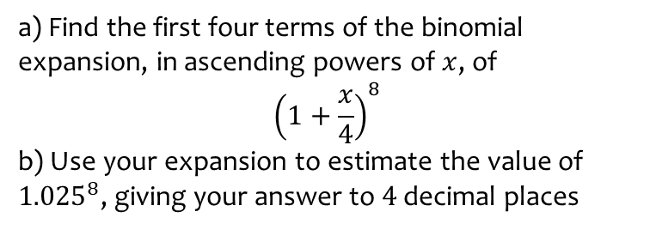
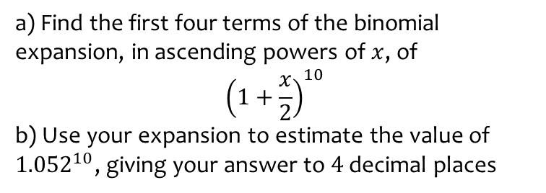
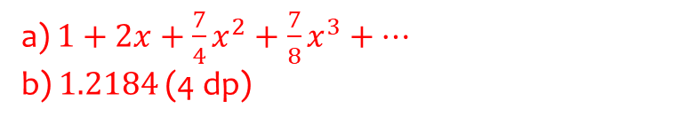
Worked example
Your turn
a) Find the first four terms of the binomial expansion, in ascending powers of $x$, of
$${\left(1+\frac{x}{2}\right)}^{10}$$
b) Use your expansion to estimate the value of ${1.052}^{10}$, giving your answer to $4$ decimal places
a) Find the first four terms of the binomial expansion, in ascending powers of $x$, of
$${\left(1+\frac{x}{4}\right)}^{8}$$
b) Use your expansion to estimate the value of ${1.025}^{8}$, giving your answer to $4$ decimal places
a) $1+2x+\frac{7}{4}x^{2}+\frac{7}{8}x^{3}+…$
b) $1.2184$ (4 dp)

Slide 3
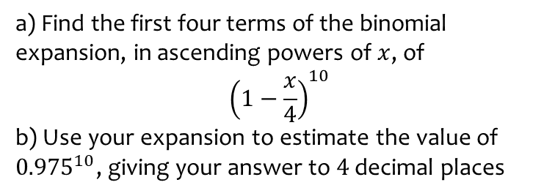
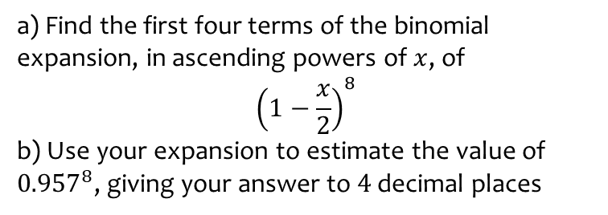
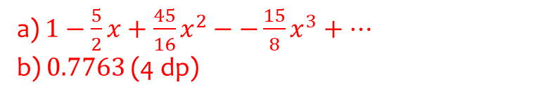
Worked example
Your turn
a) Find the first four terms of the binomial expansion, in ascending powers of $x$, of
$${\left(1−\frac{x}{2}\right)}^{8}$$
b) Use your expansion to estimate the value of ${0.957}^{8}$, giving your answer to $4$ decimal places
a) Find the first four terms of the binomial expansion, in ascending powers of $x$, of
$${\left(1−\frac{x}{4}\right)}^{10}$$
b) Use your expansion to estimate the value of ${0.975}^{10}$, giving your answer to $4$ decimal places
a) $1−\frac{5}{2}x+\frac{45}{16}x^{2}−−\frac{15}{8}x^{3}+…$
b) $0.7763$ (4 dp)

Slide 4
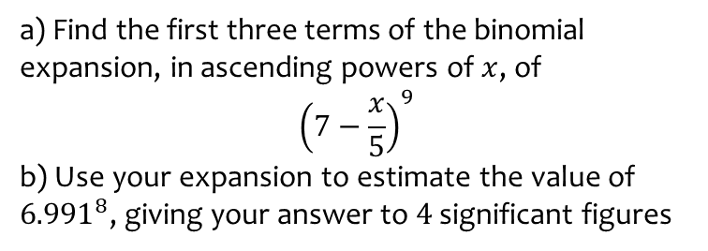
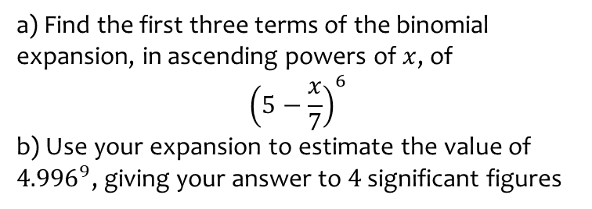
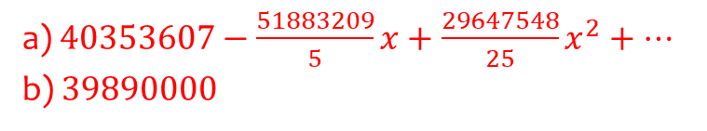
Worked example
Your turn
a) Find the first three terms of the binomial expansion, in ascending powers of $x$, of
$${\left(5−\frac{x}{7}\right)}^{6}$$
b) Use your expansion to estimate the value of ${4.996}^{9}$, giving your answer to $4$ significant figures
a) Find the first three terms of the binomial expansion, in ascending powers of $x$, of
$${\left(7−\frac{x}{5}\right)}^{9}$$
b) Use your expansion to estimate the value of ${6.991}^{8}$, giving your answer to $4$ significant figures
a) $40353607−\frac{51883209}{5}x+\frac{29647548}{25}x^{2}+…$
b) $39890000$

Slide 5
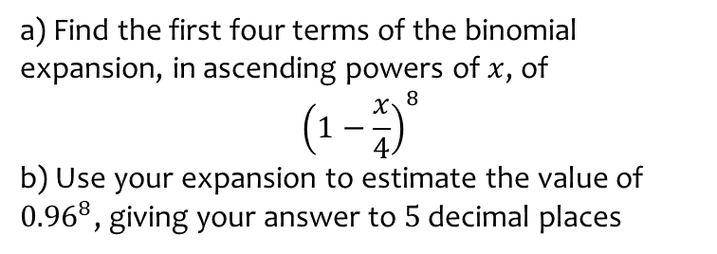
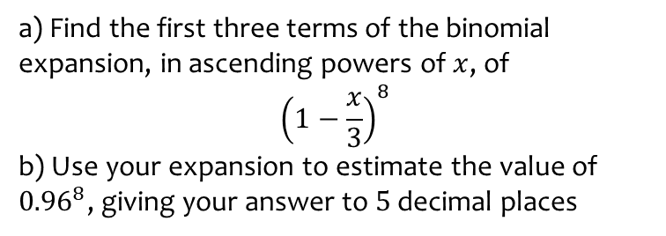
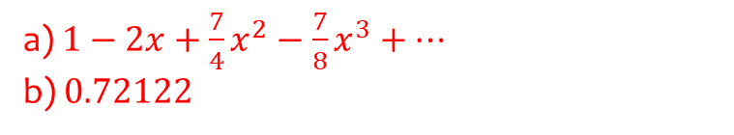
Worked example
Your turn
a) Find the first three terms of the binomial expansion, in ascending powers of $x$, of
$${\left(1−\frac{x}{3}\right)}^{8}$$
b) Use your expansion to estimate the value of ${0.96}^{8}$, giving your answer to $5$ decimal places
a) Find the first four terms of the binomial expansion, in ascending powers of $x$, of
$${\left(1−\frac{x}{4}\right)}^{8}$$
b) Use your expansion to estimate the value of ${0.96}^{8}$, giving your answer to $5$ decimal places
a) $1−2x+\frac{7}{4}x^{2}−\frac{7}{8}x^{3}+…$
b) $0.72122$

