Slide 1
8.5) Modelling with parametric equations

Slide 2
Worked example
Your turn
A plane’s position at time $t$ seconds after take-off can be modelled with the following parametric equations:
$$x=\left(v\cos{θ}\right)t m, y=\left(v\sin{θ}\right)t m, t>0$$
where $v$ is the speed of the plane, $θ$ is the angle of elevation of its path, $x$ is the horizontal distance travelled and $y$ is the vertical distance travelled, relative to a fixed origin.
When the plane has travelled 500m horizontally, it has climbed 125m.
Given that the plane’s speed is 40 m s⁻¹
a) find the parametric equations for the plane’s motion.
b) find the vertical height of the plane after 20 seconds.
c) show that the plane’s motion is a straight line.
d) explain why the domain of $t$, $t>0$, is not realistic.
A plane’s position at time $t$ seconds after take-off can be modelled with the following parametric equations:
$$x=\left(v\cos{θ}\right)t m, y=\left(v\sin{θ}\right)t m, t>0$$
where $v$ is the speed of the plane, $θ$ is the angle of elevation of its path, $x$ is the horizontal distance travelled and $y$ is the vertical distance travelled, relative to a fixed origin.
When the plane has travelled 600m horizontally, it has climbed 120m.
Given that the plane’s speed is 50 m s⁻¹,
a) find the parametric equations for the plane’s motion.
b) find the vertical height of the plane after 10 seconds.
c) show that the plane’s motion is a straight line.
a) $x=49.0t, y=9.80t$ (3 sf)
b) $98 m$
c) $y=\frac{1}{5}x$ which is linear

Slide 3
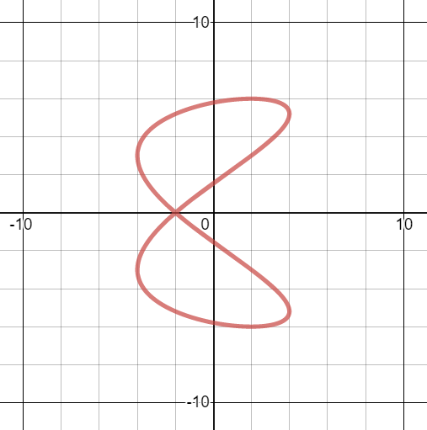
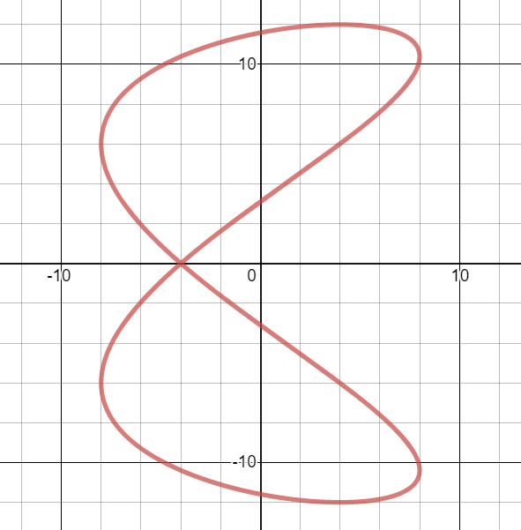
Worked example
Your turn
The motion of a figure skater relative to a fixed origin, $O$, at time $t$ minutes is modelled using the parametric equations
$$x=4\cos{10t}, y=6\sin\left(5t−\frac{π}{3}\right), t≥0$$
where $x$ and $y$ are measured in metres.
Find the coordinates of the figure skater at the beginning of his motion.
Find the coordinates of the point where the figure skater intersects his own path.
Find the coordinates of the points where the path of the figure skater crosses the $y$-axis.
Determine how long it takes the figure skater to complete one complete figure-of-eight motion.
The motion of a figure skater relative to a fixed origin, $O$, at time $t$ minutes is modelled using the parametric equations
$$x=8\cos{20t}, y=12\sin\left(10t−\frac{π}{3}\right), t≥0$$
where $x$ and $y$ are measured in metres.
Find the coordinates of the figure skater at the beginning of his motion.
Find the coordinates of the point where the figure skater intersects his own path.
Find the coordinates of the points where the path of the figure skater crosses the $y$-axis.
Determine how long it takes the figure skater to complete one complete figure-of-eight motion.
a) $t=0, x=8, y=−6\sqrt{3}$
b) $(−4, 0)$
c) $\left(0,−3.11\right), \left(0,11.59\right), \left(0,3.11\right),\left(0,−11.59\right)$ (2 dp)
d) $\frac{π}{5}$ minutes $=37.7$ seconds (1 dp)
Graphs used with permission from DESMOS: https://www.desmos.com/

Slide 4
Worked example
Your turn
A stone is thrown from the top of a $50 m$ high cliff with an initial speed of $5 ms^{−1}$ at an angle of $30°$ above the horizontal. Its position after $t$ seconds can be described using the parametric equations
$$x=\frac{5\sqrt{3}}{2}t m, y=\left(−4.9t^{2}+\frac{5\sqrt{3}}{2}t+50\right)m, 0≤t≤k$$
where $x$ is the horizontal distance, $y$ is the vertical distance from the ground and $k$ is a constant.
Given that the model is valid from the time the stone is thrown to the time it hits the ground,
find the value of $k$
find the horizontal distance travelled by the stone once it hits the ground
A stone is thrown from the top of a $25 m$ high cliff with an initial speed of $5 ms^{−1}$ at an angle of $45°$ above the horizontal. Its position after $t$ seconds can be described using the parametric equations
$$x=\frac{5\sqrt{2}}{2}t m, y=\left(−4.9t^{2}+\frac{5\sqrt{2}}{2}t+25\right)m, 0≤t≤k$$
where $x$ is the horizontal distance, $y$ is the vertical distance from the ground and $k$ is a constant.
Given that the model is valid from the time the stone is thrown to the time it hits the ground,
find the value of $k$
find the horizontal distance travelled by the stone once it hits the ground
a) $k=2.65$ (2 dp)
b) $9.36 m$ (2 dp)

