Slide 1
8.5) Integrating vectors

Slide 2
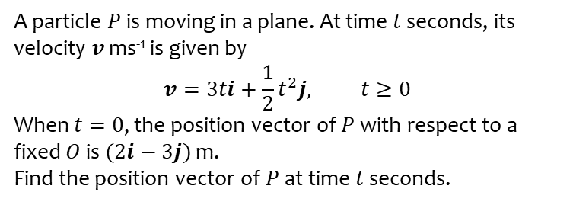
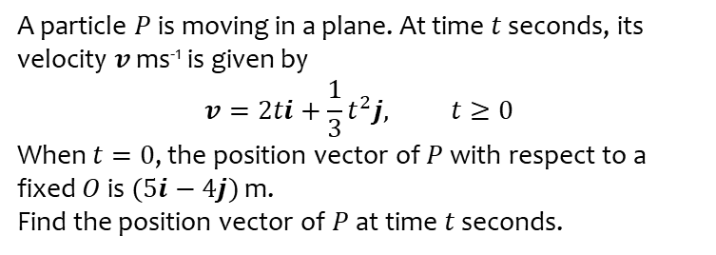
Worked example
Your turn
A particle $P$ is moving in a plane. At time $t$ seconds, its velocity $v$ ms⁻¹ is given by
$$v=2ti+\frac{1}{3}t^{2}j, t≥0$$
When $t=0$, the position vector of $P$ with respect to a fixed $O$ is $(5i−4j)$ m.
Find the position vector of $P$ at time $t$ seconds.
A particle $P$ is moving in a plane. At time $t$ seconds, its velocity $v$ ms⁻¹ is given by
$$v=3ti+\frac{1}{2}t^{2}j, t≥0$$
When $t=0$, the position vector of $P$ with respect to a fixed $O$ is $(2i−3j)$ m.
Find the position vector of $P$ at time $t$ seconds.
$$\left(\left(\frac{3t^{2}}{2}+2\right)i+\left(\frac{t^{3}}{6}−3\right)j\right)m$$

Slide 3
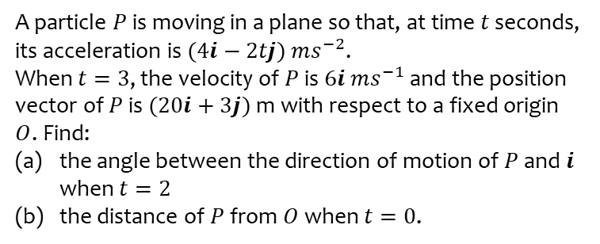
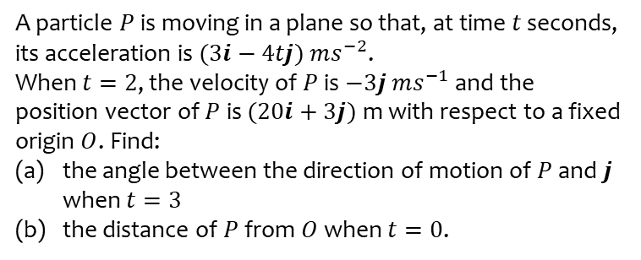
Worked example
Your turn
A particle $P$ is moving in a plane so that, at time $t$ seconds, its acceleration is $(3i−4tj)$ $ms^{−2}$.
When $t=2$, the velocity of $P$ is $−3j$ $ms^{−1}$ and the position vector of $P$ is $(20i+3j)$ m with respect to a fixed origin $O$. Find:
the angle between the direction of motion of $P$ and $j$ when $t=3$
the distance of $P$ from $O$ when $t=0$.
A particle $P$ is moving in a plane so that, at time $t$ seconds, its acceleration is $(4i−2tj)$ $ms^{−2}$.
When $t=3$, the velocity of $P$ is $6i$ $ms^{−1}$ and the position vector of $P$ is $(20i+3j)$ m with respect to a fixed origin $O$. Find:
the angle between the direction of motion of $P$ and $i$ when $t=2$
the distance of $P$ from $O$ when $t=0$.
a) $68.2°$ (1 dp)
b) $25 m$

Slide 4
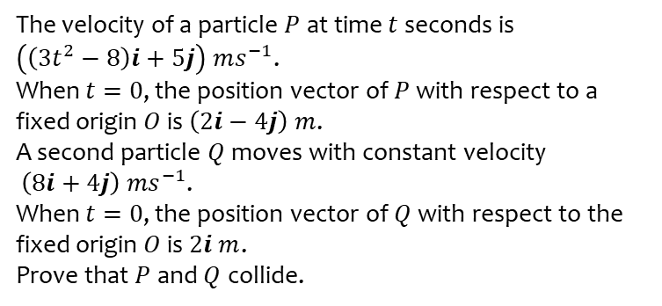
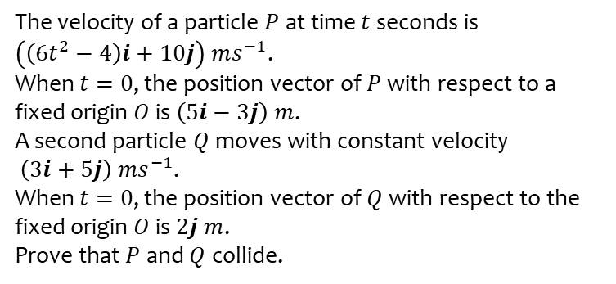
Worked example
Your turn
The velocity of a particle $P$ at time $t$ seconds is
$\left(\left(6t^{2}−4\right)i+10j\right) ms^{−1}$.
When $t=0$, the position vector of $P$ with respect to a fixed origin $O$ is $\left(5i−3j\right) m$.
A second particle $Q$ moves with constant velocity
$\left(3i+5j\right) {ms}^{−1}$.
When $t=0$, the position vector of $Q$ with respect to the fixed origin $O$ is $2j m$.
Prove that $P$ and $Q$ collide.
The velocity of a particle $P$ at time $t$ seconds is
$\left(\left(3t^{2}−8\right)i+5j\right) ms^{−1}$.
When $t=0$, the position vector of $P$ with respect to a fixed origin $O$ is $\left(2i−4j\right) m$.
A second particle $Q$ moves with constant velocity
$\left(8i+4j\right) {ms}^{−1}$.
When $t=0$, the position vector of $Q$ with respect to the fixed origin $O$ is $2i m$.
Prove that $P$ and $Q$ collide.
Proof

