Slide 1
8.4) Working with vectors

Slide 2
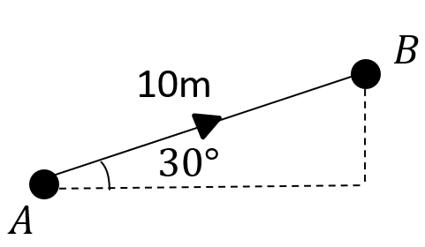
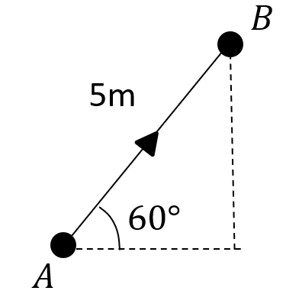
Worked example
Your turn
Convert from scalar to vector form:
Convert from scalar to vector form:
Displacement (from A) $=\left(\begin{matrix}5\cos{60°} \\ 5\sin{60°}\end{matrix}\right)=\left(\begin{matrix}2.5 \\ 4.33\end{matrix}\right) m$
Diagrams/Graphs used with permission from DrFrostMaths: https://www.drfrostmaths.com/

Slide 3
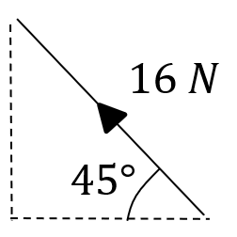
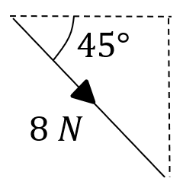
Worked example
Your turn
Convert from scalar to vector form:
Convert from scalar to vector form:
$$\text{Force} \text{vector} =\left(\begin{matrix}8cos45° \\ −8\sin{45°}\end{matrix}\right)=\left(\begin{matrix}4\sqrt{2} \\ −4\sqrt{2}\end{matrix}\right) N$$
Diagrams/Graphs used with permission from DrFrostMaths: https://www.drfrostmaths.com/

Slide 4
Worked example
Your turn
Convert from vector to scalar form:
Velocity $=\left(\begin{matrix}−3 \\ 4\end{matrix}\right) ms^{−1}$
Convert from vector to scalar form:
Velocity $=\left(\begin{matrix}5 \\ −12\end{matrix}\right) ms^{−1}$
Speed $=13 ms^{−1}$

Slide 5
Worked example
Your turn
Convert from vector to scalar form:
Acceleration $=\left(3i−4j\right) ms^{−2}$
Convert from vector to scalar form:
Acceleration $=\left(−6i+8j\right) ms^{−2}$
Magnitude of the acceleration $=10 ms^{−1}$

Slide 6
Worked example
Your turn
The velocity of a particle is given by
$v=2i+7j ms^{−1}$.
Find:
The speed of the particle
The angle the direction of motion of the particle makes with the unit vector $i$
The angle the direction of motion of the particle makes with the unit vector $j$
The velocity of a particle is given by
$v=3i+5j ms^{−1}$.
Find:
The speed of the particle
The angle the direction of motion of the particle makes with the unit vector $i$
The angle the direction of motion of the particle makes with the unit vector $j$
a) $5.83 ms^{−1}$ (2 dp)
b) $59.04°$ (2 dp)
c) $30.96°$ (2 dp)

Slide 7
Worked example
Your turn
The velocity of a particle is given by
$v=3i−5j ms^{−1}$.
Find:
The speed of the particle
The angle the direction of motion of the particle makes with the unit vector $i$
The angle the direction of motion of the particle makes with the unit vector $j$
The velocity of a particle is given by
$v=2i−7j ms^{−1}$.
Find:
The speed of the particle
The angle the direction of motion of the particle makes with the unit vector $i$
The angle the direction of motion of the particle makes with the unit vector $j$
a) $7.28 ms^{−1}$ (2 dp)
b) $74.05°$ (2 dp)
c) $164.05°$ (2 dp)

Slide 8
Worked example
Your turn
A man walks from $A$ to $B$ and then from $B$ to $C$.
His displacement from $A$ to $B$ is $5i−6j$ m.
His displacement from $B$ to $C$ is $4i+12j$ m.
What is the magnitude of the displacement from $A$ to $C$?
What is the total distance the man has walked in getting from $A$ to $C$.
A man walks from $A$ to $B$ and then from $B$ to $C$.
His displacement from $A$ to $B$ is $6i+4j$ m.
His displacement from $B$ to $C$ is $5i−12j$ m.
What is the magnitude of the displacement from $A$ to $C$?
What is the total distance the man has walked in getting from $A$ to $C$.
a) $13.60 km$ (2 dp)
b) $20.21 km$ (2 dp)

