Slide 1
8.4) Points of intersection

Slide 2
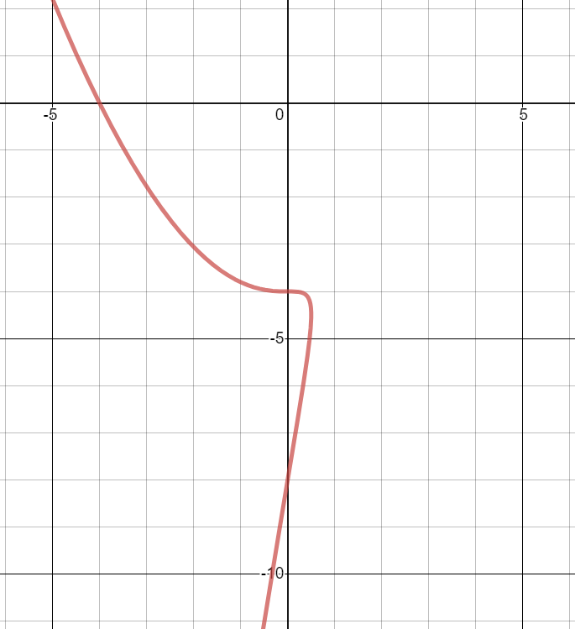
Worked example
Your turn
A curve $C$ is given by the parametric equations
$x=at^{2}+t$, $y=a\left(t^{3}+27\right)$, $t∈ℝ$,
where $a$ is a non-zero constant.
Given that $C$ passes through the point $\left(−6,0\right)$,
a) find the value of $a$.
b) find the coordinates of the points $A$ and $B$ where the curve crosses the $y$-axis.
A curve $C$ is given by the parametric equations
$x=at^{2}+t$, $y=a\left(t^{3}+8\right)$, $t∈ℝ$,
where $a$ is a non-zero constant.
Given that $C$ passes through the point $\left(−4,0\right)$,
a) find the value of $a$.
b) find the coordinates of the points $A$ and $B$ where the curve crosses the $y$-axis.
a) $a=−\frac{1}{2}$
b) $(0,−4)$ and $(0, −8)$
Graphs used with permission from DESMOS: https://www.desmos.com/

Slide 3
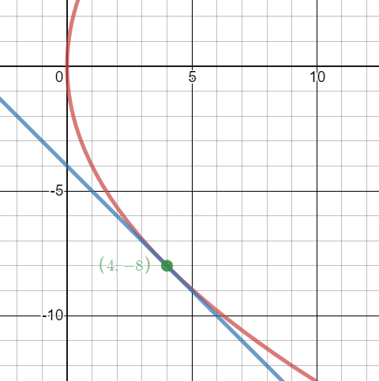
Worked example
Your turn
A curve $C$ is given by the parametric equations
$x=t^{2}, y=2t$, $t∈ℝ$
Find the coordinates of the point(s) of intersection between the curve $C$ and the line $x+y−8=0$
A curve $C$ is given by the parametric equations
$x=t^{2}, y=4t$, $t∈ℝ$
Find the coordinates of the point(s) of intersection between the curve $C$ and the line $x+y+4=0$
$$(4, −8)$$
Graphs used with permission from DESMOS: https://www.desmos.com/

Slide 4
Worked example
Your turn
A curve $C$ is given by the parametric equations
$$x=\cos{t}−\sin{t}, y={\left(t+\frac{π}{6}\right)}^{2}, −\frac{π}{3}<t<\frac{3π}{2}$$
a) Find the point where the curve intersects the line $y=π^{2}$.
b) Find the coordinates of the points where the curve cuts the $y$-axis.
A curve $C$ is given by the parametric equations
$$x=\cos{t}+\sin{t}, y={\left(t−\frac{π}{6}\right)}^{2}, −\frac{π}{2}<t<\frac{4π}{3}$$
a) Find the point where the curve intersects the line $y=π^{2}$.
b) Find the coordinates of the points where the curve cuts the $y$-axis.
a) $\left(−\frac{1+\sqrt{3}}{2},π^{2}\right)$
b) $\left(0,\frac{25π^{2}}{144}\right)$ and $\left(0,\frac{49π^{2}}{144}\right)$

Slide 5
Worked example
Your turn
A curve $C$ is given by the parametric equations
$$x=1−\frac{1}{3}t, y=3^{t}−1, t∈ℝ$$
Find the coordinates of the $x$ and $y$intercepts
A curve $C$ is given by the parametric equations
$$x=1−\frac{1}{2}t, y=2^{t}−1, t∈ℝ$$
Find the coordinates of the $x$ and $y$intercepts
$(0, 3)$ and $(1, 0)$

Slide 6
Worked example
Your turn
A curve $C$ is given by the parametric equations
$$x=e^{3t}, y=e^{t}+1, t∈ℝ$$
A straight line $l$ passes through the points $A$ and $B$ where $t=\ln{3}$ and $t=\ln{4}$respectively.
Find an equation for $l$ in the form $ax+by+c=0$
A curve $C$ is given by the parametric equations
$$x=e^{2t}, y=e^{t}−1, t∈ℝ$$
A straight line $l$ passes through the points $A$ and $B$ where $t=\ln{2}$ and $t=\ln{3}$respectively.
Find an equation for $l$ in the form $ax+by+c=0$
$$x−5y+1=0$$

