Slide 1
8.4) Differentiating vectors

Slide 2
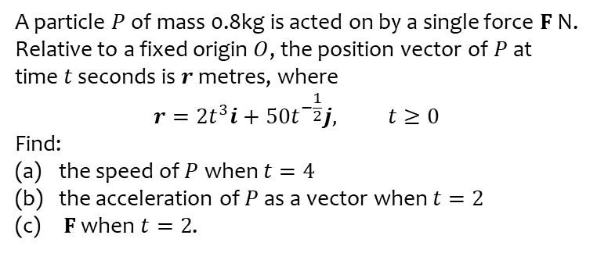
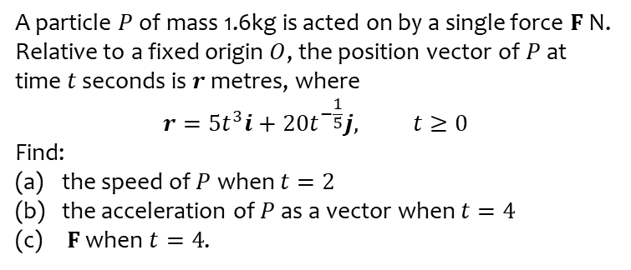
Worked example
Your turn
A particle $P$ of mass 1.6kg is acted on by a single force $F$ N. Relative to a fixed origin $O$, the position vector of $P$ at time $t$ seconds is $r$ metres, where
$$r=5t^{3}i+20t^{−\frac{1}{5}}j, t≥0$$
Find:
the speed of $P$ when $t=2$
the acceleration of $P$ as a vector when $t=4$
$F$ when $t=4$.
A particle $P$ of mass 0.8kg is acted on by a single force $F$ N. Relative to a fixed origin $O$, the position vector of $P$ at time $t$ seconds is $r$ metres, where
$$r=2t^{3}i+50t^{−\frac{1}{2}}j, t≥0$$
Find:
the speed of $P$ when $t=4$
the acceleration of $P$ as a vector when $t=2$
$F$ when $t=2$.
a) $96 ms^{−1}$ (2 sf)
b) $\left(24i+6.6j\right) ms^{−2}$ (2 sf)
c) $\left(19i+5.3j\right) N$ (2 sf)

