Slide 1
8.3) Curve sketching

Slide 2
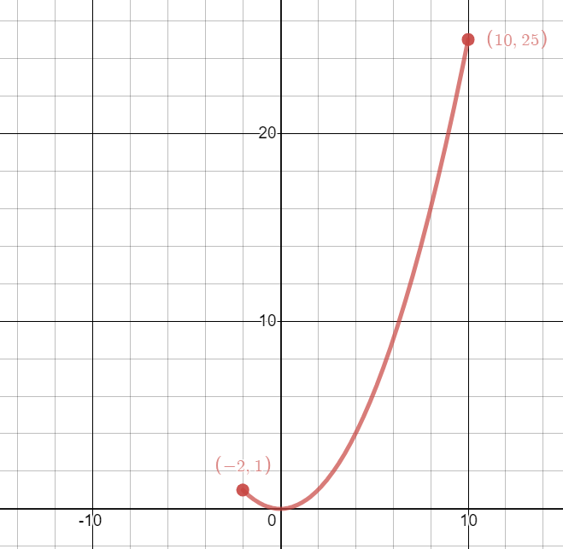
Worked example
Your turn
Draw the curve given by the parametric equations
$$x=3t, y=t^{2}, −5≤t≤1$$
Draw the curve given by the parametric equations
$$x=2t, y=t^{2}, −1≤t≤5$$
$$y=\frac{x^{2}}{4}, −2≤x≤10$$
Graphs used with permission from DESMOS: https://www.desmos.com/

Slide 3
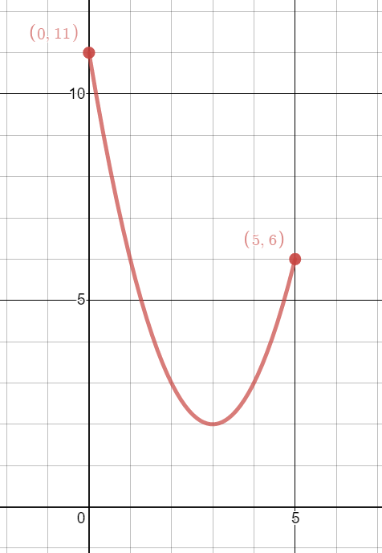
Worked example
Your turn
Draw the curve given by the parametric equations
$$x=2−t, y=t^{2}−3, −3≤t≤2$$
Draw the curve given by the parametric equations
$$x=3−t, y=t^{2}+2, −2≤t≤3$$
$$y=x^{2}−6x+11, 0≤x≤5$$
Graphs used with permission from DESMOS: https://www.desmos.com/

Slide 4
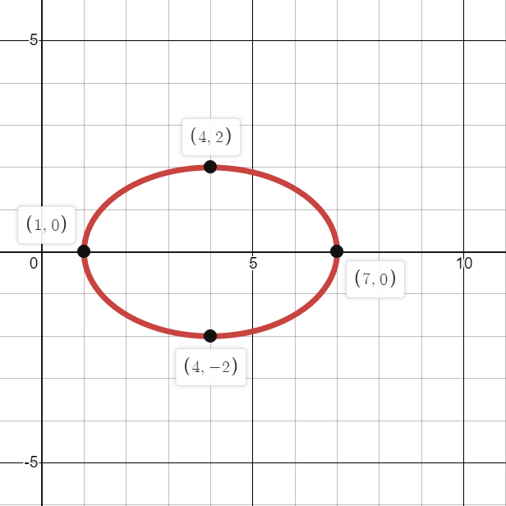
Worked example
Your turn
Draw the curve given by the parametric equations
$$x=2\cos{t}−3, y=4\sin{t}, 0≤t≤2π$$
Draw the curve given by the parametric equations
$$x=3\cos{t}+4, y=2\sin{t}, 0≤t≤2π$$
$${\left(\frac{x−4}{3}\right)}^{2}+{\left(\frac{y}{2}\right)}^{2}=1, 1≤x≤7$$
Graphs used with permission from DESMOS: https://www.desmos.com/

