Slide 1
8.3) Variable acceleration in one dimension

Slide 2
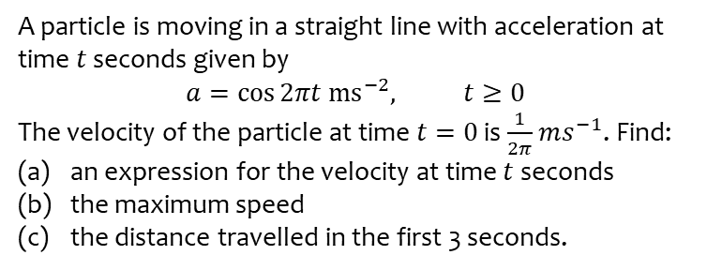
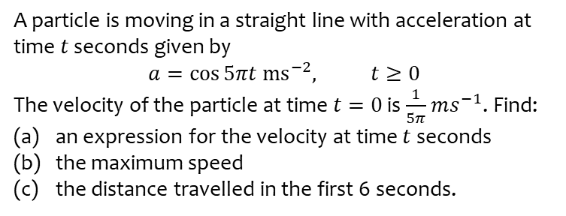
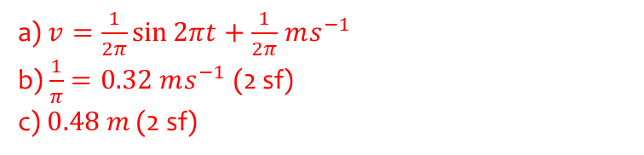
Worked example
Your turn
A particle is moving in a straight line with acceleration at time $t$ seconds given by
$$a=\cos{5πt ms^{−2}, t≥0}$$
The velocity of the particle at time $t=0$ is $\frac{1}{5π}$ $ms^{−1}$. Find:
an expression for the velocity at time $t$ seconds
the maximum speed
the distance travelled in the first 6 seconds.
A particle is moving in a straight line with acceleration at time $t$ seconds given by
$$a=\cos{2πt ms^{−2}, t≥0}$$
The velocity of the particle at time $t=0$ is $\frac{1}{2π}$ $ms^{−1}$. Find:
an expression for the velocity at time $t$ seconds
the maximum speed
the distance travelled in the first 3 seconds.
a) $v=\frac{1}{2π}\sin{2πt}+\frac{1}{2π}$ $ms^{−1}$
b) $\frac{1}{π}=0.32 ms^{−1}$ (2 sf)
c) $0.48 m$ (2 sf)

Slide 3
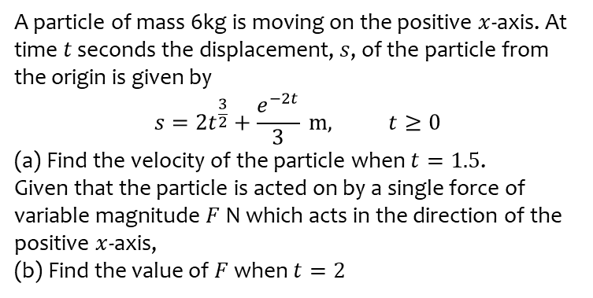
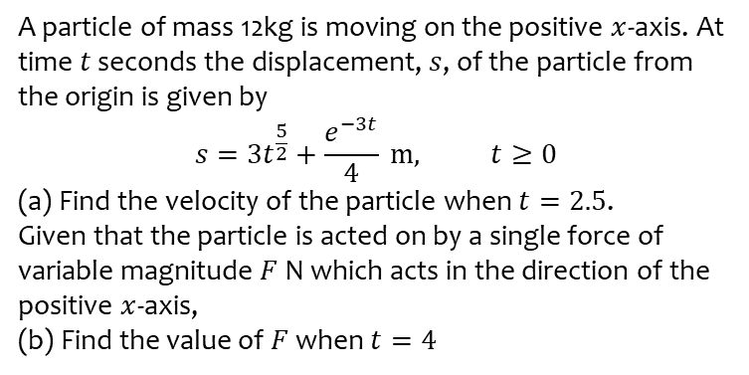
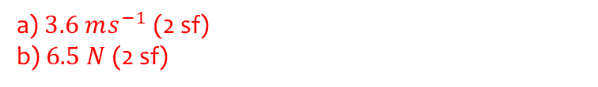
Worked example
Your turn
A particle of mass 12kg is moving on the positive $x$-axis. At time $t$ seconds the displacement, $s$, of the particle from the origin is given by
$$s=3t^{\frac{5}{2}}+\frac{e^{−3t}}{4} m, t≥0$$
(a) Find the velocity of the particle when $t=2.5$.
Given that the particle is acted on by a single force of variable magnitude $F$ N which acts in the direction of the positive $x$-axis,
(b) Find the value of $F$ when $t=4$
A particle of mass 6kg is moving on the positive $x$-axis. At time $t$ seconds the displacement, $s$, of the particle from the origin is given by
$$s=2t^{\frac{3}{2}}+\frac{e^{−2t}}{3} m, t≥0$$
(a) Find the velocity of the particle when $t=1.5$.
Given that the particle is acted on by a single force of variable magnitude $F$ N which acts in the direction of the positive $x$-axis,
(b) Find the value of $F$ when $t=2$
a) $3.6 ms^{−1}$ (2 sf)
b) $6.5 N$ (2 sf)

