Slide 1
8.2) Vector methods with projectiles

Slide 2
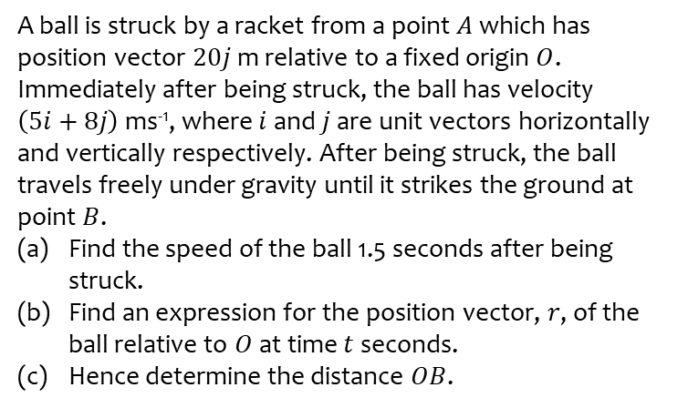
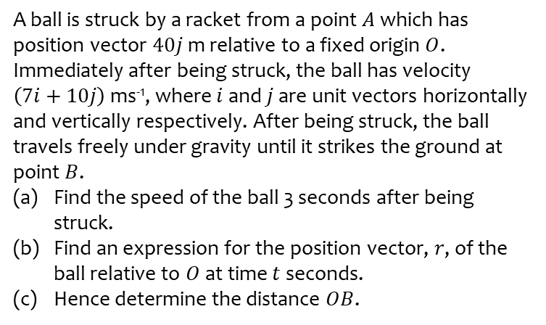
Worked example
Your turn
A ball is struck by a racket from a point $A$ which has position vector $40j$ m relative to a fixed origin $O$. Immediately after being struck, the ball has velocity $\left(7i+10j\right)$ ms⁻¹, where $i$ and $j$ are unit vectors horizontally and vertically respectively. After being struck, the ball travels freely under gravity until it strikes the ground at point $B$.
Find the speed of the ball 3 seconds after being struck.
Find an expression for the position vector, $r$, of the ball relative to $O$ at time $t$ seconds.
Hence determine the distance $OB$.
A ball is struck by a racket from a point $A$ which has position vector $20j$ m relative to a fixed origin $O$. Immediately after being struck, the ball has velocity $\left(5i+8j\right)$ ms⁻¹, where $i$ and $j$ are unit vectors horizontally and vertically respectively. After being struck, the ball travels freely under gravity until it strikes the ground at point $B$.
Find the speed of the ball 1.5 seconds after being struck.
Find an expression for the position vector, $r$, of the ball relative to $O$ at time $t$ seconds.
Hence determine the distance $OB$.
a) $8.4 ms^{−1}$ (2 sf)
b) $\left(\left(5t\right)i+\left(8t−4.9t^{2}+20\right)j\right) m$
c) $15 m$ (2 sf)

Slide 3
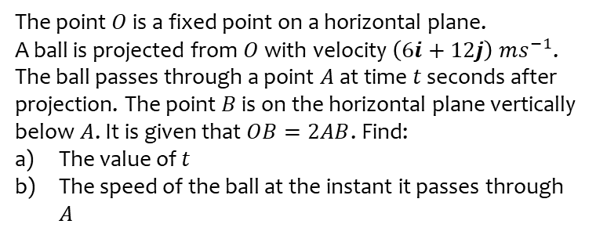
Worked example
Your turn
The point $O$ is a fixed point on a horizontal plane.
A ball is projected from $O$ with velocity $\left(4i+8j\right) ms^{−1}$.
The ball passes through a point $A$ at time $t$ seconds after projection. The point $B$ is on the horizontal plane vertically below $A$. It is given that $OB=4AB$. Find:
The value of $t$
The speed of the ball at the instant it passes through $A$
The point $O$ is a fixed point on a horizontal plane.
A ball is projected from $O$ with velocity $\left(6i+12j\right) ms^{−1}$.
The ball passes through a point $A$ at time $t$ seconds after projection. The point $B$ is on the horizontal plane vertically below $A$. It is given that $OB=2AB$. Find:
The value of $t$
The speed of the ball at the instant it passes through $A$
a) $t=1.8$ (2 sf)
b) $8.5 ms^{−1}$ (2 sf)

