Slide 1
8.2) Using trigonometric identities

Slide 2
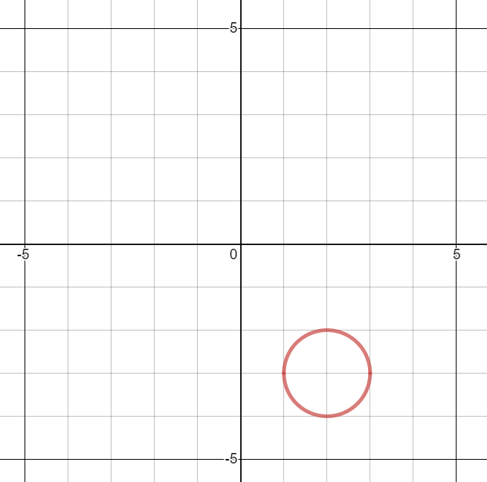
Worked example
Your turn
A curve has parametric equations
$$x=\sin{t}−2\text{, }y=\cos{t}+3\text{, }t∈ℝ$$
Find:
A Cartesian equation of the curve in the form $y=f(x)$
Sketch the curve
A curve has parametric equations
$$x=\sin{t}+2\text{, }y=\cos{t}−3\text{, }t∈ℝ$$
Find:
A Cartesian equation of the curve in the form $y=f(x)$
Sketch the curve
a) ${\left(x−2\right)}^{2}+{\left(y+3\right)}^{2}=1$
b) Circle, radius $1$, centre $(2, −3)$
Graphs used with permission from DESMOS: https://www.desmos.com/

Slide 3
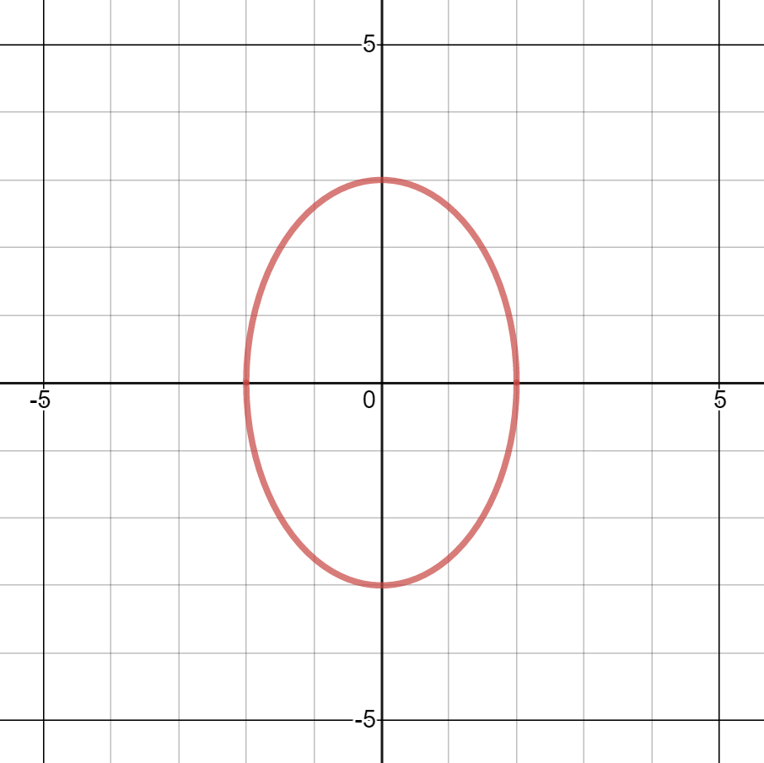
Worked example
Your turn
A curve has parametric equations
$$x=2\sin{t}\text{, }y=3\cos{t}\text{, }t∈ℝ$$
Find a Cartesian equation of the curve in the form $y=f(x)$
A curve has parametric equations
$$x=3\sin{t}\text{, }y=2\cos{t}\text{, }t∈ℝ$$
Find a Cartesian equation of the curve in the form $y=f(x)$
$${\left(\frac{x}{3}\right)}^{2}+{\left(\frac{y}{2}\right)}^{2}=1$$
Graphs used with permission from DESMOS: https://www.desmos.com/

Slide 4
Worked example
Your turn
A curve has parametric equations
$$x=\cos{t}, y=\sin{2t}, −\frac{π}{2}≤t≤\frac{π}{2}$$
Find:
A Cartesian equation of the curve in the form $y=f(x)$
The valid domain and range of $f(x)$
A curve has parametric equations
$$x=\sin{t}, y=\sin{2t}, −\frac{π}{2}≤t≤\frac{π}{2}$$
Find:
A Cartesian equation of the curve in the form $y=f(x)$
The valid domain and range of $f(x)$
a) $y=2x\sqrt{1−x^{2}}$
b) Domain: $−1≤x≤1$
Range: $−1≤f(x)≤1$

Slide 5
Worked example
Your turn
A curve has parametric equations
$$x=4\cos{t}, y=\cos{2t}−1, 0≤t≤π$$
Find a Cartesian equation of the curve in the form
$y=f\left(x\right), −k≤x≤k$, stating the value of the constant $k$
A curve has parametric equations
$$x=2\sin{t}, y=1−\cos{2t}, −\frac{π}{2}≤t≤\frac{π}{2}$$
Find a Cartesian equation of the curve in the form
$y=f\left(x\right), −k≤x≤k$, stating the value of the constant $k$
$y=\frac{x^{2}}{2}, −2≤x≤2$ ($k=2$)

Slide 6
Worked example
Your turn
A curve has parametric equations
$$x=\cot{t}+1, y=cosec^{2} t−3, 0<t<π$$
Find a Cartesian equation of the curve in the form $y=f\left(x\right)$ and state the domain of $x$ for which the curve is defined
A curve has parametric equations
$$x=\cot{t}+2, y=cosec^{2} t−2, 0<t<π$$
Find a Cartesian equation of the curve in the form $y=f\left(x\right)$ and state the domain of $x$ for which the curve is defined
$$y=x^{2}−4x+3, x∈ℝ$$

Slide 7
Worked example
Your turn
A curve has parametric equations
$$x=\sqrt{5}\sin{2t}, y=10\sin^{2}{t}, 0≤t<π$$
Find a Cartesian equation of the curve
A curve has parametric equations
$$x=\sqrt{3}\sin{2t}, y=4\cos^{2}{t}, 0≤t<π$$
Find a Cartesian equation of the curve
$$x^{2}=3y\left(1−\frac{y}{4}\right)$$

Slide 8
Worked example
Your turn
A curve has parametric equations
$$x=2\sin{t}, y=\sin\left(t+\frac{π}{6}\right), −\frac{π}{2}<t<\frac{π}{2}$$
Find a Cartesian equation of the curve in the form $y=f\left(x\right)$ and state the domain of $x$ for which the curve is defined
A curve has parametric equations
$$x=2\cos{t}, y=\sin\left(t−\frac{π}{6}\right), 0<t<π$$
Find a Cartesian equation of the curve in the form $y=f\left(x\right)$ and state the domain of $x$ for which the curve is defined
$$y=\frac{1}{4}\left(\sqrt{12−3x^{2}}−x\right), −2<x<2$$

Slide 9
Worked example
Your turn
A curve has parametric equations
$$x=\tan{t}, y=5 sin\left(t−π\right), 0<t<\frac{π}{2}$$
Find a Cartesian equation of the curve
A curve has parametric equations
$$x=\tan{t}, y=4 sin\left(t+π\right), 0<t<\frac{π}{2}$$
Find a Cartesian equation of the curve
$$x=−\frac{y}{\sqrt{16−y^{2}}}$$

