Slide 1
8.1) Vectors in kinematics

Slide 2
Worked example
Your turn
A particle starts from the position vector $(7i−2j)$ m and moves with constant velocity $(−3i+j)$ ms⁻¹.
Find the position vector of the particle 2 seconds later.
Find the time at which the particle is due north of the origin.
A particle starts from the position vector $(3i+7j)$ m and moves with constant velocity $(2i−j)$ ms⁻¹.
Find the position vector of the particle 4 seconds later.
Find the time at which the particle is due east of the origin.
a) $\left(11i+3j\right) ms^{−1}$
b) $7$ s

Slide 3
Worked example
Your turn
A particle $P$ has velocity $\left(−i+5j\right)$ ms⁻¹. The particle moves with constant acceleration $a=\left(4i+7j\right)$ ms⁻². Find:
the speed of the particle at time $t=6$ seconds.
the bearing on which it is travelling at time $t=6$ seconds.
A particle $P$ has velocity $\left(−3i+j\right)$ ms⁻¹. The particle moves with constant acceleration $a=\left(2i+3j\right)$ ms⁻². Find:
the speed of the particle at time $t=3$ seconds.
the bearing on which it is travelling at time $t=3$ seconds.
a) $10.4 ms^{−1}$ (3 sf)
b) $017°$

Slide 4
Worked example
Your turn
An ice skater is skating on a large flat ice rink. At time $t=0$ the skater is at a fixed point $O$ and is travelling with velocity $\left(−4i−9j\right)$ $ms^{−1}$.
At time $t=5$ s the skater is travelling with velocity $\left(−34i+29j\right)$ $ms^{−1}$.
Relative to $O$, the skater has position vector $s$ at time $t$ seconds.
Modelling the ice skater as a particle with constant acceleration, find:
The acceleration of the ice skater
An expression for $s$ in terms of $t$
The time at which the skater is directly south-west of $O$.
A second skater travels so that she has position vector
$r=\left(−132i+\left( 6−22t\right)j\right)$ m relative to $O$ at time $t$.
(d) Show that the two skaters will meet.
An ice skater is skating on a large flat ice rink. At time $t=0$ the skater is at a fixed point $O$ and is travelling with velocity $\left(2.4i−0.6j\right)$ $ms^{−1}$.
At time $t=20$ s the skater is travelling with velocity $\left(−5.6i+3.4j\right)$ $ms^{−1}$.
Relative to $O$, the skater has position vector $s$ at time $t$ seconds.
Modelling the ice skater as a particle with constant acceleration, find:
The acceleration of the ice skater
An expression for $s$ in terms of $t$
The time at which the skater is directly north-east of $O$.
A second skater travels so that she has position vector
$r=\left(1.1t−6\right)j$ m relative to $O$ at time $t$.
(d) Show that the two skaters will meet.
a) $\left(−0.4i+0.2j\right) ms^{−2}$
b) $\left(\left(2.4t−0.2t^{2}\right)i+\left(−0.6t+0.1t^{2}\right)j\right) m$
c) $t=10$ s
d) Shown: Meet when $t=12$ s

Slide 5
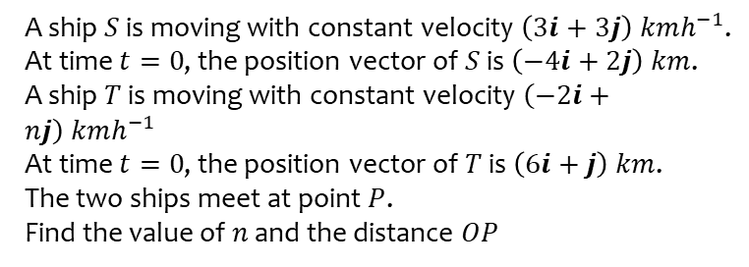
Worked example
Your turn
A ship $S$ is moving with constant velocity $\left(2i+4j\right) kmh^{−1}$.
At time $t=0$, the position vector of $S$ is $\left(−3i+5j\right) km$.
A ship $T$ is moving with constant velocity $\left(6i+nj\right) kmh^{−1}$
At time $t=0$, the position vector of $T$ is $\left(−15i+2j\right) km$.
The two ships meet at point $P$.
Find the value of $n$ and the distance $OP$
A ship $S$ is moving with constant velocity $\left(3i+3j\right) kmh^{−1}$.
At time $t=0$, the position vector of $S$ is $\left(−4i+2j\right) km$.
A ship $T$ is moving with constant velocity $\left(−2i+nj\right) kmh^{−1}$
At time $t=0$, the position vector of $T$ is $\left(6i+j\right) km$.
The two ships meet at point $P$.
Find the value of $n$ and the distance $OP$
$n=3.5, OP=8.25 km$ (3 sf)

