Slide 1
8.1) Parametric equations

Slide 2
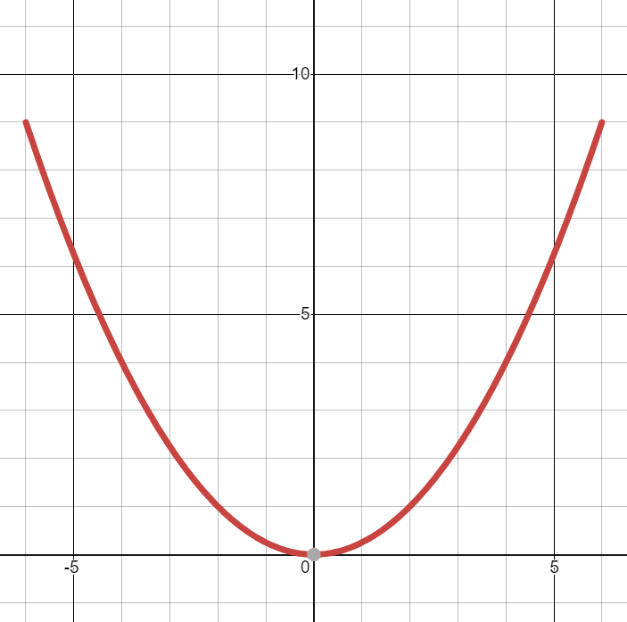
Worked example
Your turn
A curve has parametric equations
$$x=3t, y=t^{2}, −4<t<4$$
Find:
A Cartesian equation of the curve in the form $y=f(x)$
The domain and range of $f\left(x\right)$
Sketch the curve
A curve has parametric equations
$$x=2t, y=t^{2}, −3<t<3$$
Find:
A Cartesian equation of the curve in the form $y=f(x)$
The domain and range of $f\left(x\right)$
Sketch the curve
a) $y=\frac{x^{2}}{4}$
b) Domain: $−6<x<6$
Range: $0≤f(x)<9$
c)
Graphs used with permission from DESMOS: https://www.desmos.com/

Slide 3
Worked example
Your turn
A curve has parametric equations
$$x=\ln\left(t+5\right), y=\frac{1}{t+7}, t>−4$$
Find:
A Cartesian equation of the curve in the form $y=f(x)$
The domain and range of $f\left(x\right)$
A curve has parametric equations
$$x=\ln\left(t+3\right), y=\frac{1}{t+5}, t>−2$$
Find:
A Cartesian equation of the curve in the form $y=f(x)$
The domain and range of $f\left(x\right)$
a) $y=\frac{1}{e^{x}+2}$
b) Domain: $x>0$
Range: $0<f(x)<\frac{1}{3}$

Slide 4
Worked example
Your turn
A curve has parametric equations
$$x=\ln{t}, y=t^{3}−4, t>0$$
Find:
A Cartesian equation of the curve in the form $y=f(x)$
The domain and range of $f\left(x\right)$
A curve has parametric equations
$$x=\ln{t}, y=t^{2}−1, t>0$$
Find:
A Cartesian equation of the curve in the form $y=f(x)$
The domain and range of $f\left(x\right)$
a) $y=e^{2x}−1$
b) Domain: $x∈ℝ$
Range: $f\left(x\right)>−1$

Slide 5
Worked example
Your turn
A curve has parametric equations
$$x=\frac{3t}{1−t}, y=5t+\frac{2}{t},$$
Show that the Cartesian equation of the curve is
$$y=\frac{ax^{2}+bx+c}{x\left(x+3\right)}$$
where $a$, $b$ and $c$ are constants to be found.
A curve has parametric equations
$$x=\frac{5t}{1−t}, y=2t+\frac{3}{t},$$
Show that the Cartesian equation of the curve is
$$y=\frac{ax^{2}+bx+c}{x\left(x+5\right)}$$
where $a$, $b$ and $c$ are constants to be found.
Shown
$$a=5, b=30, c=75$$

