Slide 1
8.1) Constructing a model

Slide 2
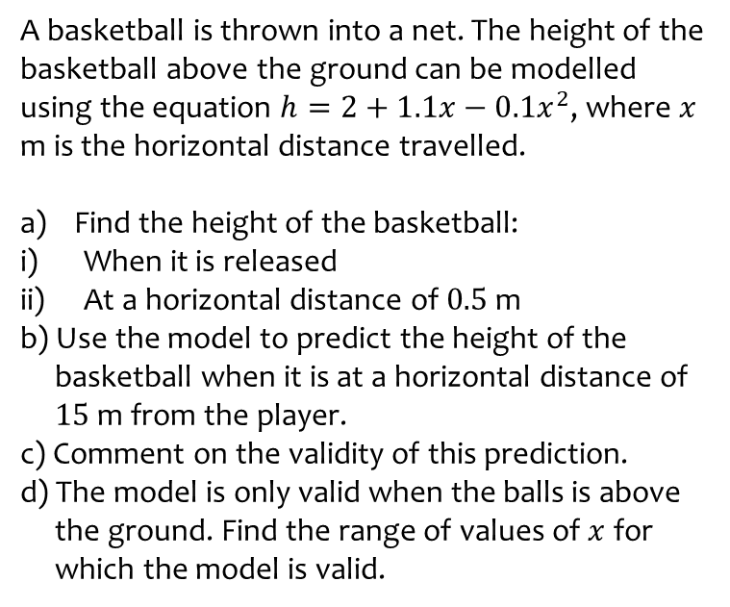
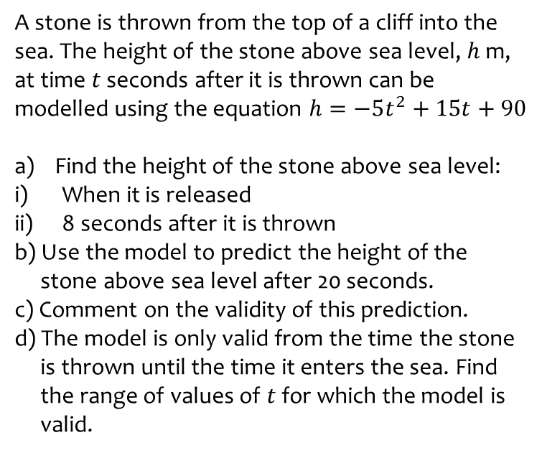
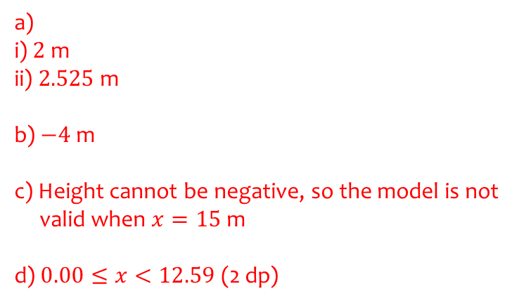
Worked example
Your turn
A stone is thrown from the top of a cliff into the sea. The height of the stone above sea level, $h$ m, at time $t$ seconds after it is thrown can be modelled using the equation $h=−5t^{2}+15t+90$
Find the height of the stone above sea level:
When it is released
8 seconds after it is thrown
b) Use the model to predict the height of the
stone above sea level after 20 seconds.
c) Comment on the validity of this prediction.
d) The model is only valid from the time the stone
is thrown until the time it enters the sea. Find
the range of values of $t$ for which the model is
valid.
A basketball is thrown into a net. The height of the basketball above the ground can be modelled using the equation $h=2+1.1x−0.1x^{2}$, where $x$ m is the horizontal distance travelled.
Find the height of the basketball:
When it is released
At a horizontal distance of $0.5$ m
b) Use the model to predict the height of the
basketball when it is at a horizontal distance of
$15$m from the player.
c) Comment on the validity of this prediction.
d) The model is only valid when the balls is above
the ground. Find the range of values of $x$ for
which the model is valid.
a)
i) $2$m
ii) $2.525$ m
b) $−4$m
c) Height cannot be negative, so the model is not
valid when $x=15$m
d) $0.00≤x<12.59$ (2 dp)

