Slide 1
8) The binomial expansion
8.1) Pascal’s triangle
8.2) Factorial notation
8.3) The binomial expansion
8.4) Solving binomial problems
8.5) Binomial estimation

Slide 2
8.1) Pascal’s triangle
Chapter CONTENTS

Slide 3
Worked example
Your turn
Use Pascal’s triangle to find the expansion of
$${\left(x+4y\right)}^{5}$$
Use Pascal’s triangle to find the expansion of
$${\left(x+2y\right)}^{3}$$
$$x^{3}+6x^{2}y+12xy^{2}+8y^{3}$$

Slide 4
Worked example
Your turn
Use Pascal’s triangle to find the expansion of
$${\left(5x−2\right)}^{4}$$
Use Pascal’s triangle to find the expansion of
$${\left(2x−5\right)}^{4}$$
$$16x^{4}−160x^{3}+600x^{2}−1000x+625$$

Slide 5
Worked example
Your turn
Find the expansion of ${\left(3+2x\right)}^{4}$
Find the expansion of ${\left(2+3x\right)}^{4}$
$$16+96x+216x^{2}+216x^{3}+81x^{4}$$

Slide 6
Worked example
Your turn
Find the expansion of ${\left(1−4x\right)}^{3}$
Find the expansion of ${\left(1−2x\right)}^{3}$
$$1−6x+12x^{2}−8x^{3}$$

Slide 7
Worked example
Your turn
The coefficient of $x^{2}$ in the expansion of ${\left(2−cx\right)}^{3}$ is 294.
Find the possible value(s) of the constant $c$.
The coefficient of $x^{2}$ in the expansion of ${\left(2−cx\right)}^{5}$ is 720.
Find the possible value(s) of the constant $c$.
$$c=±3$$

Slide 8
Worked example
Your turn
The coefficient of $x^{3}$ in the expansion of ${\left(3−cx\right)}^{5}$ is $720$.
Find the possible value(s) of the constant $c$.
The coefficient of $x^{3}$ in the expansion of ${\left(2−cx\right)}^{5}$ is $−1080$.
Find the possible value(s) of the constant $c$.
$$c=3$$

Slide 9
Worked example
Your turn
In the binomial expansion of ${\left(3+kx\right)}^{7},$ where $k$ is a constant, the coefficient of $x^{2}$ is $2$ times the coefficient of $x$.
Find the value of $k$
In the binomial expansion of ${\left(2+kx\right)}^{7},$ where $k$ is a constant, the coefficient of $x^{2}$ is $6$ times the coefficient of $x$.
Find the value of $k$
$$k=4$$

Slide 10
8.2) Factorial notation
Chapter CONTENTS

Slide 11
Worked example
Your turn
Find the number of different ways of arranging the letters $ABCD$
Find the number of different ways of arranging the letters $ABCDE$
$$5!=120$$

Slide 12
Worked example
Your turn
Find the number of ways of a football coach choosing $11$ starting players from a squad of $18$
Find the number of ways of a netball coach choosing $7$ starting players from a squad of $12$
$$\frac{12!}{7!5!}=792$$

Slide 13

Worked example
Your turn
Using factorials, evaluate:
$$1!$$
$$\left(\begin{matrix}10 \\ 0\end{matrix}\right)$$
Using factorials, evaluate:
$$0!$$
$$\left(\begin{matrix}20 \\ 1\end{matrix}\right)$$
$$1$$
$$20$$
$$190$$
$$190$$

Slide 14
8.3) The binomial expansion
Chapter CONTENTS

Slide 15
Worked example
Your turn
Use the binomial theorem to find the expansion of ${\left(2−3x\right)}^{5}$
Use the binomial theorem to find the expansion of ${\left(3−2x\right)}^{5}$
$$243−810x+1080x^{2}−720x^{3}+240x^{4}−32x^{5}$$

Slide 16
Worked example
Your turn
Find the first four terms in ascending powers of $x$ in the binomial expansion of
$${\left(1+3x\right)}^{11}$$
Find the first four terms in ascending powers of $x$ in the binomial expansion of
$${\left(1+2x\right)}^{10}$$
$$1+20x+180x^{2}+960x^{3}+…$$

Slide 17
Worked example
Your turn
Find the first four terms in ascending powers of $x$ in the binomial expansion of
$${\left(6−\frac{1}{3}x\right)}^{10}$$
Find the first four terms in ascending powers of $x$ in the binomial expansion of
$${\left(10−\frac{1}{2}x\right)}^{6}$$
$$1000000−300000x+37500x^{2}−2500x^{3}+…$$

Slide 18
Worked example
Your turn
Find the first 3 terms in the expansion of ${\left(3−\frac{1}{2}x\right)}^{5}$, in ascending powers of $x$.
Find the first 3 terms in the expansion of ${\left(2−\frac{1}{3}x\right)}^{7}$, in ascending powers of $x$.
$$128−\frac{448}{3}x+\frac{224}{3}x^{2}+…$$

Slide 19
Worked example
Your turn
Find the binomial expansion of ${\left(x+\frac{1}{x}\right)}^{7}$ giving each term in its simplest form
Find the binomial expansion of ${\left(x+\frac{1}{x}\right)}^{5}$ giving each term in its simplest form
$$x^{5}+5x^{3}+10x+\frac{10}{x}+\frac{5}{x^{3}}+\frac{1}{x^{5}}$$

Slide 20
8.4) Solving binomial problems
Chapter CONTENTS

Slide 21
Worked example
Your turn
Find the coefficient of $x^{6}$ in the binomial expansion of ${\left(3+2x\right)}^{10}$
Find the coefficient of $x^{4}$ in the binomial expansion of ${\left(2+3x\right)}^{10}$
$$1088640$$

Slide 22
Worked example
Your turn
Find the coefficient of $x^{3}$ in the binomial expansion of $\left(3+x\right){\left(2−3x\right)}^{7}$
Find the coefficient of $x^{3}$ in the binomial expansion of $\left(2+x\right){\left(3−2x\right)}^{7}$
$$−24948$$

Slide 23
Worked example
Your turn
The coefficient of $x^{6}$ in the expansion of ${\left(1+qx\right)}^{10}$ is 153090. Find the possible value(s) of the constant $q$.
The coefficient of $x^{4}$ in the expansion of ${\left(1+qx\right)}^{10}$ is 3360. Find the possible value(s) of the constant $q$.
$$q=±2$$

Slide 24
Worked example
Your turn
In the expansion of ${\left(1+ax\right)}^{8}$, where $a$ is a non-zero constant the coefficient of $x^{3}$ is quadruple the coefficient of $x^{2}$.
Find the value of $a$.
In the expansion of ${\left(1+ax\right)}^{10}$, where $a$ is a non-zero constant the coefficient of $x^{3}$ is double the coefficient of $x^{2}$.
Find the value of $a$.
$$a=\frac{3}{4}$$

Slide 25
Worked example
Your turn
Given that, in the expansion of ${\left(1+qx\right)}^{8}$, the coefficient of $x$ is $−r$ and the coefficient of $x^{2}$ is $14r$, find the value of $q$ and the value of $r$
Given that, in the expansion of ${\left(1+qx\right)}^{8}$, the coefficient of $x$ is $−r$ and the coefficient of $x^{2}$ is $7r$, find the value of $q$ and the value of $r$
$$q=−2, r=16$$

Slide 26
Worked example
Your turn
In the binomial expansion of ${\left(1+x\right)}^{40}$, the coefficients of $x^{19}$ and $x^{20}$ are $p$ and $q$ respectively. Find the value of $\frac{q}{p}$
In the binomial expansion of ${\left(1+x\right)}^{20}$, the coefficients of $x^{9}$ and $x^{11}$ are $p$ and $q$ respectively. Find the value of $\frac{q}{p}$
$$1$$

Slide 27
8.5) Binomial estimation
Chapter CONTENTS

Slide 28
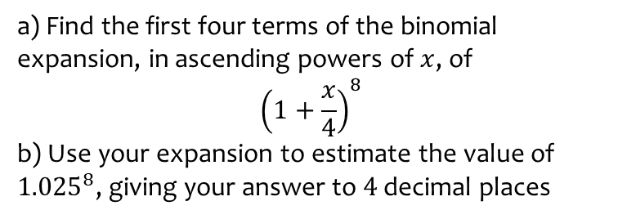
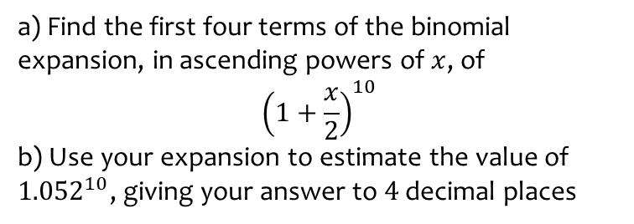
Worked example
Your turn
a) Find the first four terms of the binomial expansion, in ascending powers of $x$, of
$${\left(1+\frac{x}{2}\right)}^{10}$$
b) Use your expansion to estimate the value of ${1.052}^{10}$, giving your answer to $4$ decimal places
a) Find the first four terms of the binomial expansion, in ascending powers of $x$, of
$${\left(1+\frac{x}{4}\right)}^{8}$$
b) Use your expansion to estimate the value of ${1.025}^{8}$, giving your answer to $4$ decimal places
a) $1+2x+\frac{7}{4}x^{2}+\frac{7}{8}x^{3}+…$
b) $1.2184$ (4 dp)

Slide 29
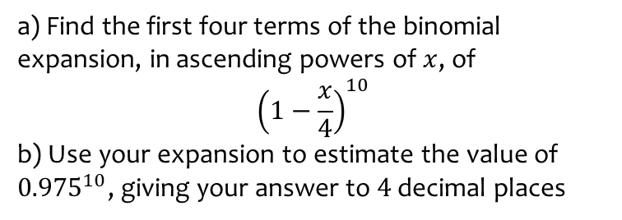
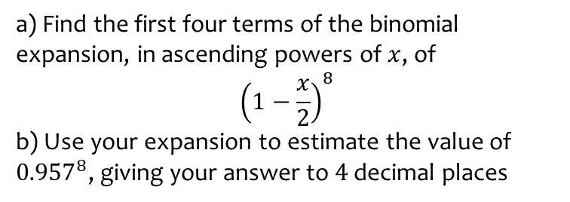
Worked example
Your turn
a) Find the first four terms of the binomial expansion, in ascending powers of $x$, of
$${\left(1−\frac{x}{2}\right)}^{8}$$
b) Use your expansion to estimate the value of ${0.957}^{8}$, giving your answer to $4$ decimal places
a) Find the first four terms of the binomial expansion, in ascending powers of $x$, of
$${\left(1−\frac{x}{4}\right)}^{10}$$
b) Use your expansion to estimate the value of ${0.975}^{10}$, giving your answer to $4$ decimal places
a) $1−\frac{5}{2}x+\frac{45}{16}x^{2}−−\frac{15}{8}x^{3}+…$
b) $0.7763$ (4 dp)

Slide 30
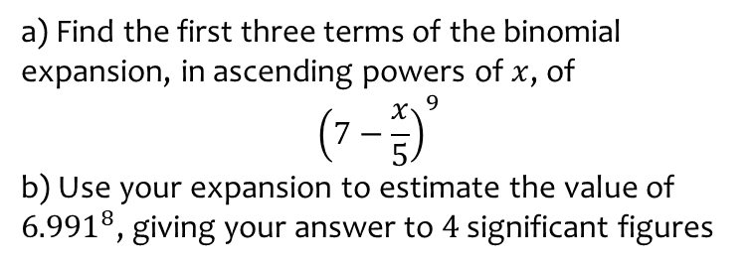
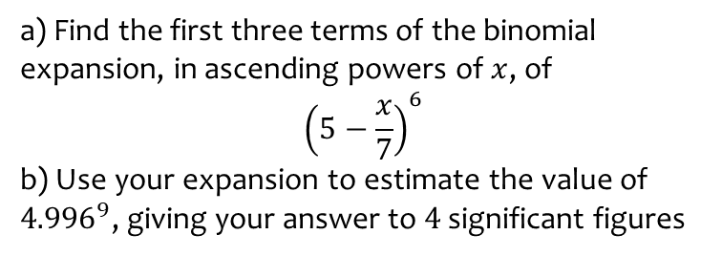
Worked example
Your turn
a) Find the first three terms of the binomial expansion, in ascending powers of $x$, of
$${\left(5−\frac{x}{7}\right)}^{6}$$
b) Use your expansion to estimate the value of ${4.996}^{9}$, giving your answer to $4$ significant figures
a) Find the first three terms of the binomial expansion, in ascending powers of $x$, of
$${\left(7−\frac{x}{5}\right)}^{9}$$
b) Use your expansion to estimate the value of ${6.991}^{8}$, giving your answer to $4$ significant figures
a) $40353607−\frac{51883209}{5}x+\frac{29647548}{25}x^{2}+…$
b) $39890000$

Slide 31
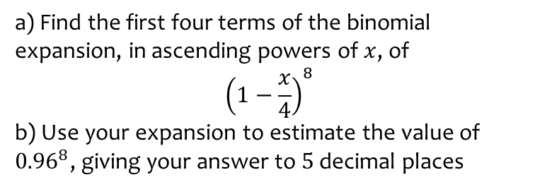
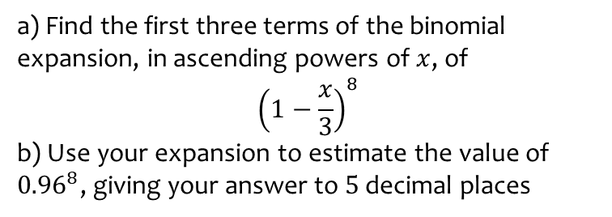
Worked example
Your turn
a) Find the first three terms of the binomial expansion, in ascending powers of $x$, of
$${\left(1−\frac{x}{3}\right)}^{8}$$
b) Use your expansion to estimate the value of ${0.96}^{8}$, giving your answer to $5$ decimal places
a) Find the first four terms of the binomial expansion, in ascending powers of $x$, of
$${\left(1−\frac{x}{4}\right)}^{8}$$
b) Use your expansion to estimate the value of ${0.96}^{8}$, giving your answer to $5$ decimal places
a) $1−2x+\frac{7}{4}x^{2}−\frac{7}{8}x^{3}+…$
b) $0.72122$

