Slide 1
8) Parametric equations
8.1) Parametric equations
8.2) Using trigonometric identities
8.3) Curve sketching
8.4) Points of intersection
8.5) Modelling with parametric equations

Slide 2
8.1) Parametric equations
Chapter CONTENTS

Slide 3
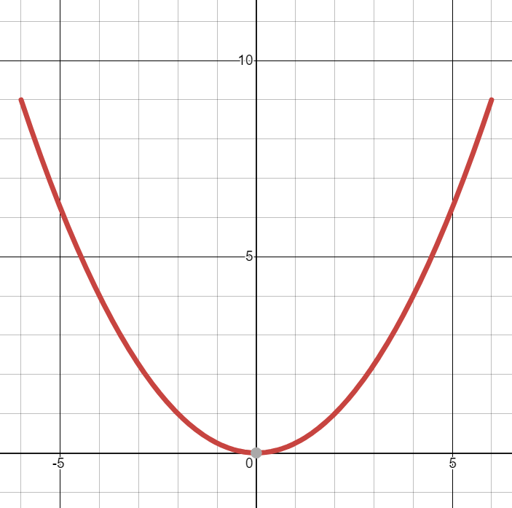
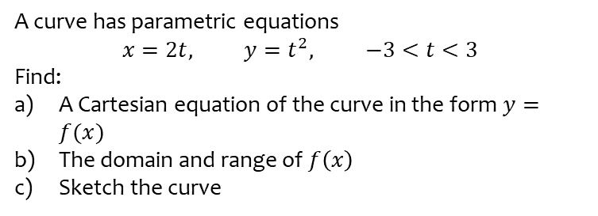
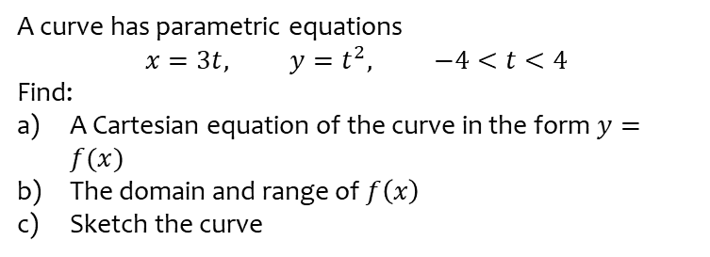
Worked example
Your turn
A curve has parametric equations
$$x=3t, y=t^{2}, −4<t<4$$
Find:
A Cartesian equation of the curve in the form $y=f(x)$
The domain and range of $f\left(x\right)$
Sketch the curve
A curve has parametric equations
$$x=2t, y=t^{2}, −3<t<3$$
Find:
A Cartesian equation of the curve in the form $y=f(x)$
The domain and range of $f\left(x\right)$
Sketch the curve
a) $y=\frac{x^{2}}{4}$
b) Domain: $−6<x<6$
Range: $0≤f(x)<9$
c)
Graphs used with permission from DESMOS: https://www.desmos.com/

Slide 4
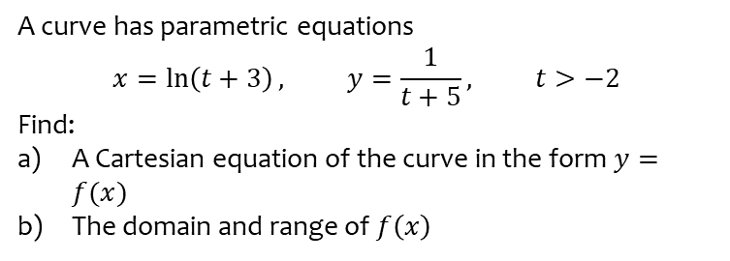
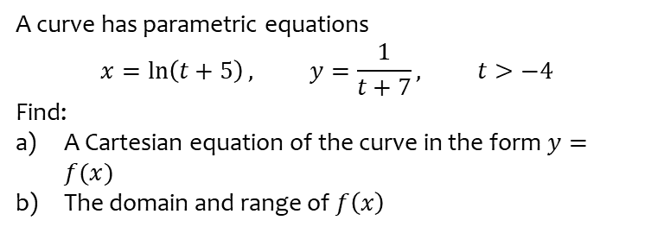
Worked example
Your turn
A curve has parametric equations
$$x=\ln\left(t+5\right), y=\frac{1}{t+7}, t>−4$$
Find:
A Cartesian equation of the curve in the form $y=f(x)$
The domain and range of $f\left(x\right)$
A curve has parametric equations
$$x=\ln\left(t+3\right), y=\frac{1}{t+5}, t>−2$$
Find:
A Cartesian equation of the curve in the form $y=f(x)$
The domain and range of $f\left(x\right)$
a) $y=\frac{1}{e^{x}+2}$
b) Domain: $x>0$
Range: $0<f(x)<\frac{1}{3}$

Slide 5
Worked example
Your turn
A curve has parametric equations
$$x=\ln{t}, y=t^{3}−4, t>0$$
Find:
A Cartesian equation of the curve in the form $y=f(x)$
The domain and range of $f\left(x\right)$
A curve has parametric equations
$$x=\ln{t}, y=t^{2}−1, t>0$$
Find:
A Cartesian equation of the curve in the form $y=f(x)$
The domain and range of $f\left(x\right)$
a) $y=e^{2x}−1$
b) Domain: $x∈ℝ$
Range: $f\left(x\right)>−1$

Slide 6
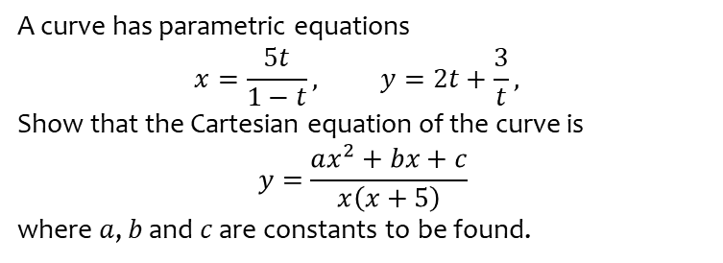
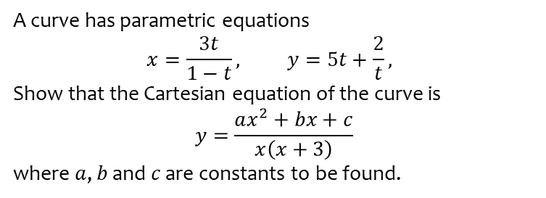
Worked example
Your turn
A curve has parametric equations
$$x=\frac{3t}{1−t}, y=5t+\frac{2}{t},$$
Show that the Cartesian equation of the curve is
$$y=\frac{ax^{2}+bx+c}{x\left(x+3\right)}$$
where $a$, $b$ and $c$ are constants to be found.
A curve has parametric equations
$$x=\frac{5t}{1−t}, y=2t+\frac{3}{t},$$
Show that the Cartesian equation of the curve is
$$y=\frac{ax^{2}+bx+c}{x\left(x+5\right)}$$
where $a$, $b$ and $c$ are constants to be found.
Shown
$$a=5, b=30, c=75$$

Slide 7
8.2) Using trigonometric identities
Chapter CONTENTS

Slide 8
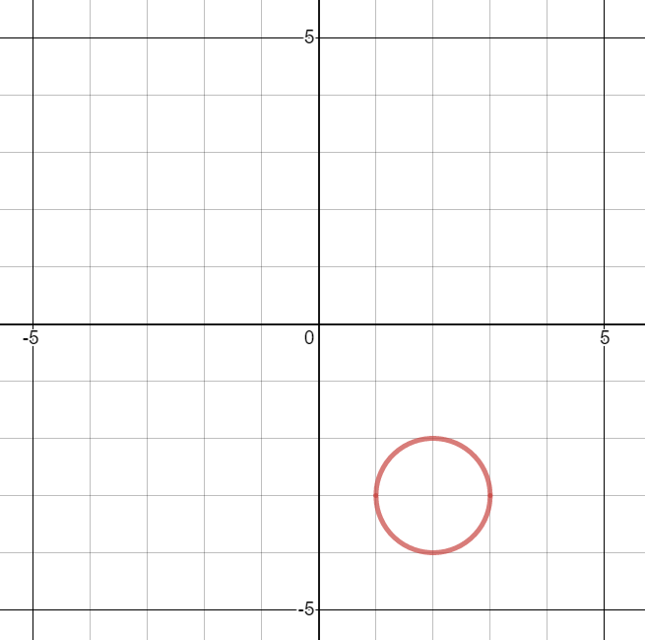
Worked example
Your turn
A curve has parametric equations
$$x=\sin{t}−2\text{, }y=\cos{t}+3\text{, }t∈ℝ$$
Find:
A Cartesian equation of the curve in the form $y=f(x)$
Sketch the curve
A curve has parametric equations
$$x=\sin{t}+2\text{, }y=\cos{t}−3\text{, }t∈ℝ$$
Find:
A Cartesian equation of the curve in the form $y=f(x)$
Sketch the curve
a) ${\left(x−2\right)}^{2}+{\left(y+3\right)}^{2}=1$
b) Circle, radius $1$, centre $(2, −3)$
Graphs used with permission from DESMOS: https://www.desmos.com/

Slide 9
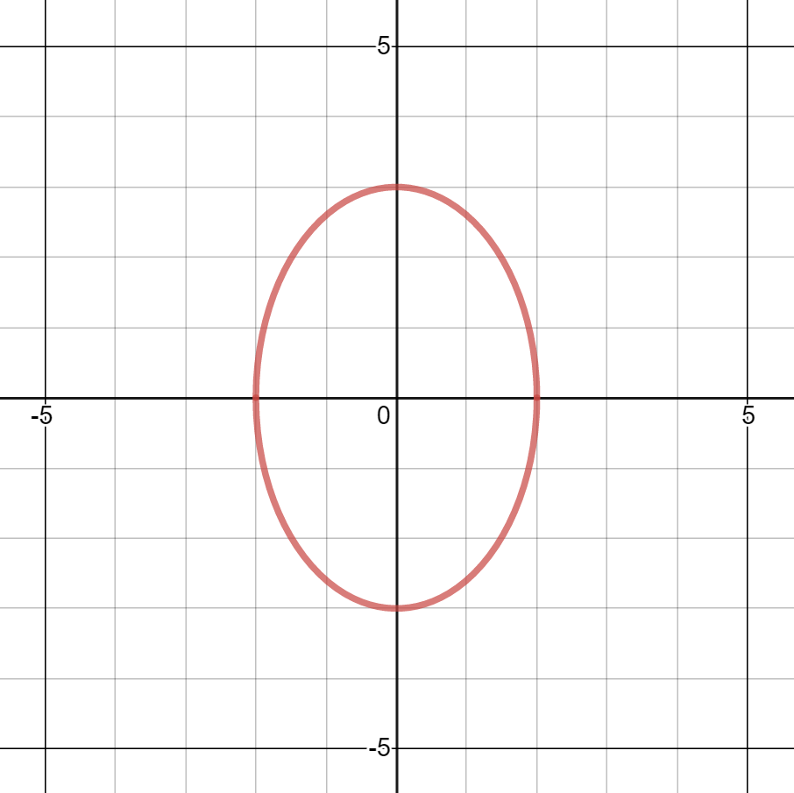
Worked example
Your turn
A curve has parametric equations
$$x=2\sin{t}\text{, }y=3\cos{t}\text{, }t∈ℝ$$
Find a Cartesian equation of the curve in the form $y=f(x)$
A curve has parametric equations
$$x=3\sin{t}\text{, }y=2\cos{t}\text{, }t∈ℝ$$
Find a Cartesian equation of the curve in the form $y=f(x)$
$${\left(\frac{x}{3}\right)}^{2}+{\left(\frac{y}{2}\right)}^{2}=1$$
Graphs used with permission from DESMOS: https://www.desmos.com/

Slide 10
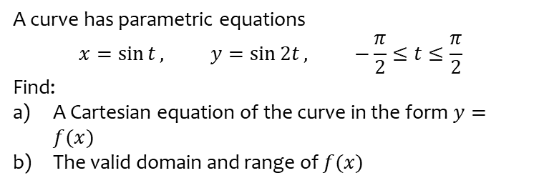
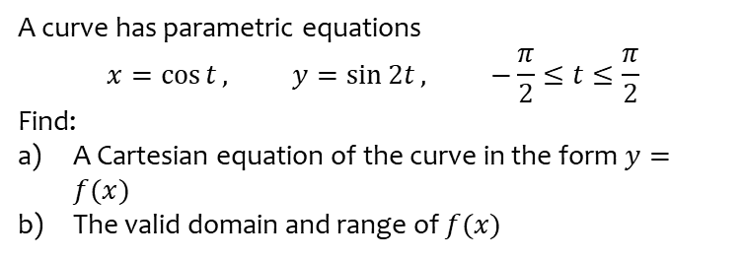
Worked example
Your turn
A curve has parametric equations
$$x=\cos{t}, y=\sin{2t}, −\frac{π}{2}≤t≤\frac{π}{2}$$
Find:
A Cartesian equation of the curve in the form $y=f(x)$
The valid domain and range of $f(x)$
A curve has parametric equations
$$x=\sin{t}, y=\sin{2t}, −\frac{π}{2}≤t≤\frac{π}{2}$$
Find:
A Cartesian equation of the curve in the form $y=f(x)$
The valid domain and range of $f(x)$
a) $y=2x\sqrt{1−x^{2}}$
b) Domain: $−1≤x≤1$
Range: $−1≤f(x)≤1$

Slide 11
Worked example
Your turn
A curve has parametric equations
$$x=4\cos{t}, y=\cos{2t}−1, 0≤t≤π$$
Find a Cartesian equation of the curve in the form
$y=f\left(x\right), −k≤x≤k$, stating the value of the constant $k$
A curve has parametric equations
$$x=2\sin{t}, y=1−\cos{2t}, −\frac{π}{2}≤t≤\frac{π}{2}$$
Find a Cartesian equation of the curve in the form
$y=f\left(x\right), −k≤x≤k$, stating the value of the constant $k$
$y=\frac{x^{2}}{2}, −2≤x≤2$ ($k=2$)

Slide 12
Worked example
Your turn
A curve has parametric equations
$$x=\cot{t}+1, y=cosec^{2} t−3, 0<t<π$$
Find a Cartesian equation of the curve in the form $y=f\left(x\right)$ and state the domain of $x$ for which the curve is defined
A curve has parametric equations
$$x=\cot{t}+2, y=cosec^{2} t−2, 0<t<π$$
Find a Cartesian equation of the curve in the form $y=f\left(x\right)$ and state the domain of $x$ for which the curve is defined
$$y=x^{2}−4x+3, x∈ℝ$$

Slide 13
Worked example
Your turn
A curve has parametric equations
$$x=\sqrt{5}\sin{2t}, y=10\sin^{2}{t}, 0≤t<π$$
Find a Cartesian equation of the curve
A curve has parametric equations
$$x=\sqrt{3}\sin{2t}, y=4\cos^{2}{t}, 0≤t<π$$
Find a Cartesian equation of the curve
$$x^{2}=3y\left(1−\frac{y}{4}\right)$$

Slide 14
Worked example
Your turn
A curve has parametric equations
$$x=2\sin{t}, y=\sin\left(t+\frac{π}{6}\right), −\frac{π}{2}<t<\frac{π}{2}$$
Find a Cartesian equation of the curve in the form $y=f\left(x\right)$ and state the domain of $x$ for which the curve is defined
A curve has parametric equations
$$x=2\cos{t}, y=\sin\left(t−\frac{π}{6}\right), 0<t<π$$
Find a Cartesian equation of the curve in the form $y=f\left(x\right)$ and state the domain of $x$ for which the curve is defined
$$y=\frac{1}{4}\left(\sqrt{12−3x^{2}}−x\right), −2<x<2$$

Slide 15
Worked example
Your turn
A curve has parametric equations
$$x=\tan{t}, y=5 sin\left(t−π\right), 0<t<\frac{π}{2}$$
Find a Cartesian equation of the curve
A curve has parametric equations
$$x=\tan{t}, y=4 sin\left(t+π\right), 0<t<\frac{π}{2}$$
Find a Cartesian equation of the curve
$$x=−\frac{y}{\sqrt{16−y^{2}}}$$

Slide 16
8.3) Curve sketching
Chapter CONTENTS

Slide 17
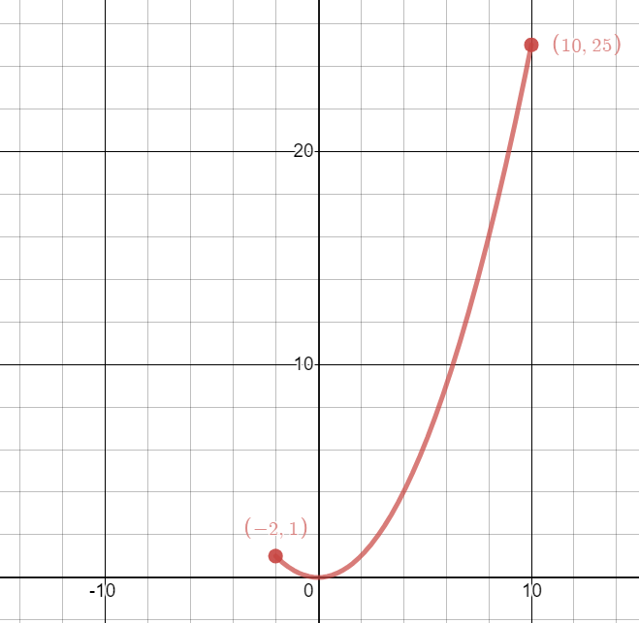
Worked example
Your turn
Draw the curve given by the parametric equations
$$x=3t, y=t^{2}, −5≤t≤1$$
Draw the curve given by the parametric equations
$$x=2t, y=t^{2}, −1≤t≤5$$
$$y=\frac{x^{2}}{4}, −2≤x≤10$$
Graphs used with permission from DESMOS: https://www.desmos.com/

Slide 18
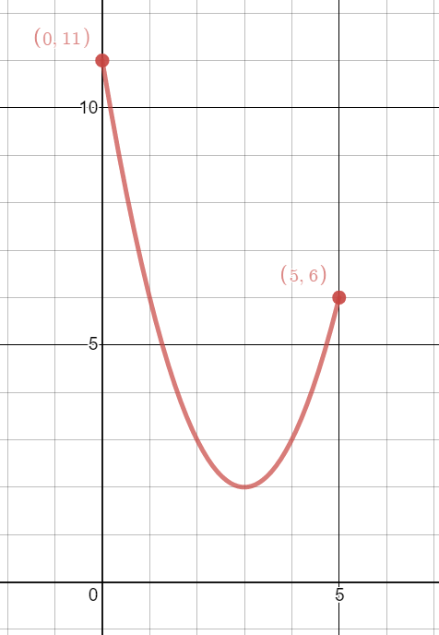
Worked example
Your turn
Draw the curve given by the parametric equations
$$x=2−t, y=t^{2}−3, −3≤t≤2$$
Draw the curve given by the parametric equations
$$x=3−t, y=t^{2}+2, −2≤t≤3$$
$$y=x^{2}−6x+11, 0≤x≤5$$
Graphs used with permission from DESMOS: https://www.desmos.com/

Slide 19
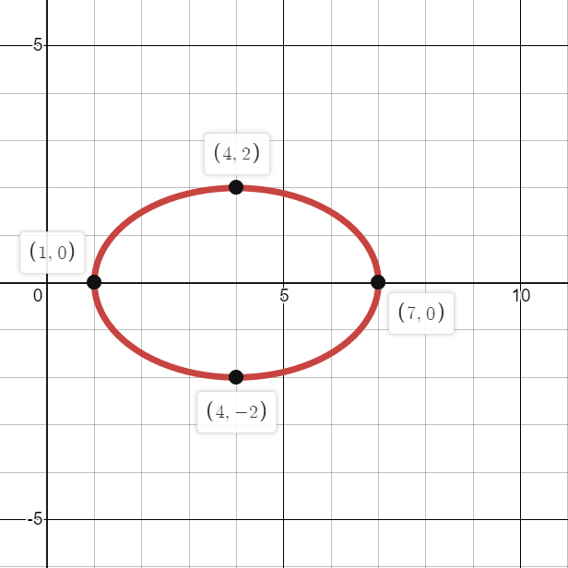
Worked example
Your turn
Draw the curve given by the parametric equations
$$x=2\cos{t}−3, y=4\sin{t}, 0≤t≤2π$$
Draw the curve given by the parametric equations
$$x=3\cos{t}+4, y=2\sin{t}, 0≤t≤2π$$
$${\left(\frac{x−4}{3}\right)}^{2}+{\left(\frac{y}{2}\right)}^{2}=1, 1≤x≤7$$
Graphs used with permission from DESMOS: https://www.desmos.com/

Slide 20
8.4) Points of intersection
Chapter CONTENTS

Slide 21
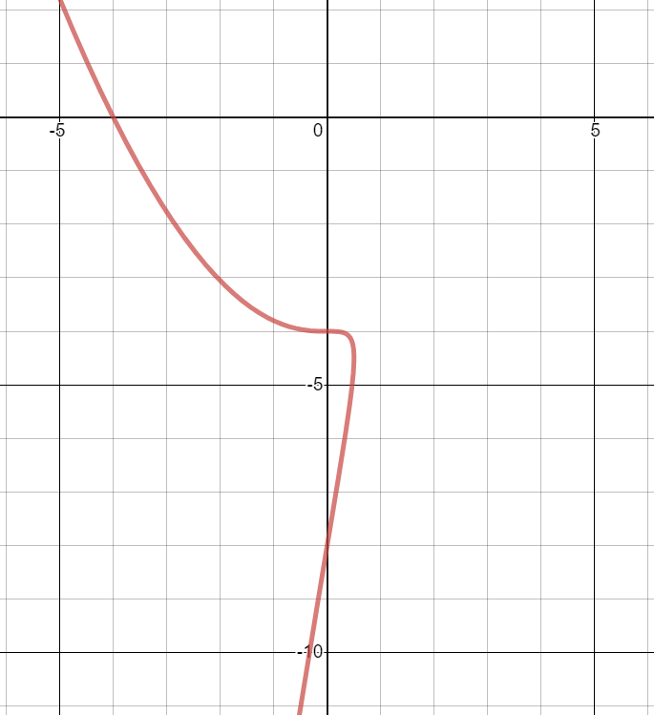
Worked example
Your turn
A curve $C$ is given by the parametric equations
$x=at^{2}+t$, $y=a\left(t^{3}+27\right)$, $t∈ℝ$,
where $a$ is a non-zero constant.
Given that $C$ passes through the point $\left(−6,0\right)$,
a) find the value of $a$.
b) find the coordinates of the points $A$ and $B$ where the curve crosses the $y$-axis.
A curve $C$ is given by the parametric equations
$x=at^{2}+t$, $y=a\left(t^{3}+8\right)$, $t∈ℝ$,
where $a$ is a non-zero constant.
Given that $C$ passes through the point $\left(−4,0\right)$,
a) find the value of $a$.
b) find the coordinates of the points $A$ and $B$ where the curve crosses the $y$-axis.
a) $a=−\frac{1}{2}$
b) $(0,−4)$ and $(0, −8)$
Graphs used with permission from DESMOS: https://www.desmos.com/

Slide 22
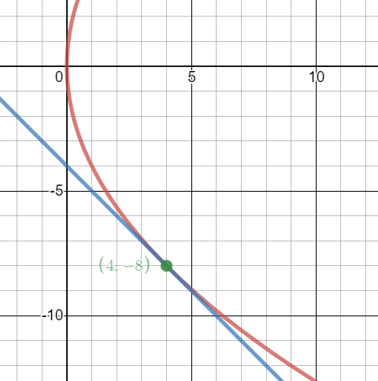
Worked example
Your turn
A curve $C$ is given by the parametric equations
$x=t^{2}, y=2t$, $t∈ℝ$
Find the coordinates of the point(s) of intersection between the curve $C$ and the line $x+y−8=0$
A curve $C$ is given by the parametric equations
$x=t^{2}, y=4t$, $t∈ℝ$
Find the coordinates of the point(s) of intersection between the curve $C$ and the line $x+y+4=0$
$$(4, −8)$$
Graphs used with permission from DESMOS: https://www.desmos.com/

Slide 23
Worked example
Your turn
A curve $C$ is given by the parametric equations
$$x=\cos{t}−\sin{t}, y={\left(t+\frac{π}{6}\right)}^{2}, −\frac{π}{3}<t<\frac{3π}{2}$$
a) Find the point where the curve intersects the line $y=π^{2}$.
b) Find the coordinates of the points where the curve cuts the $y$-axis.
A curve $C$ is given by the parametric equations
$$x=\cos{t}+\sin{t}, y={\left(t−\frac{π}{6}\right)}^{2}, −\frac{π}{2}<t<\frac{4π}{3}$$
a) Find the point where the curve intersects the line $y=π^{2}$.
b) Find the coordinates of the points where the curve cuts the $y$-axis.
a) $\left(−\frac{1+\sqrt{3}}{2},π^{2}\right)$
b) $\left(0,\frac{25π^{2}}{144}\right)$ and $\left(0,\frac{49π^{2}}{144}\right)$

Slide 24
Worked example
Your turn
A curve $C$ is given by the parametric equations
$$x=1−\frac{1}{3}t, y=3^{t}−1, t∈ℝ$$
Find the coordinates of the $x$ and $y$intercepts
A curve $C$ is given by the parametric equations
$$x=1−\frac{1}{2}t, y=2^{t}−1, t∈ℝ$$
Find the coordinates of the $x$ and $y$intercepts
$(0, 3)$ and $(1, 0)$

Slide 25
Worked example
Your turn
A curve $C$ is given by the parametric equations
$$x=e^{3t}, y=e^{t}+1, t∈ℝ$$
A straight line $l$ passes through the points $A$ and $B$ where $t=\ln{3}$ and $t=\ln{4}$respectively.
Find an equation for $l$ in the form $ax+by+c=0$
A curve $C$ is given by the parametric equations
$$x=e^{2t}, y=e^{t}−1, t∈ℝ$$
A straight line $l$ passes through the points $A$ and $B$ where $t=\ln{2}$ and $t=\ln{3}$respectively.
Find an equation for $l$ in the form $ax+by+c=0$
$$x−5y+1=0$$

Slide 26
8.5) Modelling with parametric equations
Chapter CONTENTS

Slide 27
Worked example
Your turn
A plane’s position at time $t$ seconds after take-off can be modelled with the following parametric equations:
$$x=\left(v\cos{θ}\right)t m, y=\left(v\sin{θ}\right)t m, t>0$$
where $v$ is the speed of the plane, $θ$ is the angle of elevation of its path, $x$ is the horizontal distance travelled and $y$ is the vertical distance travelled, relative to a fixed origin.
When the plane has travelled 500m horizontally, it has climbed 125m.
Given that the plane’s speed is 40 m s⁻¹
a) find the parametric equations for the plane’s motion.
b) find the vertical height of the plane after 20 seconds.
c) show that the plane’s motion is a straight line.
d) explain why the domain of $t$, $t>0$, is not realistic.
A plane’s position at time $t$ seconds after take-off can be modelled with the following parametric equations:
$$x=\left(v\cos{θ}\right)t m, y=\left(v\sin{θ}\right)t m, t>0$$
where $v$ is the speed of the plane, $θ$ is the angle of elevation of its path, $x$ is the horizontal distance travelled and $y$ is the vertical distance travelled, relative to a fixed origin.
When the plane has travelled 600m horizontally, it has climbed 120m.
Given that the plane’s speed is 50 m s⁻¹,
a) find the parametric equations for the plane’s motion.
b) find the vertical height of the plane after 10 seconds.
c) show that the plane’s motion is a straight line.
a) $x=49.0t, y=9.80t$ (3 sf)
b) $98 m$
c) $y=\frac{1}{5}x$ which is linear

Slide 28
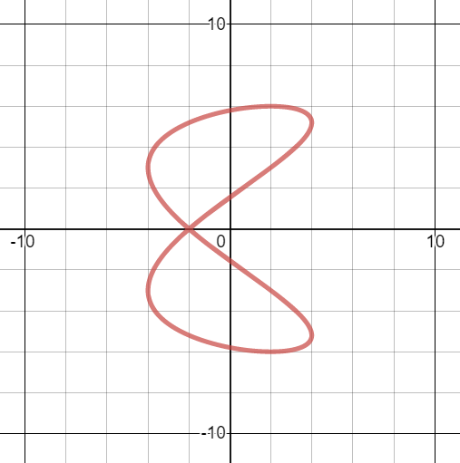
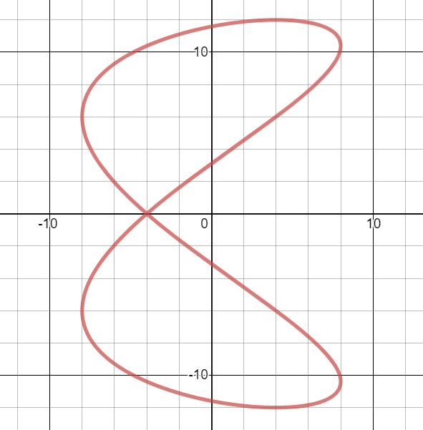
Worked example
Your turn
The motion of a figure skater relative to a fixed origin, $O$, at time $t$ minutes is modelled using the parametric equations
$$x=4\cos{10t}, y=6\sin\left(5t−\frac{π}{3}\right), t≥0$$
where $x$ and $y$ are measured in metres.
Find the coordinates of the figure skater at the beginning of his motion.
Find the coordinates of the point where the figure skater intersects his own path.
Find the coordinates of the points where the path of the figure skater crosses the $y$-axis.
Determine how long it takes the figure skater to complete one complete figure-of-eight motion.
The motion of a figure skater relative to a fixed origin, $O$, at time $t$ minutes is modelled using the parametric equations
$$x=8\cos{20t}, y=12\sin\left(10t−\frac{π}{3}\right), t≥0$$
where $x$ and $y$ are measured in metres.
Find the coordinates of the figure skater at the beginning of his motion.
Find the coordinates of the point where the figure skater intersects his own path.
Find the coordinates of the points where the path of the figure skater crosses the $y$-axis.
Determine how long it takes the figure skater to complete one complete figure-of-eight motion.
a) $t=0, x=8, y=−6\sqrt{3}$
b) $(−4, 0)$
c) $\left(0,−3.11\right), \left(0,11.59\right), \left(0,3.11\right),\left(0,−11.59\right)$ (2 dp)
d) $\frac{π}{5}$ minutes $=37.7$ seconds (1 dp)
Graphs used with permission from DESMOS: https://www.desmos.com/

Slide 29
Worked example
Your turn
A stone is thrown from the top of a $50 m$ high cliff with an initial speed of $5 ms^{−1}$ at an angle of $30°$ above the horizontal. Its position after $t$ seconds can be described using the parametric equations
$$x=\frac{5\sqrt{3}}{2}t m, y=\left(−4.9t^{2}+\frac{5\sqrt{3}}{2}t+50\right)m, 0≤t≤k$$
where $x$ is the horizontal distance, $y$ is the vertical distance from the ground and $k$ is a constant.
Given that the model is valid from the time the stone is thrown to the time it hits the ground,
find the value of $k$
find the horizontal distance travelled by the stone once it hits the ground
A stone is thrown from the top of a $25 m$ high cliff with an initial speed of $5 ms^{−1}$ at an angle of $45°$ above the horizontal. Its position after $t$ seconds can be described using the parametric equations
$$x=\frac{5\sqrt{2}}{2}t m, y=\left(−4.9t^{2}+\frac{5\sqrt{2}}{2}t+25\right)m, 0≤t≤k$$
where $x$ is the horizontal distance, $y$ is the vertical distance from the ground and $k$ is a constant.
Given that the model is valid from the time the stone is thrown to the time it hits the ground,
find the value of $k$
find the horizontal distance travelled by the stone once it hits the ground
a) $k=2.65$ (2 dp)
b) $9.36 m$ (2 dp)

