Slide 1
Modelling with
Differential Equations
Twitter: @Owen134866
www.mathsfreeresourcelibrary.com

Slide 2
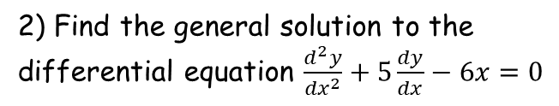
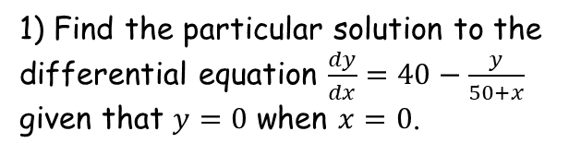


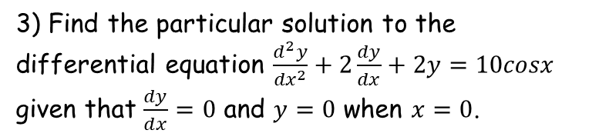
Prior Knowledge Check
1) Find the particular solution to the differential equation $\frac{dy}{dx}=40−\frac{y}{50+x}$ given that $y=0$ when $x=0$.
3) Find the particular solution to the differential equation $\frac{d^{2}y}{{dx}^{2}}+2\frac{dy}{dx}+2y=10cosx$ given that $\frac{dy}{dx}=0$ and $y=0$ when $x=0$.
$$y=\frac{20x^{2}+2000x}{x+50}$$
$$y=4sinx+2cosx+e^{−x}\left(−2cosx−6sinx\right)$$
2) Find the general solution to the differential equation $\frac{d^{2}y}{{dx}^{2}}+5\frac{dy}{dx}−6x=0$
$$y={Ae}^{−6x}+B$$

Slide 3
Teachings for
Exercise 8A

Slide 4
Modelling with Differential Equations
You need to be able to model and work with first-order differential equations in practical situations
Most of this chapter you will be answering questions related to mechanics
Some of the problems in this section you may also be able to solve using processes you have already seen, but it is important to see the link to differential equations
8A

Slide 5





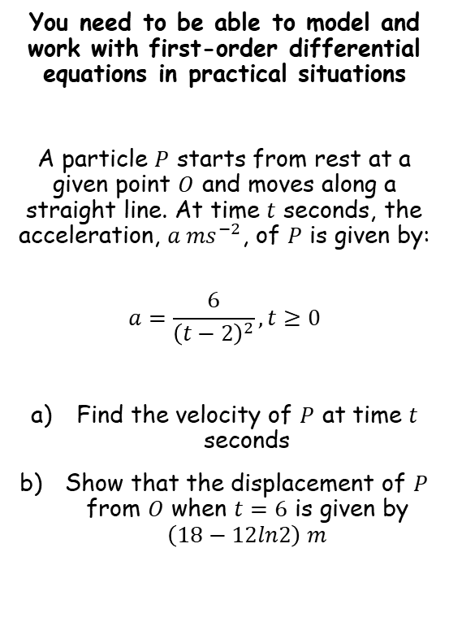
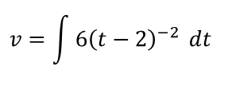

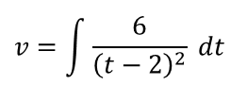



Modelling with Differential Equations
$$a=\frac{6}{{\left(t−2\right)}^{2}}$$
You need to be able to model and work with first-order differential equations in practical situations
A particle $P$ starts from rest at a given point $O$ and moves along a straight line. At time $t$ seconds, the acceleration, $a {ms}^{−2}$, of $P$ is given by:
$$a=\frac{6}{{\left(t−2\right)}^{2}},t≥0$$
Find the velocity of $P$ at time $t$ seconds
Show that the displacement of $P$ from $O$ when $t=6$ is given by $\left(18−12ln2\right) m$
Acceleration is the rate of change of velocity with respect to time
$$\frac{dv}{dt}=\frac{6}{{\left(t−2\right)}^{2}}$$
Integrate both sides with respect to $t$
$$v=\int{\frac{6}{{\left(t−2\right)}^{2}}} dt$$
Rewrite
$$v=\int{6{\left(t−2\right)}^{−2}} dt$$
Integrate
$$v=−\frac{6}{t+2}+c$$
When $t=0$, $v=0$
$$0=−\frac{6}{0+2}+c$$
Calculate $c$
$$3=c$$
Now we know the full relationship
$$v=−\frac{6}{t+2}+3$$
8A

Slide 6



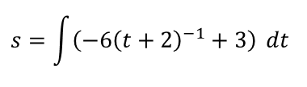

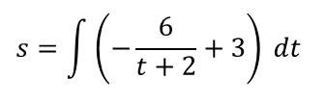





Modelling with Differential Equations
$$v=−\frac{6}{t+2}+3$$
You need to be able to model and work with first-order differential equations in practical situations
A particle $P$ starts from rest at a given point $O$ and moves along a straight line. At time $t$ seconds, the acceleration, $a {ms}^{−2}$, of $P$ is given by:
$$a=\frac{6}{{\left(t−2\right)}^{2}},t≥0$$
Find the velocity of $P$ at time $t$ seconds
Show that the displacement of $P$ from $O$ when $t=6$ is given by $\left(18−12ln2\right) m$
Velocity is the rate of change of displacement with respect to time
$$\frac{ds}{dt}=−\frac{6}{t+2}+3$$
Integrate both sides with respect to $t$
$$s=\int{\left(−\frac{6}{t+2}+3\right)} dt$$
Rewrite
$$s=\int{\left(−6{\left(t+2\right)}^{−1}+3\right)} dt$$
Integrate using whatever techniques you need
$$s=−6ln\left(t+2\right)+3t+c$$
When $t=0$, $s=0$
$$0=−6ln2+c$$
Rearrange
$$6ln2=c$$
We now have the full relationship!
$$s=−6ln\left(t+2\right)+3t+6ln2$$
$$v=−\frac{6}{t+2}+3$$
8A

Slide 7






Modelling with Differential Equations
$$s=−6ln\left(t+2\right)+3t+6ln2$$
You need to be able to model and work with first-order differential equations in practical situations
A particle $P$ starts from rest at a given point $O$ and moves along a straight line. At time $t$ seconds, the acceleration, $a {ms}^{−2}$, of $P$ is given by:
$$a=\frac{6}{{\left(t−2\right)}^{2}},t≥0$$
Find the velocity of $P$ at time $t$ seconds
Show that the displacement of $P$ from $O$ when $t=6$ is given by $\left(18−12ln2\right) m$
Let $t=6$
$$s=−6ln\left(8\right)+3(6)+6ln2$$
Write as a power
$$s=−6ln2^{3}+3(6)+6ln2$$
Use the power law
$$s=−18ln2+18+6ln2$$
Simplify
$$s=18−12ln2$$
$$v=−\frac{6}{t+2}+3$$
8A

Slide 8


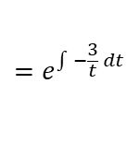

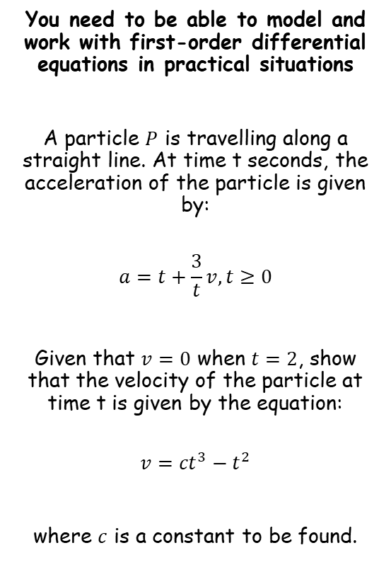
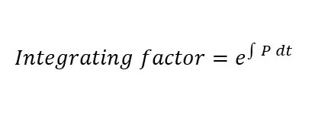





Modelling with Differential Equations
You need to be able to model and work with first-order differential equations in practical situations
A particle $P$ is travelling along a straight line. At time t seconds, the acceleration of the particle is given by:
$$a=t+\frac{3}{t}v, t≥0$$
Given that $v=0$ when $t=2$, show that the velocity of the particle at time t is given by the equation:
$$v={ct}^{3}−t^{2}$$
where $c$ is a constant to be found.
$$a=t+\frac{3}{t}v$$
Rewrite acceleration as a differential
$$\frac{dv}{dt}=t+\frac{3}{t}v$$
Subtract $\frac{3}{t}v$ from both sides
$$\frac{dv}{dt}−\frac{3}{t}v=t$$
Notice that this is the form of a first-order differential equation
➔ We need to find the integrating factor so that we can use the reverse of the product rule…
$$Integrating factor=e^{\int{P} dt}$$
Replace $P$ (the coefficient of $v$ in this case)
$$=e^{\int{−\frac{3}{t}} dt}$$
Integrate
$$=e^{−3lnt}$$
Use the power law
$$=e^{lnt^{−3}}$$
Simplify
$$=t^{−3}$$
8A

Slide 9











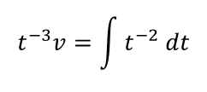

Modelling with Differential Equations
You need to be able to model and work with first-order differential equations in practical situations
A particle $P$ is travelling along a straight line. At time t seconds, the acceleration of the particle is given by:
$$a=t+\frac{3}{t}v, t≥0$$
Given that $v=0$ when $t=2$, show that the velocity of the particle at time t is given by the equation:
$$v={ct}^{3}−t^{2}$$
where $c$ is a constant to be found.
$$a=t+\frac{3}{t}v$$
Rewrite acceleration as a differential
$$\frac{dv}{dt}=t+\frac{3}{t}v$$
Subtract $\frac{3}{t}v$ from both sides
$$\frac{dv}{dt}−\frac{3}{t}v=t$$
Multiply all by $t^{−3}$
$$t^{−3}\frac{dv}{dt}−3t^{−2}v=t^{−2}$$
→ We now have the pattern we need!
Write the left side as a differential
$$\frac{d}{dt}\left(t^{−3}v\right)=t^{−2}$$
Integrate both sides with respect to $t$
$$t^{−3}v=\int{t^{−2} dt}$$
Integrate right side
$$t^{−3}v=−t^{−1}+c$$
Multiply by $t^{3}$
$$v=−t^{2}+ct^{3}$$
When $t=2$, $v=0$
$$v=\frac{1}{2}t^{3}−t^{2}$$
$$0=−{(2)}^{2}+c{(2)}^{3}$$
$$\frac{1}{2}=c$$
Calculate $c$
8A

Slide 10

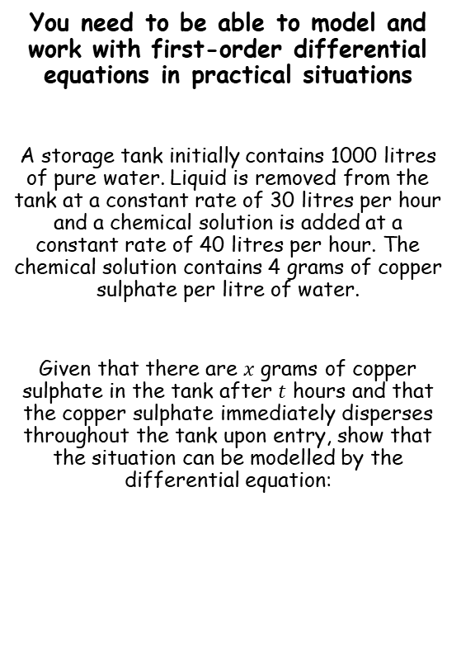

Modelling with Differential Equations
$$\frac{dx}{dt}=160−\frac{3x}{100+t}$$
You need to be able to model and work with first-order differential equations in practical situations
A storage tank initially contains 1000 litres of pure water. Liquid is removed from the tank at a constant rate of 30 litres per hour and a chemical solution is added at a constant rate of 40 litres per hour. The chemical solution contains 4 grams of copper sulphate per litre of water.
Given that there are $x$ grams of copper sulphate in the tank after $t$ hours and that the copper sulphate immediately disperses throughout the tank upon entry, show that the situation can be modelled by the differential equation:
We are being asked to find a relationship for the rate of change of copper sulphate in the tank
This will depend on the amount of copper sulphate being added to the tank
As well as the amount leaving the tank (which will have been mixed with the water in there already)
So we need to find relationships for the above…
$$\frac{dx}{dt}=160−\frac{3x}{100+t}, t≥0$$
8A

Slide 11
Modelling with Differential Equations
You need to be able to model and work with first-order differential equations in practical situations
A storage tank initially contains 1000 litres of pure water. Liquid is removed from the tank at a constant rate of 30 litres per hour and a chemical solution is added at a constant rate of 40 litres per hour. The chemical solution contains 4 grams of copper sulphate per litre of water.
Given that there are $x$ grams of copper sulphate in the tank after $t$ hours and that the copper sulphate immediately disperses throughout the tank upon entry, show that the situation can be modelled by the differential equation:
Amount of copper sulphate being added
40 litres of solution is added per hour, and the copper sulphate is 4 grams per litre
→ So 160 grams is being added per hour
$$\frac{dx}{dt}=160−\frac{3x}{100+t}, t≥0$$
Added copper sulphate per hour = 160g
8A

Slide 12

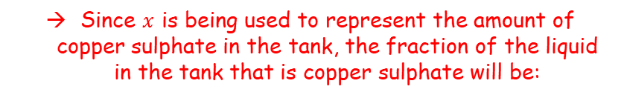


Modelling with Differential Equations
You need to be able to model and work with first-order differential equations in practical situations
A storage tank initially contains 1000 litres of pure water. Liquid is removed from the tank at a constant rate of 30 litres per hour and a chemical solution is added at a constant rate of 40 litres per hour. The chemical solution contains 4 grams of copper sulphate per litre of water.
Given that there are $x$ grams of copper sulphate in the tank after $t$ hours and that the copper sulphate immediately disperses throughout the tank upon entry, show that the situation can be modelled by the differential equation:
Amount of copper sulphate being lost
We need to know what fraction of the liquid in the tank is made up of copper sulphate
So we need to know how much liquid is in the tank at a given time
Amount of solution being added
Amount of liquid being removed
$$=1000+40t−30t$$
$$=1000+10t$$
Since $x$ is being used to represent the amount of copper sulphate in the tank, the fraction of the liquid in the tank that is copper sulphate will be:
$$\frac{dx}{dt}=160−\frac{3x}{100+t}, t≥0$$
Added copper sulphate per hour = 160g
$$\frac{x}{1000+10t}$$
8A

Slide 13



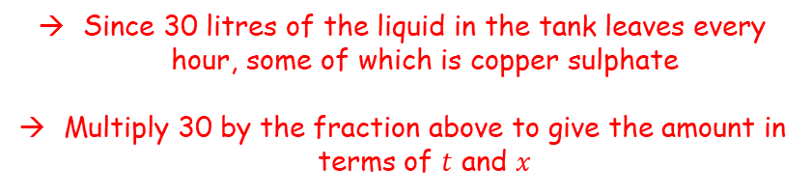
Modelling with Differential Equations
You need to be able to model and work with first-order differential equations in practical situations
A storage tank initially contains 1000 litres of pure water. Liquid is removed from the tank at a constant rate of 30 litres per hour and a chemical solution is added at a constant rate of 40 litres per hour. The chemical solution contains 4 grams of copper sulphate per litre of water.
Given that there are $x$ grams of copper sulphate in the tank after $t$ hours and that the copper sulphate immediately disperses throughout the tank upon entry, show that the situation can be modelled by the differential equation:
Amount of copper sulphate being lost
$$Fraction of copper sulphate in the tank=\frac{x}{1000+10t}$$
Since 30 litres of the liquid in the tank leaves every hour, some of which is copper sulphate
Multiply 30 by the fraction above to give the amount in terms of $t$ and $x$
Lost copper sulphate per hour =
$$30×\frac{x}{1000+10t}$$
$$=\frac{3x}{100+t}$$
$$\frac{dx}{dt}=160−\frac{3x}{100+t}, t≥0$$
Added copper sulphate per hour = 160g
Lost copper sulphate per hour = $\frac{3x}{100+t}$ g
8A

Slide 14


Modelling with Differential Equations
You need to be able to model and work with first-order differential equations in practical situations
A storage tank initially contains 1000 litres of pure water. Liquid is removed from the tank at a constant rate of 30 litres per hour and a chemical solution is added at a constant rate of 40 litres per hour. The chemical solution contains 4 grams of copper sulphate per litre of water.
Given that there are $x$ grams of copper sulphate in the tank after $t$ hours and that the copper sulphate immediately disperses throughout the tank upon entry, show that the situation can be modelled by the differential equation:
Change in the amount of copper sulphate in the tank per hour
$$\frac{dx}{dt}=Amount added per hour −amount lost per hour$$
Replace
$$\frac{dx}{dt}=160−\frac{3x}{100+t}$$
$$\frac{dx}{dt}=160−\frac{3x}{100+t}, t≥0$$
Added copper sulphate per hour = 160g
Lost copper sulphate per hour = $\frac{3x}{100+t}$ g
8A

Slide 15
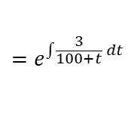
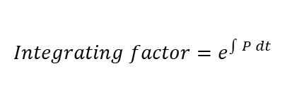








Modelling with Differential Equations
You need to be able to model and work with first-order differential equations in practical situations
A storage tank initially contains 1000 litres of pure water. Liquid is removed from the tank at a constant rate of 30 litres per hour and a chemical solution is added at a constant rate of 40 litres per hour. The chemical solution contains 4 grams of copper sulphate per litre of water.
Hence, find the number of grams of copper sulphate in the tank after 6 hours.
→ When you have the variables mixed up like above, you will often need to use an integrating factor to create the product rule pattern (as in the previous question)
$$\frac{dx}{dt}=160−\frac{3x}{100+t}$$
Add $\frac{3x}{100+t}$
$$\frac{dx}{dt}+\frac{3x}{100+t}=160$$
Rewrite if it helps!
$$\frac{dx}{dt}+\frac{3}{100+t}x=160$$
Now we have the pattern for the product rule, we need to find the integrating factor to make it work!
$$\frac{dx}{dt}=160−\frac{3x}{100+t}, t≥0$$
$$Integrating factor=e^{\int{P} dt}$$
Replace $P$ (the coefficient of $x$ in this case)
$$=e^{\int{\frac{3}{100+t}} dt}$$
Integrate
$$=e^{3ln⁡(100+t)}$$
Use the power law
$$=e^{ln{\left(100+t\right)}^{3}}$$
Simplify
$$={(100+t)}^{3}$$
8A

Slide 16








Modelling with Differential Equations
You need to be able to model and work with first-order differential equations in practical situations
A storage tank initially contains 1000 litres of pure water. Liquid is removed from the tank at a constant rate of 30 litres per hour and a chemical solution is added at a constant rate of 40 litres per hour. The chemical solution contains 4 grams of copper sulphate per litre of water.
Hence, find the number of grams of copper sulphate in the tank after 6 hours.
→ When you have the variables mixed up like above, you will often need to use an integrating factor to create the product rule pattern (as in the previous question)
$$\frac{dx}{dt}=160−\frac{3x}{100+t}$$
Add $\frac{3x}{100+t}$
$$\frac{dx}{dt}+\frac{3x}{100+t}=160$$
Rewrite if it helps!
$$\frac{dx}{dt}+\frac{3}{100+t}x=160$$
Multiply by ${(100+t)}^{3}$
$${\left(100+t\right)}^{3}\frac{dx}{dt}+3{\left(100+t\right)}^{2}x=160{\left(100+t\right)}^{3}$$
Write as a differential
$$\frac{d}{dt}\left({\left(100+t\right)}^{3}x\right)=160{\left(100+t\right)}^{3}$$
$$\frac{dx}{dt}=160−\frac{3x}{100+t}, t≥0$$
Integrate with respect to $t$
$${\left(100+t\right)}^{3}x=\int{160{\left(100+t\right)}^{3} dt}$$
Integrate
$${\left(100+t\right)}^{3}x=40{\left(100+t\right)}^{4}+c$$
Divide by${(100+t)}^{3}$
$$x=40(100+t)+\frac{c}{{\left(100+t\right)}^{3}}$$
Now we need to find the value of $c$…
8A

Slide 17






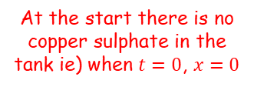

Modelling with Differential Equations
You need to be able to model and work with first-order differential equations in practical situations
A storage tank initially contains 1000 litres of pure water. Liquid is removed from the tank at a constant rate of 30 litres per hour and a chemical solution is added at a constant rate of 40 litres per hour. The chemical solution contains 4 grams of copper sulphate per litre of water.
Hence, find the number of grams of copper sulphate in the tank after 6 hours.
→ When you have the variables mixed up like above, you will often need to use an integrating factor to create the product rule pattern (as in the previous question)
$$x=40(100+t)+\frac{c}{{\left(100+t\right)}^{3}}$$
At the start there is no copper sulphate in the tank ie) when $t=0$, $x=0$
$$0=40(100)+\frac{c}{{\left(100\right)}^{3}}$$
Calculate
$$c=−4,000,000,000$$
We now have the full formula
$$x=40\left(100+t\right)−\frac{4,000,000,000}{{\left(100+t\right)}^{3}}$$
Let $t=6$
$$\frac{dx}{dt}=160−\frac{3x}{100+t}, t≥0$$
$$x=40\left(100+6\right)−\frac{4,000,000,000}{{\left(100+6\right)}^{3}}$$
Calculate
$$x=882 grams$$
8A

Slide 18
Modelling with Differential Equations
You need to be able to model and work with first-order differential equations in practical situations
A storage tank initially contains 1000 litres of pure water. Liquid is removed from the tank at a constant rate of 30 litres per hour and a chemical solution is added at a constant rate of 40 litres per hour. The chemical solution contains 4 grams of copper sulphate per litre of water.
Suggest a possible refinement for the model
→ The model could be refined so that the copper sulphate does not immediately disperse upon entering the tank (which is unrealistic)
$$\frac{dx}{dt}=160−\frac{3x}{100+t}, t≥0$$
8A

Slide 19
Teachings for
Exercise 8B

Slide 20
Modelling with Differential Equations
a
You can solve problems about a particle which is moving in a straight line with simple harmonic motion
Simple harmonic motion is motion where the acceleration of a particle P is always directed towards a single fixed point which is on the line of motion of P.
It creates an oscillating pattern around a fixed centre.
Let’s look at a diagram. Imagine that left to right is the positive direction…
P
On this side:
Displacement = positive
Acceleration = negative
a
P
On this side:
Displacement = negative
Acceleration = positive
The acceleration is always directed towards the centre point, and increases in size as the distance does
So if the particle is further from the centre, the acceleration towards the centre will be larger
As is passes through the centre, the acceleration changes direction
8B

Slide 21





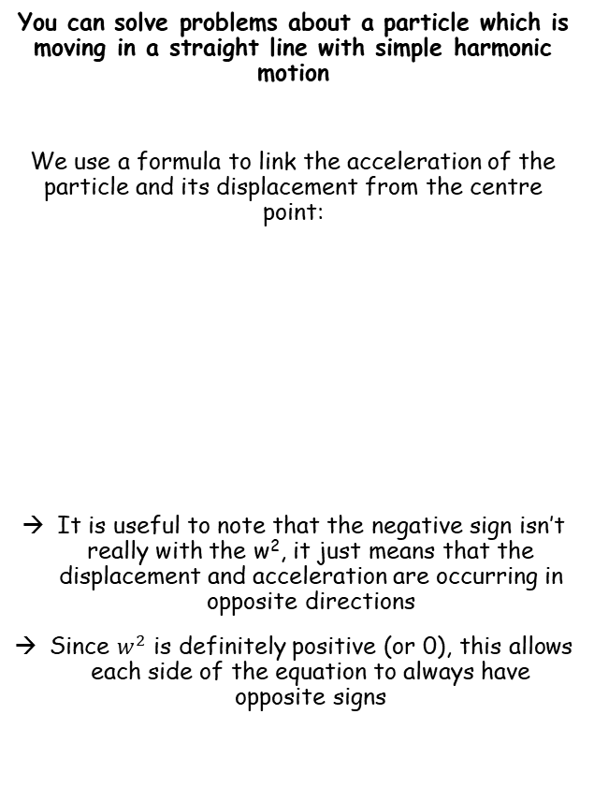








Modelling with Differential Equations
$$\ddot{x}=−w^{2}x$$
Dot notation is Isaac Newton’s notation for calculus, and is often still used in Physics…
You can solve problems about a particle which is moving in a straight line with simple harmonic motion
We use a formula to link the acceleration of the particle and its displacement from the centre point:
It is useful to note that the negative sign isn’t really with the w², it just means that the displacement and acceleration are occurring in opposite directions
Since $w^{2}$ is definitely positive (or 0), this allows each side of the equation to always have opposite signs
$$x$$
Differentiate once
$$\frac{dx}{dt}$$
$$=\dot{x}$$
$$=v$$
$$\ddot{x}=−w^{2}x$$
Differentiate again
$$\frac{d^{2}x}{dt^{2}}$$
$$=\ddot{x}$$
$$=a$$
Acceleration, in Newton’s notation
The letter w is a constant dependent on the question
The value x is the displacement
You can also use the chain rule to write equivalent expressions like this…
$$\ddot{x}=\frac{dv}{dt}$$
Write the right side using the chain rule
$$=\frac{dv}{dx}×\frac{dx}{dt}$$
Remember that $\frac{dx}{dt}=v$
We will use this on the next slide…
$$=v\frac{dv}{dx}$$
8B

Slide 22











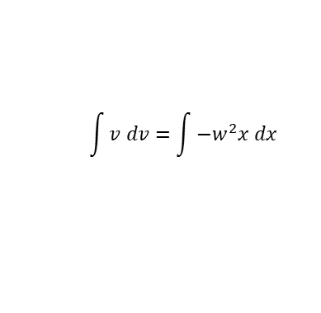
Modelling with Differential Equations
$$v^{2}=w^{2}\left(a^{2}−x^{2}\right)$$
$$\ddot{x}=−w^{2}x$$
$$\ddot{x}=−w^{2}x$$
You can solve problems about a particle which is moving in a straight line with simple harmonic motion
The equation we just saw links the acceleration and the displacement of a particle moving with simple harmonic motion
We can manipulate this equation to create links between other variables…
Replace $\ddot{x}$ with $v\frac{dv}{dx}$
$$v\frac{dv}{dx}=−w^{2}x$$
Multiply by dx
$$v dv=−w^{2}x dx$$
$$\int{v dv}=\int{−w^{2}x dx }$$
Take Integrals of both sides
Integrate each side
$$\frac{1}{2}v^{2}=−\frac{1}{2}w^{2}x^{2}+C$$
Let the maximum displacement be ‘a’. At this point, the velocity is 0 as it is changing direction
P
$$\frac{1}{2}{(0)}^{2}=−\frac{1}{2}w^{2}{(a)}^{2}+C$$
At a, the maximum displacement, v = 0 as the direction of movement changes
Calculate C
$$C=\frac{1}{2}w^{2}a^{2}$$
Replace C in the equation from before
$$\frac{1}{2}v^{2}=−\frac{1}{2}w^{2}x^{2}+\frac{1}{2}w^{2}a^{2}$$
Multiply by 2
$$v^{2}=−w^{2}x^{2}+w^{2}a^{2}$$
This is another important relationship to remember!
Factorise the right side
$$v^{2}=w^{2}\left(a^{2}−x^{2}\right)$$
8B

Slide 23


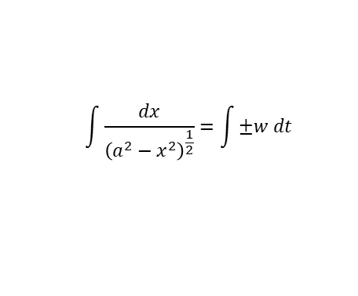






Modelling with Differential Equations
$$v^{2}=w^{2}\left(a^{2}−x^{2}\right)$$
$$\ddot{x}=−w^{2}x$$
You can solve problems about a particle which is moving in a straight line with simple harmonic motion
There is one further manipulation we can do:
So far we have a formula linking the acceleration and displacement
And we have one linking velocity and displacement
However, we might want to know the displacement at a given time, and hence we need a relationship between displacement and time
$$v^{2}=w^{2}\left(a^{2}−x^{2}\right)$$
Square root both sides
$$v=±w{\left(a^{2}−x^{2}\right)}^{\frac{1}{2}}$$
Write v as ^{dx}/_{dt} (this brings t into the equation)
$$\frac{dx}{dt}=±w{\left(a^{2}−x^{2}\right)}^{\frac{1}{2}}$$
Multiply by dt
$$dx=±w{\left(a^{2}−x^{2}\right)}^{\frac{1}{2}} dt$$
Divide by the whole bracket on the right
$$\frac{1}{{\left(a^{2}−x^{2}\right)}^{\frac{1}{2}}} dx=±w dt$$
$$\ddot{x}=−w^{2}x$$
The left side can be written with dx as the numerator
$$\frac{dx}{{\left(a^{2}−x^{2}\right)}^{\frac{1}{2}}}=±w dt$$
Take Integrals of both sides
$$v^{2}=w^{2}\left(a^{2}−x^{2}\right)$$
$$\int{\frac{dx}{{\left(a^{2}−x^{2}\right)}^{\frac{1}{2}}}}=\int{±w dt }$$
To Integrate the left side, we will need to use a substitution
8B

Slide 24

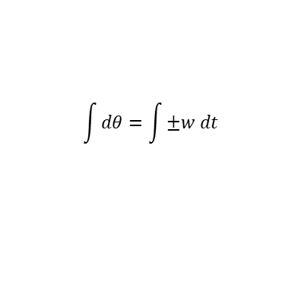

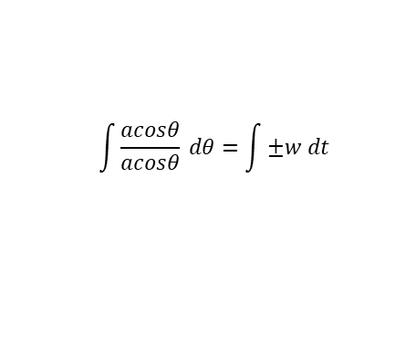


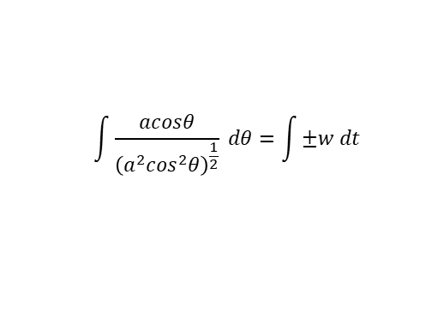
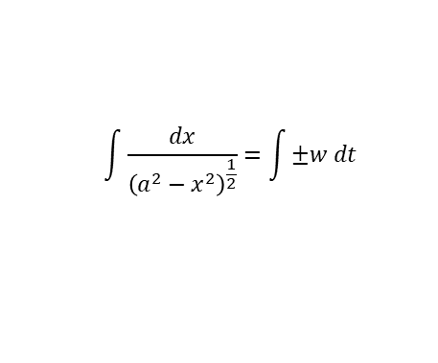

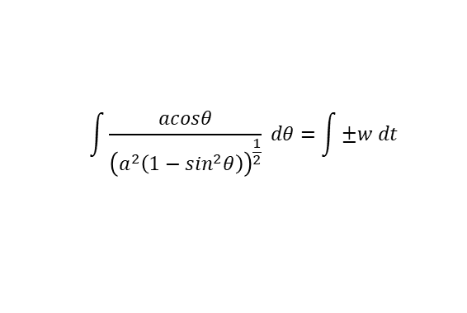
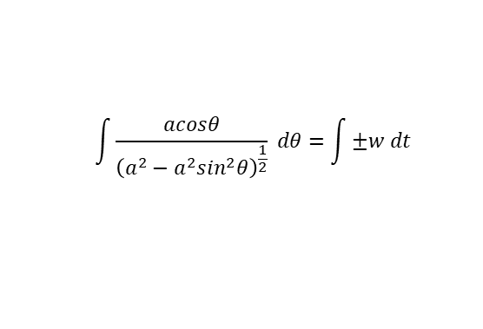

Modelling with Differential Equations
$$v^{2}=w^{2}\left(a^{2}−x^{2}\right)$$
$$\ddot{x}=−w^{2}x$$
$$\int{\frac{dx}{{\left(a^{2}−x^{2}\right)}^{\frac{1}{2}}}}=\int{±w dt }$$
You can solve problems about a particle which is moving in a straight line with simple harmonic motion
Let:
Replace terms with the equivalents we have created
$$\int{\frac{acosθ}{{\left(a^{2}−a^{2}\sin^{2}θ\right)}^{\frac{1}{2}}} dθ}=\int{±w dt }$$
Factorise the denominator
$$x=asinθ$$
$$\int{\frac{acosθ}{{\left(a^{2}\left(1−\sin^{2}θ\right)\right)}^{\frac{1}{2}}} dθ}=\int{±w dt }$$
Differentiate with respect to θ
Simplify using sin²θ + cos²θ = 1
$$\int{\frac{acosθ}{{\left(a^{2}\cos^{2}θ\right)}^{\frac{1}{2}}} dθ}=\int{±w dt }$$
$$\frac{dx}{dθ}=acosθ$$
Square root the denominator
Multiply by dθ
$$\int{\frac{acosθ}{acosθ} dθ}=\int{±w dt }$$
The fraction cancels out
$$dx=acosθ dθ$$
$$\int{dθ}=\int{±w dt }$$
Integrate each side, remember w is a constant and add C (in the books, ‘alpha’ is used. I have used C to avoid confusion with a, the amplitude!)
We can ignore the negative value of wt here…
It just represents the oscillation starting in a different direction first ie) left then right, rather than right then left
Resolving in the direction you want means you can just use the positive value
$$θ=±wt+C$$
Do ‘asin’ of each side
$$asinθ=asin\left(wt+C \right)$$
Remember that asinθ is equal to ‘x’
$$x=asin\left(wt+C \right)$$
8B

Slide 25


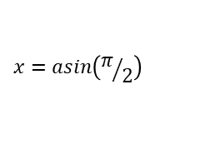





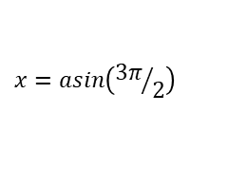








Modelling with Differential Equations
$$v^{2}=w^{2}\left(a^{2}−x^{2}\right)$$
$$\ddot{x}=−w^{2}x$$
You can solve problems about a particle which is moving in a straight line with simple harmonic motion
This represents the displacement of the particle from the centre in terms of t, the time.
As sine is involved, the pattern will be periodic ie) oscillating, like the sin graph
Remember that a is the amplitude of the motion, ie) the greatest displacement from the centre
(The amplitude is not the distance between the opposite ‘extremes’, it is the distance from the centre to one ‘extreme’)
Therefore: -a ≤ x ≤ a
There are ‘special cases’ that are very useful!
$$x=asin\left(wt+C \right)$$
Case number 1: C = 0
$$x=asin(wt)$$
x
$$x=asin\left(wt+C \right)$$
a
$$0$$
t
$$\frac{π}{2w}$$
$$\frac{π}{w}$$
$$\frac{3π}{2w}$$
$$\frac{2π}{w}$$
-a
$$x=asin(wt)$$
Let t = 0
$$x=asin(0)$$
$$x=0$$
$$x=asin(wt)$$
Let t = ^{π}/_{2w}
$$x=asin\left(π/2\right)$$
$$x=a$$
$$x=asin(wt)$$
Let t = ^{π}/_{w}
$$x=asin\left(π\right)$$
$$x=0$$
$$x=asin(wt)$$
Let t = ^{3π}/_{2w}
$$x=asin\left({3π}/2\right)$$
$$x=−a$$
$$x=asin(wt)$$
Let t = ^{2π}/_{w}
$$x=asin\left(2π\right)$$
$$x=0$$
8B

Slide 26
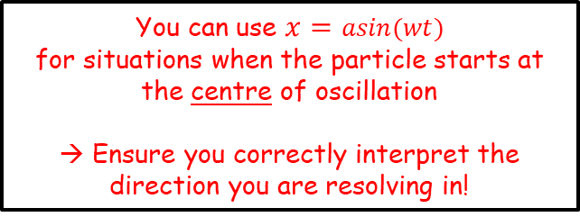
Modelling with Differential Equations
$$x=asin\left(wt\right) if the particle starts at the centre$$
$$v^{2}=w^{2}\left(a^{2}−x^{2}\right)$$
$$\ddot{x}=−w^{2}x$$
You can solve problems about a particle which is moving in a straight line with simple harmonic motion
This represents the displacement of the particle from the centre in terms of t, the time.
As sine is involved, the pattern will be periodic ie) oscillating, like the sin graph
Remember that a is the amplitude of the motion, ie) the greatest displacement from the centre
(The amplitude is not the distance between the opposite ‘extremes’, it is the distance from the centre to one ‘extreme’)
Therefore: -a ≤ x ≤ a
There are ‘special cases’ that are very useful!
$$x=asin\left(wt+C \right)$$
Case number 1: C = 0
$$x=asin(wt)$$
x
$$x=asin\left(wt+C \right)$$
a
$$0$$
t
$$\frac{π}{2w}$$
$$\frac{π}{w}$$
$$\frac{3π}{2w}$$
$$\frac{2π}{w}$$
-a
You can use $x=asin(wt)$
for situations when the particle starts at the centre of oscillation
→ Ensure you correctly interpret the direction you are resolving in!
8B

Slide 27
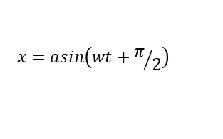
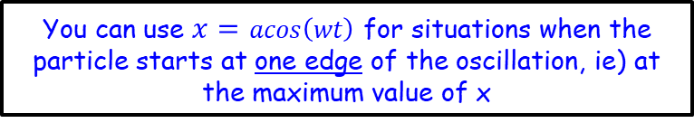
Modelling with Differential Equations
$$x=asin\left(wt\right) if the particle starts at the centre$$
$$x=acos\left(wt\right) if the particle starts at one edge$$
$$\ddot{x}=−w^{2}x$$
$$v^{2}=w^{2}\left(a^{2}−x^{2}\right)$$
You can solve problems about a particle which is moving in a straight line with simple harmonic motion
This represents the displacement of the particle from the centre in terms of t, the time.
As sine is involved, the pattern will be periodic ie) oscillating, like the sin graph
Remember that a is the amplitude of the motion, ie) the greatest displacement from the centre
(The amplitude is not the distance between the opposite ‘extremes’, it is the distance from the centre to one ‘extreme’)
Therefore: -a ≤ x ≤ a
There are ‘special cases’ that are very useful!
$$x=asin\left(wt+C \right)$$
Case number 2: C = ^{π}/₂
$$x=asin\left(wt+π/2\right)$$
x
a
$$x=asin\left(wt+C \right)$$
a
$$0$$
t
$$\frac{π}{2w}$$
$$\frac{π}{w}$$
$$\frac{3π}{2w}$$
$$\frac{2π}{w}$$
-a
If we calculate points in a similar way to before, we end up with the graph above, which is the same as the cos graph…
You can use $x=acos\left(wt\right)$ for situations when the particle starts at one edge of the oscillation, ie) at the maximum value of x
8B

Slide 28


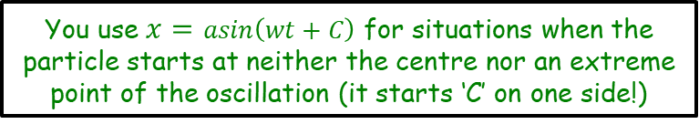
Modelling with Differential Equations
$$x=asin\left(wt\right) if the particle starts at the centre$$
$$x=acos\left(wt\right) if the particle starts at one edge$$
$$\ddot{x}=−w^{2}x$$
$$Period=\frac{2π}{w}$$
$$v^{2}=w^{2}\left(a^{2}−x^{2}\right)$$
You can solve problems about a particle which is moving in a straight line with simple harmonic motion
This represents the displacement of the particle from the centre in terms of t, the time.
As sine is involved, the pattern will be periodic ie) oscillating, like the sin graph
Remember that a is the amplitude of the motion, ie) the greatest displacement from the centre
(The amplitude is not the distance between the opposite ‘extremes’, it is the distance from the centre to one ‘extreme’)
Therefore: -a ≤ x ≤ a
There are ‘special cases’ that are very useful!
$$x=asin\left(wt+C \right)$$
Case number 3:
C is neither 0 or ^{π}/₂
x
$$x=asin\left(wt+C \right)$$
a
$$0$$
t
$$\frac{π}{2w}$$
$$\frac{π}{w}$$
$$\frac{3π}{2w}$$
$$\frac{2π}{w}$$
-a
This graph will be a translation of x = asin(wt) a distance C to the left
You use $x=asin\left(wt+C\right)$ for situations when the particle starts at neither the centre nor an extreme point of the oscillation (it starts ‘C’ on one side!)
Note that in all cases, the period of the motion is given by: $\frac{2π}{w}$
8B

Slide 29


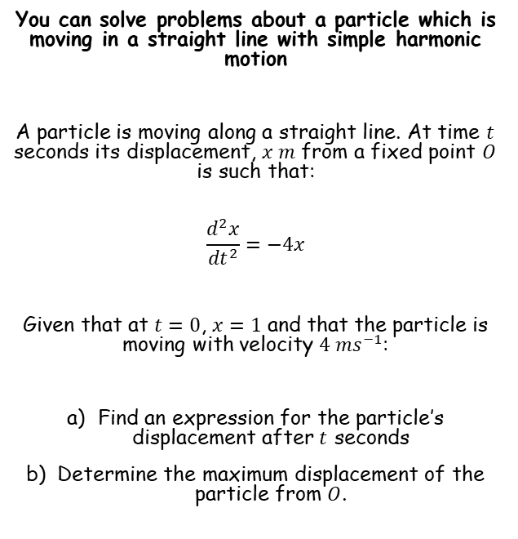








Modelling with Differential Equations
$$Ae^{m_{1}x}+Be^{m_{2}x}$$
$$(A+Bx)e^{mx}$$
$$e^{px}\left(Acosqx+Bsinqx\right)$$
$$\ddot{x}=−w^{2}x$$
$$Period=\frac{2π}{w}$$
$$v^{2}=w^{2}\left(a^{2}−x^{2}\right)$$
You can solve problems about a particle which is moving in a straight line with simple harmonic motion
A particle is moving along a straight line. At time $t$ seconds its displacement, $x m$ from a fixed point $O$ is such that:
$$\frac{d^{2}x}{{dt}^{2}}=−4x$$
Given that at $t=0$, $x=1$ and that the particle is moving with velocity $4 {ms}^{−1}$:
Find an expression for the particle’s displacement after $t$ seconds
Determine the maximum displacement of the particle from $O$.
$$\frac{d^{2}x}{{dt}^{2}}=−4x$$
Rearrange so we can use the techniques for second-order differentials
$$\frac{d^{2}x}{{dt}^{2}}+4x=0$$
Write the auxiliary equation
$$m^{2}+4=0$$
Subtract 4
$$m^{2}=−4$$
Square root
$$m=±2i$$
Use the appropriate form from above (remember in this case $p=0$ as there is no real part)
$$x=Acos2t+Bsin2t$$
8B

Slide 30













Modelling with Differential Equations
$$Ae^{m_{1}x}+Be^{m_{2}x}$$
$$(A+Bx)e^{mx}$$
$$e^{px}\left(Acosqx+Bsinqx\right)$$
$$\ddot{x}=−w^{2}x$$
$$Period=\frac{2π}{w}$$
$$v^{2}=w^{2}\left(a^{2}−x^{2}\right)$$
You can solve problems about a particle which is moving in a straight line with simple harmonic motion
A particle is moving along a straight line. At time $t$ seconds its displacement, $x m$ from a fixed point $O$ is such that:
$$\frac{d^{2}x}{{dt}^{2}}=−4x$$
Given that at $t=0$, $x=1$ and that the particle is moving with velocity $4 {ms}^{−1}$:
Find an expression for the particle’s displacement after $t$ seconds
Determine the maximum displacement of the particle from $O$.
$$x=Acos2t+Bsin2t$$
When $t=0$, $x=1$
$$1=Acos2(0)+Bsin2(0)$$
Calculate
$$1=A$$
We can now include this in the relationship we have
$$x=cos2t+Bsin2t$$
Now we need to use the information we are given regarding velocity
$$x=cos2t+Bsin2t$$
Differentiate since $\frac{dx}{dt}$ is the velocity
$$\frac{dx}{dt}=−2sin2t+2Bcos2t$$
When $t=0$, $\frac{dx}{dt}=4$
$$4=−2sin2(0)+2Bcos2(0)$$
Simplify
$$4=2B$$
Calculate
$$2=B$$
Now we have the full equation for displacement!
$$x=cos2t+2sin2t$$
8B

Slide 31








Modelling with Differential Equations
$$Ae^{m_{1}x}+Be^{m_{2}x}$$
$$(A+Bx)e^{mx}$$
$$e^{px}\left(Acosqx+Bsinqx\right)$$
$$\ddot{x}=−w^{2}x$$
$$Period=\frac{2π}{w}$$
$$v^{2}=w^{2}\left(a^{2}−x^{2}\right)$$
You can solve problems about a particle which is moving in a straight line with simple harmonic motion
A particle is moving along a straight line. At time $t$ seconds its displacement, $x m$ from a fixed point $O$ is such that:
$$\frac{d^{2}x}{{dt}^{2}}=−4x$$
Given that at $t=0$, $x=1$ and that the particle is moving with velocity $4 {ms}^{−1}$:
Find an expression for the particle’s displacement after $t$ seconds
Determine the maximum displacement of the particle from $O$.
To find the maximum displacement, we need the amplitude of the graph
→ So we will need to write it in terms of sine or cosine only
$$x=cos2t+2sin2t$$
Write the left side as a bracket including sine
$$Rsin\left(2t+θ\right)=cos2t+2sin2t$$
Expand the bracket
$$Rsin2tcosθ+Rcos2tsinθ=cos2t+2sin2t$$
Compare terms on each side…
$$Rcosθ=2$$
$$Rsinθ=1$$
$$tanθ=\frac{1}{2}$$
Combine
Calculate $θ$
$$x=cos2t+2sin2t$$
$$θ=0.4636..$$
We can then use the exact value of $θ$ to find that $R=\sqrt{5}$
8B

Slide 32



Modelling with Differential Equations
$$Ae^{m_{1}x}+Be^{m_{2}x}$$
$$(A+Bx)e^{mx}$$
$$e^{px}\left(Acosqx+Bsinqx\right)$$
$$\ddot{x}=−w^{2}x$$
$$Period=\frac{2π}{w}$$
$$v^{2}=w^{2}\left(a^{2}−x^{2}\right)$$
You can solve problems about a particle which is moving in a straight line with simple harmonic motion
A particle is moving along a straight line. At time $t$ seconds its displacement, $x m$ from a fixed point $O$ is such that:
$$\frac{d^{2}x}{{dt}^{2}}=−4x$$
Given that at $t=0$, $x=1$ and that the particle is moving with velocity $4 {ms}^{−1}$:
Find an expression for the particle’s displacement after $t$ seconds
Determine the maximum displacement of the particle from $O$.
$$x=cos2t+2sin2t$$
Replace using the expression we worked out
$$x=\sqrt{5}sin\left(2t+0.4636…\right)$$
The greatest value of this will be $\sqrt{5}$, so this is the maximum displacement of the particle from $O$.
$$x=cos2t+2sin2t$$
8B

Slide 33
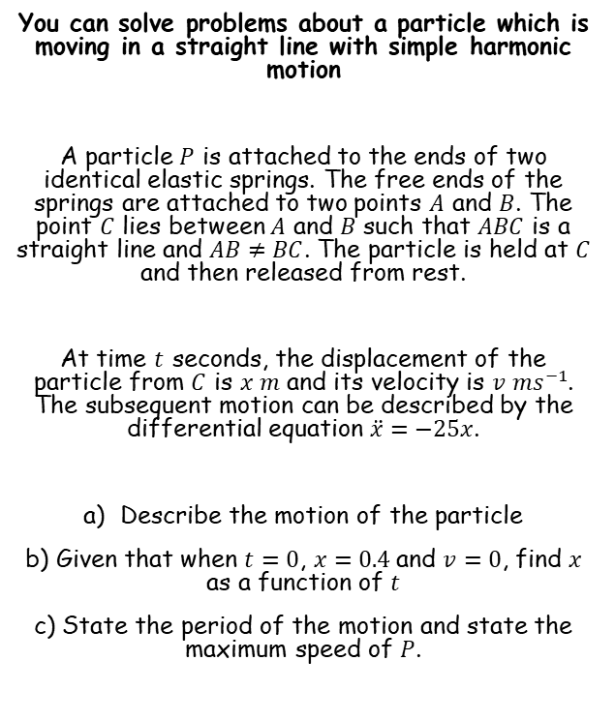
Modelling with Differential Equations
$$Ae^{m_{1}x}+Be^{m_{2}x}$$
$$(A+Bx)e^{mx}$$
$$e^{px}\left(Acosqx+Bsinqx\right)$$
$$\ddot{x}=−w^{2}x$$
$$Period=\frac{2π}{w}$$
$$v^{2}=w^{2}\left(a^{2}−x^{2}\right)$$
You can solve problems about a particle which is moving in a straight line with simple harmonic motion
A particle $P$ is attached to the ends of two identical elastic springs. The free ends of the springs are attached to two points $A$ and $B$. The point $C$ lies between $A$ and $B$ such that $ABC$ is a straight line and $AB≠BC$. The particle is held at $C$ and then released from rest.
At time $t$ seconds, the displacement of the particle from $C$ is $x m$ and its velocity is $v {ms}^{−1}$. The subsequent motion can be described by the differential equation $\ddot{x}=−25x$.
Describe the motion of the particle
b) Given that when $t=0$, $x=0.4$and $v=0$, find $x$ as a function of $t$
c) State the period of the motion and state the maximum speed of $P$.
‘The particle moves with simple harmonic motion’
8B

Slide 34






Modelling with Differential Equations
$$Ae^{m_{1}x}+Be^{m_{2}x}$$
$$(A+Bx)e^{mx}$$
$$e^{px}\left(Acosqx+Bsinqx\right)$$
$$\ddot{x}=−w^{2}x$$
$$Period=\frac{2π}{w}$$
$$v^{2}=w^{2}\left(a^{2}−x^{2}\right)$$
You can solve problems about a particle which is moving in a straight line with simple harmonic motion
A particle $P$ is attached to the ends of two identical elastic springs. The free ends of the springs are attached to two points $A$ and $B$. The point $C$ lies between $A$ and $B$ such that $ABC$ is a straight line and $AB≠BC$. The particle is held at $C$ and then released from rest.
At time $t$ seconds, the displacement of the particle from $C$ is $x m$ and its velocity is $v {ms}^{−1}$. The subsequent motion can be described by the differential equation $\ddot{x}=−25x$.
Describe the motion of the particle
b) Given that when $t=0$, $x=0.4$and $v=0$, find $x$ as a function of $t$
c) State the period of the motion and state the maximum speed of $P$.
$$\ddot{x}=−25x$$
Rearrange so that second order differential techniques can be used
$$\frac{d^{2}x}{dt^{2}}+25x=0$$
Write the auxiliary equation
$$m^{2}+25=0$$
Subtract 25
$$m^{2}=−25$$
Square root
$$m=±5i$$
Choose the appropriate form above
$$x=Acos5t+Bsin5t$$
8B

Slide 35











Modelling with Differential Equations
$$Ae^{m_{1}x}+Be^{m_{2}x}$$
$$(A+Bx)e^{mx}$$
$$e^{px}\left(Acosqx+Bsinqx\right)$$
$$\ddot{x}=−w^{2}x$$
$$Period=\frac{2π}{w}$$
$$v^{2}=w^{2}\left(a^{2}−x^{2}\right)$$
You can solve problems about a particle which is moving in a straight line with simple harmonic motion
A particle $P$ is attached to the ends of two identical elastic springs. The free ends of the springs are attached to two points $A$ and $B$. The point $C$ lies between $A$ and $B$ such that $ABC$ is a straight line and $AB≠BC$. The particle is held at $C$ and then released from rest.
At time $t$ seconds, the displacement of the particle from $C$ is $x m$ and its velocity is $v {ms}^{−1}$. The subsequent motion can be described by the differential equation $\ddot{x}=−25x$.
Describe the motion of the particle
b) Given that when $t=0$, $x=0.4$and $v=0$, find $x$ as a function of $t$
c) State the period of the motion and state the maximum speed of $P$.
$$x=Acos5t+Bsin5t$$
When $t=0$, $x=0.4$
$$0.4=Acos5(0)+Bsin5(0)$$
Simplify
$$0.4=A$$
Now we know part of the relationship
$$x=0.4cos5t+Bsin5t$$
Now we can differentiate to use the information we have about the velocity of the particle..
$$x=0.4cos5t+Bsin5t$$
$$\frac{dx}{dt}=−2sin5t+5Bcos5t$$
Differentiate
When $t=0$, $v=0$
$$0=−2sin5(0)+5Bcos5(0)$$
Calculate
$$0=B$$
We now have the full relationship between $x$ and $t$
$$x=0.4cos5t$$
8B

Slide 36






Modelling with Differential Equations
$$Ae^{m_{1}x}+Be^{m_{2}x}$$
$$(A+Bx)e^{mx}$$
$$e^{px}\left(Acosqx+Bsinqx\right)$$
$$\ddot{x}=−w^{2}x$$
$$Period=\frac{2π}{w}$$
$$v^{2}=w^{2}\left(a^{2}−x^{2}\right)$$
You can solve problems about a particle which is moving in a straight line with simple harmonic motion
A particle $P$ is attached to the ends of two identical elastic springs. The free ends of the springs are attached to two points $A$ and $B$. The point $C$ lies between $A$ and $B$ such that $ABC$ is a straight line and $AB≠BC$. The particle is held at $C$ and then released from rest.
At time $t$ seconds, the displacement of the particle from $C$ is $x m$ and its velocity is $v {ms}^{−1}$. The subsequent motion can be described by the differential equation $\ddot{x}=−25x$.
Describe the motion of the particle
b) Given that when $t=0$, $x=0.4$and $v=0$, find $x$ as a function of $t$
c) State the period of the motion and state the maximum speed of $P$.
$$Period=\frac{2π}{w}$$
We can get the value of $w$ from the original equation we were given
$$=\frac{2π}{5}$$
To get the maximum speed, we can differentiate the relationship we worked out…
$$x=0.4cos5t$$
Differentiate (in this case I used dot notation, but alternatives would be ok)
$$\dot{x}=−2sin5t$$
So the maximum speed would be $2 ms^{−1}$
$$x=0.4cos5t$$
8B

Slide 37
Teachings for
Exercise 8C

Slide 38
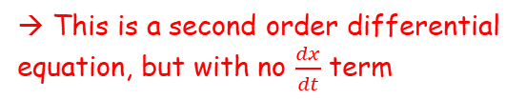

Modelling with Differential Equations
You need to be able to use differential equations when working with damped harmonic motion
In the previous section, the problems you solved related to simple harmonic motion
You saw that this was based on the trigonometrical graphs
However, in many cases harmonic motion will not continue indefinitely and experiences a ‘dampening’ effect which slows it down
For example, a swing is subject to air resistance so each oscillation becomes smaller than the previous one
They took the form $\frac{d^{2}x}{dt^{2}}+w^{2}x=0$
→ This is a second order differential equation, but with no $\frac{dx}{dt}$ term
8C

Slide 39
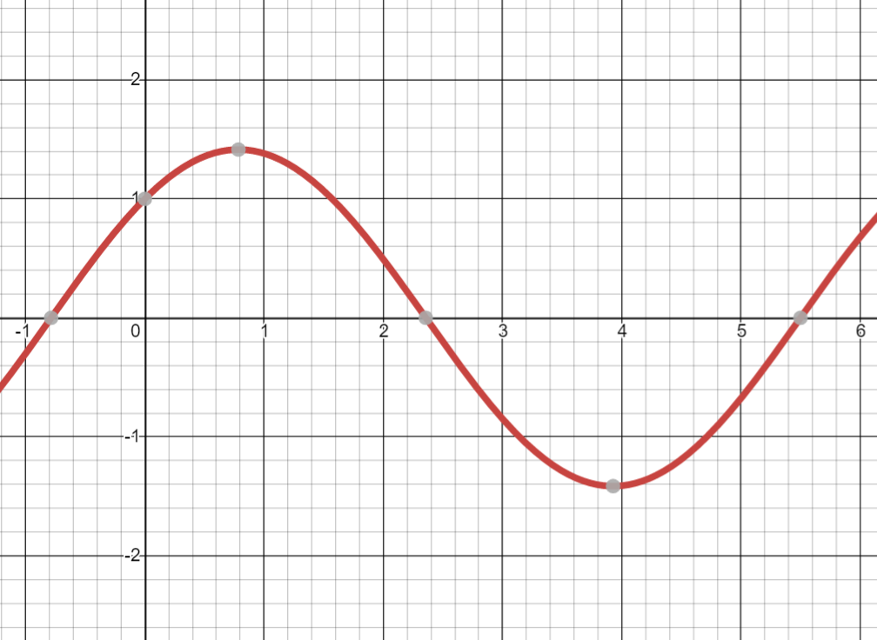


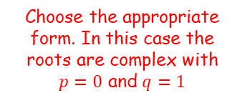
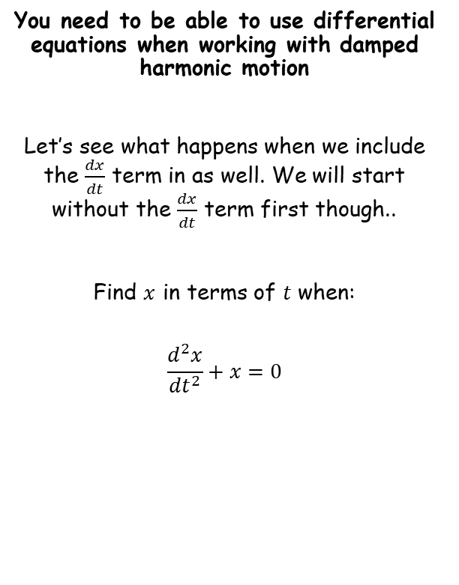




Modelling with Differential Equations
$$Ae^{m_{1}x}+Be^{m_{2}x}$$
$$(A+Bx)e^{mx}$$
$$e^{px}\left(Acosqx+Bsinqx\right)$$
$$\frac{d^{2}x}{{dt}^{2}}+x=0$$
You need to be able to use differential equations when working with damped harmonic motion
Let’s see what happens when we include the $\frac{dx}{dt}$ term in as well. We will start without the $\frac{dx}{dt}$ term first though..
Find $x$ in terms of $t$ when:
$$\frac{d^{2}x}{{dt}^{2}}+x=0$$
Write the auxiliary equation
$$m^{2}+1=0$$
Solve for $m$
$$m=±i$$
Choose the appropriate form. In this case the roots are complex with $p=0$ and $q=1$
$$x=Acost+Bsint$$
$$x=cost+sint$$
(I let A and B equal 1 just to get the graph drawn)
You can see from the graph that this motion will continue indefinitely!
8C

Slide 40
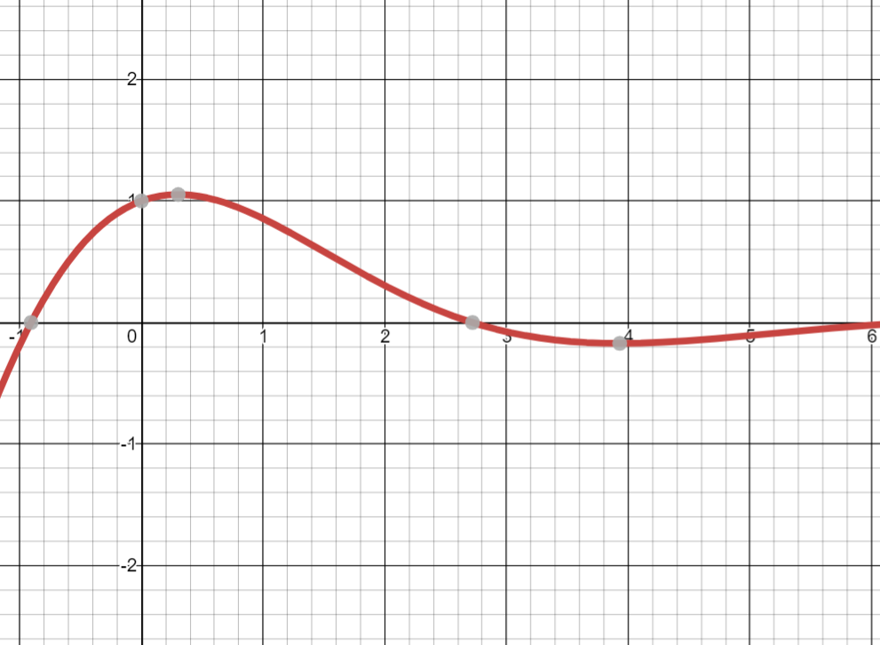
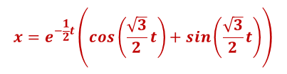

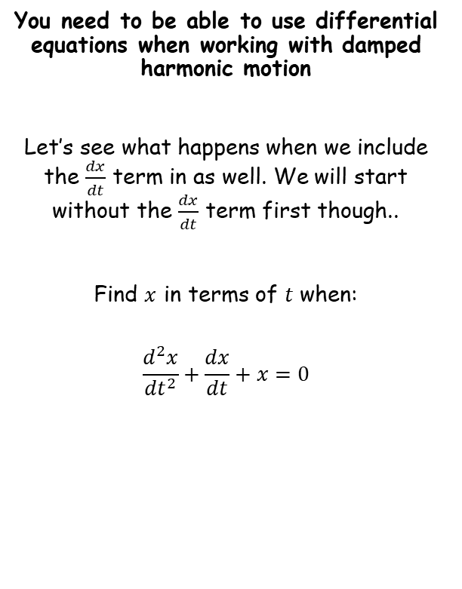
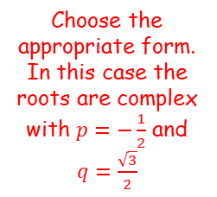



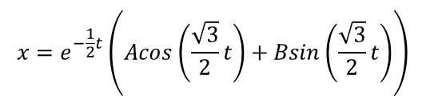
Modelling with Differential Equations
$$Ae^{m_{1}x}+Be^{m_{2}x}$$
$$(A+Bx)e^{mx}$$
$$e^{px}\left(Acosqx+Bsinqx\right)$$
$$\frac{d^{2}x}{{dt}^{2}}+\frac{dx}{dt}+x=0$$
You need to be able to use differential equations when working with damped harmonic motion
Let’s see what happens when we include the $\frac{dx}{dt}$ term in as well. We will start without the $\frac{dx}{dt}$ term first though..
Find $x$ in terms of $t$ when:
$$\frac{d^{2}x}{{dt}^{2}}+\frac{dx}{dt}+x=0$$
Write the auxiliary equation
$$m^{2}+m+1=0$$
Choose the appropriate form. In this case the roots are complex with $p=−\frac{1}{2}$ and $q=\frac{\sqrt{3}}{2}$
$$m=−\frac{1}{2}±\frac{\sqrt{3}}{2}i$$
Solve for $m$
$$x=e^{−\frac{1}{2}t}\left(Acos\left(\frac{\sqrt{3}}{2}t\right)+Bsin\left(\frac{\sqrt{3}}{2}t\right)\right)$$
$$x=e^{−\frac{1}{2}t}\left(cos\left(\frac{\sqrt{3}}{2}t\right)+sin\left(\frac{\sqrt{3}}{2}t\right)\right)$$
(I let A and B equal 1 just to get the graph drawn)
Notice that the oscillation slows down!
8C

Slide 41
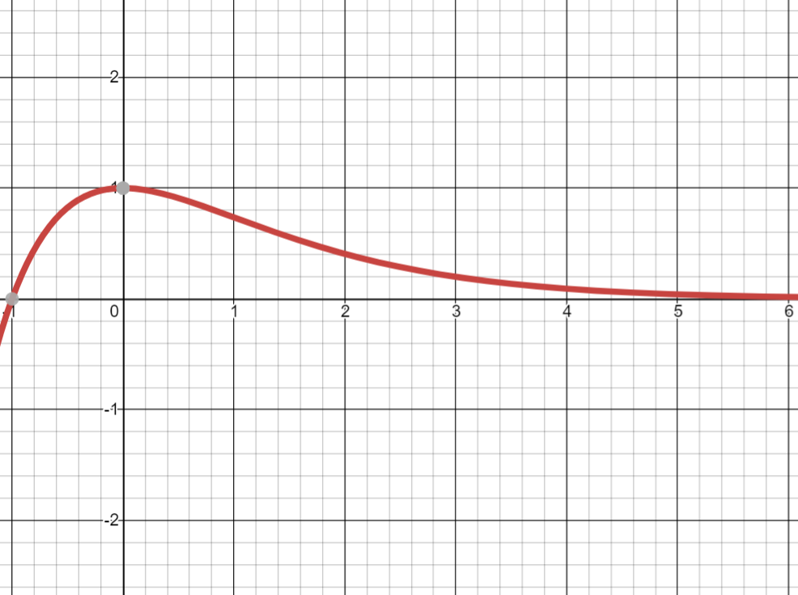


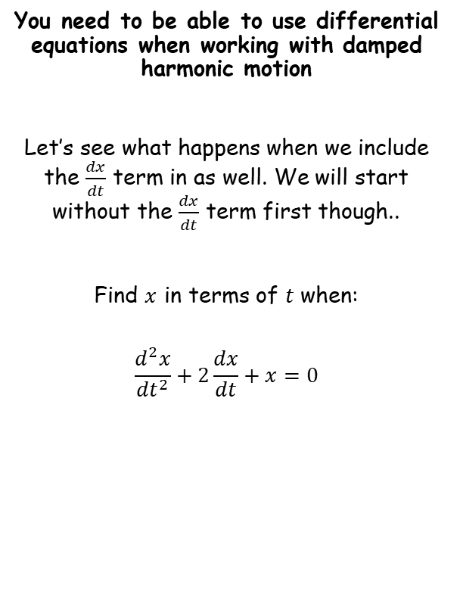
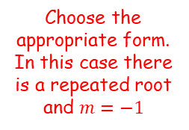



Modelling with Differential Equations
$$Ae^{m_{1}x}+Be^{m_{2}x}$$
$$(A+Bx)e^{mx}$$
$$e^{px}\left(Acosqx+Bsinqx\right)$$
$$\frac{d^{2}x}{{dt}^{2}}+2\frac{dx}{dt}+x=0$$
You need to be able to use differential equations when working with damped harmonic motion
Let’s see what happens when we include the $\frac{dx}{dt}$ term in as well. We will start without the $\frac{dx}{dt}$ term first though..
Find $x$ in terms of $t$ when:
$$\frac{d^{2}x}{{dt}^{2}}+2\frac{dx}{dt}+x=0$$
Write the auxiliary equation
$$m^{2}+2m+1=0$$
Solve for $m$
Choose the appropriate form. In this case there is a repeated root and $m=−1$
$$m=−1$$
$$x=\left(A+Bt\right)e^{−t}$$
$$x=\left(1+t\right)e^{−t}$$
(I let A and B equal 1 just to get the graph drawn)
Notice that there is no oscillation!
8C

Slide 42
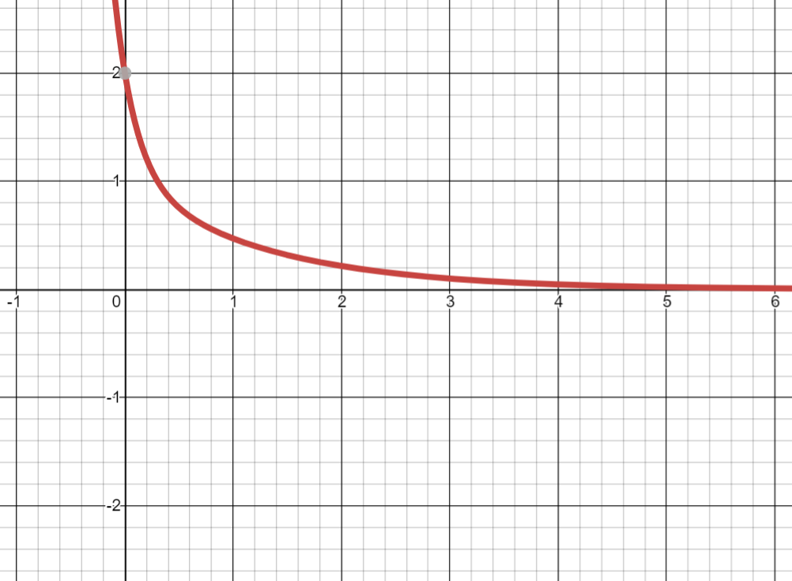


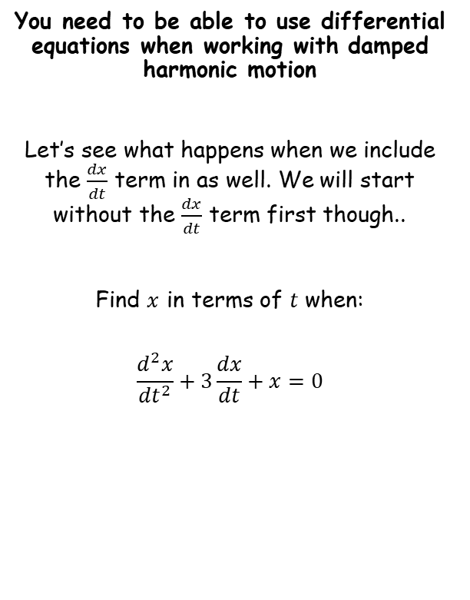
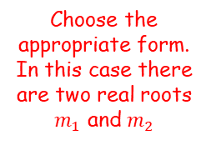



Modelling with Differential Equations
$$Ae^{m_{1}x}+Be^{m_{2}x}$$
$$(A+Bx)e^{mx}$$
$$e^{px}\left(Acosqx+Bsinqx\right)$$
$$\frac{d^{2}x}{{dt}^{2}}+3\frac{dx}{dt}+x=0$$
You need to be able to use differential equations when working with damped harmonic motion
Let’s see what happens when we include the $\frac{dx}{dt}$ term in as well. We will start without the $\frac{dx}{dt}$ term first though..
Find $x$ in terms of $t$ when:
$$\frac{d^{2}x}{{dt}^{2}}+3\frac{dx}{dt}+x=0$$
Write the auxiliary equation
$$m^{2}+3m+1=0$$
$$m=\frac{−3±\sqrt{5}}{2}$$
Solve for $m$
Choose the appropriate form. In this case there are two real roots $m_{1}$ and $m_{2}$
$$x=Ae^{\left(\frac{−3+\sqrt{5}}{2}\right)t}+Be^{\left(\frac{−3−\sqrt{5}}{2}\right)t}$$
$$x=e^{\left(\frac{−3+\sqrt{5}}{2}\right)t}+e^{\left(\frac{−3−\sqrt{5}}{2}\right)t}$$
(I let A and B equal 1 just to get the graph drawn)
Notice that there is no oscillation!
8C

Slide 43











Modelling with Differential Equations
The point to take from this is that a second order differential equation will lead to a different type of harmonic motion, depending on the numbers within it!
You need to be able to use differential equations when working with damped harmonic motion
$$\frac{d^{2}x}{{dt}^{2}}+x=0$$
$$\frac{d^{2}x}{{dt}^{2}}+\frac{dx}{dt}+x=0$$
$$\frac{d^{2}x}{{dt}^{2}}+2\frac{dx}{dt}+x=0$$
$$\frac{d^{2}x}{{dt}^{2}}+3\frac{dx}{dt}+x=0$$
$$x=e^{−\frac{1}{2}t}\left(cos\left(\frac{\sqrt{3}}{2}t\right)+sin\left(\frac{\sqrt{3}}{2}t\right)\right)$$
$$x=e^{\left(\frac{−3+\sqrt{5}}{2}\right)t}+e^{\left(\frac{−3−\sqrt{5}}{2}\right)t}$$
$$x=cost+sint$$
$$x=\left(1+t\right)e^{−t}$$
Simple harmonic motion
Damped harmonic motion
‘Light damping’
Damped harmonic motion
‘Critical damping’
Damped harmonic motion
‘Heavy damping’
The original equation has complex roots
The original equation has repeated roots
The original equation has two real roots
This means that $b^{2}−4ac<0$ for the original equation
This means that $b^{2}−4ac=0$ for the original equation
This means that $b^{2}−4ac>0$ for the original equation
8C

Slide 44




Modelling with Differential Equations
You need to be able to use differential equations when working with damped harmonic motion
If a particle is moving with damped harmonic motion given by:
$$\frac{d^{2}x}{{dt}^{2}}+k\frac{dx}{dt}+ω^{2}x=0$$
If $k^{2}<4ω^{2}$, then there will be light dampening and oscillations will be performed
If $k^{2}=4{\text{ω}}^{2}$, then there will be critical dampening and no oscillations will be performed
If $k^{2}>4ω$, then there will be heavy damping
and no oscillations will be performed
Note that these are equivalent to the rules for $b^{2}−4ac$shown on the previous slide!
8C

Slide 45





















Modelling with Differential Equations
$$\frac{d^{2}x}{{dt}^{2}}+k\frac{dx}{dt}+ω^{2}x=0$$
$$k^{2}<4ω^{2}→Light damping$$
$$k^{2}=4ω^{2}→Critical damping$$
$$k^{2}>4ω^{2}→Heavy damping$$
$$Ae^{m_{1}x}+Be^{m_{2}x}$$
$$(A+Bx)e^{mx}$$
$$e^{px}\left(Acosqx+Bsinqx\right)$$
Draw a diagram, including forces
You need to be able to use differential equations when working with damped harmonic motion
A particle $P$ of mass 0.5kg moves in a horizontal straight line. At time $t$ seconds, the displacement of $P$ from a fixed point $O$, on the line is $x m$ and the velocity of $P$ is ${v ms}^{−1}$. A force of magnitude $8x N$ acts on $P$ in the direction $PO$. The particle is also subject to a resistance of magnitude $4v N$. When $t=0$, $x=1.5$ and $P$ is moving in the direction of $x$ increasing with speed $4 ms^{−1}$.
Show that $\frac{d^{2}x}{{dt}^{2}}+8\frac{dx}{dt}+16x=0$
$$4v$$
$$\ddot{x}$$
$$8x$$
$$O$$
$$P$$
$$x$$
Resolve horizontally (→)
$$F=ma$$
Sub in values
$$−8x−4v=0.5\ddot{x}$$
Rearrange
$$0=0.5\ddot{x}+4v+8x$$
Multiply by 2
$$0=\ddot{x}+8v+16x$$
Replace $\ddot{x}$ and $v$ with equivalent notation
$$0=\frac{d^{2}x}{{dt}^{2}}+8\frac{dx}{dt}+16x$$
→ Remember that although $x$ and $v$ are not forces, there are forces in this question which are based on them…
8C

Slide 46














Modelling with Differential Equations
$$\frac{d^{2}x}{{dt}^{2}}+k\frac{dx}{dt}+ω^{2}x=0$$
$$k^{2}<4ω^{2}→Light damping$$
$$k^{2}=4ω^{2}→Critical damping$$
$$k^{2}>4ω^{2}→Heavy damping$$
$$Ae^{m_{1}x}+Be^{m_{2}x}$$
$$(A+Bx)e^{mx}$$
$$e^{px}\left(Acosqx+Bsinqx\right)$$
$$\frac{d^{2}x}{{dt}^{2}}+8\frac{dx}{dt}+16x=0$$
You need to be able to use differential equations when working with damped harmonic motion
A particle $P$ of mass 0.5kg moves in a horizontal straight line. At time $t$ seconds, the displacement of $P$ from a fixed point $O$, on the line is $x m$ and the velocity of $P$ is ${v ms}^{−1}$. A force of magnitude $8x N$ acts on $P$ in the direction $PO$. The particle is also subject to a resistance of magnitude $4v N$. When $t=0$, $x=1.5$ and $P$ is moving in the direction of $x$ increasing with speed $4 ms^{−1}$.
Show that $\frac{d^{2}x}{{dt}^{2}}+8\frac{dx}{dt}+16x=0$
Find the value of $x$ when $t=1$
Write the auxiliary equation
$$m^{2}+8m+16=0$$
Solve
$$m=−4$$
Choose the appropriate form. There is a repeated root $m=−4$
$$x=(A+Bt)e^{−4t}$$
Now we need to use the information we have to find $A$ and $B$
$$x=(A+Bt)e^{−4t}$$
When $t=0$, $x=1.5$
$$1.5=(A+B(0))e^{−4(0)}$$
Solve for $A$
$$1.5=A$$
Now we know $A$
$$x=(1.5+Bt)e^{−4t}$$
8C

Slide 47














Modelling with Differential Equations
$$\frac{d^{2}x}{{dt}^{2}}+k\frac{dx}{dt}+ω^{2}x=0$$
$$k^{2}<4ω^{2}→Light damping$$
$$k^{2}=4ω^{2}→Critical damping$$
$$k^{2}>4ω^{2}→Heavy damping$$
$$Ae^{m_{1}x}+Be^{m_{2}x}$$
$$(A+Bx)e^{mx}$$
$$e^{px}\left(Acosqx+Bsinqx\right)$$
$$x=(1.5+Bt)e^{−4t}$$
Expand the bracket
You need to be able to use differential equations when working with damped harmonic motion
A particle $P$ of mass 0.5kg moves in a horizontal straight line. At time $t$ seconds, the displacement of $P$ from a fixed point $O$, on the line is $x m$ and the velocity of $P$ is ${v ms}^{−1}$. A force of magnitude $8x N$ acts on $P$ in the direction $PO$. The particle is also subject to a resistance of magnitude $4v N$. When $t=0$, $x=1.5$ and $P$ is moving in the direction of $x$ increasing with speed $4 ms^{−1}$.
Show that $\frac{d^{2}x}{{dt}^{2}}+8\frac{dx}{dt}+16x=0$
Find the value of $x$ when $t=1$
$$x=1.5e^{−4t}+Bte^{−4t}$$
Differentiate (product rule needed)
$$\frac{dx}{dt}=$$
$$−6e^{−4t}$$
$$+\left(Bt\frac{d}{dt}\left(e^{−4t}\right)+\frac{d}{dt}\left(Bt\right)e^{−4t}\right)$$
Work out the bracket
$$\frac{dx}{dt}=$$
$$−6e^{−4t}$$
$$+ \left(Bt\left(−4e^{−4t}\right)+Be^{−4t}\right)$$
When $t=0$, $v=4$
$$4=−6e^{−4(0)}+ \left(B(0)\left(−4e^{−4(0)}\right)+Be^{−4(0)}\right)$$
Simplify
$$4=−6+B$$
Calculate $B$
$$10=B$$
Now we have the full relationship
$$x=(1.5+10t)e^{−4t}$$
Let $t=1$
$$x=(1.5+10(1))e^{−4(1)}$$
Calculate
$x=0.211$ (3sf)
8C

Slide 48








Modelling with Differential Equations
$$\frac{d^{2}x}{{dt}^{2}}+k\frac{dx}{dt}+ω^{2}x=0$$
$$k^{2}<4ω^{2}→Light damping$$
$$k^{2}=4ω^{2}→Critical damping$$
$$k^{2}>4ω^{2}→Heavy damping$$
$$Ae^{m_{1}x}+Be^{m_{2}x}$$
$$(A+Bx)e^{mx}$$
$$e^{px}\left(Acosqx+Bsinqx\right)$$
$$\frac{d^{2}x}{{dt}^{2}}+6k\frac{dx}{dt}+{5k}^{2}x=0$$
You need to be able to use differential equations when working with damped harmonic motion
A particle $P$ hangs freely in equilibrium attached to one end of a light elastic string. The other end of the string is attached to a fixed point $A$. The particle is pulled down and held at rest in a container of liquid which exerts a resistance on the motion on $P$. $P$ is then released from rest. While the string remains taut and the particle in the liquid, the motion can be modelled using the equation:
Where $k$ is a positive real constant.
Find the general solution to the differential equation and state the type of damping the particle is subject to.
Write the auxiliary equation
$$m^{2}+6km+{5k}^{2}=0$$
Factorise
$$\left(m+5k\right)\left(m+k\right)=0$$
Solve
Choose an appropriate form. Since $k$ is a real constant, the solutions will be as well.
$$m=−k,−5k$$
$$x=Ae^{−kt}+Be^{−5kt}$$
Since the auxiliary equation had 2 real roots, the particle will be subject to heavy dampening
$$\frac{d^{2}x}{{dt}^{2}}+6k\frac{dx}{dt}+{5k}^{2}x=0$$
8C

Slide 49













Modelling with Differential Equations
$$\frac{d^{2}x}{{dt}^{2}}+k\frac{dx}{dt}+ω^{2}x=0$$
$$k^{2}<4ω^{2}→Light damping$$
$$k^{2}=4ω^{2}→Critical damping$$
$$k^{2}>4ω^{2}→Heavy damping$$
$$Ae^{m_{1}x}+Be^{m_{2}x}$$
$$(A+Bx)e^{mx}$$
$$e^{px}\left(Acosqx+Bsinqx\right)$$
$$\frac{d^{2}x}{{dt}^{2}}+2k\frac{dx}{dt}+{2k}^{2}x=0$$
You need to be able to use differential equations when working with damped harmonic motion
One end of a light elastic spring is attached to a fixed point $A$. A particle $P$ is attached to the other end and hangs in equilibrium vertically below $A$. The particle is pulled vertically down from its equilibrium position and released from rest. A resistance proportional to the speed of $P$ acts on $P$.
The equation of motion of $P$ is given as:
Where $k$ is a positive real constant and $x$ is the displacement of $P$ from its equilibrium position.
a) Find the general solution to the differential equation.
Write the auxiliary equation
$$m^{2}+2km+{2k}^{2}=0$$
Use the quadratic formula
$$m=\frac{−b±\sqrt{b^{2}−4ac}}{2a}$$
Sub in $a$, $b$ and $c$
$$m=\frac{−2k±\sqrt{{(2k)}^{2}−4(1)(2k^{2})}}{2(1)}$$
Simplify
$$m=\frac{−2k±\sqrt{−4k^{2}}}{2}$$
$$\sqrt{−4k^{2}}=\sqrt{−4}\sqrt{k^{2}}=2ik$$
$$m=\frac{−2k±2ik}{2}$$
$$\frac{d^{2}x}{{dt}^{2}}+2k\frac{dx}{dt}+{2k}^{2}x=0$$
Simplify
$$m=−k±ik$$
Use the complex form with $p=k$ and $q=k$
$$x=e^{−kt}\left(Acoskt+Bsinkt\right)$$
8C

Slide 50



Modelling with Differential Equations
$$\frac{d^{2}x}{{dt}^{2}}+k\frac{dx}{dt}+ω^{2}x=0$$
$$k^{2}<4ω^{2}→Light damping$$
$$k^{2}=4ω^{2}→Critical damping$$
$$k^{2}>4ω^{2}→Heavy damping$$
$$Ae^{m_{1}x}+Be^{m_{2}x}$$
$$(A+Bx)e^{mx}$$
$$e^{px}\left(Acosqx+Bsinqx\right)$$
You need to be able to use differential equations when working with damped harmonic motion
One end of a light elastic spring is attached to a fixed point $A$. A particle $P$ is attached to the other end and hangs in equilibrium vertically below $A$. The particle is pulled vertically down from its equilibrium position and released from rest. A resistance proportional to the speed of $P$ acts on $P$.
The equation of motion of $P$ is given as:
Where $k$ is a positive real constant and $x$ is the displacement of $P$ from its equilibrium position.
b) Find the period of the motion
$$x=e^{−kt}\left(Acoskt+Bsinkt\right)$$
The period of the regular sine or cosine graph is $2π$. This has been vertically ‘stretched’ by a factor $\frac{1}{k}$.
→ So the period of this motion will be $\frac{2π}{k}$
$$\frac{d^{2}x}{{dt}^{2}}+2k\frac{dx}{dt}+{2k}^{2}x=0$$
8C

Slide 51


Modelling with Differential Equations
$$\frac{d^{2}x}{{dt}^{2}}+k\frac{dx}{dt}+ω^{2}x=0$$
$$k^{2}<4ω^{2}→Light damping$$
$$k^{2}=4ω^{2}→Critical damping$$
$$k^{2}>4ω^{2}→Heavy damping$$
$$Ae^{m_{1}x}+Be^{m_{2}x}$$
$$(A+Bx)e^{mx}$$
$$e^{px}\left(Acosqx+Bsinqx\right)$$
You need to be able to use differential equations when working with forced harmonic motion
Forced harmonic motion involved situations when an outside force affects the motion.
For example, someone pushing a swing means the swing will oscillate differently to what it would do naturally.
Second-order non-homogenous differential equations can be used to model this…
The $f(t)$ is used to include the outside force
→ You will therefore need to use particular integrals when solving these problems (as in the previous chapter)
$$\frac{d^{2}x}{{dt}^{2}}+k\frac{dx}{dt}+ω^{2}x=f(t)$$
8C

Slide 52











Modelling with Differential Equations
$$\frac{d^{2}x}{{dt}^{2}}+k\frac{dx}{dt}+ω^{2}x=0$$
$$k^{2}<4ω^{2}→Light damping$$
$$k^{2}=4ω^{2}→Critical damping$$
$$k^{2}>4ω^{2}→Heavy damping$$
$$Ae^{m_{1}x}+Be^{m_{2}x}$$
$$(A+Bx)e^{mx}$$
$$e^{px}\left(Acosqx+Bsinqx\right)$$
Draw a diagram, including forces
You need to be able to use differential equations when working with forced harmonic motion
A particle $P$ of mass 1.5kg is moving along the x-axis. At time $t$ the displacement of $P$ from the origin $O$ is $x$ metres and the speed of $P$ is $v {ms}^{−1}$. Three forces act on $P$, namely a restoring force of $7.5x N$, a resistance to motion of $P$ of magnitude $6v N$ and a force of magnitude $12sint N$ acting in the direction $OP$. When $t=0$, $x=5$ and $\frac{dx}{dt}=2$.
Show that $\frac{d^{2}x}{{dt}^{2}}+4\frac{dx}{dt}+5x=8sint$
$$12sint$$
$$6v$$
$$\ddot{x}$$
$$7.5x$$
$$O$$
$$P$$
$$x$$
Resolve horizontally (→)
$$F=ma$$
Sub in values
$$12sint−6v−7.5x=1.5\ddot{x}$$
Rearrange
$$12sint=1.5\ddot{x}+6v+7.5x$$
A ‘restoring force’ is a force which acts to bring the particle into equilibrium. So in this case it acts in the direction $PO$
Divide by 1.5
$$8sint=\ddot{x}+4v+5x$$
Replace with equivalent notation
$$8sint=\frac{d^{2}x}{{dt}^{2}}+4\frac{dx}{dt}+5x$$
8C

Slide 53







Modelling with Differential Equations
$$\frac{d^{2}x}{{dt}^{2}}+k\frac{dx}{dt}+ω^{2}x=0$$
$$k^{2}<4ω^{2}→Light damping$$
$$k^{2}=4ω^{2}→Critical damping$$
$$k^{2}>4ω^{2}→Heavy damping$$
$$Ae^{m_{1}x}+Be^{m_{2}x}$$
$$(A+Bx)e^{mx}$$
$$e^{px}\left(Acosqx+Bsinqx\right)$$
You need to be able to use differential equations when working with forced harmonic motion
A particle $P$ of mass 1.5kg is moving along the x-axis. At time $t$ the displacement of $P$ from the origin $O$ is $x$ metres and the speed of $P$ is $v {ms}^{−1}$. Three forces act on $P$, namely a restoring force of $7.5x N$, a resistance to motion of $P$ of magnitude $6v N$ and a force of magnitude $12sint N$ acting in the direction $OP$. When $t=0$, $x=5$ and $\frac{dx}{dt}=2$.
Show that $\frac{d^{2}x}{{dt}^{2}}+4\frac{dx}{dt}+5x=8sint$
Find $x$ as a function of $t$
Complementary function
$$\frac{d^{2}x}{{dt}^{2}}+4\frac{dx}{dt}+5x=0$$
Write the auxiliary equation
$$m^{2}+4m+5=0$$
Solve
$$m=−2±i$$
Roots are complex with $p=−2$ and $q=1$
$$x=e^{−2t}\left(Acost+Bsint\right)$$
$$CF=e^{−2t}\left(Acost+Bsint\right)$$
8C

Slide 54








Modelling with Differential Equations
$$\frac{d^{2}x}{{dt}^{2}}+k\frac{dx}{dt}+ω^{2}x=0$$
$$k^{2}<4ω^{2}→Light damping$$
$$k^{2}=4ω^{2}→Critical damping$$
$$k^{2}>4ω^{2}→Heavy damping$$
$$Ae^{m_{1}x}+Be^{m_{2}x}$$
$$(A+Bx)e^{mx}$$
$$e^{px}\left(Acosqx+Bsinqx\right)$$
You need to be able to use differential equations when working with forced harmonic motion
A particle $P$ of mass 1.5kg is moving along the x-axis. At time $t$ the displacement of $P$ from the origin $O$ is $x$ metres and the speed of $P$ is $v {ms}^{−1}$. Three forces act on $P$, namely a restoring force of $7.5x N$, a resistance to motion of $P$ of magnitude $6v N$ and a force of magnitude $12sint N$ acting in the direction $OP$. When $t=0$, $x=5$ and $\frac{dx}{dt}=2$.
Show that $\frac{d^{2}x}{{dt}^{2}}+4\frac{dx}{dt}+5x=8sint$
Find $x$ as a function of $t$
Particular Integral
→ Since the function involves $sint$, we should consider $x=psint+qcost$ as a possible form
$$x=psint+qcost$$
$$\frac{dx}{dt}=pcost−qsint$$
Differentiate
$$\frac{d^{2}x}{dt^{2}}=−psint−qcost$$
Differentiate again
→ Remember that these need to make the original equation work!
$$\frac{d^{2}x}{{dt}^{2}}+4\frac{dx}{dt}+5x=8sint$$
Sub in from above
$$\left(−psint−qcost\right)+4\left(pcost−qsint\right)+5\left(psint+qcost\right)=8sint$$
Simplify
$$CF=e^{−2t}\left(Acost+Bsint\right)$$
$$\left(4p−4q\right)sint+\left(4p+4q\right)cost=8sint$$
Compare coefficients
$$4p−4q=8$$
$$4p+4q=0$$
8C

Slide 55





Modelling with Differential Equations
$$\frac{d^{2}x}{{dt}^{2}}+k\frac{dx}{dt}+ω^{2}x=0$$
$$k^{2}<4ω^{2}→Light damping$$
$$k^{2}=4ω^{2}→Critical damping$$
$$k^{2}>4ω^{2}→Heavy damping$$
$$Ae^{m_{1}x}+Be^{m_{2}x}$$
$$(A+Bx)e^{mx}$$
$$e^{px}\left(Acosqx+Bsinqx\right)$$
You need to be able to use differential equations when working with forced harmonic motion
A particle $P$ of mass 1.5kg is moving along the x-axis. At time $t$ the displacement of $P$ from the origin $O$ is $x$ metres and the speed of $P$ is $v {ms}^{−1}$. Three forces act on $P$, namely a restoring force of $7.5x N$, a resistance to motion of $P$ of magnitude $6v N$ and a force of magnitude $12sint N$ acting in the direction $OP$. When $t=0$, $x=5$ and $\frac{dx}{dt}=2$.
Show that $\frac{d^{2}x}{{dt}^{2}}+4\frac{dx}{dt}+5x=8sint$
Find $x$ as a function of $t$
Particular Integral
→ Since the function involves $sint$, we should consider $x=psint+qcost$ as a possible form
$$x=psint+qcost$$
$$\frac{dx}{dt}=pcost−qsint$$
Differentiate
$$\frac{d^{2}x}{dt^{2}}=−psint−qcost$$
Differentiate again
$$4p−4q=8$$
$$4p+4q=0$$
Solving the simultaneous equations gives $p=1$ and $q=−1$
So we now know the particular integral…
$$x=sint−cost$$
$$CF=e^{−2t}\left(Acost+Bsint\right)$$
Therefore…
$$PI=sint−cost$$
$$x=e^{−2t}\left(Acost+Bsint\right)+sint−cost$$
8C

Slide 56



Modelling with Differential Equations
$$\frac{d^{2}x}{{dt}^{2}}+k\frac{dx}{dt}+ω^{2}x=0$$
$$k^{2}<4ω^{2}→Light damping$$
$$k^{2}=4ω^{2}→Critical damping$$
$$k^{2}>4ω^{2}→Heavy damping$$
$$Ae^{m_{1}x}+Be^{m_{2}x}$$
$$(A+Bx)e^{mx}$$
$$e^{px}\left(Acosqx+Bsinqx\right)$$
You need to be able to use differential equations when working with forced harmonic motion
A particle $P$ of mass 1.5kg is moving along the x-axis. At time $t$ the displacement of $P$ from the origin $O$ is $x$ metres and the speed of $P$ is $v {ms}^{−1}$. Three forces act on $P$, namely a restoring force of $7.5x N$, a resistance to motion of $P$ of magnitude $6v N$ and a force of magnitude $12sint N$ acting in the direction $OP$. When $t=0$, $x=5$ and $\frac{dx}{dt}=2$.
Show that $\frac{d^{2}x}{{dt}^{2}}+4\frac{dx}{dt}+5x=8sint$
Find $x$ as a function of $t$
$$x=e^{−2t}\left(Acost+Bsint\right)+sint−cost$$
When $t=0$, $x=5$
$$5=e^{−2(0)}\left(Acos(0)+Bsin(0)\right)+sin⁡(0)−cos⁡(0)$$
Simplify
$$5=A−1$$
Add 1
$$6=A$$
$$x=e^{−2t}\left(6cost+Bsint\right)+sint−cost$$
Now we need to use the other piece of information…
$$x=e^{−2t}\left(Acost+Bsint\right)+sint−cost$$
8C

Slide 57



Modelling with Differential Equations
$$\frac{d^{2}x}{{dt}^{2}}+k\frac{dx}{dt}+ω^{2}x=0$$
$$k^{2}<4ω^{2}→Light damping$$
$$k^{2}=4ω^{2}→Critical damping$$
$$k^{2}>4ω^{2}→Heavy damping$$
$$Ae^{m_{1}x}+Be^{m_{2}x}$$
$$(A+Bx)e^{mx}$$
$$e^{px}\left(Acosqx+Bsinqx\right)$$
You need to be able to use differential equations when working with forced harmonic motion
$$x=e^{−2t}\left(6cost+Bsint\right)+sint−cost$$
Differentiate using the product rule where needed
$$\frac{dx}{dt}=e^{−2t}\frac{d}{dt}\left(6cost+Bsint\right)+\frac{d}{dt}\left(e^{−2t}\right)\left(6cost+Bsint\right)+cost+sint$$
Calculate the differentials
$$\frac{dx}{dt}=e^{−2t}\left(−6sint+Bcost\right)−2e^{−2t}\left(6cost+Bsint\right)+cost+sint$$
When $t=0$, $\frac{dx}{dt}=2$
$$2=e^{−2(0)}\left(−6sin⁡(0)+Bcos(0)\right)−2e^{−2(0)}\left(6cos(0)+Bsin(0)\right)+cos(0)+sin(0)$$
Calculate parts
$$2=B−12+1$$
Calculate
$$13=B$$
Now we know the full relationship!
$$x=e^{−2t}\left(6cost+13sint\right)+sint−cost$$
8C

Slide 58















Modelling with Differential Equations
$$\frac{d^{2}x}{{dt}^{2}}+k\frac{dx}{dt}+ω^{2}x=0$$
$$k^{2}<4ω^{2}→Light damping$$
$$k^{2}=4ω^{2}→Critical damping$$
$$k^{2}>4ω^{2}→Heavy damping$$
$$Ae^{m_{1}x}+Be^{m_{2}x}$$
$$(A+Bx)e^{mx}$$
$$e^{px}\left(Acosqx+Bsinqx\right)$$
$$x=e^{−2t}\left(6cost+13sint\right)+sint−cost$$
You need to be able to use differential equations when working with forced harmonic motion
A particle $P$ of mass 1.5kg is moving along the x-axis. At time $t$ the displacement of $P$ from the origin $O$ is $x$ metres and the speed of $P$ is $v {ms}^{−1}$. Three forces act on $P$, namely a restoring force of $7.5x N$, a resistance to motion of $P$ of magnitude $6v N$ and a force of magnitude $12sint N$ acting in the direction $OP$. When $t=0$, $x=5$ and $\frac{dx}{dt}=2$.
Show that $\frac{d^{2}x}{{dt}^{2}}+4\frac{dx}{dt}+5x=8sint$
Find $x$ as a function of $t$
Describe the motion when $t$ is large
As $t→∞$, $e^{−2t}→0$
$$x=sint−cost$$
Write $x$ as a single trig function
$$Rsin(t−α)=sint−cost$$
Expand
$$Rsintcosα−Rsinαcost=sint−cost$$
Compare coefficients of $sint$ and $cost$
$$Rcosα=1$$
$$Rsinα=1$$
Divide
$$tanα=1$$
$$α=\frac{π}{4}$$
Solve for $α$
Use $α$ to find $R$
$$R=\sqrt{2}$$
Bring together
$$x=\sqrt{2}sin\left(t−\frac{π}{4}\right)$$
$$x=e^{−2t}\left(6cost+13sint\right)+sint−cost$$
So as $t→∞$, the motion becomes simple harmonic motion with amplitude $\sqrt{2}$ and period $2π$
8C

Slide 59

Modelling with Differential Equations
$$\frac{d^{2}x}{{dt}^{2}}+k\frac{dx}{dt}+ω^{2}x=0$$
$$k^{2}<4ω^{2}→Light damping$$
$$k^{2}=4ω^{2}→Critical damping$$
$$k^{2}>4ω^{2}→Heavy damping$$
$$Ae^{m_{1}x}+Be^{m_{2}x}$$
$$(A+Bx)e^{mx}$$
$$e^{px}\left(Acosqx+Bsinqx\right)$$
You need to be able to use differential equations when working with forced harmonic motion
A particle $P$ of mass 1.5kg is moving along the x-axis. At time $t$ the displacement of $P$ from the origin $O$ is $x$ metres and the speed of $P$ is $v {ms}^{−1}$. Three forces act on $P$, namely a restoring force of $7.5x N$, a resistance to motion of $P$ of magnitude $6v N$ and a force of magnitude $12sint N$ acting in the direction $OP$. When $t=0$, $x=5$ and $\frac{dx}{dt}=2$.
Show that $\frac{d^{2}x}{{dt}^{2}}+4\frac{dx}{dt}+5x=8sint$
Find $x$ as a function of $t$
Describe the motion when $t$ is large
$$x=e^{−2t}\left(6cost+13sint\right)+sint−cost$$
$$x=e^{−2t}\left(6cost+13sint\right)+sint−cost$$
8C

Slide 60


Modelling with Differential Equations
$$\frac{d^{2}x}{{dt}^{2}}+k\frac{dx}{dt}+ω^{2}x=0$$
$$k^{2}<4ω^{2}→Light damping$$
$$k^{2}=4ω^{2}→Critical damping$$
$$k^{2}>4ω^{2}→Heavy damping$$
$$Ae^{m_{1}x}+Be^{m_{2}x}$$
$$(A+Bx)e^{mx}$$
$$e^{px}\left(Acosqx+Bsinqx\right)$$
Before we start answering the question, what is going on here?
You need to be able to use differential equations when working with forced harmonic motion
A particle $P$ is attached to end $A$ of a light elastic string $AB$. Initially the particle and the string lie at rest on a smooth horizontal plane. At time $t=0$, the end $B$ of the string is set into motion and moves with constant speed $U$ in the direction $AB$, and the extension in the string is $x$. Air resistance acting on $P$ is proportional to its speed. The subsequent motion can be modelled by the differential equation:
Find an expression for $x$ in terms of $U$, $k$ and $t$.
Elastic string
Imagine you start walking away from the box at a constant speed
As the tension increases the box will start to move towards you
However, as the tension then decreases, as well as friction/air resistance coming into play, it then slows down again
We end up with a movement where the box keeps moving, but with variable speed
This is essentially what is happening in the question!
The extension of the string will keep increasing and decreasing, which is what we are modelling
$$\frac{d^{2}x}{{dt}^{2}}+2k\frac{dx}{dt}+k^{2}x=2kU$$
Please note this question has been slightly modified from the book. Myself and several other Maths teachers felt that it didn’t quite make sense!
8C

Slide 61







Modelling with Differential Equations
$$\frac{d^{2}x}{{dt}^{2}}+k\frac{dx}{dt}+ω^{2}x=0$$
$$k^{2}<4ω^{2}→Light damping$$
$$k^{2}=4ω^{2}→Critical damping$$
$$k^{2}>4ω^{2}→Heavy damping$$
$$Ae^{m_{1}x}+Be^{m_{2}x}$$
$$(A+Bx)e^{mx}$$
$$e^{px}\left(Acosqx+Bsinqx\right)$$
You need to be able to use differential equations when working with forced harmonic motion
A particle $P$ is attached to end $A$ of a light elastic string $AB$. Initially the particle and the string lie at rest on a smooth horizontal plane. At time $t=0$, the end $B$ of the string is set into motion and moves with constant speed $U$ in the direction $AB$, and the extension in the string is $x$. Air resistance acting on $P$ is proportional to its speed. The subsequent motion can be modelled by the differential equation:
Find an expression for $x$ in terms of $U$, $k$ and $t$.
Complementary function
$$\frac{d^{2}x}{{dt}^{2}}+2k\frac{dx}{dt}+k^{2}x=0$$
Write the auxiliary equation
$$m^{2}+2km+k^{2}=0$$
Factorise
$$\left(m+k\right)\left(m+k\right)=0$$
Solve
$$m=−k$$
Choose the appropriate form. The is a repeated root $m=−k$
$$x=(A+Bt)e^{−kt}$$
$$\frac{d^{2}x}{{dt}^{2}}+2k\frac{dx}{dt}+k^{2}x=2kU$$
$$CF=(A+Bt)e^{−kt}$$
8C

Slide 62










Modelling with Differential Equations
$$\frac{d^{2}x}{{dt}^{2}}+k\frac{dx}{dt}+ω^{2}x=0$$
$$k^{2}<4ω^{2}→Light damping$$
$$k^{2}=4ω^{2}→Critical damping$$
$$k^{2}>4ω^{2}→Heavy damping$$
$$Ae^{m_{1}x}+Be^{m_{2}x}$$
$$(A+Bx)e^{mx}$$
$$e^{px}\left(Acosqx+Bsinqx\right)$$
You need to be able to use differential equations when working with forced harmonic motion
A particle $P$ is attached to end $A$ of a light elastic string $AB$. Initially the particle and the string lie at rest on a smooth horizontal plane. At time $t=0$, the end $B$ of the string is set into motion and moves with constant speed $U$ in the direction $AB$, and the extension in the string is $x$. Air resistance acting on $P$ is proportional to its speed. The subsequent motion can be modelled by the differential equation:
Find an expression for $x$ in terms of $U$, $k$ and $t$.
Particular Integral
→ Since the right hand side of the equation is a constant, we should consider $x=a$ as a possible form
$$x=a$$
$$\frac{dx}{dt}=0$$
Differentiate
$$\frac{d^{2}x}{{dt}^{2}}=0$$
Differentiate
→ Remember that these need to make the original equation work!
$$\frac{d^{2}x}{{dt}^{2}}+2k\frac{dx}{dt}+k^{2}x=2kU$$
$$\frac{d^{2}x}{{dt}^{2}}+2k\frac{dx}{dt}+k^{2}x=2kU$$
The first 2 terms will cancel
$$k^{2}(a)=2kU$$
$$a=\frac{2U}{k}$$
Divide by $k^{2}$
$$CF=(A+Bt)e^{−kt}$$
$$PI=\frac{2U}{k}$$
This is the particular integral
$$x=\frac{2U}{k}$$
8C

Slide 63






Modelling with Differential Equations
$$\frac{d^{2}x}{{dt}^{2}}+k\frac{dx}{dt}+ω^{2}x=0$$
$$k^{2}<4ω^{2}→Light damping$$
$$k^{2}=4ω^{2}→Critical damping$$
$$k^{2}>4ω^{2}→Heavy damping$$
$$Ae^{m_{1}x}+Be^{m_{2}x}$$
$$(A+Bx)e^{mx}$$
$$e^{px}\left(Acosqx+Bsinqx\right)$$
Add together the Complementary Function and the Particular Integral
You need to be able to use differential equations when working with forced harmonic motion
A particle $P$ is attached to end $A$ of a light elastic string $AB$. Initially the particle and the string lie at rest on a smooth horizontal plane. At time $t=0$, the end $B$ of the string is set into motion and moves with constant speed $U$ in the direction $AB$, and the extension in the string is $x$. Air resistance acting on $P$ is proportional to its speed. The subsequent motion can be modelled by the differential equation:
Find an expression for $x$ in terms of $U$, $k$ and $t$.
$$x=\left(A+Bt\right)e^{−kt}+\frac{2U}{k}$$
When $t=0$, the extension in the string is 0
$$0=\left(A+B(0)\right)e^{−k(0)}+\frac{2U}{k}$$
Calculate $A$
$$−\frac{2U}{k}=A$$
We now know more of the relationship
$$x=\left(−\frac{2U}{k}+Bt\right)e^{−kt}+\frac{2U}{k}$$
$$\frac{d^{2}x}{{dt}^{2}}+2k\frac{dx}{dt}+k^{2}x=2kU$$
$$CF=(A+Bt)e^{−kt}$$
$$PI=\frac{2U}{k}$$
8C

Slide 64









Modelling with Differential Equations
$$\frac{d^{2}x}{{dt}^{2}}+k\frac{dx}{dt}+ω^{2}x=0$$
$$k^{2}<4ω^{2}→Light damping$$
$$k^{2}=4ω^{2}→Critical damping$$
$$k^{2}>4ω^{2}→Heavy damping$$
$$Ae^{m_{1}x}+Be^{m_{2}x}$$
$$(A+Bx)e^{mx}$$
$$e^{px}\left(Acosqx+Bsinqx\right)$$
You need to be able to use differential equations when working with forced harmonic motion
A particle $P$ is attached to end $A$ of a light elastic string $AB$. Initially the particle and the string lie at rest on a smooth horizontal plane. At time $t=0$, the end $B$ of the string is set into motion and moves with constant speed $U$ in the direction $AB$, and the extension in the string is $x$. Air resistance acting on $P$ is proportional to its speed. The subsequent motion can be modelled by the differential equation:
Find an expression for $x$ in terms of $U$, $k$ and $t$.
$$x=\left(−\frac{2U}{k}+Bt\right)e^{−kt}+\frac{2U}{k}$$
Differentiate using the product rule where needed
$$\frac{dx}{dt}=\left(−\frac{2U}{k}+Bt\right)\frac{d}{dt}\left(e^{−kt}\right)+\frac{d}{dt}\left(−\frac{2U}{k}+Bt\right)\left(e^{−kt}\right)$$
Calculate differentials
$$\frac{dx}{dt}=−k\left(−\frac{2U}{k}+Bt\right)e^{−kt}+Be^{−kt}$$
When $t=0$, $v=U$
$$U=−k\left(−\frac{2U}{k}+B(0)\right)e^{−k(0)}+Be^{−k(0)}$$
Simplify
$$U=2U+B$$
Subtract $2U$
$$\frac{d^{2}x}{{dt}^{2}}+2k\frac{dx}{dt}+k^{2}x=2kU$$
$$−U=B$$
We now know the full relationship!
$$x=\left(−\frac{2U}{k}−Ut\right)e^{−kt}+\frac{2U}{k}$$
$$CF=(A+Bt)e^{−kt}$$
$$PI=\frac{2U}{k}$$
8C

Slide 65
Teachings for
Exercise 8D

Slide 66




Modelling with Differential Equations
$$Ae^{m_{1}x}+Be^{m_{2}x}$$
$$(A+Bx)e^{mx}$$
$$e^{px}\left(Acosqx+Bsinqx\right)$$
These two rates of change are interlinked!
$$\frac{dx}{dt}=ax+by+f(t)$$
You can also use ‘coupled’ first-order differential equations when there are multiple variables
It is possible that two (or more) rates of change could be inter-connected.
For example, the rate of growth of a population of bears will depend on the number of bears, and can also depend on the number of fish.
In the same area, the rate of growth of the population of fish will depend on the number of fish, as well as the number of bears…
Let $x$ be the number of bears at time $t$, and $y$ be the number of fish at time $t$.
And is also proportional to other factors (eg climate)
The rate of change of the number of bears
Is proportional to the number of bears
Is also proportional to the number of fish
$$\frac{dy}{dt}=cx+dy+g(t)$$
And is also proportional to other factors (eg climate)
The rate of change of the number of fish
Is proportional to the number of bears
Is also proportional to the number of fish
8D

Slide 67










Modelling with Differential Equations
$$Ae^{m_{1}x}+Be^{m_{2}x}$$
$$(A+Bx)e^{mx}$$
$$e^{px}\left(Acosqx+Bsinqx\right)$$
$$\frac{dx}{dt}=0.3x+0.1y$$
You can also use ‘coupled’ first-order differential equations when there are multiple variables
At the start of 2010, a survey began on the number of bears and fish on a remote island in Northern Canada. After $t$ years the number of bears, $x$, and the number of fish, $y$, in the area are modelled by the differential equations:
Show that $\frac{d^{2}x}{{dt}^{2}}−0.8\frac{dx}{dt}+0.16x=0$
→ You can solve the equations using a substitution method (similar to simultaneous equations)
Multiply by 10
$$10\frac{dx}{dt}=3x+y$$
Rearrange – we now have an expression for $y$ in terms of $x$
$$y=10\frac{dx}{dt}−3x$$
Differentiate $y$ with respect to $t$, – we now have an expression for $\frac{dy}{dt}$ in terms of $x$
$$\frac{dy}{dt}=10\frac{d^{2}x}{{dt}^{2}}−3\frac{dx}{dt}$$
$$\frac{dx}{dt}=0.3x+0.1y$$
Now we can replace all the $y$ terms in the second equation with expressions in $x$…
$$\frac{dy}{dt}=−0.1x+0.5y$$
8D

Slide 68







Modelling with Differential Equations
$$Ae^{m_{1}x}+Be^{m_{2}x}$$
$$(A+Bx)e^{mx}$$
$$e^{px}\left(Acosqx+Bsinqx\right)$$
$$y=10\frac{dx}{dt}−3x$$
$$\frac{dy}{dt}=10\frac{d^{2}x}{{dt}^{2}}−3\frac{dx}{dt}$$
You can also use ‘coupled’ first-order differential equations when there are multiple variables
At the start of 2010, a survey began on the number of bears and fish on a remote island in Northern Canada. After $t$ years the number of bears, $x$, and the number of fish, $y$, in the area are modelled by the differential equations:
Show that $\frac{d^{2}x}{{dt}^{2}}−0.8\frac{dx}{dt}+0.16x=0$
→ You can solve the equations using a substitution method (similar to simultaneous equations)
Now we can replace all the $y$ terms in the second equation with expressions in $x$…
$$\frac{dy}{dt}=−0.1x+0.5y$$
Replace $y$ terms using the above
$$10\frac{d^{2}x}{{dt}^{2}}−3\frac{dx}{dt}=−0.1x+0.5\left(10\frac{dx}{dt}−3x\right)$$
Expand the bracket
$$\frac{dx}{dt}=0.3x+0.1y$$
$$10\frac{d^{2}x}{{dt}^{2}}−3\frac{dx}{dt}=−0.1x+5\frac{dx}{dt}−1.5x$$
Rearrange
$$\frac{dy}{dt}=−0.1x+0.5y$$
$$10\frac{d^{2}x}{{dt}^{2}}−8\frac{dx}{dt}+1.6x=0$$
Divide by 10
$$\frac{d^{2}x}{{dt}^{2}}−0.8\frac{dx}{dt}+0.16x=0$$
8D

Slide 69







Modelling with Differential Equations
$$Ae^{m_{1}x}+Be^{m_{2}x}$$
$$(A+Bx)e^{mx}$$
$$e^{px}\left(Acosqx+Bsinqx\right)$$
$$x=(A+Bt)e^{0.4t}$$
$$\frac{d^{2}x}{{dt}^{2}}−0.8\frac{dx}{dt}+0.16x=0$$
You can also use ‘coupled’ first-order differential equations when there are multiple variables
At the start of 2010, a survey began on the number of bears and fish on a remote island in Northern Canada. After $t$ years the number of bears, $x$, and the number of fish, $y$, in the area are modelled by the differential equations:
Show that $\frac{d^{2}x}{{dt}^{2}}−0.8\frac{dx}{dt}+0.16x=0$
Find the general solution for the number of bears on the island at time $t$
Write the auxiliary equation
$$m^{2}−0.8m+0.16=0$$
Solve
$$m=0.4$$
Choose the appropriate form from above. There is a repeated root $m=0.4$
$$x=(A+Bt)e^{0.4t}$$
$$\frac{dx}{dt}=0.3x+0.1y$$
$$\frac{dy}{dt}=−0.1x+0.5y$$
8D

Slide 70






Modelling with Differential Equations
$$Ae^{m_{1}x}+Be^{m_{2}x}$$
$$(A+Bx)e^{mx}$$
$$e^{px}\left(Acosqx+Bsinqx\right)$$
$$x=(A+Bt)e^{0.4t}$$
$$x=(A+Bt)e^{0.4t}$$
Differentiate using the product rule
You can also use ‘coupled’ first-order differential equations when there are multiple variables
At the start of 2010, a survey began on the number of bears and fish on a remote island in Northern Canada. After $t$ years the number of bears, $x$, and the number of fish, $y$, in the area are modelled by the differential equations:
Show that $\frac{d^{2}x}{{dt}^{2}}−0.8\frac{dx}{dt}+0.16x=0$
Find the general solution for the number of bears on the island at time $t$
Find the general solution for the number of fish on the island at time $t$
$$\frac{dx}{dt}=\left(A+Bt\right)\frac{d}{dt}\left(e^{0.4t}\right)+\frac{d}{dt}\left(A+Bt\right)\left(e^{0.4t}\right)$$
Calculate differentials
$$\frac{dx}{dt}=0.4\left(A+Bt\right)e^{0.4t}+B\left(e^{0.4t}\right)$$
Expand
$$\frac{dx}{dt}=0.4Ae^{0.4t}+0.4Bte^{0.4t}+Be^{0.4t}$$
$$\frac{dx}{dt}=0.3x+0.1y$$
Now we can replace all the $x$ terms in the first equation with expressions in $y$…
$$\frac{dy}{dt}=−0.1x+0.5y$$
8D

Slide 71



Modelling with Differential Equations
$$Ae^{m_{1}x}+Be^{m_{2}x}$$
$$(A+Bx)e^{mx}$$
$$e^{px}\left(Acosqx+Bsinqx\right)$$
$$x=(A+Bt)e^{0.4t}$$
$$y=Ae^{0.4t}+Bte^{0.4t}+10Be^{0.4t}$$
$$\frac{dx}{dt}=0.4Ae^{0.4t}+0.4Bte^{0.4t}+Be^{0.4t}$$
$$x=(A+Bt)e^{0.4t}$$
You can also use ‘coupled’ first-order differential equations when there are multiple variables
At the start of 2010, a survey began on the number of bears and fish on a remote island in Northern Canada. After $t$ years the number of bears, $x$, and the number of fish, $y$, in the area are modelled by the differential equations:
Show that $\frac{d^{2}x}{{dt}^{2}}−0.8\frac{dx}{dt}+0.16x=0$
Find the general solution for the number of bears on the island at time $t$
Find the general solution for the number of fish on the island at time $t$
Now we can replace all the $x$ terms in the first equation with expressions in $y$…
$$\frac{dx}{dt}=0.3x+0.1y$$
Replace
$$0.4Ae^{0.4t}+0.4Bte^{0.4t}+Be^{0.4t}=0.3(A+Bt)e^{0.4t}+0.1y$$
Expand
$$\frac{dx}{dt}=0.3x+0.1y$$
$$0.4Ae^{0.4t}+0.4Bte^{0.4t}+Be^{0.4t}=0.3Ae^{0.4t}+0.3Bte^{0.4t}+0.1y$$
Rearrange
$$0.1Ae^{0.4t}+0.1Bte^{0.4t}+Be^{0.4t}=0.1y$$
$$\frac{dy}{dt}=−0.1x+0.5y$$
Multiply by 10
$$Ae^{0.4t}+Bte^{0.4t}+10Be^{0.4t}=y$$
8D

Slide 72












Modelling with Differential Equations
$$Ae^{m_{1}x}+Be^{m_{2}x}$$
$$(A+Bx)e^{mx}$$
$$e^{px}\left(Acosqx+Bsinqx\right)$$
$$x=(A+Bt)e^{0.4t}$$
$$x=(5+1.5t)e^{0.4t}$$
$$y=Ae^{0.4t}+Bte^{0.4t}+10Be^{0.4t}$$
Use the number of bears in one equation
$$y=5e^{0.4t}+1.5te^{0.4t}+15e^{0.4t}$$
You can also use ‘coupled’ first-order differential equations when there are multiple variables
At the start of 2010, a survey began on the number of bears and fish on a remote island in Northern Canada. After $t$ years the number of bears, $x$, and the number of fish, $y$, in the area are modelled by the differential equations:
d) At the start of 2010, there were 5 bears and 20 fish on the island. Use this information to predict the number of bears on the island in 2020.
$$x=(A+Bt)e^{0.4t}$$
When $t=0$, $x=5$
$$5=(A+B(0))e^{0.4(0)}$$
Calculate
$$5=A$$
Now we can use the number of fish with our other equation
$$y=Ae^{0.4t}+Bte^{0.4t}+10Be^{0.4t}$$
When $t=0$, $y=20$
$$20=Ae^{0.4(0)}+B(0)e^{0.4(0)}+10Be^{0.4(0)}$$
Simplify
$$20=A+10B$$
We know $A=5$
$$1.5=B$$
We can update our equations now…
8D

Slide 73





Modelling with Differential Equations
$$Ae^{m_{1}x}+Be^{m_{2}x}$$
$$(A+Bx)e^{mx}$$
$$e^{px}\left(Acosqx+Bsinqx\right)$$
$$x=(5+1.5t)e^{0.4t}$$
$$y=5e^{0.4t}+1.5te^{0.4t}+15e^{0.4t}$$
$$x=(5+1.5t)e^{0.4t}$$
You can also use ‘coupled’ first-order differential equations when there are multiple variables
At the start of 2010, a survey began on the number of bears and fish on a remote island in Northern Canada. After $t$ years the number of bears, $x$, and the number of fish, $y$, in the area are modelled by the differential equations:
d) At the start of 2020, there were 5 bears and 20 fish on the island. Use this information to predict the number of bears on the island in 2020.
e) Comment on the suitability of the model
In 2020, $t=10$
$$x=(5+1.5(10))e^{0.4(10)}$$
Calculate
$$x=1092$$
→ The model predicts that the number of bears (and fish) will grow without limit, which is unrealistic
8D

Slide 74










Modelling with Differential Equations
$$\frac{dy}{dt}=\frac{3}{70}x−\frac{4}{9}y$$
You can also use ‘coupled’ first-order differential equations when there are multiple variables
Two barrels contain contaminated water. At time $t$ seconds, the amount of contaminant in barrel $A$ is $x$ ml and the amount in barrel $B$ is $y$ ml. Additional contaminated water flows into barrel $A$ at a rate of 5 ml per second. Contaminated water flows from barrel $A$ to barrel $B$ and then back to barrel $A$ through two connecting hoses, and then drains out of barrel $A$ to leave the system completely. The system is modelled using the following differential equations:
Show that $630\frac{d^{2}y}{{dt}^{2}}+370\frac{dy}{dt}+28y=135$
Rearrange
$$\frac{dy}{dt}+\frac{4}{9}y=\frac{3}{70}x$$
Multiply by 70
$$70\frac{dy}{dt}+\frac{280}{9}y=3x$$
Divide by 3
$$\frac{70}{3}\frac{dy}{dt}+\frac{280}{27}y=x$$
Differentiate $x$ with respect to $t$
$$\frac{70}{3}\frac{d^{2}y}{dt^{2}}+\frac{280}{27}\frac{dy}{dt}=\frac{dx}{dt}$$
→ We can now replace these in the first equation
$$\frac{dx}{dt}=5+\frac{4}{9}y−\frac{1}{7}x$$
$$\frac{dy}{dt}=\frac{3}{70}x−\frac{4}{9}y$$
We need to replace $x$ terms with $y$ terms…
8D

Slide 75










Modelling with Differential Equations
$$x=\frac{70}{3}\frac{dy}{dt}+\frac{280}{27}y$$
$$\frac{dx}{dt}=\frac{70}{3}\frac{d^{2}y}{dt^{2}}+\frac{280}{27}\frac{dy}{dt}$$
You can also use ‘coupled’ first-order differential equations when there are multiple variables
Two barrels contain contaminated water. At time $t$ seconds, the amount of contaminant in barrel $A$ is $x$ ml and the amount in barrel $B$ is $y$ ml. Additional contaminated water flows into barrel $A$ at a rate of 5 ml per second. Contaminated water flows from barrel $A$ to barrel $B$ and then back to barrel $A$ through two connecting hoses, and then drains out of barrel $A$ to leave the system completely. The system is modelled using the following differential equations:
Show that $630\frac{d^{2}y}{{dt}^{2}}+370\frac{dy}{dt}+28y=135$
→ We can now replace these in the first equation
$$\frac{dx}{dt}=5+\frac{4}{9}y−\frac{1}{7}x$$
Replace
$$\frac{70}{3}\frac{d^{2}y}{dt^{2}}+\frac{280}{27}\frac{dy}{dt}=5+\frac{4}{9}y−\frac{1}{7}\left(\frac{70}{3}\frac{dy}{dt}+\frac{280}{27}y\right)$$
Expand bracket
$$\frac{70}{3}\frac{d^{2}y}{dt^{2}}+\frac{280}{27}\frac{dy}{dt}=5+\frac{4}{9}y−\frac{10}{3}\frac{dy}{dt}−\frac{40}{27}y$$
Add $\frac{10}{3}\frac{dy}{dt}$, group $y$ terms on right
$$\frac{70}{3}\frac{d^{2}y}{dt^{2}}+\frac{370}{27}\frac{dy}{dt}=5−\frac{28}{27}y$$
Add $\frac{28}{27}y$
$$\frac{70}{3}\frac{d^{2}y}{dt^{2}}+\frac{370}{27}\frac{dy}{dt}+\frac{28}{27}y=5$$
$$\frac{dx}{dt}=5+\frac{4}{9}y−\frac{1}{7}x$$
$$\frac{dy}{dt}=\frac{3}{70}x−\frac{4}{9}y$$
Multiply by 27
$$630\frac{d^{2}y}{dt^{2}}+370\frac{dy}{dt}+28y=135$$
8D

