Slide 1
8) Further kinematics
8.1) Vectors in kinematics
8.2) Vector methods with projectiles
8.3) Variable acceleration in one dimension
8.4) Differentiating vectors
8.5) Integrating vectors

Slide 2
8.1) Vectors in kinematics
Chapter CONTENTS

Slide 3
Worked example
Your turn
A particle starts from the position vector $(7i−2j)$ m and moves with constant velocity $(−3i+j)$ ms⁻¹.
Find the position vector of the particle 2 seconds later.
Find the time at which the particle is due north of the origin.
A particle starts from the position vector $(3i+7j)$ m and moves with constant velocity $(2i−j)$ ms⁻¹.
Find the position vector of the particle 4 seconds later.
Find the time at which the particle is due east of the origin.
a) $\left(11i+3j\right) ms^{−1}$
b) $7$ s

Slide 4
Worked example
Your turn
A particle $P$ has velocity $\left(−i+5j\right)$ ms⁻¹. The particle moves with constant acceleration $a=\left(4i+7j\right)$ ms⁻². Find:
the speed of the particle at time $t=6$ seconds.
the bearing on which it is travelling at time $t=6$ seconds.
A particle $P$ has velocity $\left(−3i+j\right)$ ms⁻¹. The particle moves with constant acceleration $a=\left(2i+3j\right)$ ms⁻². Find:
the speed of the particle at time $t=3$ seconds.
the bearing on which it is travelling at time $t=3$ seconds.
a) $10.4 ms^{−1}$ (3 sf)
b) $017°$

Slide 5
Worked example
Your turn
An ice skater is skating on a large flat ice rink. At time $t=0$ the skater is at a fixed point $O$ and is travelling with velocity $\left(−4i−9j\right)$ $ms^{−1}$.
At time $t=5$ s the skater is travelling with velocity $\left(−34i+29j\right)$ $ms^{−1}$.
Relative to $O$, the skater has position vector $s$ at time $t$ seconds.
Modelling the ice skater as a particle with constant acceleration, find:
The acceleration of the ice skater
An expression for $s$ in terms of $t$
The time at which the skater is directly south-west of $O$.
A second skater travels so that she has position vector
$r=\left(−132i+\left( 6−22t\right)j\right)$ m relative to $O$ at time $t$.
(d) Show that the two skaters will meet.
An ice skater is skating on a large flat ice rink. At time $t=0$ the skater is at a fixed point $O$ and is travelling with velocity $\left(2.4i−0.6j\right)$ $ms^{−1}$.
At time $t=20$ s the skater is travelling with velocity $\left(−5.6i+3.4j\right)$ $ms^{−1}$.
Relative to $O$, the skater has position vector $s$ at time $t$ seconds.
Modelling the ice skater as a particle with constant acceleration, find:
The acceleration of the ice skater
An expression for $s$ in terms of $t$
The time at which the skater is directly north-east of $O$.
A second skater travels so that she has position vector
$r=\left(1.1t−6\right)j$ m relative to $O$ at time $t$.
(d) Show that the two skaters will meet.
a) $\left(−0.4i+0.2j\right) ms^{−2}$
b) $\left(\left(2.4t−0.2t^{2}\right)i+\left(−0.6t+0.1t^{2}\right)j\right) m$
c) $t=10$ s
d) Shown: Meet when $t=12$ s

Slide 6
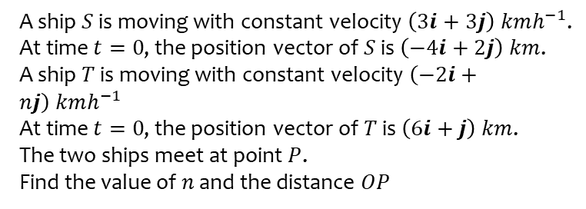
Worked example
Your turn
A ship $S$ is moving with constant velocity $\left(2i+4j\right) kmh^{−1}$.
At time $t=0$, the position vector of $S$ is $\left(−3i+5j\right) km$.
A ship $T$ is moving with constant velocity $\left(6i+nj\right) kmh^{−1}$
At time $t=0$, the position vector of $T$ is $\left(−15i+2j\right) km$.
The two ships meet at point $P$.
Find the value of $n$ and the distance $OP$
A ship $S$ is moving with constant velocity $\left(3i+3j\right) kmh^{−1}$.
At time $t=0$, the position vector of $S$ is $\left(−4i+2j\right) km$.
A ship $T$ is moving with constant velocity $\left(−2i+nj\right) kmh^{−1}$
At time $t=0$, the position vector of $T$ is $\left(6i+j\right) km$.
The two ships meet at point $P$.
Find the value of $n$ and the distance $OP$
$n=3.5, OP=8.25 km$ (3 sf)

Slide 7
8.2) Vector methods with projectiles
Chapter CONTENTS

Slide 8
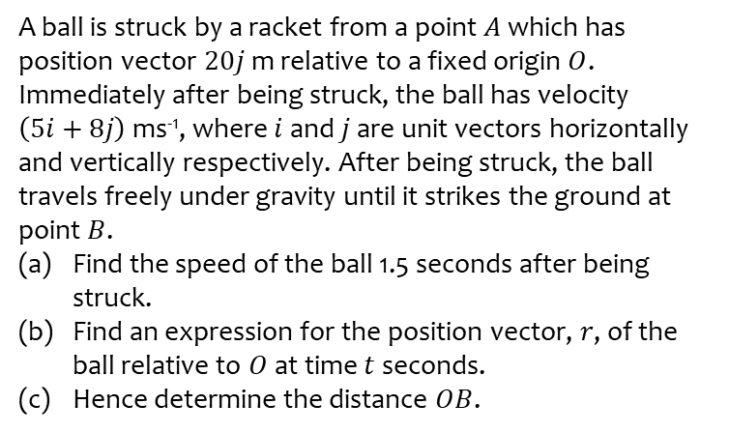
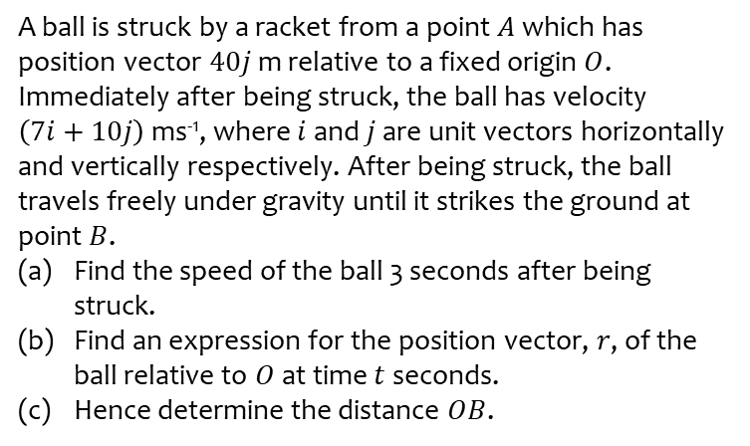
Worked example
Your turn
A ball is struck by a racket from a point $A$ which has position vector $40j$ m relative to a fixed origin $O$. Immediately after being struck, the ball has velocity $\left(7i+10j\right)$ ms⁻¹, where $i$ and $j$ are unit vectors horizontally and vertically respectively. After being struck, the ball travels freely under gravity until it strikes the ground at point $B$.
Find the speed of the ball 3 seconds after being struck.
Find an expression for the position vector, $r$, of the ball relative to $O$ at time $t$ seconds.
Hence determine the distance $OB$.
A ball is struck by a racket from a point $A$ which has position vector $20j$ m relative to a fixed origin $O$. Immediately after being struck, the ball has velocity $\left(5i+8j\right)$ ms⁻¹, where $i$ and $j$ are unit vectors horizontally and vertically respectively. After being struck, the ball travels freely under gravity until it strikes the ground at point $B$.
Find the speed of the ball 1.5 seconds after being struck.
Find an expression for the position vector, $r$, of the ball relative to $O$ at time $t$ seconds.
Hence determine the distance $OB$.
a) $8.4 ms^{−1}$ (2 sf)
b) $\left(\left(5t\right)i+\left(8t−4.9t^{2}+20\right)j\right) m$
c) $15 m$ (2 sf)

Slide 9
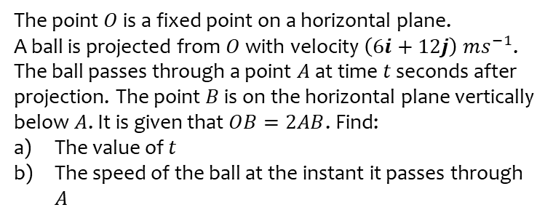
Worked example
Your turn
The point $O$ is a fixed point on a horizontal plane.
A ball is projected from $O$ with velocity $\left(4i+8j\right) ms^{−1}$.
The ball passes through a point $A$ at time $t$ seconds after projection. The point $B$ is on the horizontal plane vertically below $A$. It is given that $OB=4AB$. Find:
The value of $t$
The speed of the ball at the instant it passes through $A$
The point $O$ is a fixed point on a horizontal plane.
A ball is projected from $O$ with velocity $\left(6i+12j\right) ms^{−1}$.
The ball passes through a point $A$ at time $t$ seconds after projection. The point $B$ is on the horizontal plane vertically below $A$. It is given that $OB=2AB$. Find:
The value of $t$
The speed of the ball at the instant it passes through $A$
a) $t=1.8$ (2 sf)
b) $8.5 ms^{−1}$ (2 sf)

Slide 10
8.3) Variable acceleration in one dimension
Chapter CONTENTS

Slide 11
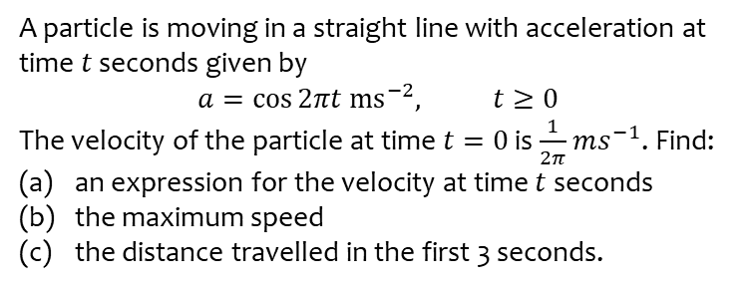
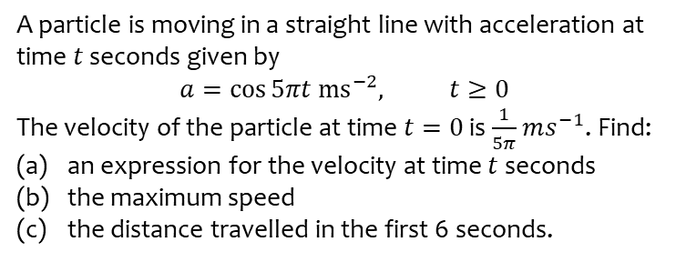
Worked example
Your turn
A particle is moving in a straight line with acceleration at time $t$ seconds given by
$$a=\cos{5πt ms^{−2}, t≥0}$$
The velocity of the particle at time $t=0$ is $\frac{1}{5π}$ $ms^{−1}$. Find:
an expression for the velocity at time $t$ seconds
the maximum speed
the distance travelled in the first 6 seconds.
A particle is moving in a straight line with acceleration at time $t$ seconds given by
$$a=\cos{2πt ms^{−2}, t≥0}$$
The velocity of the particle at time $t=0$ is $\frac{1}{2π}$ $ms^{−1}$. Find:
an expression for the velocity at time $t$ seconds
the maximum speed
the distance travelled in the first 3 seconds.
a) $v=\frac{1}{2π}\sin{2πt}+\frac{1}{2π}$ $ms^{−1}$
b) $\frac{1}{π}=0.32 ms^{−1}$ (2 sf)
c) $0.48 m$ (2 sf)

Slide 12
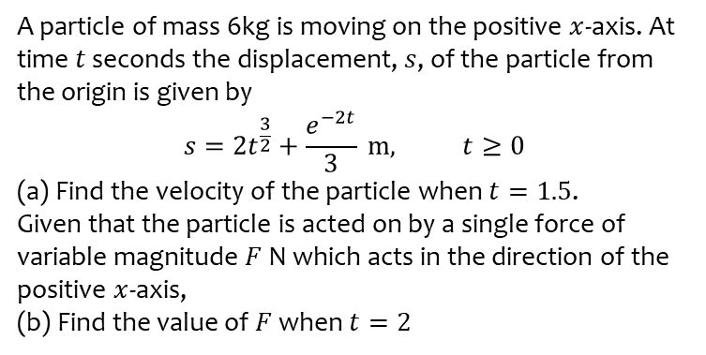
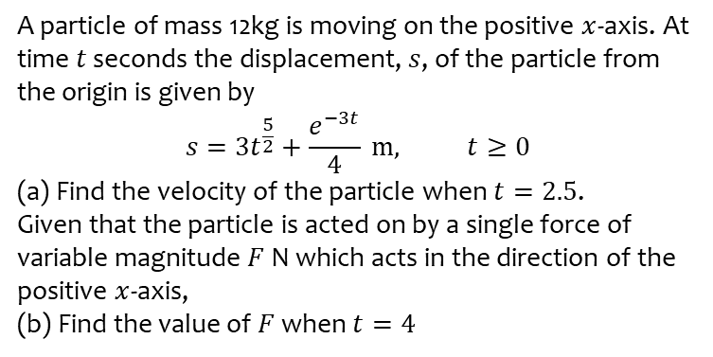
Worked example
Your turn
A particle of mass 12kg is moving on the positive $x$-axis. At time $t$ seconds the displacement, $s$, of the particle from the origin is given by
$$s=3t^{\frac{5}{2}}+\frac{e^{−3t}}{4} m, t≥0$$
(a) Find the velocity of the particle when $t=2.5$.
Given that the particle is acted on by a single force of variable magnitude $F$ N which acts in the direction of the positive $x$-axis,
(b) Find the value of $F$ when $t=4$
A particle of mass 6kg is moving on the positive $x$-axis. At time $t$ seconds the displacement, $s$, of the particle from the origin is given by
$$s=2t^{\frac{3}{2}}+\frac{e^{−2t}}{3} m, t≥0$$
(a) Find the velocity of the particle when $t=1.5$.
Given that the particle is acted on by a single force of variable magnitude $F$ N which acts in the direction of the positive $x$-axis,
(b) Find the value of $F$ when $t=2$
a) $3.6 ms^{−1}$ (2 sf)
b) $6.5 N$ (2 sf)

Slide 13
8.4) Differentiating vectors
Chapter CONTENTS

Slide 14
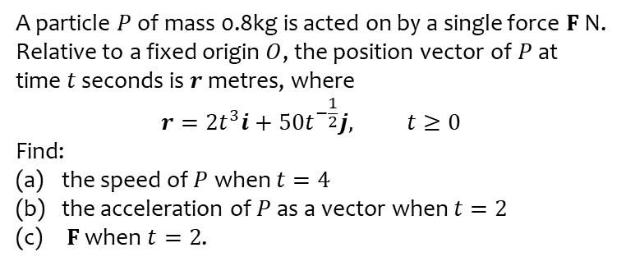
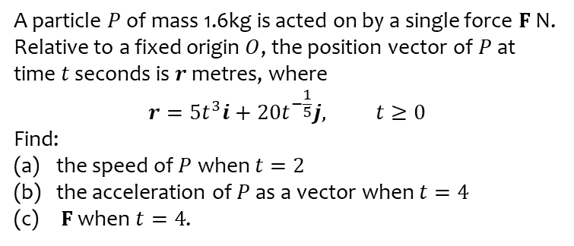
Worked example
Your turn
A particle $P$ of mass 1.6kg is acted on by a single force $F$ N. Relative to a fixed origin $O$, the position vector of $P$ at time $t$ seconds is $r$ metres, where
$$r=5t^{3}i+20t^{−\frac{1}{5}}j, t≥0$$
Find:
the speed of $P$ when $t=2$
the acceleration of $P$ as a vector when $t=4$
$F$ when $t=4$.
A particle $P$ of mass 0.8kg is acted on by a single force $F$ N. Relative to a fixed origin $O$, the position vector of $P$ at time $t$ seconds is $r$ metres, where
$$r=2t^{3}i+50t^{−\frac{1}{2}}j, t≥0$$
Find:
the speed of $P$ when $t=4$
the acceleration of $P$ as a vector when $t=2$
$F$ when $t=2$.
a) $96 ms^{−1}$ (2 sf)
b) $\left(24i+6.6j\right) ms^{−2}$ (2 sf)
c) $\left(19i+5.3j\right) N$ (2 sf)

Slide 15
8.5) Integrating vectors
Chapter CONTENTS

Slide 16
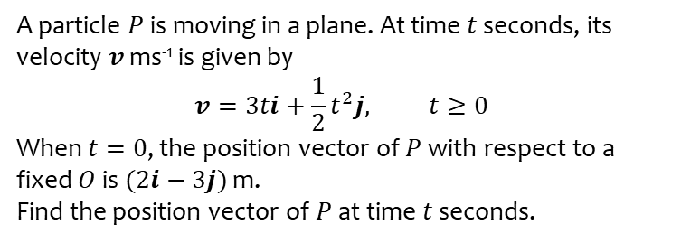
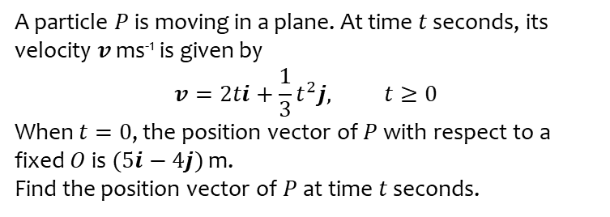
Worked example
Your turn
A particle $P$ is moving in a plane. At time $t$ seconds, its velocity $v$ ms⁻¹ is given by
$$v=2ti+\frac{1}{3}t^{2}j, t≥0$$
When $t=0$, the position vector of $P$ with respect to a fixed $O$ is $(5i−4j)$ m.
Find the position vector of $P$ at time $t$ seconds.
A particle $P$ is moving in a plane. At time $t$ seconds, its velocity $v$ ms⁻¹ is given by
$$v=3ti+\frac{1}{2}t^{2}j, t≥0$$
When $t=0$, the position vector of $P$ with respect to a fixed $O$ is $(2i−3j)$ m.
Find the position vector of $P$ at time $t$ seconds.
$$\left(\left(\frac{3t^{2}}{2}+2\right)i+\left(\frac{t^{3}}{6}−3\right)j\right)m$$

Slide 17
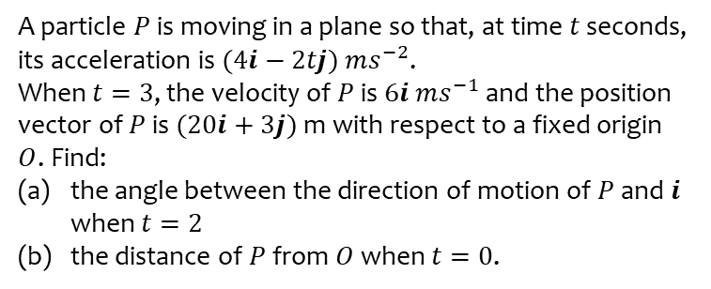
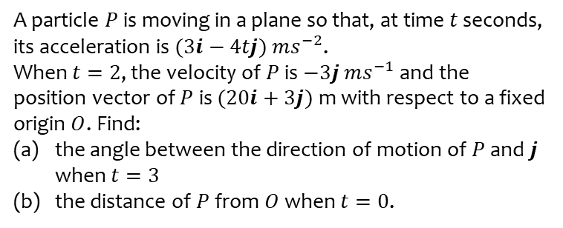
Worked example
Your turn
A particle $P$ is moving in a plane so that, at time $t$ seconds, its acceleration is $(3i−4tj)$ $ms^{−2}$.
When $t=2$, the velocity of $P$ is $−3j$ $ms^{−1}$ and the position vector of $P$ is $(20i+3j)$ m with respect to a fixed origin $O$. Find:
the angle between the direction of motion of $P$ and $j$ when $t=3$
the distance of $P$ from $O$ when $t=0$.
A particle $P$ is moving in a plane so that, at time $t$ seconds, its acceleration is $(4i−2tj)$ $ms^{−2}$.
When $t=3$, the velocity of $P$ is $6i$ $ms^{−1}$ and the position vector of $P$ is $(20i+3j)$ m with respect to a fixed origin $O$. Find:
the angle between the direction of motion of $P$ and $i$ when $t=2$
the distance of $P$ from $O$ when $t=0$.
a) $68.2°$ (1 dp)
b) $25 m$

Slide 18
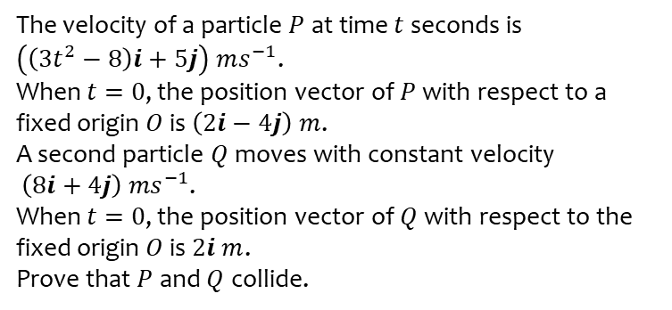
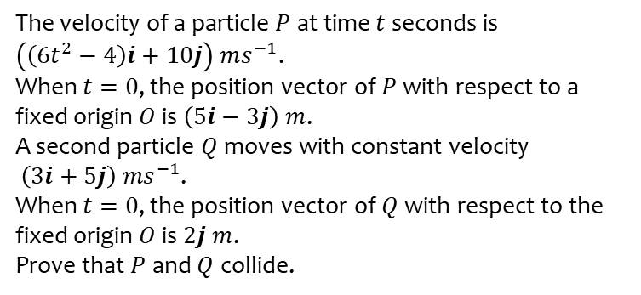
Worked example
Your turn
The velocity of a particle $P$ at time $t$ seconds is
$\left(\left(6t^{2}−4\right)i+10j\right) ms^{−1}$.
When $t=0$, the position vector of $P$ with respect to a fixed origin $O$ is $\left(5i−3j\right) m$.
A second particle $Q$ moves with constant velocity
$\left(3i+5j\right) {ms}^{−1}$.
When $t=0$, the position vector of $Q$ with respect to the fixed origin $O$ is $2j m$.
Prove that $P$ and $Q$ collide.
The velocity of a particle $P$ at time $t$ seconds is
$\left(\left(3t^{2}−8\right)i+5j\right) ms^{−1}$.
When $t=0$, the position vector of $P$ with respect to a fixed origin $O$ is $\left(2i−4j\right) m$.
A second particle $Q$ moves with constant velocity
$\left(8i+4j\right) {ms}^{−1}$.
When $t=0$, the position vector of $Q$ with respect to the fixed origin $O$ is $2i m$.
Prove that $P$ and $Q$ collide.
Proof

