Slide 1
7.7) Modelling with trigonometric functions

Slide 2
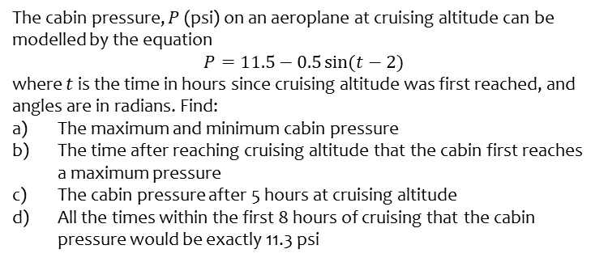
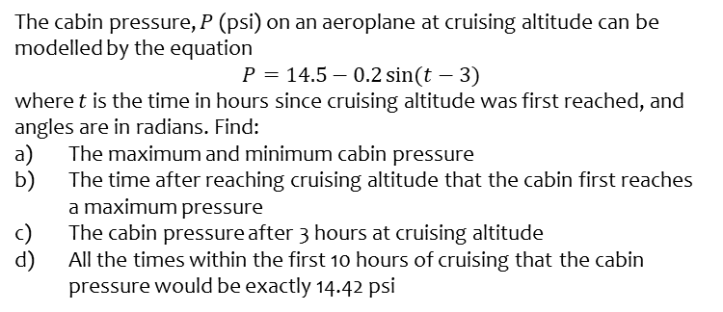
Worked example
Your turn
The cabin pressure, $P$ (psi) on an aeroplane at cruising altitude can be modelled by the equation
$$P=14.5−0.2\sin{(t−3)}$$
where $t$ is the time in hours since cruising altitude was first reached, and angles are in radians. Find:
The maximum and minimum cabin pressure
The time after reaching cruising altitude that the cabin first reaches a maximum pressure
The cabin pressure after 3 hours at cruising altitude
All the times within the first 10 hours of cruising that the cabin pressure would be exactly 14.42 psi
The cabin pressure, $P$ (psi) on an aeroplane at cruising altitude can be modelled by the equation
$$P=11.5−0.5\sin{(t−2)}$$
where $t$ is the time in hours since cruising altitude was first reached, and angles are in radians. Find:
The maximum and minimum cabin pressure
The time after reaching cruising altitude that the cabin first reaches a maximum pressure
The cabin pressure after 5 hours at cruising altitude
All the times within the first 8 hours of cruising that the cabin pressure would be exactly 11.3 psi
a) Maximum $=12$ psi ; Minimum $=11$psi
b) $0.43$hours $=26$minutes
c) $11.43$ psi
d) $2$ hours $25$ minutes, and $4$ hours $44$ minutes

Slide 3
Worked example
Your turn
Express $7\cos{θ}−5\sin{θ}$ in the form $R\cos{(θ}+α),$where $R>0$ and $0<α<\frac{π}{2}$. State the exact value of $R$ and give $α$ to four decimal places.
State the maximum value of $7\cos{θ}−5\sin{θ}$ and the value of $θ$, for $0<θ<2π$ at which this maximum occurs.
The height $H$ above ground of a passenger on a Ferris wheel is modelled by the equation
$$H=12−7\cos{(\frac{πt}{4}})+5 sin⁡(\frac{πt}{4})$$
where $H$ is measured in metres, and $t$ is the time in minutes after the wheel starts turning.
Calculate the maximum value of $H$ predicted by this model, and the value of $t$ when this maximum first occurs
Determine the time for the Ferris wheel to complete five revolutions
Express $9\cos{θ}−2\sin{θ}$ in the form $R\cos{(θ}+α),$where $R>0$ and $0<α<\frac{π}{2}$. State the exact value of $R$ and give $α$ to four decimal places.
State the maximum value of $9\cos{θ}−2\sin{θ}$ and the value of $θ$, for $0<θ<2π$ at which this maximum occurs.
The height $H$ above ground of a passenger on a Ferris wheel is modelled by the equation
$$H=10−9\cos{(\frac{πt}{5}})+2 sin⁡(\frac{πt}{5})$$
where $H$ is measured in metres, and $t$ is the time in minutes after the wheel starts turning.
Calculate the maximum value of $H$ predicted by this model, and the value of $t$ when this maximum first occurs
Determine the time for the Ferris wheel to complete two revolutions
a) $R=\sqrt{85}, α=0.2187$
b) Maximum $=\sqrt{85}$ when $θ=6.06$
c) Maximum $H=19.22m$ at $t=4.65$
d) $20$ minutes

Slide 4
Worked example
Your turn
Express $1.5\sin{θ}−2\cos{θ}$ in the form $R\sin{(θ}−α),$where $R>0$ and $0<α<\frac{π}{2}$. State the exact value of $R$ and give $α$ to four decimal places.
State the maximum value of$1.5\sin{θ}−2\cos{θ}$and the value of $θ$, for $0<θ<π$ at which this maximum occurs.
The height $H$ of sea water on a particular day can be modelled by the equation
$$H=8+1.5\sin\left(\frac{2πt}{25}\right)−2\cos\left(\frac{2πt}{25}\right), 0≤t<12$$
where $H$ is measured in metres, and $t$ is the number of hours after midnight.
Calculate the maximum value of $H$ predicted by this model, and the value of $t$ when this maximum occurs
Calculate, to the nearest minute, the times when the height of sea water is predicted, by this model, to be 7 metres.
Express $2\sin{θ}−1.5\cos{θ}$ in the form $R\sin{(θ}−α),$where $R>0$ and $0<α<\frac{π}{2}$. State the exact value of $R$ and give $α$ to four decimal places.
State the maximum value of $2\sin{θ}−1.5\cos{θ}$ and the value of $θ$, for $0<θ<π$ at which this maximum occurs.
The height $H$ of sea water on a particular day can be modelled by the equation
$$H=6+2\sin\left(\frac{4πt}{25}\right)−1.5\cos\left(\frac{4πt}{25}\right), 0≤t<12$$
where $H$ is measured in metres, and $t$ is the number of hours after midday.
Calculate the maximum value of $H$ predicted by this model, and the value of $t$ when this maximum occurs
Calculate, to the nearest minute, the times when the height of sea water is predicted, by this model, to be 7 metres.
a) $R=2.5, α=0.6435$
b) Maximum $=2.5$ when $θ=2.21$
c) Maximum $H=8.5m$ at $t=4.41$
d) $14:06$ and $18:43$

