Slide 1
7.6) Connected particles

Slide 2
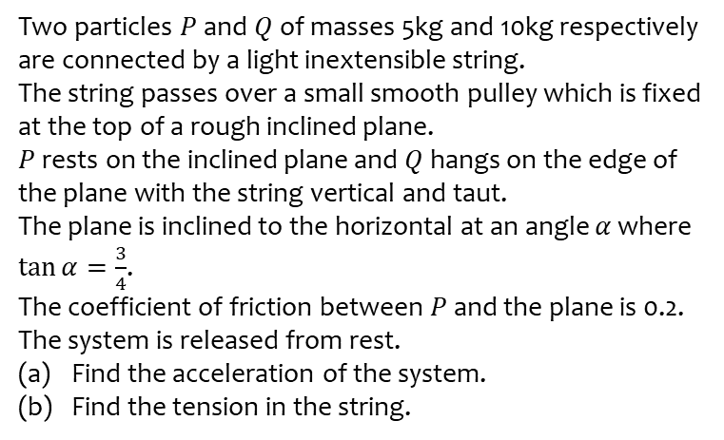
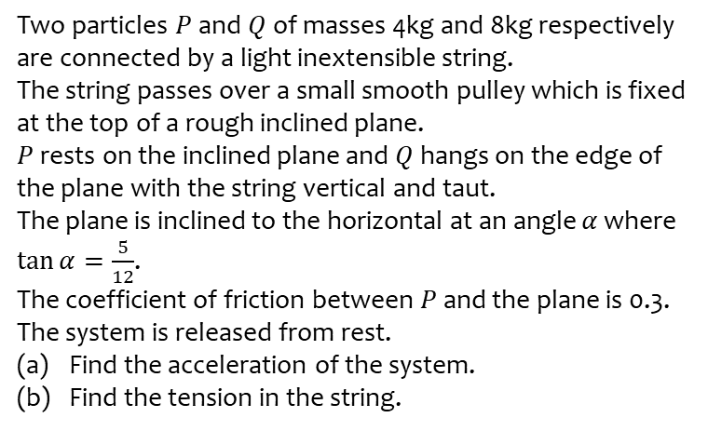
Worked example
Your turn
Two particles $P$ and $Q$ of masses 4kg and 8kg respectively are connected by a light inextensible string.
The string passes over a small smooth pulley which is fixed at the top of a rough inclined plane.
$P$ rests on the inclined plane and $Q$ hangs on the edge of the plane with the string vertical and taut.
The plane is inclined to the horizontal at an angle $α$ where $\tan{α}=\frac{5}{12}$.
The coefficient of friction between $P$ and the plane is 0.3. The system is released from rest.
Find the acceleration of the system.
Find the tension in the string.
Two particles $P$ and $Q$ of masses 5kg and 10kg respectively are connected by a light inextensible string.
The string passes over a small smooth pulley which is fixed at the top of a rough inclined plane.
$P$ rests on the inclined plane and $Q$ hangs on the edge of the plane with the string vertical and taut.
The plane is inclined to the horizontal at an angle $α$ where $\tan{α}=\frac{3}{4}$.
The coefficient of friction between $P$ and the plane is 0.2. The system is released from rest.
Find the acceleration of the system.
Find the tension in the string.
a) $4.1 ms^{−2}$ (2 sf)
b) $57 N$ (2 sf)

Slide 3
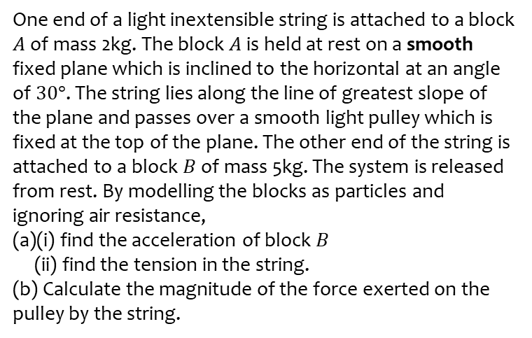
Worked example
Your turn
One end of a light inextensible string is attached to a block $A$ of mass 4kg. The block $A$ is held at rest on a smooth fixed plane which is inclined to the horizontal at an angle of $45°$. The string lies along the line of greatest slope of the plane and passes over a smooth light pulley which is fixed at the top of the plane. The other end of the string is attached to a block $B$ of mass 10kg. The system is released from rest. By modelling the blocks as particles and ignoring air resistance,
(a)(i) find the acceleration of block $B$
(ii) find the tension in the string.
(b) State how you have used the fact that the string is inextensible in your calculations.
(c) Calculate the magnitude of the force exerted on the pulley by the string.
One end of a light inextensible string is attached to a block $A$ of mass 2kg. The block $A$ is held at rest on a smooth fixed plane which is inclined to the horizontal at an angle of $30°$. The string lies along the line of greatest slope of the plane and passes over a smooth light pulley which is fixed at the top of the plane. The other end of the string is attached to a block $B$ of mass 5kg. The system is released from rest. By modelling the blocks as particles and ignoring air resistance,
(a)(i) find the acceleration of block $B$
(ii) find the tension in the string.
(b) Calculate the magnitude of the force exerted on the pulley by the string.
a)
i) $5.6 ms^{−2}$
ii) $21 N$
b) $36 N$ (2 sf)

Slide 4
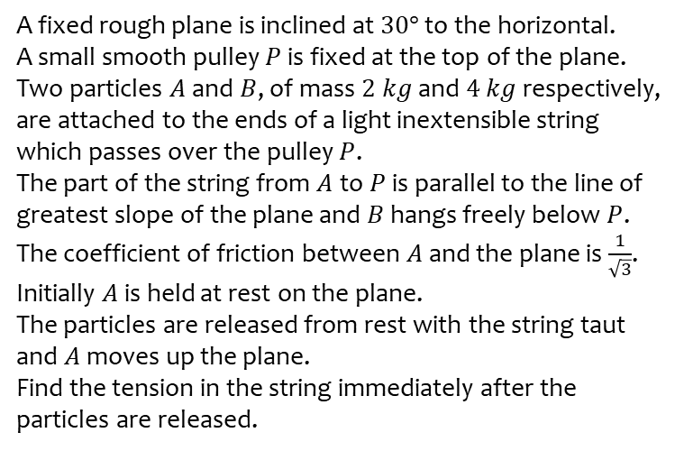
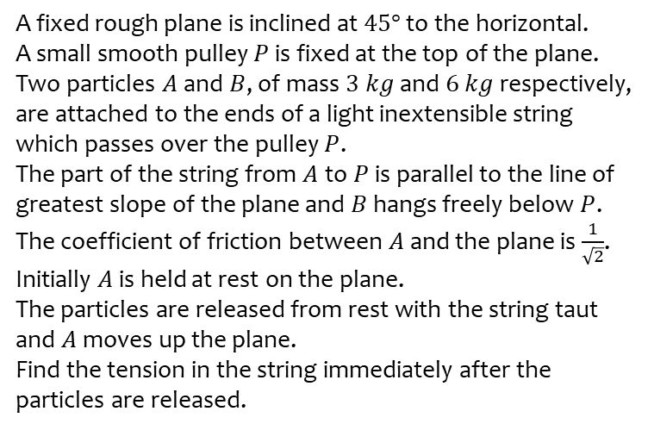
Worked example
Your turn
A fixed rough plane is inclined at $45°$ to the horizontal.
A small smooth pulley $P$ is fixed at the top of the plane.
Two particles $A$ and $B$, of mass $3 kg$ and $6 kg$ respectively, are attached to the ends of a light inextensible string which passes over the pulley $P$.
The part of the string from $A$ to $P$ is parallel to the line of greatest slope of the plane and $B$ hangs freely below $P$.
The coefficient of friction between $A$ and the plane is $\frac{1}{\sqrt{2}}$.
Initially $A$ is held at rest on the plane.
The particles are released from rest with the string taut and $A$ moves up the plane.
Find the tension in the string immediately after the particles are released.
A fixed rough plane is inclined at $30°$ to the horizontal.
A small smooth pulley $P$ is fixed at the top of the plane.
Two particles $A$ and $B$, of mass $2 kg$ and $4 kg$ respectively, are attached to the ends of a light inextensible string which passes over the pulley $P$.
The part of the string from $A$ to $P$ is parallel to the line of greatest slope of the plane and $B$ hangs freely below $P$.
The coefficient of friction between $A$ and the plane is $\frac{1}{\sqrt{3}}$.
Initially $A$ is held at rest on the plane.
The particles are released from rest with the string taut and $A$ moves up the plane.
Find the tension in the string immediately after the particles are released.
$26 N$ (2 sf)

