Slide 1
7.5) Simplifying $a\cos{x}±b\sin{x}$

Slide 2
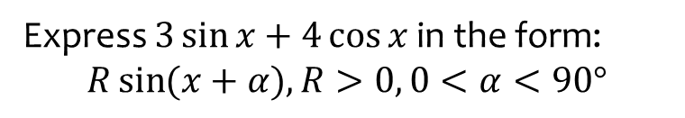
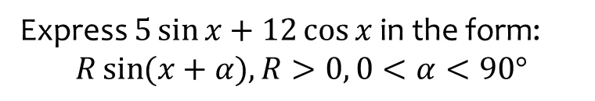

Worked example
Your turn
Express $5\sin{x}+12\cos{x}$ in the form:
$$R\sin{(x+α}), R>0, 0<α<90°$$
Express $3\sin{x}+4\cos{x}$ in the form:
$$R\sin{(x+α}), R>0, 0<α<90°$$
$$5\sin{(x+53.1°})$$

Slide 3
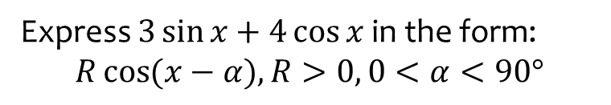
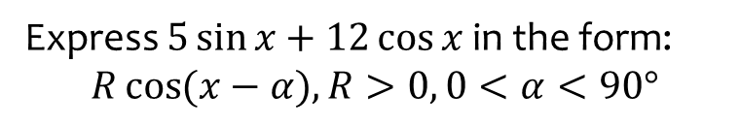

Worked example
Your turn
Express $5\sin{x}+12\cos{x}$ in the form:
$$R\cos{(x−α}), R>0, 0<α<90°$$
Express $3\sin{x}+4\cos{x}$ in the form:
$$R\cos{(x−α}), R>0, 0<α<90°$$
$$5\cos{(x−36.9°)}$$

Slide 4
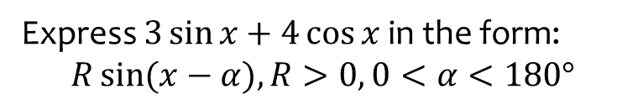
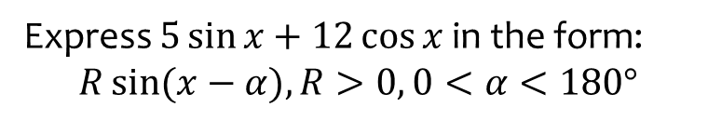

Worked example
Your turn
Express $5\sin{x}+12\cos{x}$ in the form:
$$R\sin{(x−α}), R>0, 0<α<180°$$
Express $3\sin{x}+4\cos{x}$ in the form:
$$R\sin{(x−α}), R>0, 0<α<180°$$
$$5\sin{(x+126.9°})$$

Slide 5
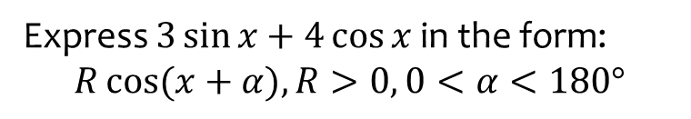
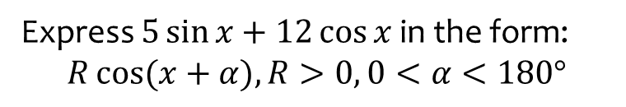

Worked example
Your turn
Express $5\sin{x}+12\cos{x}$ in the form:
$$R\cos{(x+α}), R>0, 0<α<180°$$
Express $3\sin{x}+4\cos{x}$ in the form:
$$R\cos{(x+α}), R>0, 0<α<180°$$
$$5\cos{(x+143.1°)}$$

Slide 6



Worked example
Your turn
Solve in the interval $0<θ<360°$:
$$5\cos{θ}+2\sin{θ}=3$$
Solve in the interval $0<θ<360°$:
$$2\cos{θ}+5\sin{θ}=3$$
$θ=12.1°, 124.3°$ (1 dp)

Slide 7



Worked example
Your turn
Solve in the interval $0≤θ<180°$:
$$5\sin{3θ}−12\cos{3θ}=1$$
Solve in the interval $0≤θ<180°$:
$$3\sin{3θ}−4\cos{3θ}=1$$
$θ=21.6°, 73.9°, 141.6°$ (1 dp)

Slide 8



Worked example
Your turn
Solve in the interval $0≤θ<180°$:
$$5\cos{3θ}−12\sin{3θ}=1$$
Solve in the interval $0≤θ<180°$:
$$3\cos{3θ}−4\sin{3θ}=1$$
$θ=8.4°, 76.1°, 128.4°$ (1 dp)

Slide 9



Worked example
Your turn
Solve in the interval $0≤θ<360°$:
$$\cot{θ}+4=cosec θ$$
Solve in the interval $0≤θ<360°$:
$$\cot{θ}+3=cosec θ$$
$θ=143.1°$ (1 dp)

Slide 10
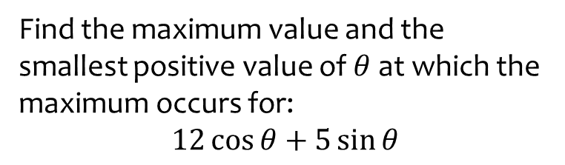

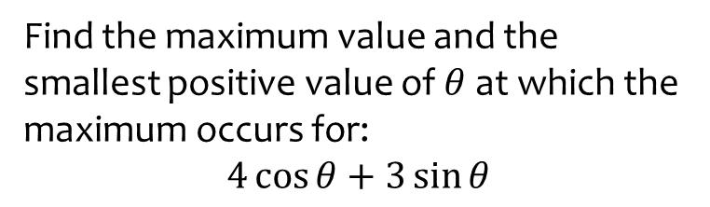
Worked example
Your turn
Find the maximum value and the smallest positive value of $θ$ at which the maximum occurs for:
$$4\cos{θ}+3\sin{θ}$$
Find the maximum value and the smallest positive value of $θ$ at which the maximum occurs for:
$$12\cos{θ}+5\sin{θ}$$
Maximum $=13$ when $θ=22.6°$ (1 dp)

Slide 11
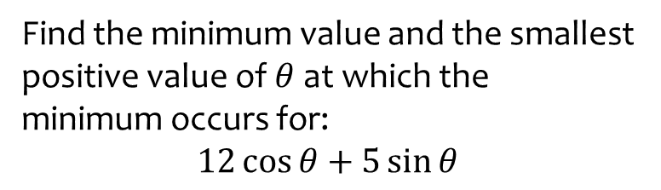
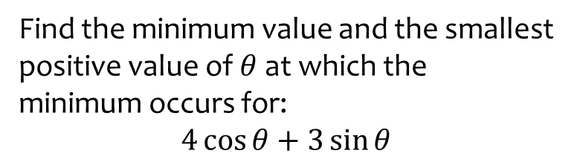

Worked example
Your turn
Find the minimum value and the smallest positive value of $θ$ at which the minimum occurs for:
$$4\cos{θ}+3\sin{θ}$$
Find the minimum value and the smallest positive value of $θ$ at which the minimum occurs for:
$$12\cos{θ}+5\sin{θ}$$
Minimum $=−13$ when $θ=202.6°$ (1 dp)

Slide 12
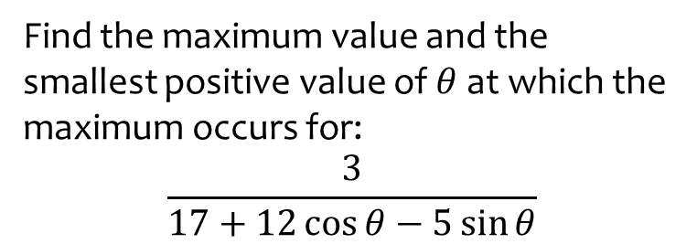
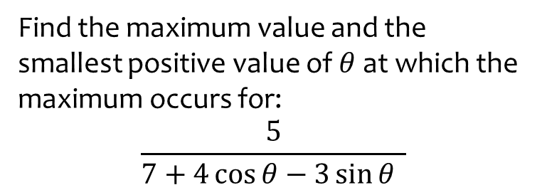

Worked example
Your turn
Find the maximum value and the smallest positive value of $θ$ at which the maximum occurs for:
$$\frac{5}{7+4\cos{θ}−3\sin{θ} }$$
Find the maximum value and the smallest positive value of $θ$ at which the maximum occurs for:
$$\frac{3}{17+12\cos{θ}−5\sin{θ}}$$
Maximum $=\frac{3}{4}$ when $θ=157.4°$ (1 dp)

Slide 13
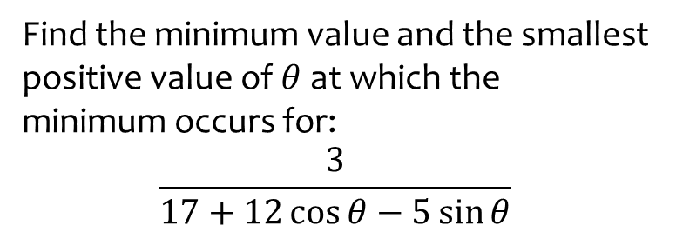

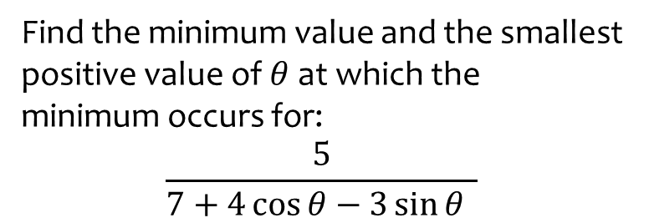
Worked example
Your turn
Find the minimum value and the smallest positive value of $θ$ at which the minimum occurs for:
$$\frac{5}{7+4\cos{θ}−3\sin{θ} }$$
Find the minimum value and the smallest positive value of $θ$ at which the minimum occurs for:
$$\frac{3}{17+12\cos{θ}−5\sin{θ}}$$
Minimum $=\frac{1}{10}$ when $θ=337.4°$ (1 dp)

