Slide 1
7.5) Methods of proof

Slide 2
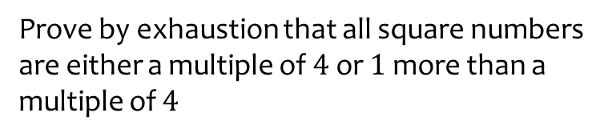
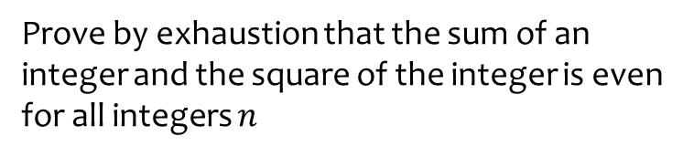
Worked example
Your turn
Prove by exhaustion that the sum of an integer and the square of the integer is even for all integers $n$
Prove by exhaustion that all square numbers are either a multiple of $4$ or $1$ more than a multiple of $4$
Proof

Slide 3
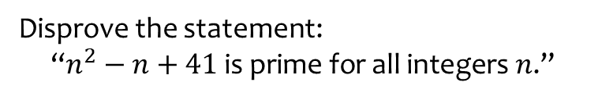
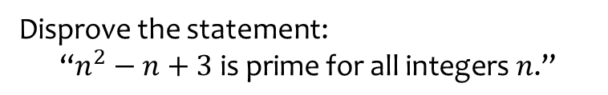
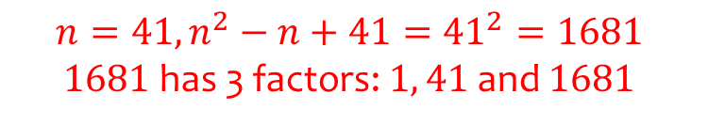
Worked example
Your turn
Disprove the statement:
$$\text{“}n^{2}−n+3 \text{is} \text{prime} \text{for} \text{all} \text{integers} n\text{.”}$$
Disprove the statement:
$$\text{“}n^{2}−n+41 \text{is} \text{prime} \text{for} \text{all} \text{integers} n\text{.”}$$
$$n=41, n^{2}−n+41={41}^{2}=1681$$
$1681$ has 3 factors: $1, 41$ and $1681$

Slide 4
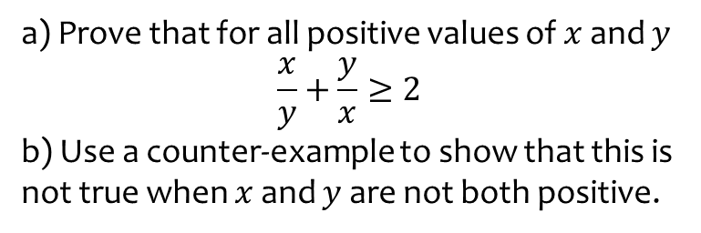
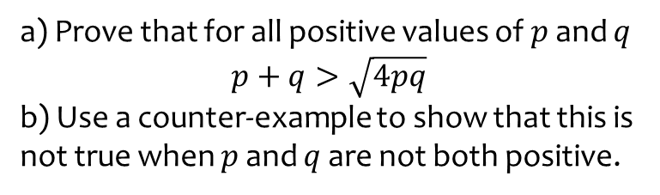
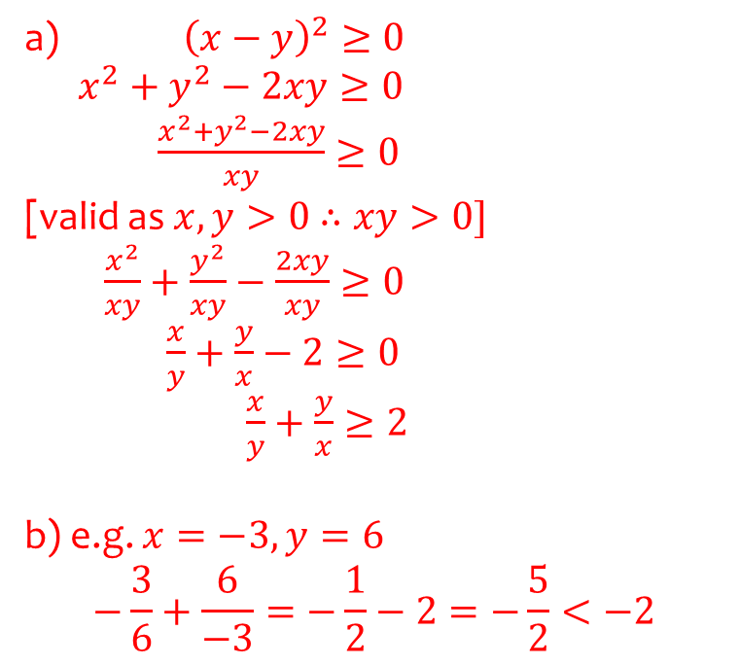
Worked example
Your turn
a) Prove that for all positive values of $p$ and $q$
$$p+q>\sqrt{4pq}$$
b) Use a counter-example to show that this is not true when $p$ and $q$ are not both positive.
a) Prove that for all positive values of $x$ and $y$
$$\frac{x}{y}+\frac{y}{x}≥2$$
b) Use a counter-example to show that this is not true when $x$ and $y$ are not both positive.
a) ${\left(x−y\right)}^{2}≥0$
$x^{2}+y^{2}−2xy≥0$
$\frac{x^{2}+y^{2}−2xy}{xy}≥0$
[valid as $x,y>0$ $∴xy>0]$
$\frac{x^{2}}{xy}+\frac{y^{2}}{xy}−\frac{2xy}{xy}≥0$
$\frac{x}{y}+\frac{y}{x}−2≥0$
$\frac{x}{y}+\frac{y}{x}≥2$
b) e.g. $x=−3, y=6$
$$−\frac{3}{6}+\frac{6}{−3}=−\frac{1}{2}−2=−\frac{5}{2}<−2$$

