Slide 1
7.5) Dynamics and inclined planes

Slide 2
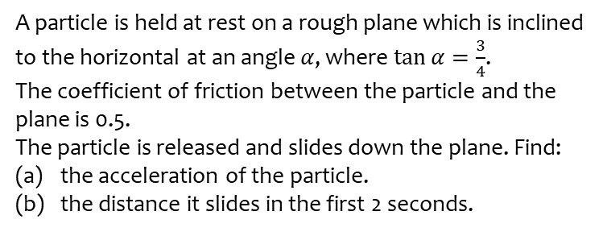
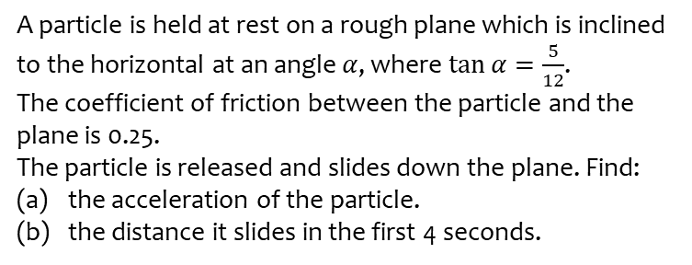
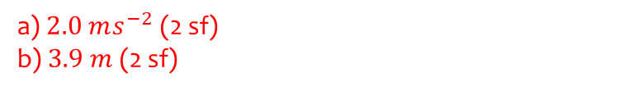
Worked example
Your turn
A particle is held at rest on a rough plane which is inclined to the horizontal at an angle $α$, where $\tan{α}=\frac{5}{12}$.
The coefficient of friction between the particle and the plane is 0.25.
The particle is released and slides down the plane. Find:
the acceleration of the particle.
the distance it slides in the first 4 seconds.
A particle is held at rest on a rough plane which is inclined to the horizontal at an angle $α$, where $\tan{α}=\frac{3}{4}$.
The coefficient of friction between the particle and the plane is 0.5.
The particle is released and slides down the plane. Find:
the acceleration of the particle.
the distance it slides in the first 2 seconds.
a) $2.0 ms^{−2}$ (2 sf)
b) $3.9 m$ (2 sf)

Slide 3
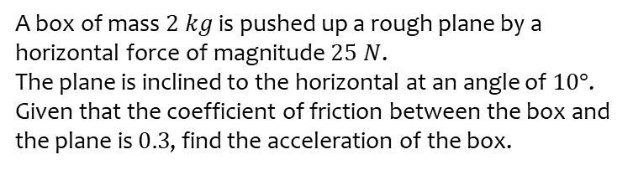
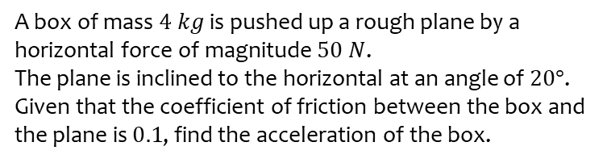
Worked example
Your turn
A box of mass $4 kg$ is pushed up a rough plane by a horizontal force of magnitude $50 N$.
The plane is inclined to the horizontal at an angle of $20°$.
Given that the coefficient of friction between the box and the plane is $0.1$, find the acceleration of the box.
A box of mass $2 kg$ is pushed up a rough plane by a horizontal force of magnitude $25 N$.
The plane is inclined to the horizontal at an angle of $10°$.
Given that the coefficient of friction between the box and the plane is $0.3$, find the acceleration of the box.
$7.1 ms^{−2}$ (2 sf) up the plane

Slide 4
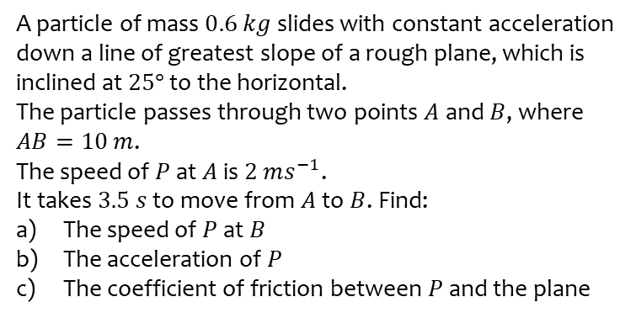
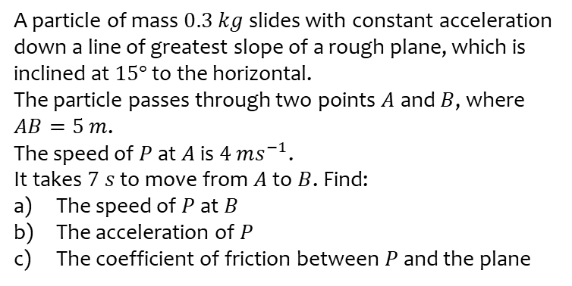
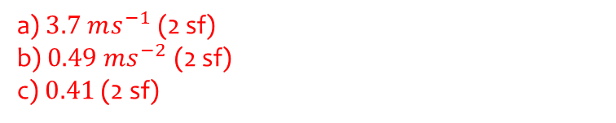
Worked example
Your turn
A particle of mass $0.3 kg$ slides with constant acceleration down a line of greatest slope of a rough plane, which is inclined at $15°$ to the horizontal.
The particle passes through two points $A$ and $B$, where $AB=5 m$.
The speed of $P$ at $A$ is $4 ms^{−1}$.
It takes $7 s$ to move from $A$ to $B$. Find:
The speed of $P$ at $B$
The acceleration of $P$
The coefficient of friction between $P$ and the plane
A particle of mass $0.6 kg$ slides with constant acceleration down a line of greatest slope of a rough plane, which is inclined at $25°$ to the horizontal.
The particle passes through two points $A$ and $B$, where $AB=10 m$.
The speed of $P$ at $A$ is $2 ms^{−1}$.
It takes $3.5 s$ to move from $A$ to $B$. Find:
The speed of $P$ at $B$
The acceleration of $P$
The coefficient of friction between $P$ and the plane
a) $3.7 ms^{−1}$ (2 sf)
b) $0.49 ms^{−2}$ (2 sf)
c) $0.41$ (2 sf)

