Slide 1
7.4) Two-tailed tests

Slide 2
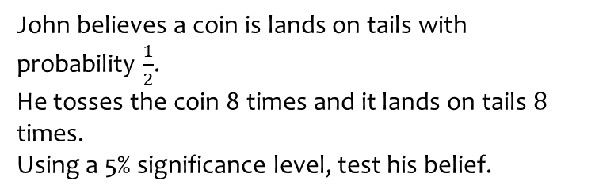
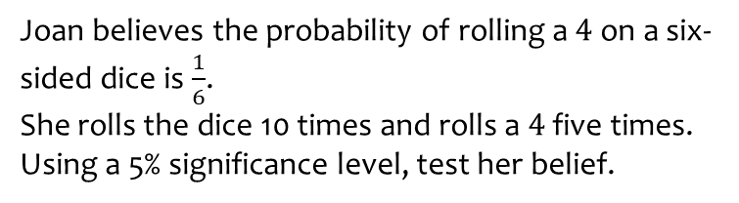
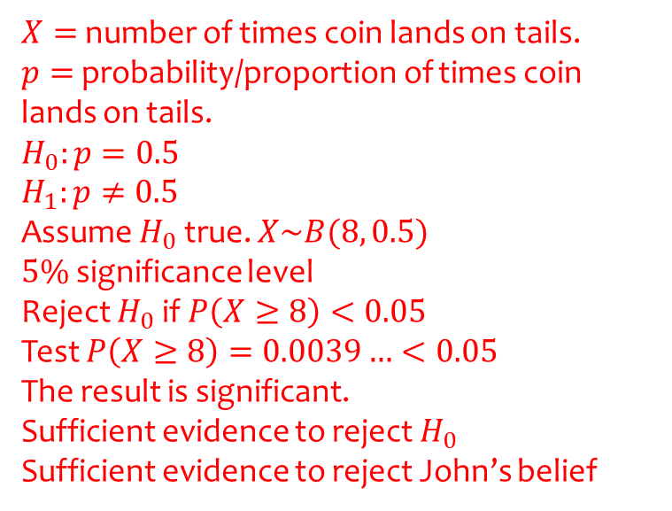
Worked example
Your turn
Joan believes the probability of rolling a $4$ on a six-sided dice is $\frac{1}{6}$.
She rolls the dice 10 times and rolls a $4$ five times.
Using a 5% significance level, test her belief.
John believes a coin is lands on tails with probability $\frac{1}{2}$.
He tosses the coin 8 times and it lands on tails $8$ times.
Using a 5% significance level, test his belief.
$X=$ number of times coin lands on tails.
$p=$ probability/proportion of times coin lands on tails.
$$H_{0}:p=0.5$$
$$H_{1}:p≠0.5$$
Assume $H_{0}$ true. $X\sim B(8, 0.5)$
$5\%$ significance level
Reject $H_{0}$ if $P\left(X≥8\right)<0.05$
Test $P\left(X≥8\right)=0.0039…<0.05$
The result is significant.
Sufficient evidence to reject $H_{0}$
Sufficient evidence to reject John’s belief

Slide 3
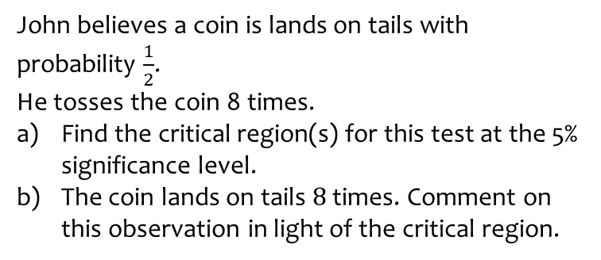
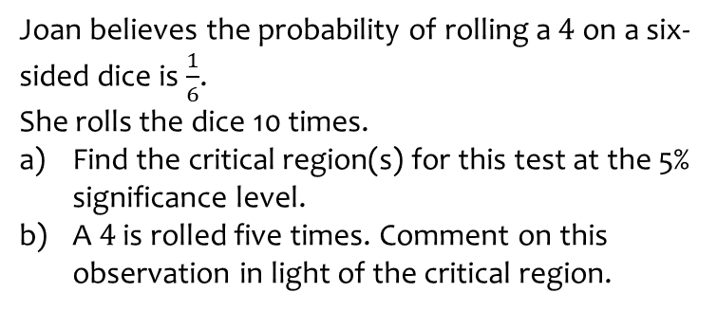
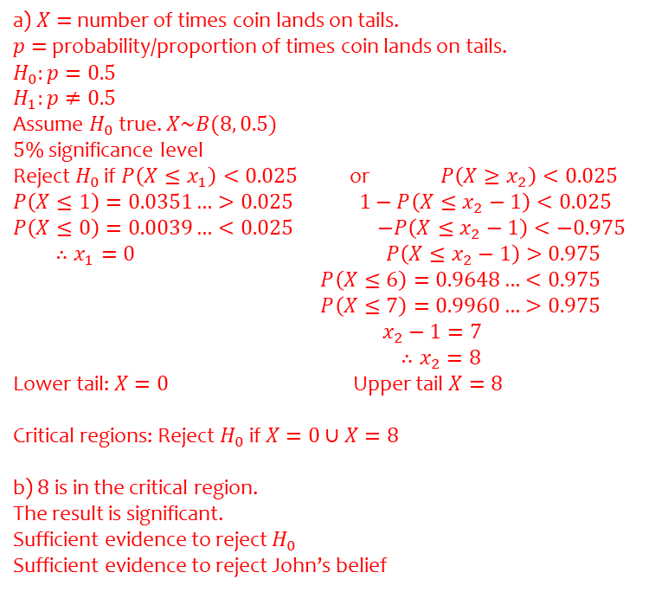
Worked example
Your turn
Joan believes the probability of rolling a $4$ on a six-sided dice is $\frac{1}{6}$.
She rolls the dice 10 times.
Find the critical region(s) for this test at the 5% significance level.
A $4$ is rolled five times. Comment on this observation in light of the critical region.
John believes a coin is lands on tails with probability $\frac{1}{2}$.
He tosses the coin 8 times.
Find the critical region(s) for this test at the 5% significance level.
The coin lands on tails $8$ times. Comment on this observation in light of the critical region.
a) $X=$ number of times coin lands on tails.
$p=$ probability/proportion of times coin lands on tails.
$$H_{0}:p=0.5$$
$$H_{1}:p≠0.5$$
Assume $H_{0}$ true. $X\sim B(8, 0.5)$
$5\%$ significance level
Reject $H_{0}$ if $P\left(X≤x_{1}\right)<0.025$ or $P\left(X≥x_{2}\right)<0.025$
$P\left(X≤1\right)=0.0351…>0.025$ $1−P\left(X≤x_{2}−1\right)<0.025$
$P\left(X≤0\right)=0.0039…<0.025$ $−P\left(X≤x_{2}−1\right)<−0.975$
$∴x_{1}=0$ $P\left(X≤x_{2}−1\right)>0.975$
$P\left(X≤6\right)=0.9648…<0.975$
$P\left(X≤7\right)=0.9960…>0.975$
$x_{2}−1=7$
$∴x_{2}=8$
Lower tail: $X=0$ Upper tail $X=8$
Critical regions: Reject $H_{0}$ if $X=0∪X=8$
b) $8$ is in the critical region.
The result is significant.
Sufficient evidence to reject $H_{0}$
Sufficient evidence to reject John’s belief

Slide 4
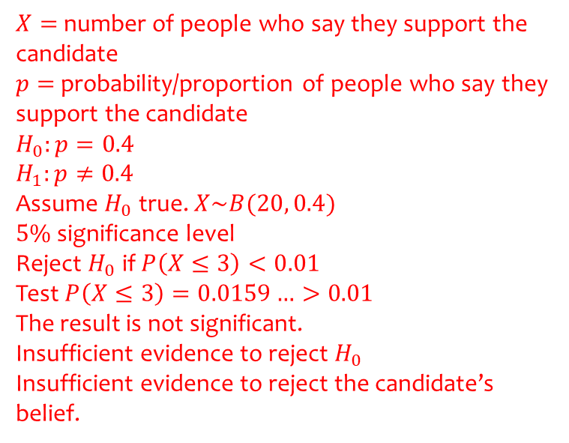
Worked example
Your turn
An election candidate believes he has the support of 30% of the residents in a particular town.
The researcher asks 30 people whether they support the candidate or not. 1 person says they support the candidate.
Test, at the 1% significance level, whether the candidate’s claim is true.
An election candidate believes she has the support of 40% of the residents in a particular town.
The researcher asks 20 people whether they support the candidate or not. 3 people say they support the candidate.
Test, at the 2% significance level, whether the candidate’s claim is true.
$X=$ number of people who say they support the candidate
$p=$ probability/proportion of people who say they support the candidate
$$H_{0}:p=0.4$$
$$H_{1}:p≠0.4$$
Assume $H_{0}$ true. $X\sim B(20, 0.4)$
$5\%$ significance level
Reject $H_{0}$ if $P\left(X≤3\right)<0.01$
Test $P\left(X≤3\right)=0.0159…>0.01$
The result is not significant.
Insufficient evidence to reject $H_{0}$
Insufficient evidence to reject the candidate’s belief.

Slide 5
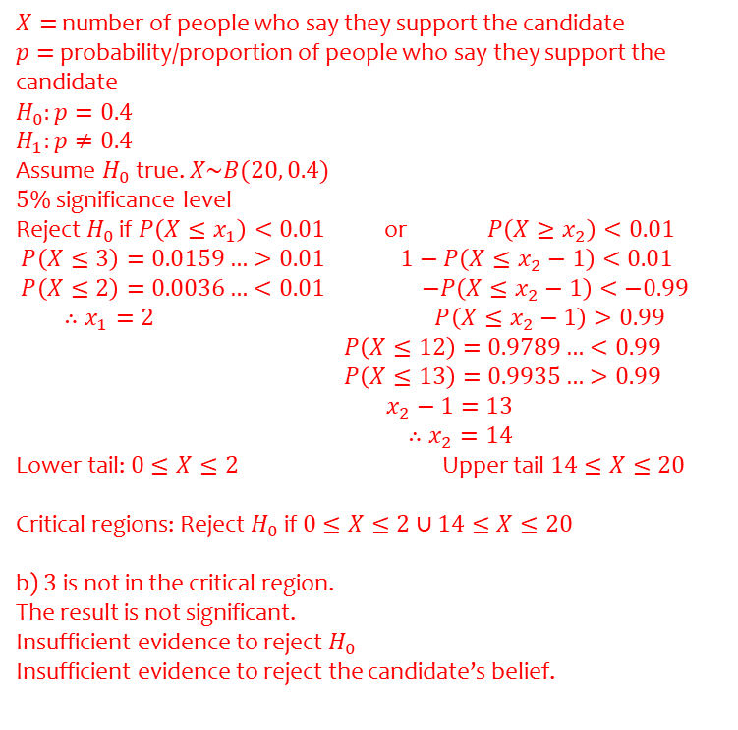
Worked example
Your turn
An election candidate believes he has the support of 30% of the residents in a particular town.
The researcher asks 30 people whether they support the candidate or not.
Find the critical region(s) for a test of the candidate’s claim at the 1% significance level.
1 person says they support the candidate. Comment on this observation in light of the critical region.
An election candidate believes she has the support of 40% of the residents in a particular town.
The researcher asks 20 people whether they support the candidate or not.
Find the critical region(s) for a test of the candidate’s claim at the 2% significance level.
3 people say they support the candidate. Comment on this observation in light of the critical region.
$X=$ number of people who say they support the candidate
$p=$ probability/proportion of people who say they support the candidate
$$H_{0}:p=0.4$$
$$H_{1}:p≠0.4$$
Assume $H_{0}$ true. $X\sim B(20, 0.4)$
$5\%$ significance level
Reject $H_{0}$ if $P\left(X≤x_{1}\right)<0.01$ or $P\left(X≥x_{2}\right)<0.01$
$P\left(X≤3\right)=0.0159…>0.01$ $1−P\left(X≤x_{2}−1\right)<0.01$
$P\left(X≤2\right)=0.0036…<0.01$ $−P\left(X≤x_{2}−1\right)<−0.99$
$∴x_{1}=2$ $P\left(X≤x_{2}−1\right)>0.99$
$P\left(X≤12\right)=0.9789…<0.99$
$P\left(X≤13\right)=0.9935…>0.99$
$x_{2}−1=13$
$∴x_{2}=14$
Lower tail: $0≤X≤2$ Upper tail $14≤X≤20$
Critical regions: Reject $H_{0}$ if $0≤X≤2∪14≤X≤20$
b) $3$ is not in the critical region.
The result is not significant.
Insufficient evidence to reject $H_{0}$
Insufficient evidence to reject the candidate’s belief.

Slide 6
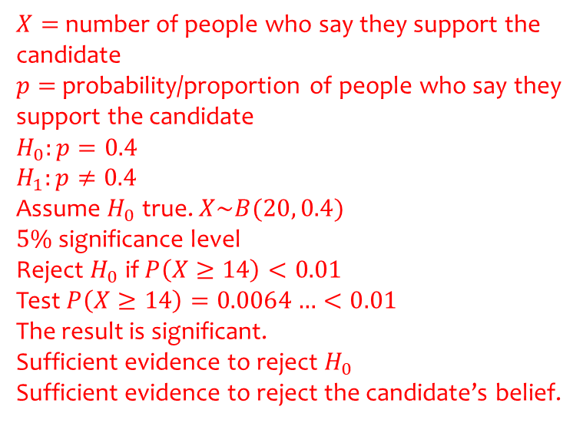
Worked example
Your turn
An election candidate believes he has the support of 30% of the residents in a particular town.
The researcher asks 30 people whether they support the candidate or not. 16 people say they support the candidate.
Test, at the 1% significance level, whether the candidate’s claim is true.
An election candidate believes she has the support of 40% of the residents in a particular town.
The researcher asks 20 people whether they support the candidate or not. 14 people say they support the candidate.
Test, at the 2% significance level, whether the candidate’s claim is true.
$X=$ number of people who say they support the candidate
$p=$ probability/proportion of people who say they support the candidate
$$H_{0}:p=0.4$$
$$H_{1}:p≠0.4$$
Assume $H_{0}$ true. $X\sim B(20, 0.4)$
$5\%$ significance level
Reject $H_{0}$ if $P\left(X≥14\right)<0.01$
Test $P\left(X≥14\right)=0.0064…<0.01$
The result is significant.
Sufficient evidence to reject $H_{0}$
Sufficient evidence to reject the candidate’s belief.

Slide 7
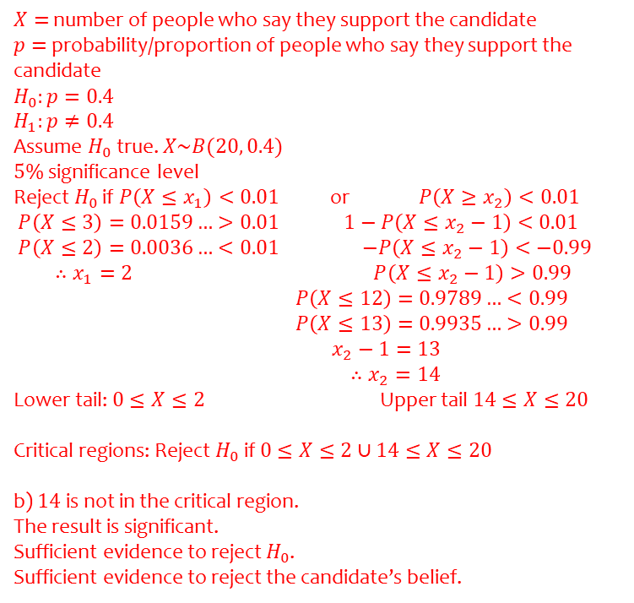
Worked example
Your turn
An election candidate believes he has the support of 30% of the residents in a particular town.
The researcher asks 30 people whether they support the candidate or not.
Find the critical region(s) for a test of the candidate’s claim at the 1% significance level.
16 people say they support the candidate. Comment on this observation in light of the critical region.
An election candidate believes she has the support of 40% of the residents in a particular town.
The researcher asks 20 people whether they support the candidate or not.
Find the critical region(s) for a test of the candidate’s claim at the 2% significance level.
14 people say they support the candidate. Comment on this observation in light of the critical region.
$X=$ number of people who say they support the candidate
$p=$ probability/proportion of people who say they support the candidate
$$H_{0}:p=0.4$$
$$H_{1}:p≠0.4$$
Assume $H_{0}$ true. $X\sim B(20, 0.4)$
$5\%$ significance level
Reject $H_{0}$ if $P\left(X≤x_{1}\right)<0.01$ or $P\left(X≥x_{2}\right)<0.01$
$P\left(X≤3\right)=0.0159…>0.01$ $1−P\left(X≤x_{2}−1\right)<0.01$
$P\left(X≤2\right)=0.0036…<0.01$ $−P\left(X≤x_{2}−1\right)<−0.99$
$∴x_{1}=2$ $P\left(X≤x_{2}−1\right)>0.99$
$P\left(X≤12\right)=0.9789…<0.99$
$P\left(X≤13\right)=0.9935…>0.99$
$x_{2}−1=13$
$∴x_{2}=14$
Lower tail: $0≤X≤2$ Upper tail $14≤X≤20$
Critical regions: Reject $H_{0}$ if $0≤X≤2∪14≤X≤20$
b) $14$ is not in the critical region.
The result is significant.
Sufficient evidence to reject $H_{0}$.
Sufficient evidence to reject the candidate’s belief.

Slide 8
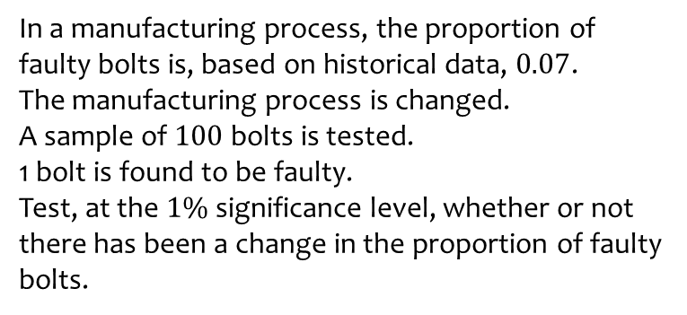
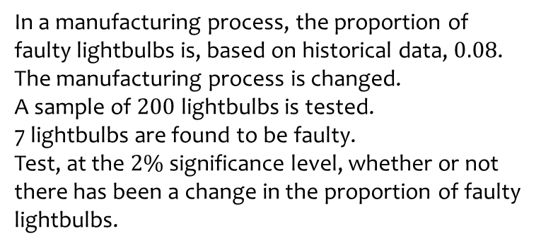
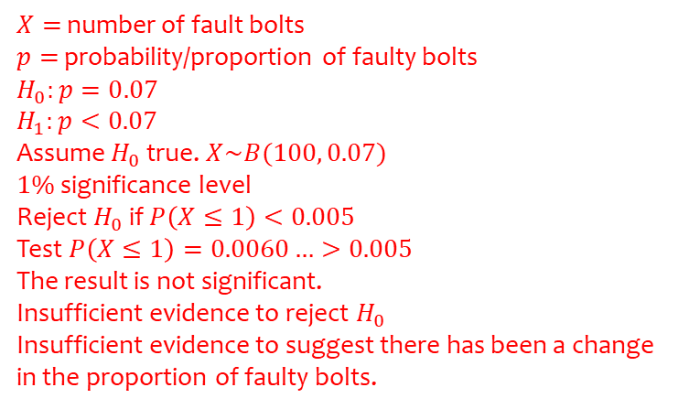
Worked example
Your turn
In a manufacturing process, the proportion of faulty lightbulbs is, based on historical data, $0.08$.
The manufacturing process is changed.
A sample of $200$ lightbulbs is tested.
7 lightbulbs are found to be faulty.
Test, at the $2\%$significance level, whether or not there has been a change in the proportion of faulty lightbulbs.
In a manufacturing process, the proportion of faulty bolts is, based on historical data, $0.07$.
The manufacturing process is changed.
A sample of $100$ bolts is tested.
1 bolt is found to be faulty.
Test, at the $1\%$significance level, whether or not there has been a change in the proportion of faulty bolts.
$X=$ number of fault bolts
$p=$ probability/proportion of faulty bolts
$$H_{0}:p=0.07$$
$$H_{1}:p<0.07$$
Assume $H_{0}$ true. $X\sim B(100, 0.07)$
$1\%$ significance level
Reject $H_{0}$ if $P\left(X≤1\right)<0.005$
Test $P\left(X≤1\right)=0.0060…>0.005$
The result is not significant.
Insufficient evidence to reject $H_{0}$
Insufficient evidence to suggest there has been a change in the proportion of faulty bolts.

Slide 9
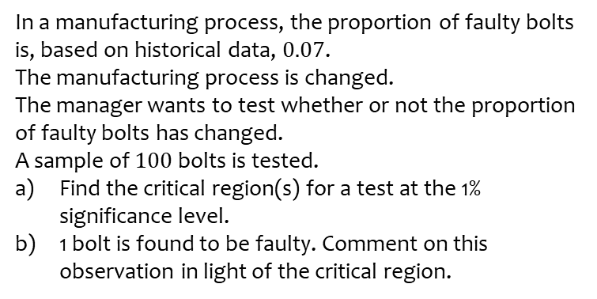
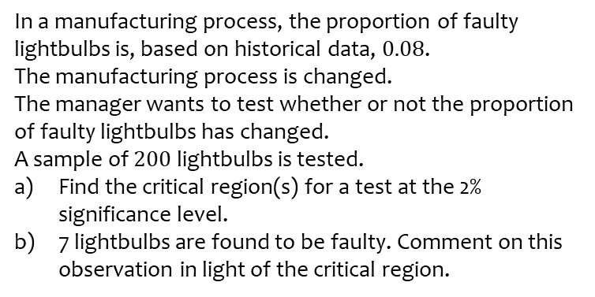
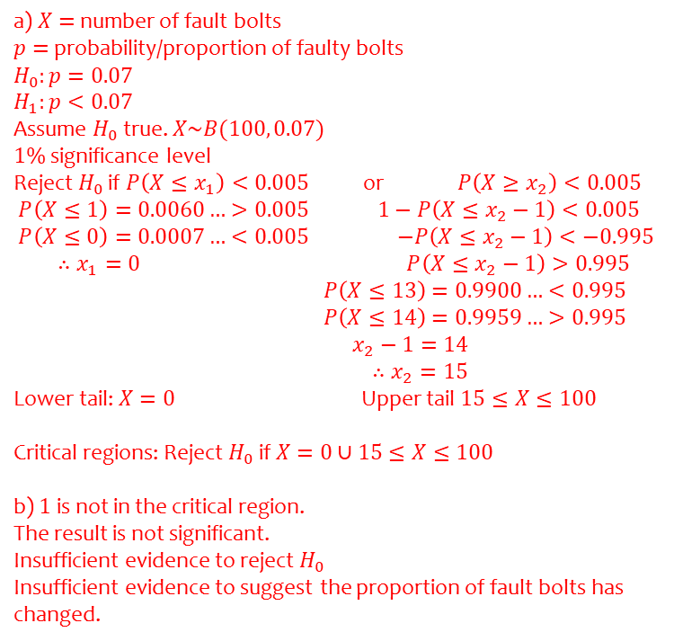
Worked example
Your turn
In a manufacturing process, the proportion of faulty lightbulbs is, based on historical data, $0.08$.
The manufacturing process is changed.
The manager wants to test whether or not the proportion of faulty lightbulbs has changed.
A sample of $200$ lightbulbs is tested.
Find the critical region(s) for a test at the 2% significance level.
7 lightbulbs are found to be faulty. Comment on this observation in light of the critical region.
In a manufacturing process, the proportion of faulty bolts is, based on historical data, $0.07$.
The manufacturing process is changed.
The manager wants to test whether or not the proportion of faulty bolts has changed.
A sample of $100$ bolts is tested.
Find the critical region(s) for a test at the 1% significance level.
1 bolt is found to be faulty. Comment on this observation in light of the critical region.
a) $X=$ number of fault bolts
$p=$ probability/proportion of faulty bolts
$$H_{0}:p=0.07$$
$$H_{1}:p<0.07$$
Assume $H_{0}$ true. $X\sim B(100, 0.07)$
$1\%$ significance level
Reject $H_{0}$ if $P\left(X≤x_{1}\right)<0.005$ or $P\left(X≥x_{2}\right)<0.005$
$P\left(X≤1\right)=0.0060…>0.005$ $1−P\left(X≤x_{2}−1\right)<0.005$
$P\left(X≤0\right)=0.0007…<0.005$ $−P\left(X≤x_{2}−1\right)<−0.995$
$∴x_{1}=0$ $P\left(X≤x_{2}−1\right)>0.995$
$P\left(X≤13\right)=0.9900…<0.995$
$P\left(X≤14\right)=0.9959…>0.995$
$x_{2}−1=14$
$∴x_{2}=15$
Lower tail: $X=0$ Upper tail $15≤X≤100$
Critical regions: Reject $H_{0}$ if $X=0∪15≤X≤100$
b) $1$ is not in the critical region.
The result is not significant.
Insufficient evidence to reject $H_{0}$
Insufficient evidence to suggest the proportion of fault bolts has changed.

Slide 10
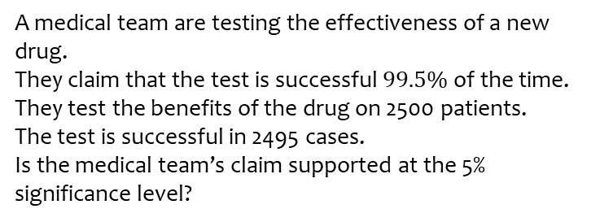
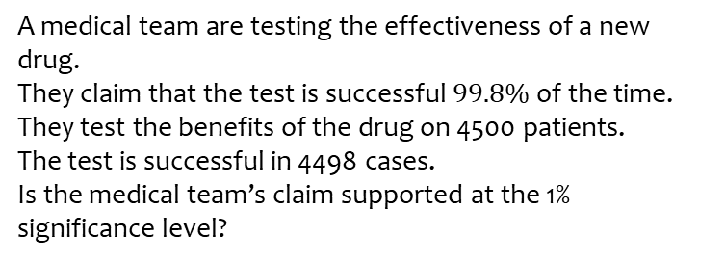
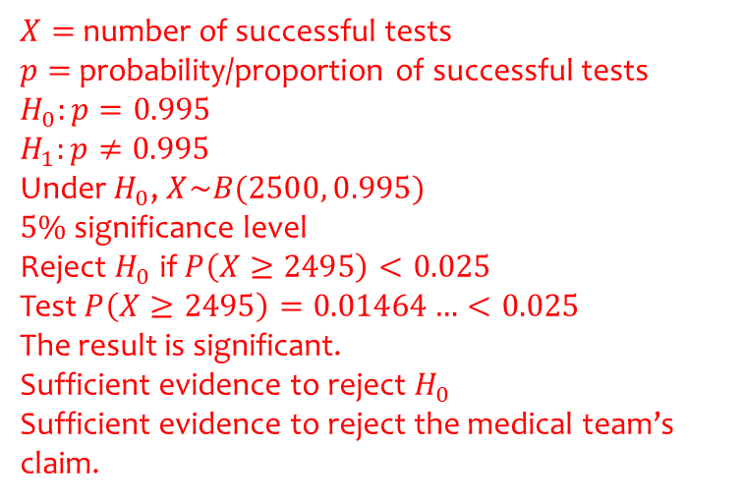
Worked example
Your turn
A medical team are testing the effectiveness of a new drug.
They claim that the test is successful $99.8\%$of the time.
They test the benefits of the drug on 4500 patients.
The test is successful in 4498 cases.
Is the medical team’s claim supported at the 1% significance level?
A medical team are testing the effectiveness of a new drug.
They claim that the test is successful $99.5\%$of the time.
They test the benefits of the drug on 2500 patients.
The test is successful in 2495 cases.
Is the medical team’s claim supported at the 5% significance level?
$X=$ number of successful tests
$p=$ probability/proportion of successful tests
$$H_{0}:p=0.995$$
$$H_{1}:p≠0.995$$
Under $H_{0}$, $X\sim B(2500, 0.995)$
$5\%$ significance level
Reject $H_{0}$ if $P\left(X≥2495\right)<0.025$
Test $P\left(X≥2495\right)=0.01464…<0.025$
The result is significant.
Sufficient evidence to reject $H_{0}$
Sufficient evidence to reject the medical team’s claim.

Slide 11
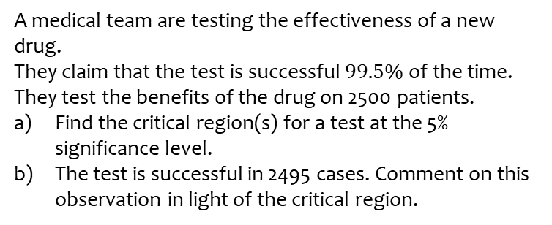
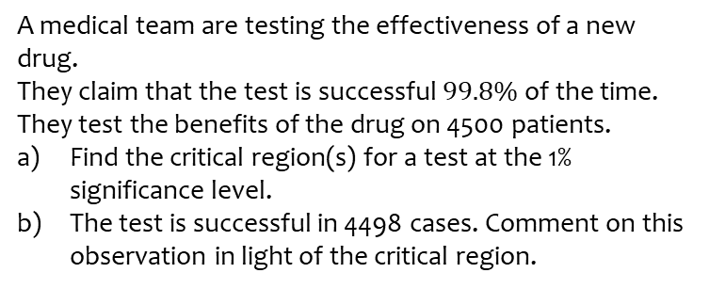
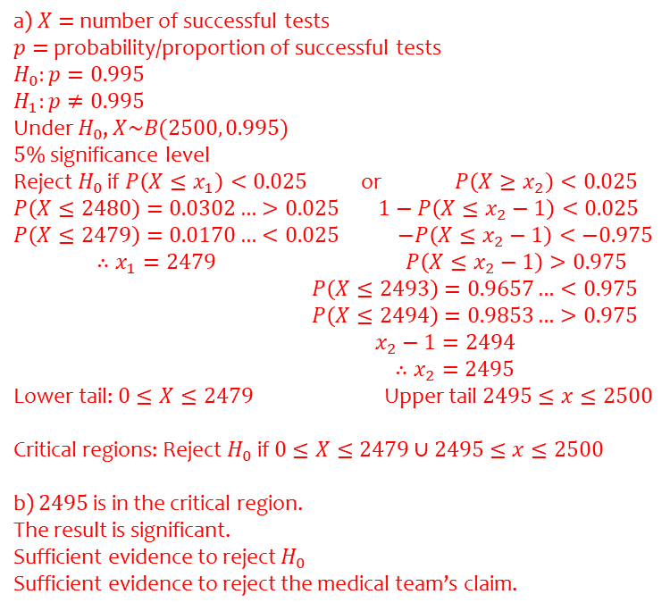
Worked example
Your turn
A medical team are testing the effectiveness of a new drug.
They claim that the test is successful $99.8\%$of the time.
They test the benefits of the drug on 4500 patients.
Find the critical region(s) for a test at the 1% significance level.
The test is successful in 4498 cases. Comment on this observation in light of the critical region.
A medical team are testing the effectiveness of a new drug.
They claim that the test is successful $99.5\%$of the time.
They test the benefits of the drug on 2500 patients.
Find the critical region(s) for a test at the 5% significance level.
The test is successful in 2495 cases. Comment on this observation in light of the critical region.
a) $X=$ number of successful tests
$p=$ probability/proportion of successful tests
$$H_{0}:p=0.995$$
$$H_{1}:p≠0.995$$
Under $H_{0}$, $X\sim B(2500, 0.995)$
$5\%$ significance level
Reject $H_{0}$ if $P\left(X≤x_{1}\right)<0.025$ or $P\left(X≥x_{2}\right)<0.025$
$P\left(X≤2480\right)=0.0302…>0.025$ $1−P\left(X≤x_{2}−1\right)<0.025$
$P\left(X≤2479\right)=0.0170…<0.025$ $−P\left(X≤x_{2}−1\right)<−0.975$
$∴x_{1}=2479$ $P\left(X≤x_{2}−1\right)>0.975$
$P\left(X≤2493\right)=0.9657…<0.975$
$P\left(X≤2494\right)=0.9853…>0.975$
$x_{2}−1=2494$
$∴x_{2}=2495$
Lower tail: $0≤X≤2479$ Upper tail $2495≤x≤2500$
Critical regions: Reject $H_{0}$ if $0≤X≤2479∪2495≤x≤2500$
b) $2495$ is in the critical region.
The result is significant.
Sufficient evidence to reject $H_{0}$
Sufficient evidence to reject the medical team’s claim.

Slide 12
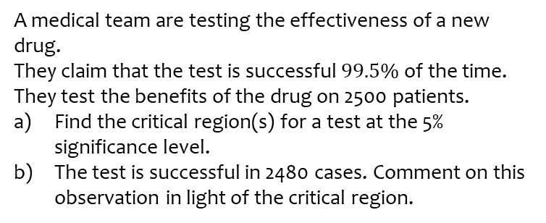
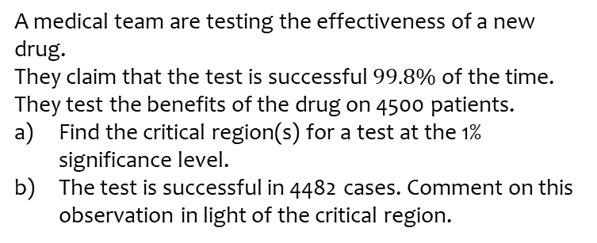
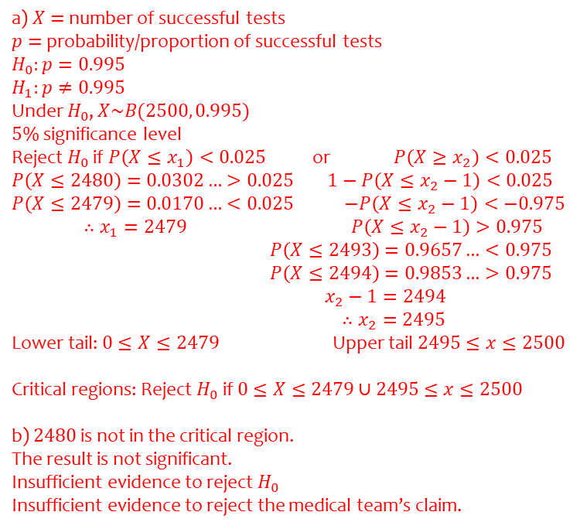
Worked example
Your turn
A medical team are testing the effectiveness of a new drug.
They claim that the test is successful $99.8\%$of the time.
They test the benefits of the drug on 4500 patients.
Find the critical region(s) for a test at the 1% significance level.
The test is successful in 4482 cases. Comment on this observation in light of the critical region.
A medical team are testing the effectiveness of a new drug.
They claim that the test is successful $99.5\%$of the time.
They test the benefits of the drug on 2500 patients.
Find the critical region(s) for a test at the 5% significance level.
The test is successful in 2480 cases. Comment on this observation in light of the critical region.
a) $X=$ number of successful tests
$p=$ probability/proportion of successful tests
$$H_{0}:p=0.995$$
$$H_{1}:p≠0.995$$
Under $H_{0}$, $X\sim B(2500, 0.995)$
$5\%$ significance level
Reject $H_{0}$ if $P\left(X≤x_{1}\right)<0.025$ or $P\left(X≥x_{2}\right)<0.025$
$P\left(X≤2480\right)=0.0302…>0.025$ $1−P\left(X≤x_{2}−1\right)<0.025$
$P\left(X≤2479\right)=0.0170…<0.025$ $−P\left(X≤x_{2}−1\right)<−0.975$
$∴x_{1}=2479$ $P\left(X≤x_{2}−1\right)>0.975$
$P\left(X≤2493\right)=0.9657…<0.975$
$P\left(X≤2494\right)=0.9853…>0.975$
$x_{2}−1=2494$
$∴x_{2}=2495$
Lower tail: $0≤X≤2479$ Upper tail $2495≤x≤2500$
Critical regions: Reject $H_{0}$ if $0≤X≤2479∪2495≤x≤2500$
b) $2480$ is not in the critical region.
The result is not significant.
Insufficient evidence to reject $H_{0}$
Insufficient evidence to reject the medical team’s claim.

