Slide 1
7.4) Mathematical proof

Slide 2
Worked example
Your turn
Prove that
$$\left(2x−3\right)\left(x−7\right)\left(x+5\right)≡2x^{3}−7x^{2}−64x+105$$
Prove that
$$\left(3x+2\right)\left(x−5\right)\left(x+7\right)≡3x^{3}+8x^{2}−101x−70$$
Proof

Slide 3
Worked example
Your turn
Prove that if three consecutive even integers are the sides of a right-angled triangle, they must be 6, 8 and 10.
Prove that if three consecutive integers are the sides of a right-angled triangle, they must be 3, 4 and 5.
Proof e.g. Pythagoras’ Theorem with $x, x+1, x+2$

Slide 4
Worked example
Your turn
Prove that $x^{2}+6x+11$ is positive for all values of $x$.
Prove that $x^{2}+4x+5$ is positive for all values of $x$.
$$x^{2}+4x+5={\left(x+2\right)}^{2}+1$$
$$k^{2}≥0$$
$${\left(x+2\right)}^{2}≥0$$
$${\left(x+2\right)}^{2}+1≥1$$

Slide 5
Worked example
Your turn
Prove that the sum of the squares of two consecutive even numbers is 4 more than a multiple of 8.
Prove that the sum of the squares of two consecutive odd numbers is 2 more than a multiple of 8.
Proof

Slide 6
Worked example
Your turn
Prove that $(1, 1)$, $(4,7)$ and $(10, 4)$ are the vertices of a right-angled triangle.
Prove that $(1, 1)$, $(3, 3)$ and $(4, 2)$ are the vertices of a right-angled triangle.
Proof e.g. Pythagoras’ Theorem or perpendicular gradients AB and BC

Slide 7
Worked example
Your turn
The equation $kx^{2}+5kx+3=0$, where $k$ is a constant, has no real roots.
Prove that $k$ satisfies the inequality $0≤k<\frac{12}{25}$
The equation $kx^{2}+3kx+2=0$, where $k$ is a constant, has no real roots.
Prove that $k$ satisfies the inequality $0≤k<\frac{8}{9}$
Proof

Slide 8

Worked example
Your turn
Prove that $4n−3+2n+7$ is a multiple of $2$ for all real integers $n$
Prove that $4n−3+2n−9$ is a multiple of $3$ for all real integers $n$
Prove that $4n−3+10n−11$ is a multiple of $7$ for all real integers $n$
$14n−14$
$$≡7\left(2n−2\right)$$
$$≡7k$$

Slide 9
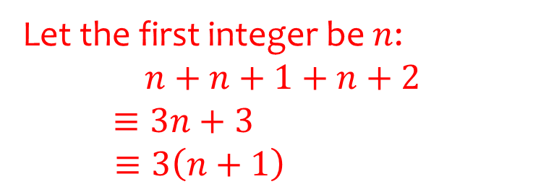
Worked example
Your turn
Prove that the sum of five consecutive integers is a multiple of $5$.
Prove that the sum of three consecutive integers is a multiple of $3$.
Let the first integer be $n$:
$$n+n+1+n+2$$
$≡3n+3$
$$≡3\left(n+1\right)$$

Slide 10
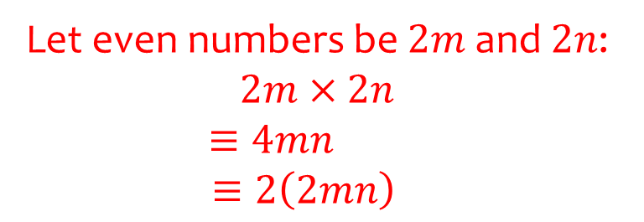
Worked example
Your turn
Prove that the product of two odd numbers is an odd number.
Prove that the product of two even numbers is an even number.
Let even numbers be $2m$ and $2n$: $2m×2n$
$$≡4mn$$
$$≡2\left(2mn\right)$$

Slide 11
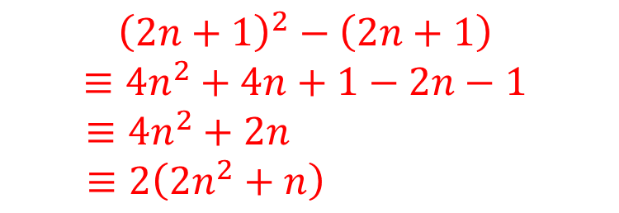
Worked example
Your turn
Prove algebraically that $n^{2}−2−{\left(n−2\right)}^{2}$ is always even, given $n$ is an integer greater than $1$
Prove algebraically that ${\left(2n+1\right)}^{2}−(2n+1)$ is an even number
$${\left(2n+1\right)}^{2}−\left(2n+1\right)$$
$$≡4n^{2}+4n+1−2n−1$$
$$≡4n^{2}+2n$$
$$≡2\left(2n^{2}+n\right)$$

Slide 12
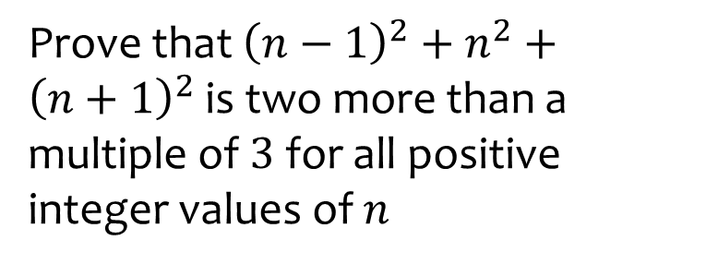
Worked example
Your turn
Prove that ${\left(n−1\right)}^{2}+n^{2}+{\left(n+1\right)}^{2}$ is two more than a multiple of $3$ for all positive integer values of $n$
Prove that ${\left(n+1\right)}^{2}−n^{2}$ is one more than a multiple of $2$ for all positive integer values of $n$
$${\left(n+1\right)}^{2}−n^{2}$$
$$≡n^{2}+2n+1−n^{2}$$
$$≡2n+1$$

Slide 13
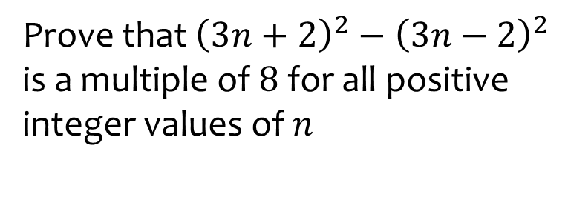
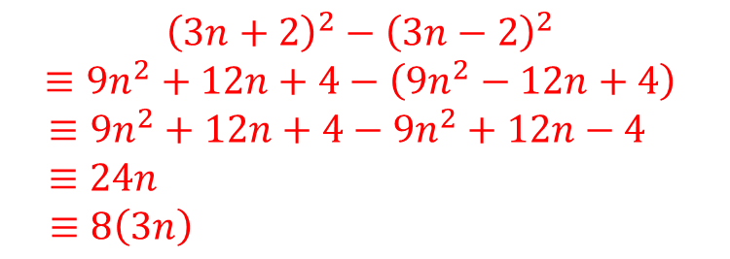
Worked example
Your turn
Prove that ${\left(2n+3\right)}^{2}−{\left(2n−3\right)}^{2}$ is a multiple of $8$ for all positive integer values of $n$
Prove that ${\left(3n+2\right)}^{2}−{\left(3n−2\right)}^{2}$ is a multiple of $8$ for all positive integer values of $n$
$${\left(3n+2\right)}^{2}−{\left(3n−2\right)}^{2}$$
$$≡9n^{2}+12n+4−\left(9n^{2}−12n+4\right)$$
$$≡9n^{2}+12n+4−9n^{2}+12n−4$$
$$≡24n$$
$$≡8\left(3n\right)$$

Slide 14
Worked example
Your turn
Prove algebraically that the difference between two different odd numbers is an even number.
Prove algebraically that the difference between two different even numbers is an even number.
Let even numbers be $2m$ and $2n$: $2m−2n$
$$≡2\left(m−n\right)$$

Slide 15
Worked example
Your turn
Prove that the product of four consecutive integers is always a multiple of $8$
Prove that the product of three consecutive integers is always a multiple of $6$
Proof by showing at least one is a multiple of 2, and one will be a multiple of 3…

Slide 16
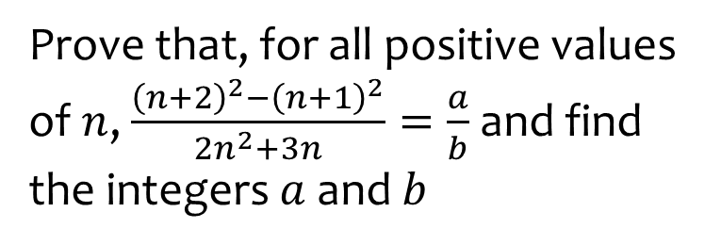
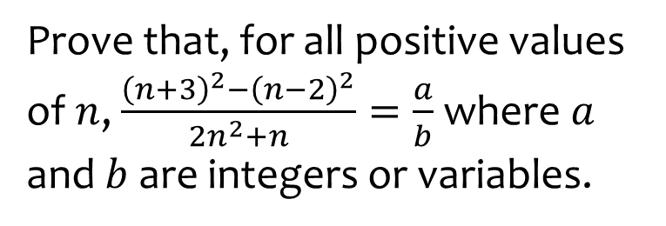
Worked example
Your turn
Prove that, for all positive values of $n$, $\frac{{\left(n+3\right)}^{2}−{\left(n−2\right)}^{2}}{2n^{2}+n}=\frac{a}{b}$ where $a$ and $b$ are integers or variables.
Prove that, for all positive values of $n$, $\frac{{\left(n+2\right)}^{2}−{\left(n+1\right)}^{2}}{2n^{2}+3n}=\frac{a}{b}$ and find the integers $a$ and $b$
$$a=1, b=n$$

