Slide 1
7.3) One-tailed tests

Slide 2



Worked example
Your turn
Joan believes a six-sided dice is biased in favour of rolling a $4$.
She rolls the dice 10 times and rolls a $4$ five times.
Using a 5% significance level, test her belief.
John believes a coin is biased in favour of landing with tails uppermost.
He tosses the coin 8 times and it lands on tails $7$ times. Using a 5% significance level, test his belief.
$X=$ number of times coin lands with tails uppermost
$p=$ probability/proportion of times coin lands with tails uppermost
$$H_{0}:p=0.5$$
$$H_{1}:p>0.5$$
Assume $H_{0}$ true. $X\sim B(8, 0.5)$
$5\%$ significance level
Reject $H_{0}$ if $P\left(X≥7\right)<0.05$
Test $P\left(X≥7\right)$
$$=1−P\left(X≤6\right)$$
$=0.0351…<0.05$
The result is significant.
Sufficient evidence to reject $H_{0}$
Sufficient evidence to support John’s belief that the coin is biased in favour of landing with tails uppermost.

Slide 3
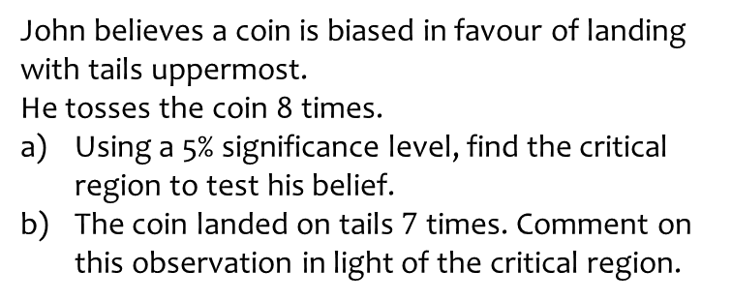
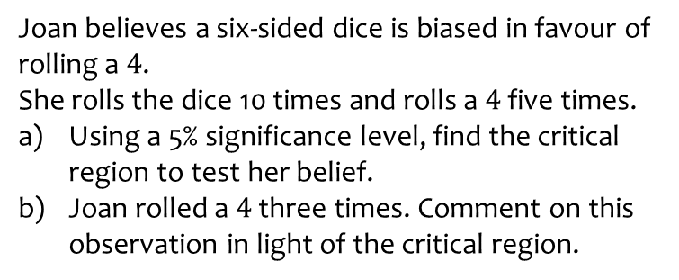

Worked example
Your turn
Joan believes a six-sided dice is biased in favour of rolling a $4$.
She rolls the dice 10 times and rolls a $4$ five times.
Using a 5% significance level, find the critical region to test her belief.
Joan rolled a $4$ three times. Comment on this observation in light of the critical region.
John believes a coin is biased in favour of landing with tails uppermost.
He tosses the coin 8 times.
Using a 5% significance level, find the critical region to test his belief.
The coin landed on tails $7$ times. Comment on this observation in light of the critical region.
a) $X=$ number of times coin lands with tails uppermost
$p=$ probability/proportion of times coin lands with tails uppermost
$$H_{0}:p=0.5$$
$$H_{1}:p>0.5$$
Assume $H_{0}$ true. $X\sim B(8, 0.5)$
$5\%$ significance level
Reject $H_{0}$ if $P\left(X≥x\right)<0.05$
$1−P\left(X≤x−1\right)<0.05$
$−P\left(X≤x−1\right)<−0.95$
$P\left(X≤x−1\right)>0.95$
$P\left(X≤5\right)=0.8554…<0.95$
$P\left(X≤6\right)=0.9648…>0.95$
$x−1=6$
$∴x=7$
Critical region: Reject $H_{0}$ if $7≤X≤8$
b) $7$ is in the critical region.
The result is significant.
Sufficient evidence to reject $H_{0}$
Sufficient evidence to support John’s belief that the coin is biased in favour of landing with tails uppermost

Slide 4
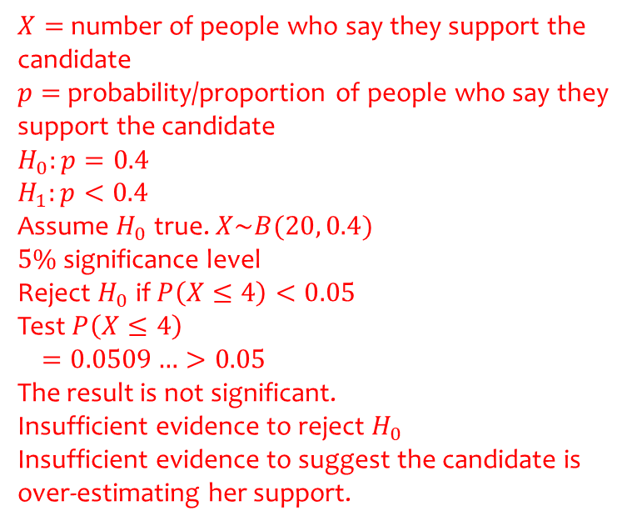
Worked example
Your turn
An election candidate believes he has the support of 30% of the residents in a particular town.
A researcher wants to test, at the 10% significance level, whether the candidate is over-estimating his support.
The researcher asks 30 people whether they support the candidate or not. 6 people say they support the candidate.
Carry out a hypothesis test for the researcher.
An election candidate believes she has the support of 40% of the residents in a particular town.
A researcher wants to test, at the 5% significance level, whether the candidate is over-estimating her support.
The researcher asks 20 people whether they support the candidate or not. 4 people say they support the candidate.
Carry out a hypothesis test for the researcher.
$X=$ number of people who say they support the candidate
$p=$ probability/proportion of people who say they support the candidate
$$H_{0}:p=0.4$$
$$H_{1}:p<0.4$$
Assume $H_{0}$ true. $X\sim B(20, 0.4)$
$5\%$ significance level
Reject $H_{0}$ if $P\left(X≤4\right)<0.05$
Test $P\left(X≤4\right)$
$$=0.0509…>0.05$$
The result is not significant.
Insufficient evidence to reject $H_{0}$
Insufficient evidence to suggest the candidate is over-estimating her support.

Slide 5
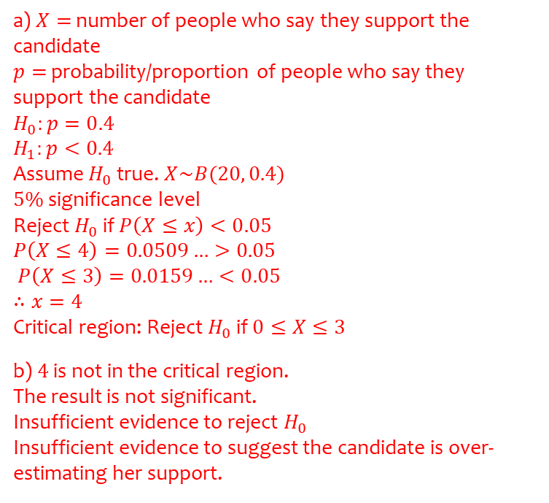
Worked example
Your turn
An election candidate believes he has the support of 30% of the residents in a particular town.
A researcher wants to test, at the 10% significance level, whether the candidate is over-estimating his support.
The researcher asks 30 people whether they support the candidate or not.
Find the critical region for this test.
6 people say they support the candidate. Comment on this observation in light of the critical region.
An election candidate believes she has the support of 40% of the residents in a particular town.
A researcher wants to test, at the 5% significance level, whether the candidate is over-estimating her support.
The researcher asks 20 people whether they support the candidate or not.
Find the critical region for this test.
4 people say they support the candidate. Comment on this observation in light of the critical region.
a) $X=$ number of people who say they support the candidate
$p=$ probability/proportion of people who say they support the candidate
$$H_{0}:p=0.4$$
$$H_{1}:p<0.4$$
Assume $H_{0}$ true. $X\sim B(20, 0.4)$
$5\%$ significance level
Reject $H_{0}$ if $P\left(X≤x\right)<0.05$
$$P\left(X≤4\right)=0.0509…>0.05$$
$P\left(X≤3\right)=0.0159…<0.05$
$$∴x=4$$
Critical region: Reject $H_{0}$ if $0≤X≤3$
b) $4$ is not in the critical region.
The result is not significant.
Insufficient evidence to reject $H_{0}$
Insufficient evidence to suggest the candidate is over-estimating her support.

Slide 6
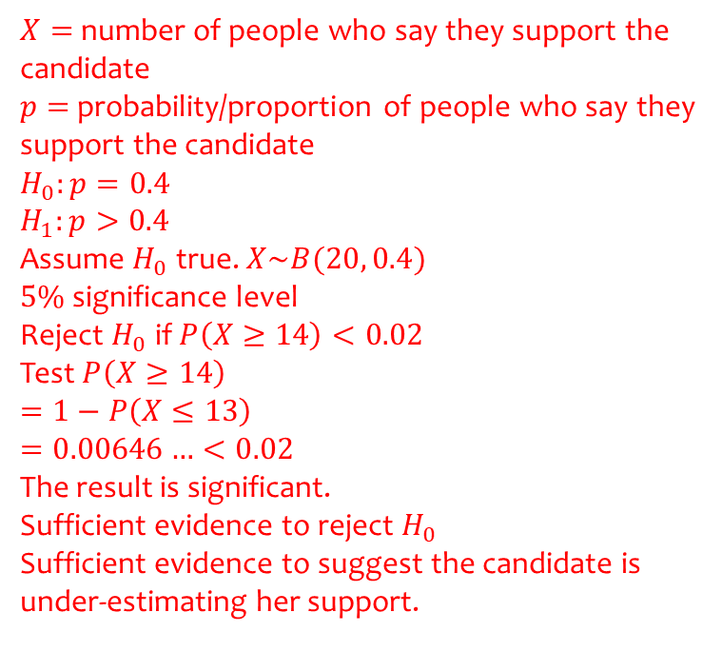
Worked example
Your turn
An election candidate believes he has the support of 30% of the residents in a particular town.
A researcher wants to test, at the 1% significance level, whether the candidate is under-estimating his support.
The researcher asks 30 people whether they support the candidate or not. 14 people say they support the candidate.
Carry out a hypothesis test for the researcher.
An election candidate believes she has the support of 40% of the residents in a particular town.
A researcher wants to test, at the 2% significance level, whether the candidate is under-estimating her support.
The researcher asks 20 people whether they support the candidate or not. 14 people say they support the candidate.
Carry out a hypothesis test for the researcher.
$X=$ number of people who say they support the candidate
$p=$ probability/proportion of people who say they support the candidate
$$H_{0}:p=0.4$$
$$H_{1}:p>0.4$$
Assume $H_{0}$ true. $X\sim B(20, 0.4)$
$5\%$ significance level
Reject $H_{0}$ if $P\left(X≥14\right)<0.02$
Test $P\left(X≥14\right)$
$$=1−P\left(X≤13\right)$$
$$=0.00646…<0.02$$
The result is significant.
Sufficient evidence to reject $H_{0}$
Sufficient evidence to suggest the candidate is under-estimating her support.

Slide 7
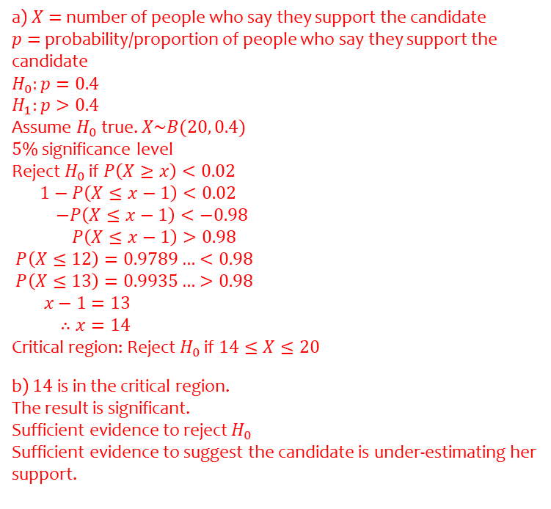
Worked example
Your turn
An election candidate believes he has the support of 30% of the residents in a particular town.
A researcher wants to test, at the 1% significance level, whether the candidate is under-estimating his support.
The researcher asks 30 people whether they support the candidate or not.
Find the critical region for this test.
14 people say they support the candidate. Comment on this observation in light of the critical region.
An election candidate believes she has the support of 40% of the residents in a particular town.
A researcher wants to test, at the 2% significance level, whether the candidate is under-estimating her support.
The researcher asks 20 people whether they support the candidate or not.
Find the critical region for this test.
14 people say they support the candidate. Comment on this observation in light of the critical region.
a) $X=$ number of people who say they support the candidate
$p=$ probability/proportion of people who say they support the candidate
$$H_{0}:p=0.4$$
$$H_{1}:p>0.4$$
Assume $H_{0}$ true. $X\sim B(20, 0.4)$
$5\%$ significance level
Reject $H_{0}$ if $P\left(X≥x\right)<0.02$
$1−P\left(X≤x−1\right)<0.02$
$−P\left(X≤x−1\right)<−0.98$
$P\left(X≤x−1\right)>0.98$
$P\left(X≤12\right)=0.9789…<0.98$
$P\left(X≤13\right)=0.9935…>0.98$
$x−1=13$
$∴x=14$
Critical region: Reject $H_{0}$ if $14≤X≤20$
b) $14$ is in the critical region.
The result is significant.
Sufficient evidence to reject $H_{0}$
Sufficient evidence to suggest the candidate is under-estimating her support.

Slide 8
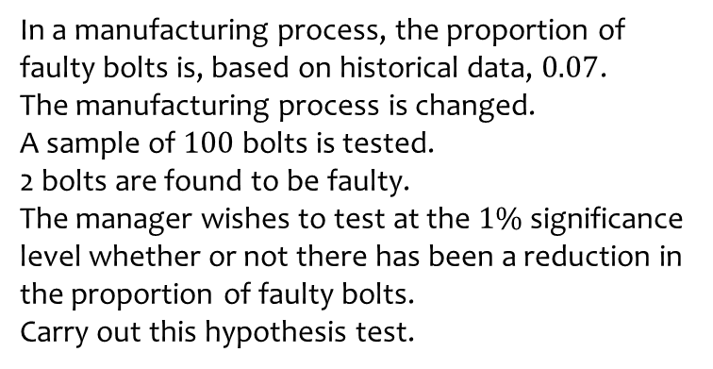
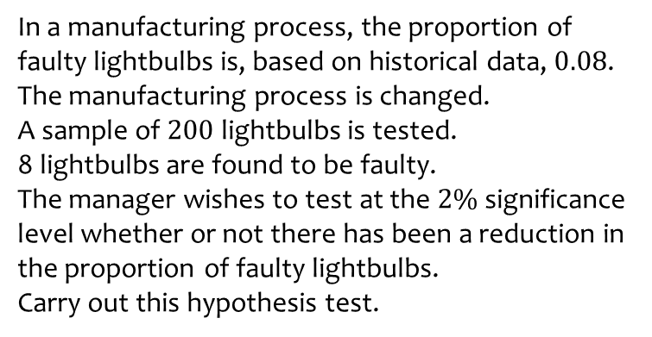
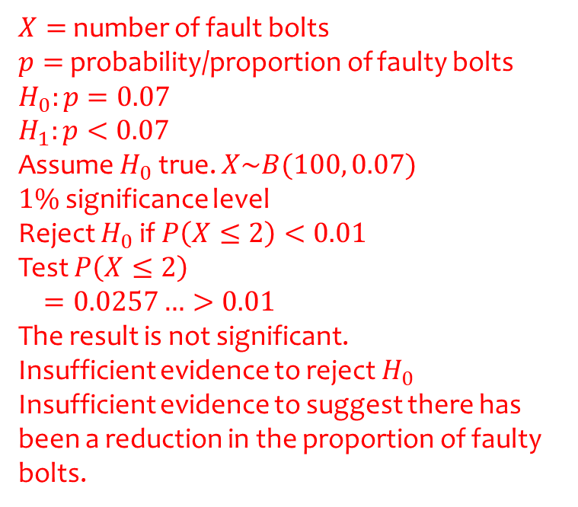
Worked example
Your turn
In a manufacturing process, the proportion of faulty lightbulbs is, based on historical data, $0.08$.
The manufacturing process is changed.
A sample of $200$ lightbulbs is tested.
8 lightbulbs are found to be faulty.
The manager wishes to test at the $2\%$significance level whether or not there has been a reduction in the proportion of faulty lightbulbs.
Carry out this hypothesis test.
In a manufacturing process, the proportion of faulty bolts is, based on historical data, $0.07$.
The manufacturing process is changed.
A sample of $100$ bolts is tested.
2 bolts are found to be faulty.
The manager wishes to test at the $1\%$significance level whether or not there has been a reduction in the proportion of faulty bolts.
Carry out this hypothesis test.
$X=$ number of fault bolts
$p=$ probability/proportion of faulty bolts
$$H_{0}:p=0.07$$
$$H_{1}:p<0.07$$
Assume $H_{0}$ true. $X\sim B(100, 0.07)$
$1\%$ significance level
Reject $H_{0}$ if $P\left(X≤2\right)<0.01$
Test $P\left(X≤2\right)$
$$=0.0257…>0.01$$
The result is not significant.
Insufficient evidence to reject $H_{0}$
Insufficient evidence to suggest there has been a reduction in the proportion of faulty bolts.

Slide 9
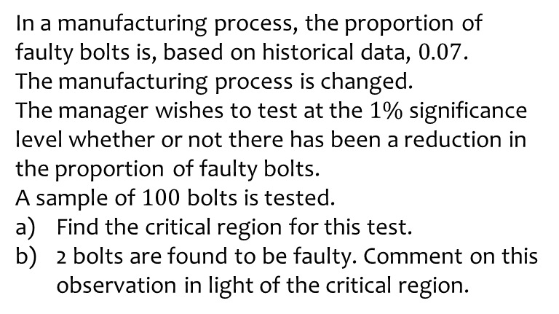
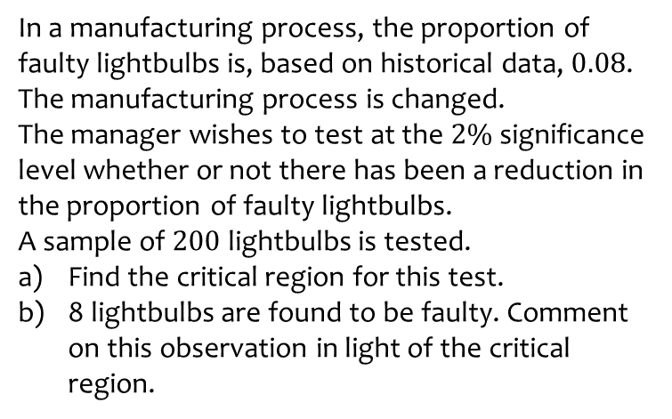
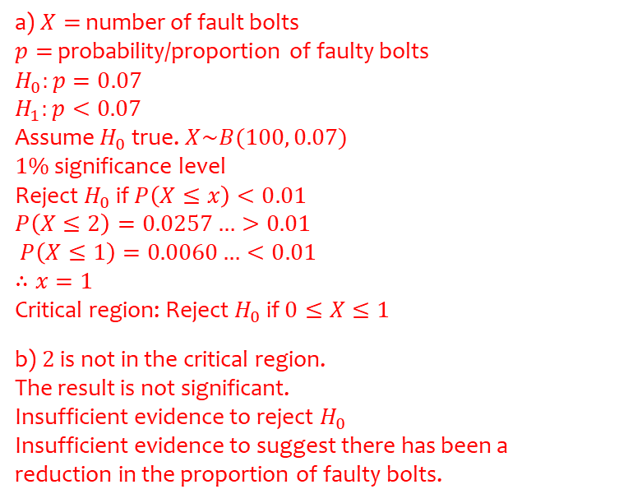
Worked example
Your turn
In a manufacturing process, the proportion of faulty lightbulbs is, based on historical data, $0.08$.
The manufacturing process is changed.
The manager wishes to test at the $2\%$significance level whether or not there has been a reduction in the proportion of faulty lightbulbs.
A sample of $200$ lightbulbs is tested.
Find the critical region for this test.
8 lightbulbs are found to be faulty. Comment on this observation in light of the critical region.
In a manufacturing process, the proportion of faulty bolts is, based on historical data, $0.07$.
The manufacturing process is changed.
The manager wishes to test at the $1\%$significance level whether or not there has been a reduction in the proportion of faulty bolts.
A sample of $100$ bolts is tested.
Find the critical region for this test.
2 bolts are found to be faulty. Comment on this observation in light of the critical region.
a) $X=$ number of fault bolts
$p=$ probability/proportion of faulty bolts
$$H_{0}:p=0.07$$
$$H_{1}:p<0.07$$
Assume $H_{0}$ true. $X\sim B(100, 0.07)$
$1\%$ significance level
Reject $H_{0}$ if $P\left(X≤x\right)<0.01$
$$P\left(X≤2\right)=0.0257…>0.01$$
$P\left(X≤1\right)=0.0060…<0.01$
$$∴x=1$$
Critical region: Reject $H_{0}$ if $0≤X≤1$
b) $2$ is not in the critical region.
The result is not significant.
Insufficient evidence to reject $H_{0}$
Insufficient evidence to suggest there has been a reduction in the proportion of faulty bolts.

Slide 10
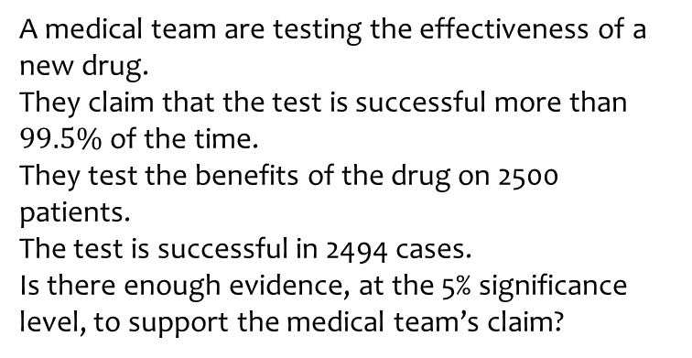
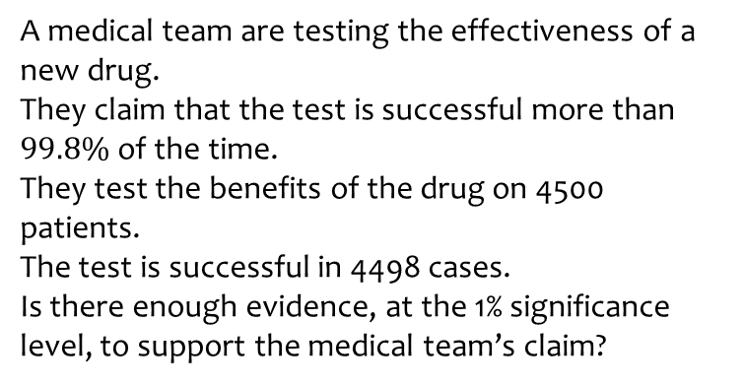
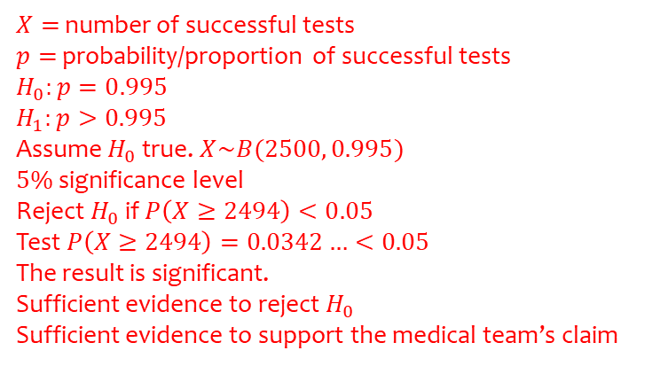
Worked example
Your turn
A medical team are testing the effectiveness of a new drug.
They claim that the test is successful more than $99.8\%$of the time.
They test the benefits of the drug on 4500 patients.
The test is successful in 4498 cases.
Is there enough evidence, at the 1% significance level, to support the medical team’s claim?
A medical team are testing the effectiveness of a new drug.
They claim that the test is successful more than $99.5\%$of the time.
They test the benefits of the drug on 2500 patients.
The test is successful in 2494 cases.
Is there enough evidence, at the 5% significance level, to support the medical team’s claim?
$X=$ number of successful tests
$p=$ probability/proportion of successful tests
$$H_{0}:p=0.995$$
$$H_{1}:p>0.995$$
Assume $H_{0}$ true. $X\sim B(2500, 0.995)$
$5\%$ significance level
Reject $H_{0}$ if $P\left(X≥2494\right)<0.05$
Test $P\left(X≥2494\right)=0.0342…<0.05$
The result is significant.
Sufficient evidence to reject $H_{0}$
Sufficient evidence to support the medical team’s claim

Slide 11
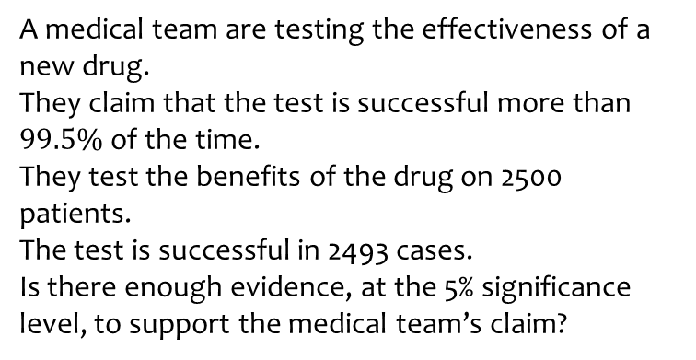
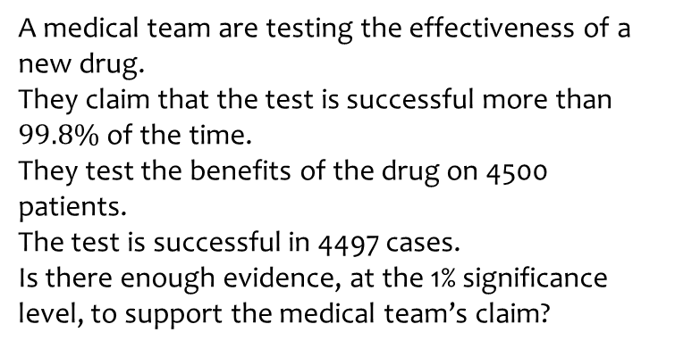
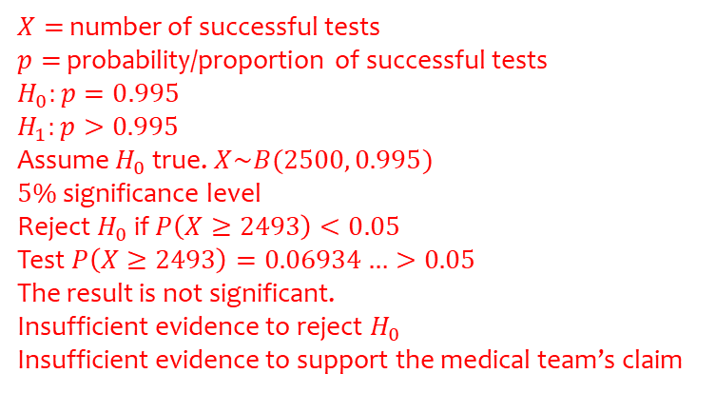
Worked example
Your turn
A medical team are testing the effectiveness of a new drug.
They claim that the test is successful more than $99.8\%$of the time.
They test the benefits of the drug on 4500 patients.
The test is successful in 4497 cases.
Is there enough evidence, at the 1% significance level, to support the medical team’s claim?
A medical team are testing the effectiveness of a new drug.
They claim that the test is successful more than $99.5\%$of the time.
They test the benefits of the drug on 2500 patients.
The test is successful in 2493 cases.
Is there enough evidence, at the 5% significance level, to support the medical team’s claim?
$X=$ number of successful tests
$p=$ probability/proportion of successful tests
$$H_{0}:p=0.995$$
$$H_{1}:p>0.995$$
Assume $H_{0}$ true. $X\sim B(2500, 0.995)$
$5\%$ significance level
Reject $H_{0}$ if $P\left(X≥2493\right)<0.05$
Test $P\left(X≥2493\right)=0.06934…>0.05$
The result is not significant.
Insufficient evidence to reject $H_{0}$
Insufficient evidence to support the medical team’s claim

Slide 12
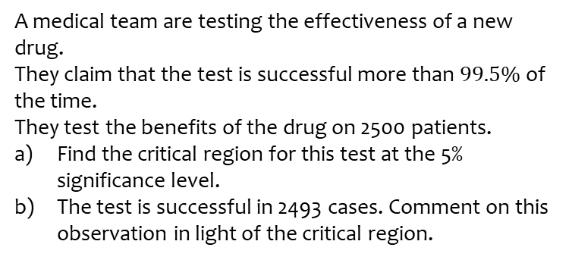
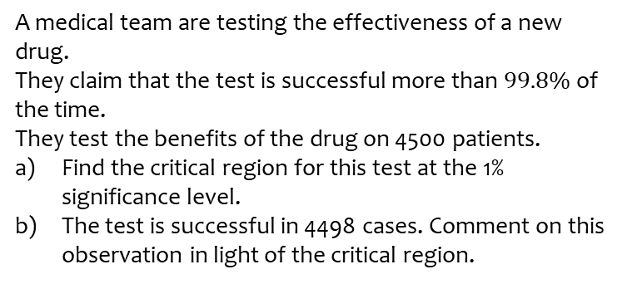
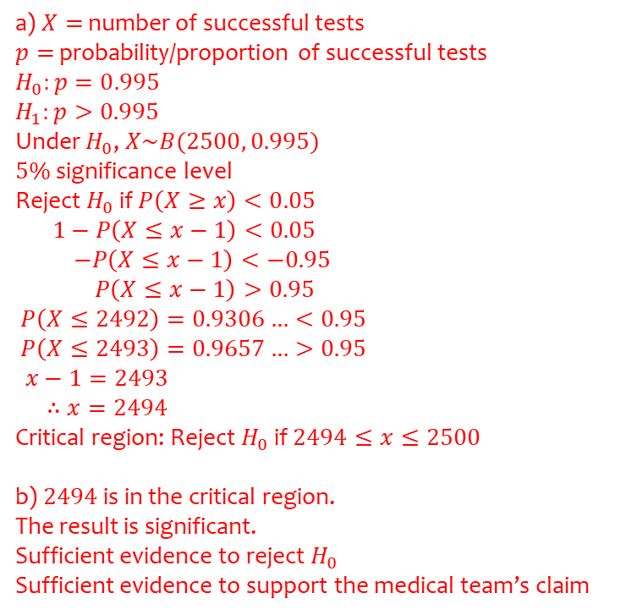
Worked example
Your turn
A medical team are testing the effectiveness of a new drug.
They claim that the test is successful more than $99.8\%$of the time.
They test the benefits of the drug on 4500 patients.
Find the critical region for this test at the 1% significance level.
The test is successful in 4498 cases. Comment on this observation in light of the critical region.
A medical team are testing the effectiveness of a new drug.
They claim that the test is successful more than $99.5\%$of the time.
They test the benefits of the drug on 2500 patients.
Find the critical region for this test at the 5% significance level.
The test is successful in 2493 cases. Comment on this observation in light of the critical region.
a) $X=$ number of successful tests
$p=$ probability/proportion of successful tests
$$H_{0}:p=0.995$$
$$H_{1}:p>0.995$$
Under $H_{0}$, $X\sim B(2500, 0.995)$
$5\%$ significance level
Reject $H_{0}$ if $P\left(X≥x\right)<0.05$
$1−P\left(X≤x−1\right)<0.05$
$−P\left(X≤x−1\right)<−0.95$
$P\left(X≤x−1\right)>0.95$
$P\left(X≤2492\right)=0.9306…<0.95$
$P\left(X≤2493\right)=0.9657…>0.95$
$x−1=2493$
$∴x=2494$
Critical region: Reject $H_{0}$ if $2494≤x≤2500$
b) $2494$ is in the critical region.
The result is significant.
Sufficient evidence to reject $H_{0}$
Sufficient evidence to support the medical team’s claim

Slide 13
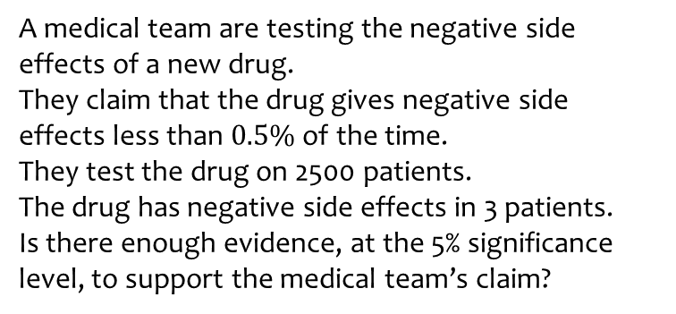
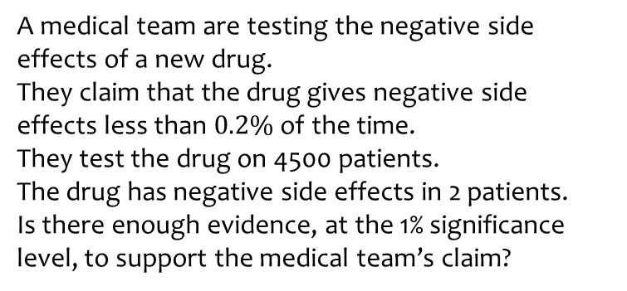
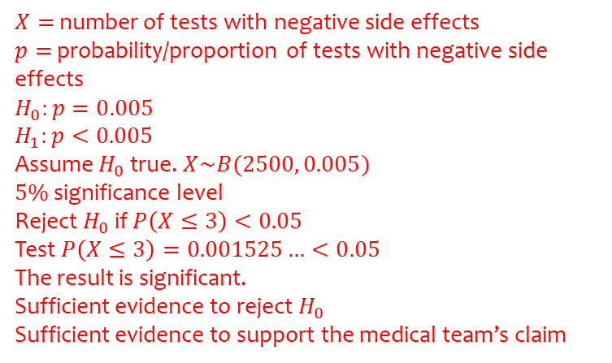
Worked example
Your turn
A medical team are testing the negative side effects of a new drug.
They claim that the drug gives negative side effects less than $0.2\%$ of the time.
They test the drug on 4500 patients.
The drug has negative side effects in 2 patients.
Is there enough evidence, at the 1% significance level, to support the medical team’s claim?
A medical team are testing the negative side effects of a new drug.
They claim that the drug gives negative side effects less than $0.5\%$ of the time.
They test the drug on 2500 patients.
The drug has negative side effects in 3 patients.
Is there enough evidence, at the 5% significance level, to support the medical team’s claim?
$X=$ number of tests with negative side effects
$p=$ probability/proportion of tests with negative side effects
$$H_{0}:p=0.005$$
$$H_{1}:p<0.005$$
Assume $H_{0}$ true. $X\sim B(2500, 0.005)$
$5\%$ significance level
Reject $H_{0}$ if $P\left(X≤3\right)<0.05$
Test $P\left(X≤3\right)=0.001525…<0.05$
The result is significant.
Sufficient evidence to reject $H_{0}$
Sufficient evidence to support the medical team’s claim

Slide 14
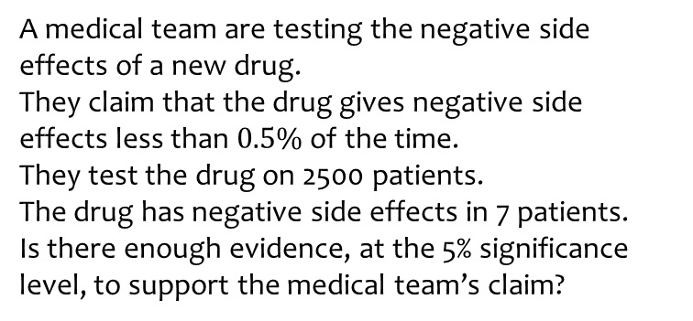
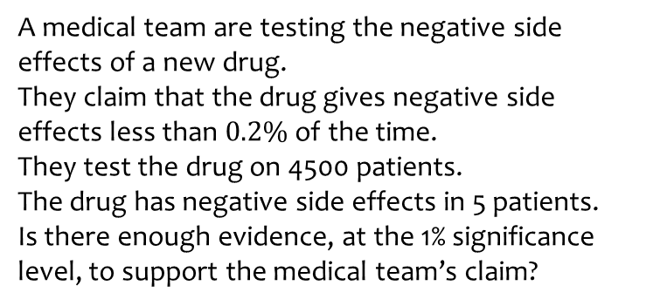
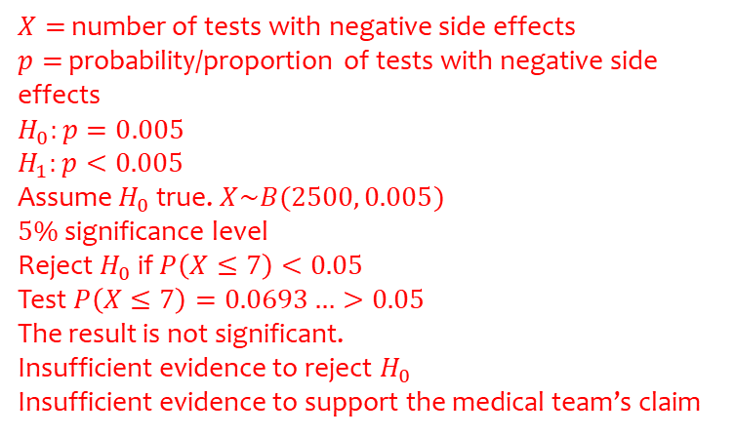
Worked example
Your turn
A medical team are testing the negative side effects of a new drug.
They claim that the drug gives negative side effects less than $0.2\%$ of the time.
They test the drug on 4500 patients.
The drug has negative side effects in 5 patients.
Is there enough evidence, at the 1% significance level, to support the medical team’s claim?
A medical team are testing the negative side effects of a new drug.
They claim that the drug gives negative side effects less than $0.5\%$ of the time.
They test the drug on 2500 patients.
The drug has negative side effects in 7 patients.
Is there enough evidence, at the 5% significance level, to support the medical team’s claim?
$X=$ number of tests with negative side effects
$p=$ probability/proportion of tests with negative side effects
$$H_{0}:p=0.005$$
$$H_{1}:p<0.005$$
Assume $H_{0}$ true. $X\sim B(2500, 0.005)$
$5\%$ significance level
Reject $H_{0}$ if $P\left(X≤7\right)<0.05$
Test $P\left(X≤7\right)=0.0693…>0.05$
The result is not significant.
Insufficient evidence to reject $H_{0}$
Insufficient evidence to support the medical team’s claim

Slide 15
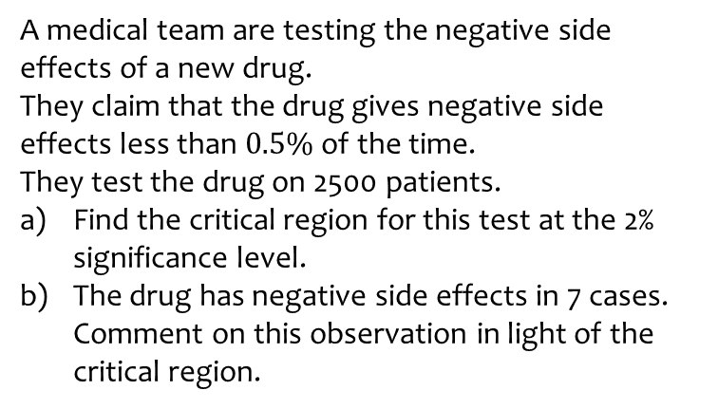
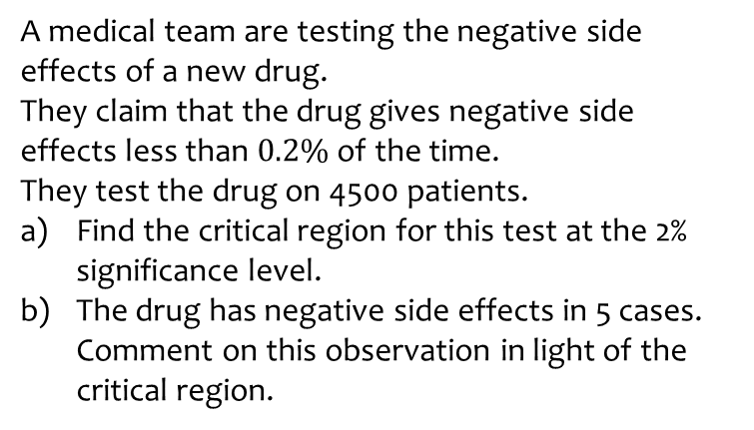
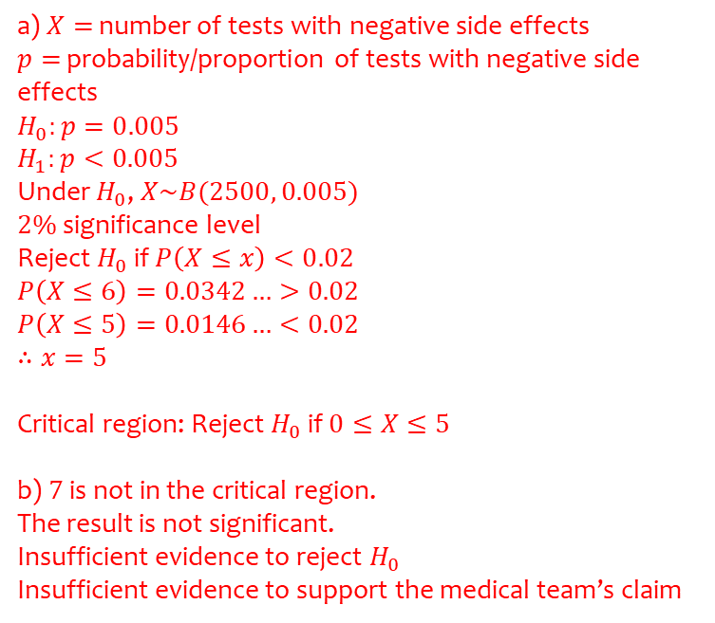
Worked example
Your turn
A medical team are testing the negative side effects of a new drug.
They claim that the drug gives negative side effects less than $0.2\%$ of the time.
They test the drug on 4500 patients.
Find the critical region for this test at the 2% significance level.
The drug has negative side effects in 5 cases. Comment on this observation in light of the critical region.
A medical team are testing the negative side effects of a new drug.
They claim that the drug gives negative side effects less than $0.5\%$ of the time.
They test the drug on 2500 patients.
Find the critical region for this test at the 2% significance level.
The drug has negative side effects in 7 cases. Comment on this observation in light of the critical region.
a) $X=$ number of tests with negative side effects
$p=$ probability/proportion of tests with negative side effects
$$H_{0}:p=0.005$$
$$H_{1}:p<0.005$$
Under $H_{0}$, $X\sim B(2500, 0.005)$
$2\%$ significance level
Reject $H_{0}$ if $P\left(X≤x\right)<0.02$
$$P\left(X≤6\right)=0.0342…>0.02$$
$$P\left(X≤5\right)=0.0146…<0.02$$
$$∴x=5$$
Critical region: Reject $H_{0}$ if $0≤X≤5$
b) $7$ is not in the critical region.
The result is not significant.
Insufficient evidence to reject $H_{0}$
Insufficient evidence to support the medical team’s claim

