Slide 1
Worked example
Your turn
A box of mass 20kg rests in limiting equilibrium on a rough plane inclined at $10°$ above the horizontal.
Find the coefficient of friction between the box and the plane.
A horizontal force of magnitude $P$ N is applied to the box. Given that the box remains in equilibrium,
(b) find the maximum possible value of $P$.
A box of mass 10kg rests in limiting equilibrium on a rough plane inclined at $20°$ above the horizontal.
Find the coefficient of friction between the box and the plane.
A horizontal force of magnitude $P$ N is applied to the box. Given that the box remains in equilibrium,
(b) find the maximum possible value of $P$.
a) $μ=0.36$ (2 sf)
b) $P=82 N$ (2 sf)

Slide 2
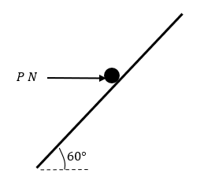
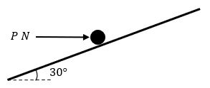
Worked example
Your turn
A parcel of weight $20 N$ lies on a rough plane inclined at an angle of $60°$ to the horizontal.
A horizontal force of magnitude $P$ Newtons acts on the parcel. The parcel is in equilibrium and on the point of slipping up the plane. The normal reaction of the plane on the parcel is $36 N$. The coefficient of friction between the parcel and the plane is $μ$. Find:
The value of $P$
The value of $μ$
The horizontal force is removed.
c) Determine whether or not the parcel moves.
A parcel of weight $10 N$ lies on a rough plane inclined at an angle of $30°$ to the horizontal.
A horizontal force of magnitude $P$ Newtons acts on the parcel. The parcel is in equilibrium and on the point of slipping up the plane. The normal reaction of the plane on the parcel is $18 N$. The coefficient of friction between the parcel and the plane is $μ$. Find:
The value of $P$
The value of $μ$
The horizontal force is removed.
c) Determine whether or not the parcel moves.
a) $19 N$ (2 sf)
b) $0.62$ (2 sf)
c) Does not slide
Diagrams/Graphs used with permission from DrFrostMaths: https://www.drfrostmaths.com/

