Slide 1
7.3) Friction and static particles

Slide 2
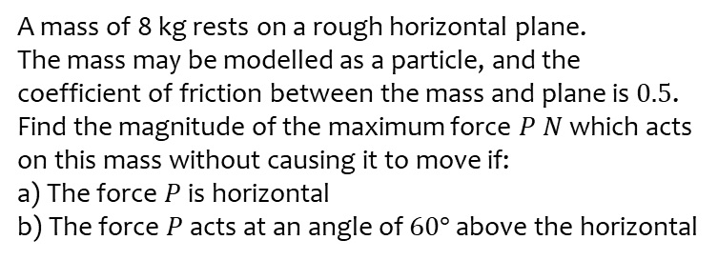
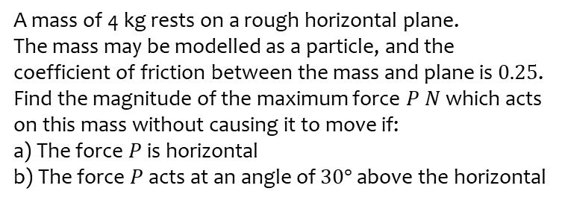
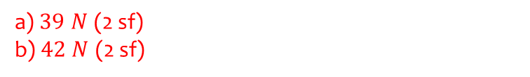
Worked example
Your turn
A mass of 4 kg rests on a rough horizontal plane.
The mass may be modelled as a particle, and the coefficient of friction between the mass and plane is $0.25$.
Find the magnitude of the maximum force $P$ $N$ which acts on this mass without causing it to move if:
a) The force $P$ is horizontal
b) The force $P$ acts at an angle of $30°$ above the horizontal
A mass of 8 kg rests on a rough horizontal plane.
The mass may be modelled as a particle, and the coefficient of friction between the mass and plane is $0.5$.
Find the magnitude of the maximum force $P$ $N$ which acts on this mass without causing it to move if:
a) The force $P$ is horizontal
b) The force $P$ acts at an angle of $60°$ above the horizontal
a) $39 N$ (2 sf)
b) $42 N$ (2 sf)

