Slide 1
7.3) Double-angle formulae

Slide 2
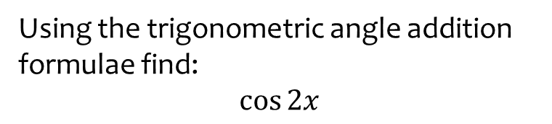

Worked example
Your turn
Using the trigonometric angle addition formulae, derive:
$$\sin{2x}$$
$$\tan{2x}$$
Using the trigonometric angle addition formulae find:
$$\cos{2x}$$
$$\cos^{2}{x}−\sin^{2}{x}$$

Slide 3
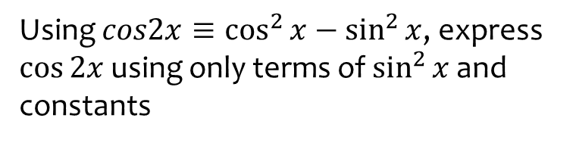
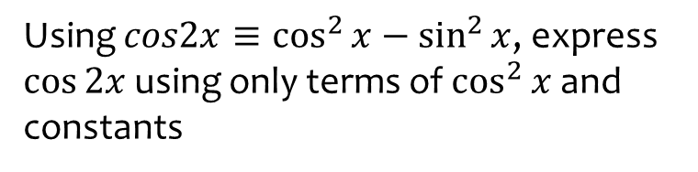
Worked example
Your turn
Using $cos2x≡\cos^{2}{x}−\sin^{2}{x}$, express $\cos{2x}$ using only terms of $\cos^{2}{x}$ and constants
Using $cos2x≡\cos^{2}{x}−\sin^{2}{x}$, express $\cos{2x}$ using only terms of $\sin^{2}{x}$ and constants
$$1−2\sin^{2}{x}$$

Slide 4



Worked example
Your turn
Use the double-angle formulae to write as a single trigonometric ratio:
$$\cos^{2}{50°}−\sin^{2}{50° }$$
$$2\cos^{2}{\frac{2π}{9}}−1$$
$$1−2\sin^{2}{30°}$$
Use the double-angle formulae to write as a single trigonometric ratio:
$$\cos^{2}{15°}−\sin^{2}{15° }$$
$$2\cos^{2}{22.5°}−1$$
$$1−2\sin^{2}{\frac{π}{4}}$$
$$\cos{30°}=\frac{\sqrt{3}}{2}$$
$$\cos{45°}=\frac{\sqrt{2}}{2}$$
$$\cos{\frac{π}{2}}=0$$

Slide 5



Worked example
Your turn
Use the double-angle formulae to write as a single trigonometric ratio:
$$\cos^{2}{2x}−\sin^{2}{2x}$$
$$4\cos^{2}{3x}−2$$
$$3−6\sin^{2}{4x}$$
Use the double-angle formulae to write as a single trigonometric ratio:
$$\cos^{2}{5x}−\sin^{2}{5x}$$
$$8\cos^{2}{6x}−4$$
$$5−10\sin^{2}{7x}$$
$$\cos{10x}$$
$$4\cos{12x}$$
$$5\cos{14x}$$

Slide 6
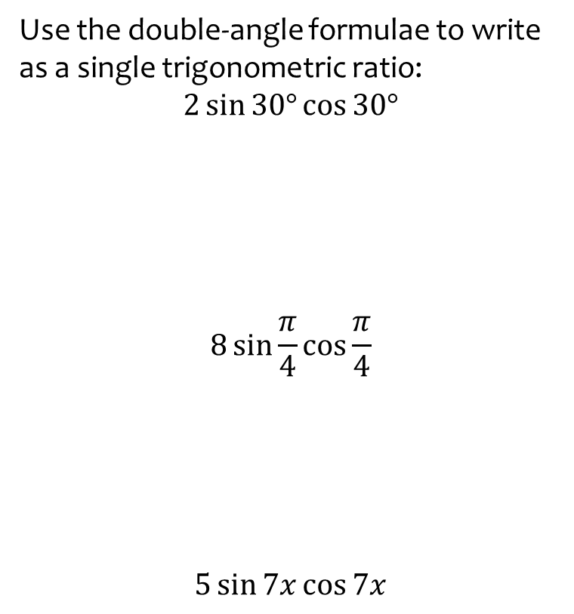
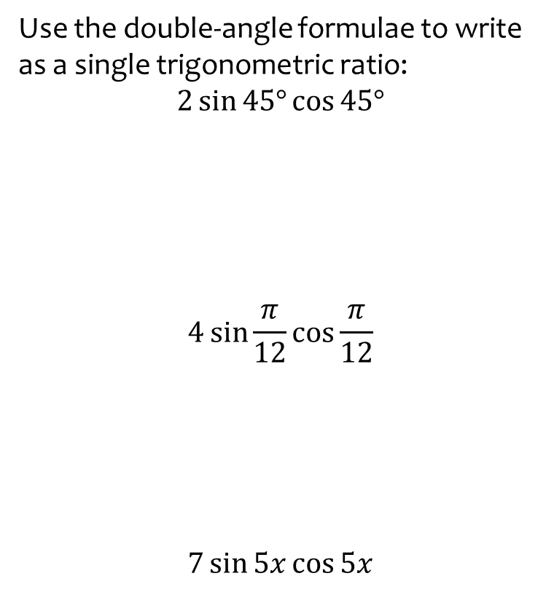

Worked example
Your turn
Use the double-angle formulae to write as a single trigonometric ratio:
$$2\sin{45°}\cos{45°}$$
$$4\sin{\frac{π}{12}}\cos{\frac{π}{12}}$$
$$7\sin{5x}\cos{5x}$$
Use the double-angle formulae to write as a single trigonometric ratio:
$$2\sin{30°}\cos{30°}$$
$$8\sin{\frac{π}{4}}\cos{\frac{π}{4}}$$
$$5\sin{7x}\cos{7x}$$
$$\sin{60°}=\frac{\sqrt{3}}{2}$$
$$16\sin{\frac{π}{2}}=16$$
$$10\sin{14x}$$

Slide 7
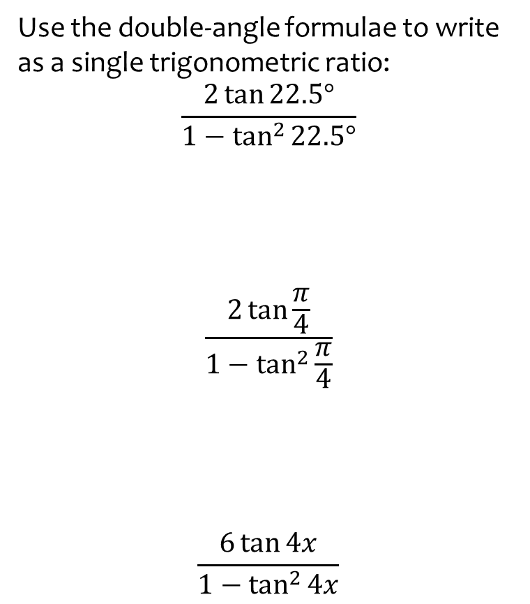
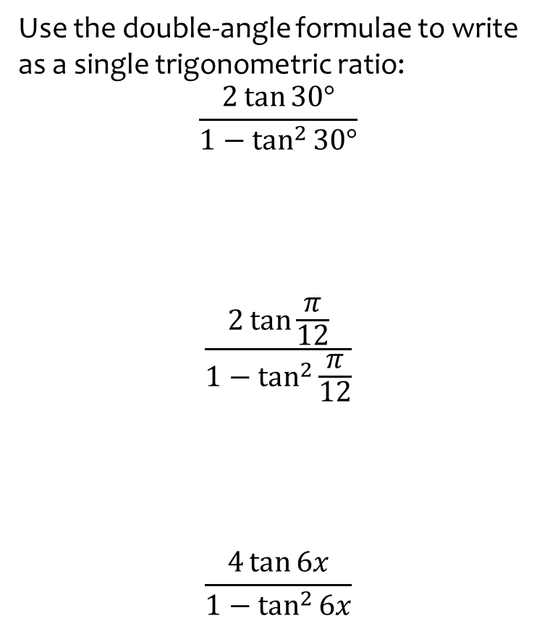

Worked example
Your turn
Use the double-angle formulae to write as a single trigonometric ratio:
$$\frac{2\tan{30°}}{1−\tan^{2}{30°}}$$
$$\frac{2\tan{\frac{π}{12}}}{1−\tan^{2}{\frac{π}{12}}}$$
$$\frac{4\tan{6x}}{1−\tan^{2}{6x}}$$
Use the double-angle formulae to write as a single trigonometric ratio:
$$\frac{2\tan{22.5°}}{1−\tan^{2}{22.5°}}$$
$$\frac{2\tan{\frac{π}{4}}}{1−\tan^{2}{\frac{π}{4}}}$$
$$\frac{6\tan{4x}}{1−\tan^{2}{4x}}$$
$$\tan{45°}=1$$
$$0$$
$$3\tan{8x}$$

Slide 8
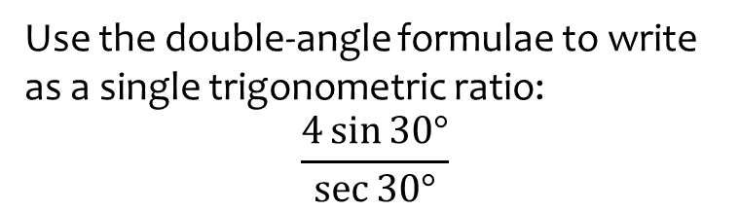
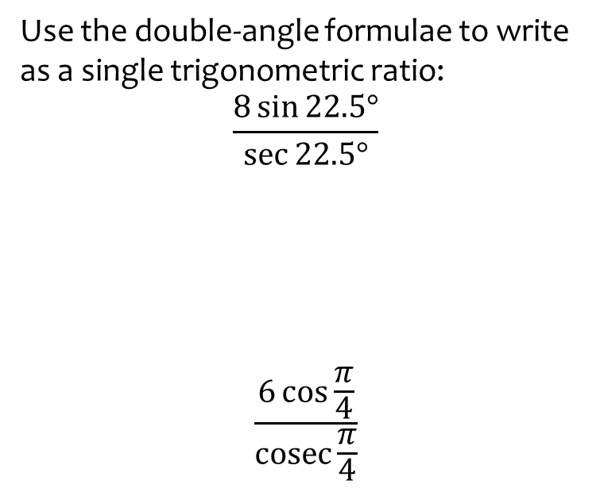
Worked example
Your turn
Use the double-angle formulae to write as a single trigonometric ratio:
$$\frac{8\sin{22.5°}}{\sec{22.5°}}$$
$$\frac{6\cos{\frac{π}{4}}}{\operatorname{cosec}{\frac{π}{4}}}$$
Use the double-angle formulae to write as a single trigonometric ratio:
$$\frac{4\sin{30°}}{\sec{30°}}$$
$$2\sin{60°}=\sqrt{3}$$

Slide 9
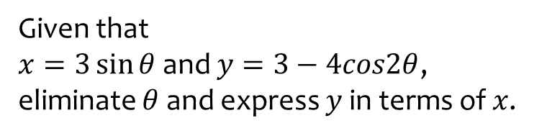


Worked example
Your turn
Given that
$x=2\sin{θ}$ and $y=4−3cos2θ$, eliminate $θ$ and express $y$ in terms of $x$.
Given that
$x=5\cos{θ}$ and $y=6−7cos2θ$, eliminate $θ$ and express $y$ in terms of $x$.
Given that
$x=3\sin{θ}$ and $y=3−4cos2θ$, eliminate $θ$ and express $y$ in terms of $x$.
$$y=\frac{8x^{2}}{9}−1$$

Slide 10
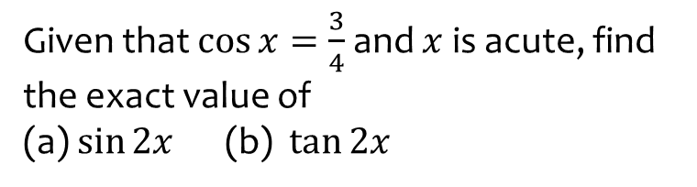
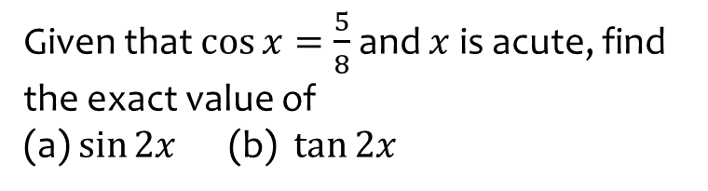
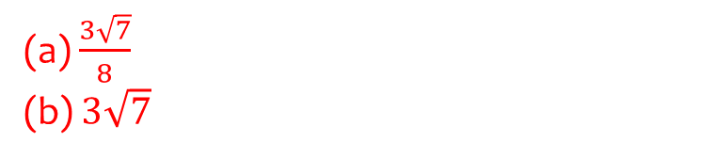
Worked example
Your turn
Given that $\cos{x}=\frac{5}{8}$ and $x$ is acute, find the exact value of
(a) $\sin{2x}$ (b) $\tan{2x}$
Given that $\cos{x}=\frac{3}{4}$ and $x$ is acute, find the exact value of
(a) $\sin{2x}$ (b) $\tan{2x}$
(a) $\frac{3\sqrt{7}}{8}$
(b) $3\sqrt{7}$

Slide 11
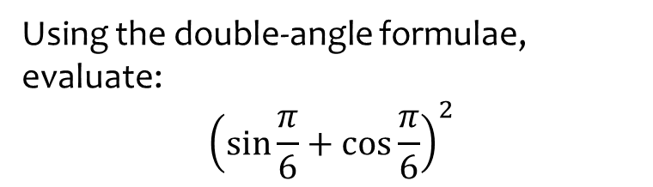


Worked example
Your turn
Using the double-angle formulae, evaluate:
$${\left(\sin{\frac{π}{3}}+\cos{\frac{π}{3}}\right)}^{2}$$
$${\left(\sin{\frac{π}{4}}−\cos{\frac{π}{4}}\right)}^{2}$$
Using the double-angle formulae, evaluate:
$${\left(\sin{\frac{π}{6}}+\cos{\frac{π}{6}}\right)}^{2}$$
$$\frac{2+\sqrt{3}}{2}$$

Slide 12
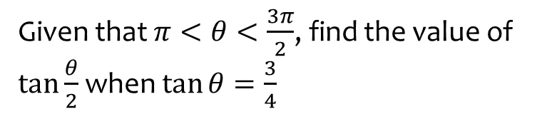
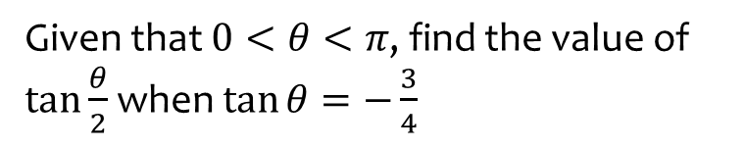
Worked example
Your turn
Given that $0<θ<π$, find the value of $\tan{\frac{θ}{2}}$ when $\tan{θ}=−\frac{3}{4}$
Given that $π<θ<\frac{3π}{2}$, find the value of $\tan{\frac{θ}{2}}$ when $\tan{θ}=\frac{3}{4}$
$$−3$$

