Slide 1
7.2) Modelling with statics

Slide 2
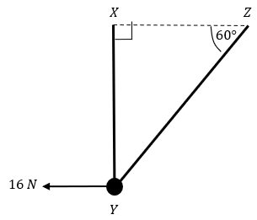
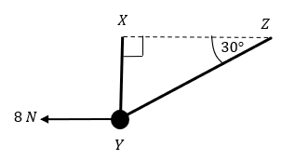
Worked example
Your turn
A smooth bead $Y$ is threaded on a light inextensible string. The ends of the string are attached to two fixed points, $X$ and $Y$, on the same horizontal level.
The bead is held in equilibrium by a horizontal force of magnitude 16 N acting parallel to $ZX$.
The bead $Y$ is vertically below $X$ and $∠XZY=60°$ as shown in the diagram.
Find the tension in the string and the weight of the bead.
A smooth bead $Y$ is threaded on a light inextensible string. The ends of the string are attached to two fixed points, $X$ and $Y$, on the same horizontal level.
The bead is held in equilibrium by a horizontal force of magnitude 8 N acting parallel to $ZX$.
The bead $Y$ is vertically below $X$ and $∠XZY=30°$ as shown in the diagram.
Find the tension in the string and the weight of the bead.
Tension $=9.24 N$ (3 sf)
Weight $=13.9 N$ (3 sf)
Diagrams/Graphs used with permission from DrFrostMaths: https://www.drfrostmaths.com/

Slide 3
Worked example
Your turn
A mass of 6kg rests on the surface of a smooth plane which is inclined at an angle of $30°$ to the horizontal.
The mass is attached to a cable which passes up the plane along the line of greatest slope and then passes over a smooth pulley at the top of the plane.
The cable carries a mass of 2kg freely suspended at the other end.
The masses are modelled as particles, and the cable as a light inextensible string.
There is a force of $P$ N acting horizontally on the 6kg mass and the system is in equilibrium.
Calculate:
the magnitude of $P$
the normal reaction between the mass and the plane
State how you have used the assumption that the pulley is smooth in your calculations.
A mass of 3kg rests on the surface of a smooth plane which is inclined at an angle of $45°$ to the horizontal.
The mass is attached to a cable which passes up the plane along the line of greatest slope and then passes over a smooth pulley at the top of the plane.
The cable carries a mass of 1kg freely suspended at the other end.
The masses are modelled as particles, and the cable as a light inextensible string.
There is a force of $P$ N acting horizontally on the 3kg mass and the system is in equilibrium.
Calculate:
the magnitude of $P$
the normal reaction between the mass and the plane
a) $P=16$ (2 sf)
b) $32$ (2 sf)

Slide 4
Worked example
Your turn
A particle of weight $4 N$ is attached at $C$ to the ends of two light inextensible strings $AC$ and $BC$.
The other ends, $A$ and $B$, are attached to a fixed horizontal ceiling. The particle hangs at rest in equilibrium, with the strings in a vertical plane. The string $AC$ is inclined at $45°$ to the horizontal and the string $BC$ is inclined at $15°$ to the horizontal. Find:
The tension in the string $AC$
The tension in the string $BC$
A particle of weight $8 N$ is attached at $C$ to the ends of two light inextensible strings $AC$ and $BC$.
The other ends, $A$ and $B$, are attached to a fixed horizontal ceiling. The particle hangs at rest in equilibrium, with the strings in a vertical plane. The string $AC$ is inclined at $35°$ to the horizontal and the string $BC$ is inclined at $25°$ to the horizontal. Find:
The tension in the string $AC$
The tension in the string $BC$
a) $8.4 N$ (2 sf)
b) $7.6 N$ (2 sf)

