Slide 1
7.2) Finding critical values

Slide 2
Worked example
Your turn
Joan believes a six-sided dice is biased in favour of rolling a $4$.
She rolls the dice 10 times and counts the number of times, $X$, it rolls a $4$.
Using a 5% significance level, find the critical region for this test.
Find the probability of incorrectly rejecting the null hypothesis (the actual significance level)
John believes a coin is biased in favour of landing with tails uppermost.
He tosses the coin 8 times and counts the number of times, $X$, it lands with tails uppermost.
Using a 5% significance level, find the critical region for this test.
Find the probability of incorrectly rejecting the null hypothesis (the actual significance level)
a) $7≤X≤8$
b) $0.0352$ (4 dp)

Slide 3
Worked example
Your turn
An election candidate believes he has the support of 30% of the residents in a particular town.
A researcher wants to test, at the 10% significance level, whether the candidate is over-estimating his support.
The researcher asks 30 people whether they support the candidate or not.
Find the critical region for this test.
Find the probability of incorrectly rejecting the null hypothesis (the actual significance level)
An election candidate believes she has the support of 40% of the residents in a particular town.
A researcher wants to test, at the 5% significance level, whether the candidate is over-estimating her support.
The researcher asks 20 people whether they support the candidate or not.
Find the critical region for this test.
Find the probability of incorrectly rejecting the null hypothesis (the actual significance level)
a) $0≤X≤3$
b) $0.0160$ (4 dp)

Slide 4
Worked example
Your turn
An election candidate believes he has the support of 30% of the residents in a particular town.
A researcher wants to test, at the 1% significance level, whether the candidate is under-estimating his support.
The researcher asks 30 people whether they support the candidate or not.
Find the critical region for this test.
Find the probability of incorrectly rejecting the null hypothesis (the actual significance level)
An election candidate believes she has the support of 40% of the residents in a particular town.
A researcher wants to test, at the 2% significance level, whether the candidate is under-estimating her support.
The researcher asks 20 people whether they support the candidate or not.
Find the critical region for this test.
Find the probability of incorrectly rejecting the null hypothesis (the actual significance level)
a) $14≤X≤20$
b) $0.0065$ (4 dp)

Slide 5
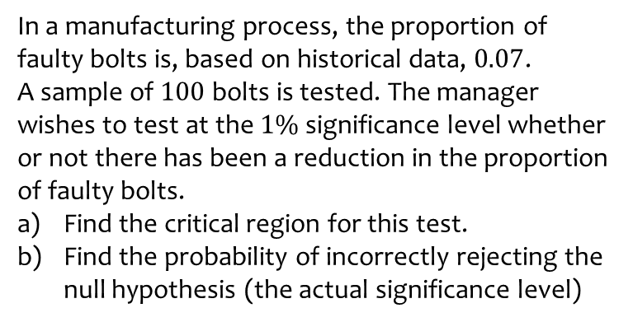
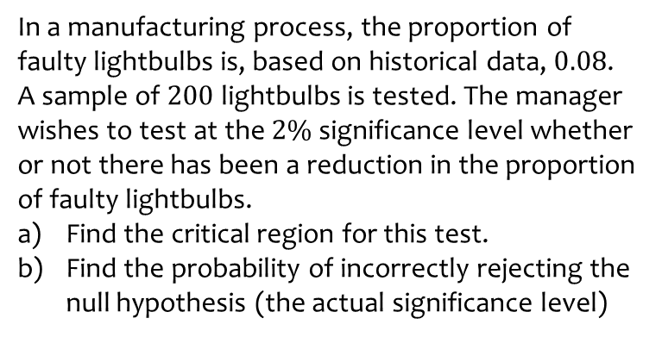
Worked example
Your turn
In a manufacturing process, the proportion of faulty lightbulbs is, based on historical data, $0.08$.
A sample of $200$ lightbulbs is tested. The manager wishes to test at the $2\%$significance level whether or not there has been a reduction in the proportion of faulty lightbulbs.
Find the critical region for this test.
Find the probability of incorrectly rejecting the null hypothesis (the actual significance level)
In a manufacturing process, the proportion of faulty bolts is, based on historical data, $0.07$.
A sample of $100$ bolts is tested. The manager wishes to test at the $1\%$significance level whether or not there has been a reduction in the proportion of faulty bolts.
Find the critical region for this test.
Find the probability of incorrectly rejecting the null hypothesis (the actual significance level)
a) $0≤X≤1$
b) $0.0060$ (4 dp)

Slide 6
Worked example
Your turn
Joan believes the probability of rolling a $4$ on a six-sided dice is $\frac{1}{6}$.
She rolls the dice 10 times and counts the number of times, $X$, it rolls a $4$.
Using a 5% significance level,
find the critical region(s) for this test.
find the probability of incorrectly rejecting the null hypothesis (the actual significance level)
John believes a coin is lands on tails with probability $\frac{1}{2}$.
He tosses the coin 8 times and counts the number of times, $X$, it lands with tails uppermost.
Using a 5% significance level,
find the critical region(s) for this test.
find the probability of incorrectly rejecting the null hypothesis (the actual significance level)
a) $X=0∪X=8$
b) $0.0078$ (4 dp)

Slide 7
Worked example
Your turn
An election candidate believes he has the support of 30% of the residents in a particular town.
A researcher wants to test, at the 10% significance level, whether this claim is true.
The researcher asks 30 people whether they support the candidate or not.
Find the critical region(s) for this test.
Find the probability of incorrectly rejecting the null hypothesis (the actual significance level)
An election candidate believes she has the support of 40% of the residents in a particular town.
A researcher wants to test, at the 5% significance level, whether this claim is true.
The researcher asks 20 people whether they support the candidate or not.
Find the critical region(s) for this test.
Find the probability of incorrectly rejecting the null hypothesis (the actual significance level)
a) $0≤X≤3∪13≤X≤20$
b) $0.0370$ (4 dp)

Slide 8
Worked example
Your turn
An election candidate believes he has the support of 30% of the residents in a particular town.
A researcher wants to test, at the 1% significance level, whether this claim is true.
The researcher asks 30 people whether they support the candidate or not.
Find the critical region(s) for this test.
Find the probability of incorrectly rejecting the null hypothesis (the actual significance level)
An election candidate believes she has the support of 40% of the residents in a particular town.
A researcher wants to test, at the 2% significance level, whether this claim is true.
The researcher asks 20 people whether they support the candidate or not.
Find the critical region(s) for this test.
Find the probability of incorrectly rejecting the null hypothesis (the actual significance level)
a) $0≤X≤2∪14≤X≤20$
b) $0.0101$ (4 dp)

Slide 9
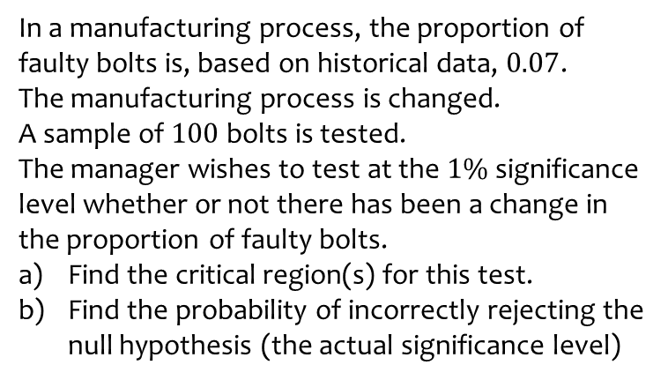
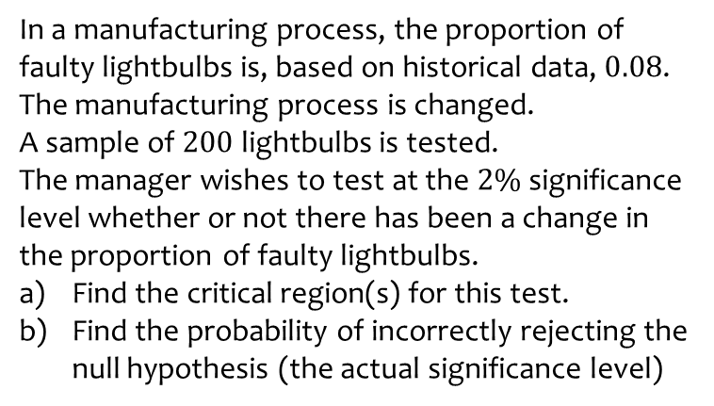
Worked example
Your turn
In a manufacturing process, the proportion of faulty lightbulbs is, based on historical data, $0.08$.
The manufacturing process is changed.
A sample of $200$ lightbulbs is tested.
The manager wishes to test at the $2\%$significance level whether or not there has been a change in the proportion of faulty lightbulbs.
Find the critical region(s) for this test.
Find the probability of incorrectly rejecting the null hypothesis (the actual significance level)
In a manufacturing process, the proportion of faulty bolts is, based on historical data, $0.07$.
The manufacturing process is changed.
A sample of $100$ bolts is tested.
The manager wishes to test at the $1\%$significance level whether or not there has been a change in the proportion of faulty bolts.
Find the critical region(s) for this test.
Find the probability of incorrectly rejecting the null hypothesis (the actual significance level)
a) $X=0∪15≤X≤100$
b) $0.0048$ (4 dp)

Slide 10
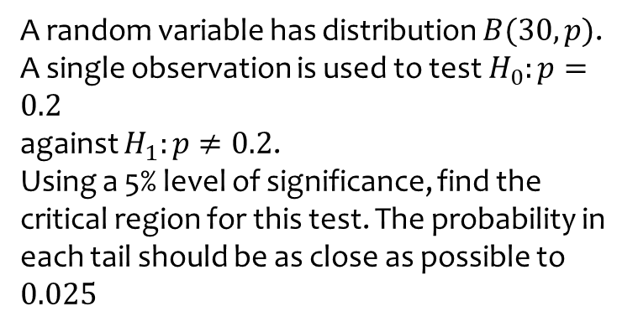
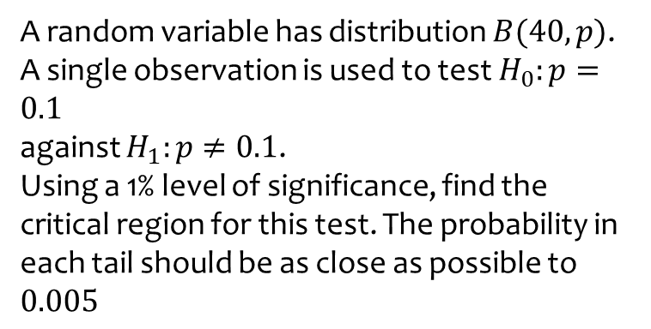
Worked example
Your turn
A random variable has distribution $B(40, p)$.
A single observation is used to test $H_{0}:p=0.1$
against $H_{1}:p≠0.1$.
Using a 1% level of significance, find the critical region for this test. The probability in each tail should be as close as possible to $0.005$
A random variable has distribution $B(30, p)$.
A single observation is used to test $H_{0}:p=0.2$
against $H_{1}:p≠0.2$.
Using a 5% level of significance, find the critical region for this test. The probability in each tail should be as close as possible to $0.025$
$$0≤X≤1∪11≤X≤30$$

