Slide 1
7.2) Using the angle addition formulae

Slide 2
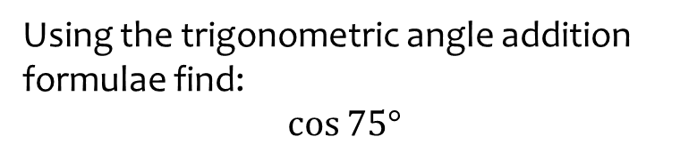


Worked example
Your turn
Using the trigonometric angle addition formulae find:
$$\sin{75°}$$
$$\tan{75°}$$
Using the trigonometric angle addition formulae find:
$$\cos{75°}$$
$$\frac{\sqrt{6}−\sqrt{2}}{4}$$

Slide 3
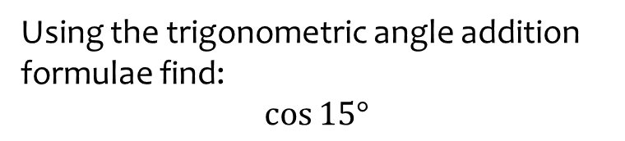


Worked example
Your turn
Using the trigonometric angle addition formulae find:
$$\sin{15°}$$
$$\tan{15°}$$
Using the trigonometric angle addition formulae find:
$$\cos{15°}$$
$$\frac{\sqrt{6}+\sqrt{2}}{4}$$

Slide 4
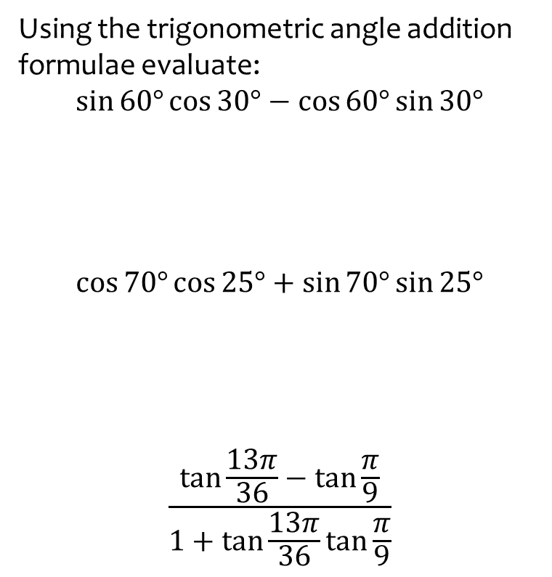
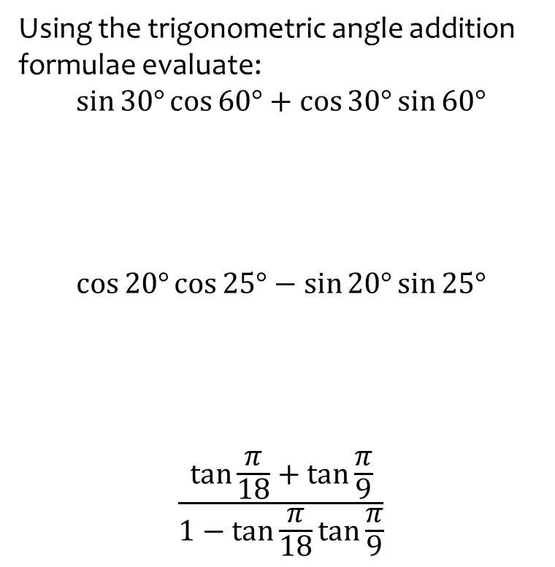

Worked example
Your turn
Using the trigonometric angle addition formulae evaluate:
$$\sin{30°}\cos{60°}+\cos{30°}\sin{60°}$$
$$\cos{20°}\cos{25°}−\sin{20°}\sin{25°}$$
$$\frac{\tan{\frac{π}{18}}+\tan{\frac{π}{9}}}{1−\tan{\frac{π}{18}}\tan{\frac{π}{9}}}$$
Using the trigonometric angle addition formulae evaluate:
$$\sin{60°}\cos{30°}−\cos{60°}\sin{30°}$$
$$\cos{70°}\cos{25°}+\sin{70°}\sin{25°}$$
$$\frac{\tan{\frac{13π}{36}}−\tan{\frac{π}{9}}}{1+\tan{\frac{13π}{36}}\tan{\frac{π}{9}}}$$
$$\sin{30°}=\frac{1}{2}$$
$$\cos{45°}=\frac{\sqrt{2}}{2}$$
$$\tan{\frac{π}{4}}=1$$

Slide 5
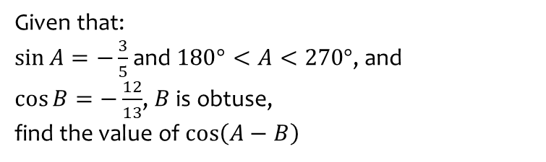
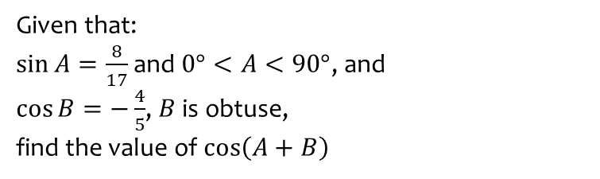

Worked example
Your turn
Given that:
$\sin{A}=\frac{8}{17}$ and $0°<A<90°$, and
$\cos{B}=−\frac{4}{5}$, $B$ is obtuse,
find the value of $\cos\left(A+B\right)$
Given that:
$\sin{A}=−\frac{3}{5}$ and $180°<A<270°$, and
$\cos{B}=−\frac{12}{13}$, $B$ is obtuse,
find the value of $\cos\left(A−B\right)$
$$\frac{33}{65}$$

Slide 6
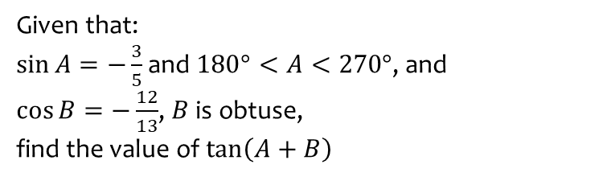
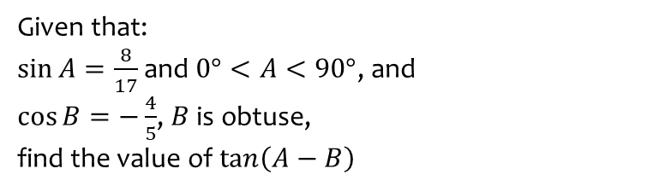

Worked example
Your turn
Given that:
$\sin{A}=\frac{8}{17}$ and $0°<A<90°$, and
$\cos{B}=−\frac{4}{5}$, $B$ is obtuse,
find the value of $\tan\left(A−B\right)$
Given that:
$\sin{A}=−\frac{3}{5}$ and $180°<A<270°$, and
$\cos{B}=−\frac{12}{13}$, $B$ is obtuse,
find the value of $\tan\left(A+B\right)$
$$\frac{16}{63}$$

Slide 7
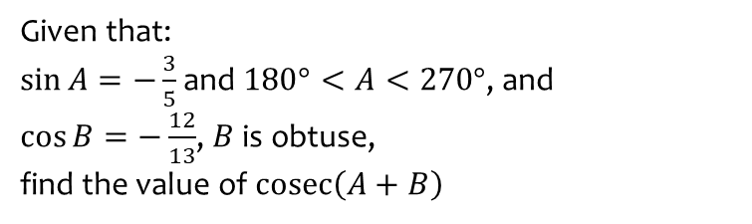
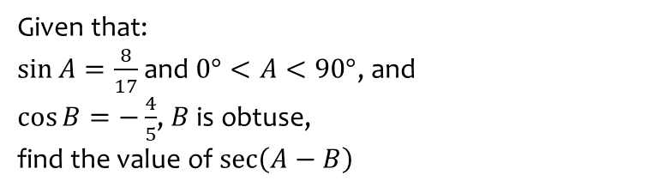

Worked example
Your turn
Given that:
$\sin{A}=\frac{8}{17}$ and $0°<A<90°$, and
$\cos{B}=−\frac{4}{5}$, $B$ is obtuse,
find the value of $\sec\left(A−B\right)$
Given that:
$\sin{A}=−\frac{3}{5}$ and $180°<A<270°$, and
$\cos{B}=−\frac{12}{13}$, $B$ is obtuse,
find the value of $\operatorname{cosec}\left(A+B\right)$
$$\frac{65}{16}$$

Slide 8
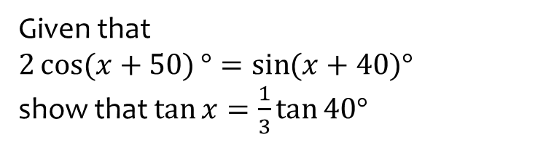
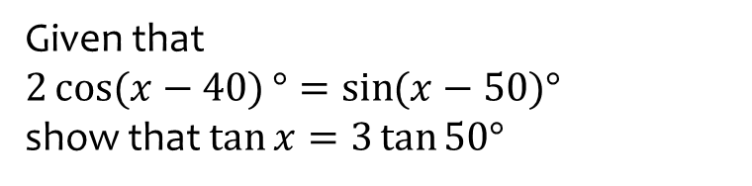
Worked example
Your turn
Given that
$2\cos{(x−40)}°=\sin{(x−50)°}$
show that $\tan{x}=3\tan{50°}$
Given that
$2\cos{(x+50)}°=\sin{(x+40)°}$
show that $\tan{x}=\frac{1}{3}\tan{40°}$
Shown

